Slide 1
A Decade of Altered Temperature Affects Soil Fungal Communities
Matt Belus
Dr. Bruce Hungate, Dr. George Koch, Rebecca Mau
Northern Arizona Department of Biological Sciences

Slide 2
NASA and Climate Change
NASA’s Mission: Drive advances in science, technology, aeronautics, and space exploration to enhance knowledge, education, innovation, economic vitality, and stewardship of Earth.
Space is vast and not fully understood, but so are the soils on Earth.

Slide 3
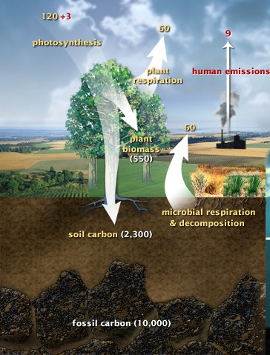
Climate Change and Soil Fungi
Soils are the largest terrestrial carbon reservoir.
Soils act as a sink and a source for carbon.
Soils contain diverse microbial communities.
Microbes, such as fungi, can influence nutrient cycles.
Image Credit: U.S. DOE, Biological and Environmental Research Information System.

Slide 4
Research Question
How will long-term warming affect soil fungal communities?

Slide 5
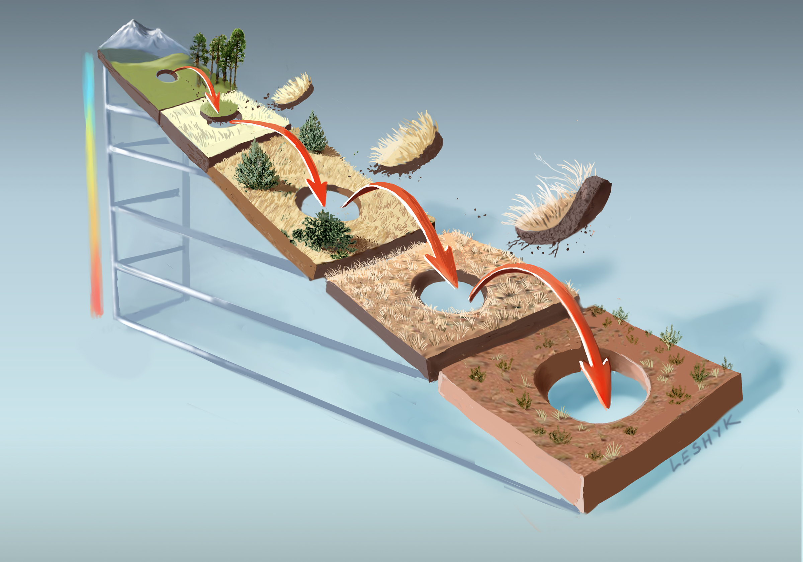
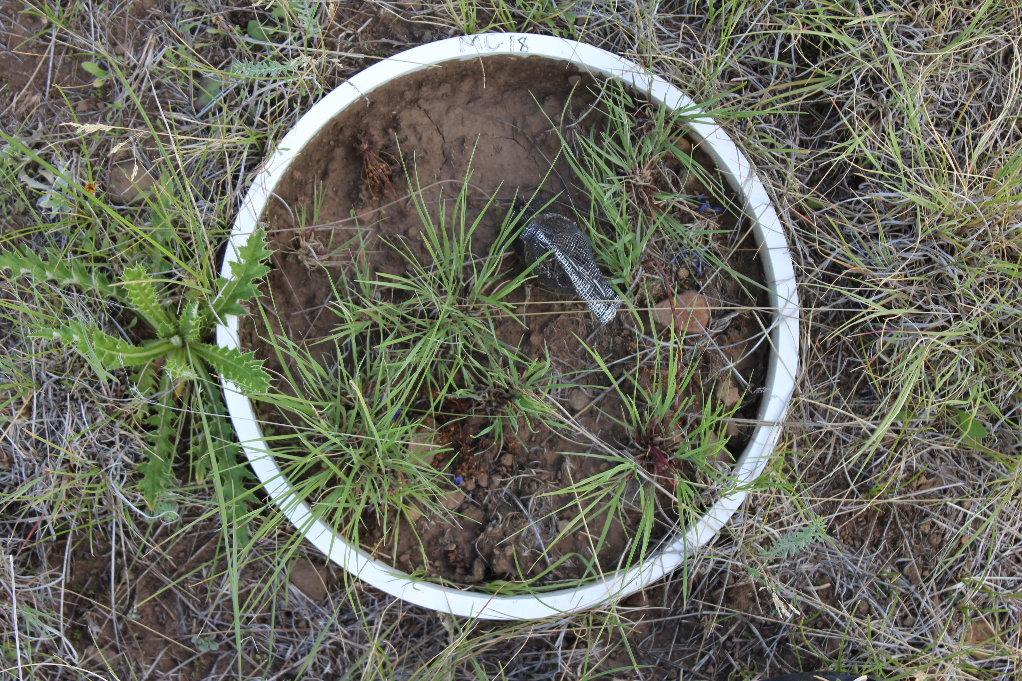
Ecosystem | Elevation (m) | Mean Annual Temperature (°C)
Mixed conifer | 2,620 | 6.6
Ponderosa pine | 2,344 | 9.1
Pinyon-juniper | 2,020 | 10.5
Desert Grassland | 1,760 | 13.0

Slide 6
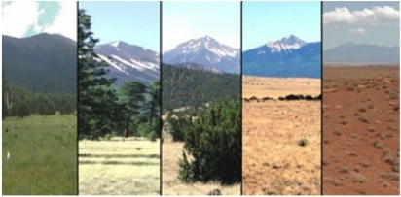


Methods
Soil samples were taken in 2011.
Genomic DNA was extracted from soils.
454 Pyrosequencing of the Internal Transcribed Spacer (ITS) region of ribosomal DNA (rDNA).
Data were analyzed with Quantitative Insights into Microbial Ecology (QIIME) and PCoRD statistical packages.

Slide 7
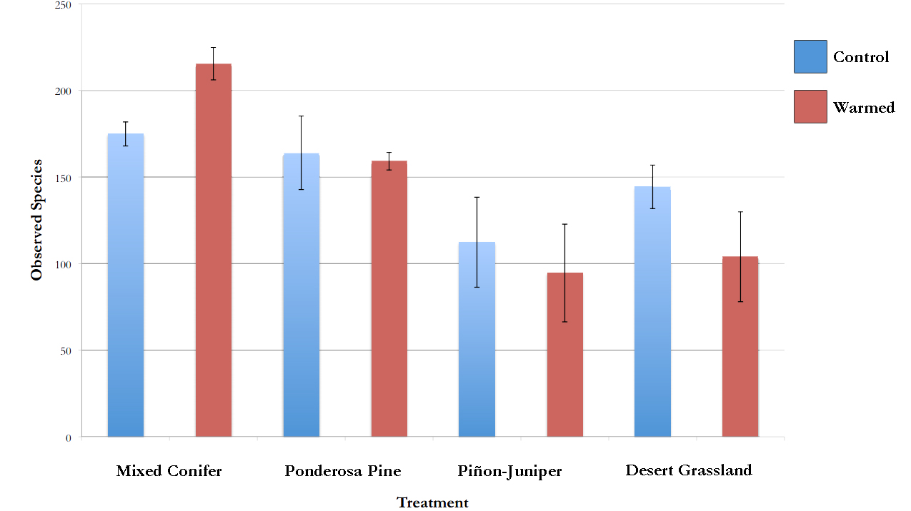
Species Richness
Source | SS | F | p
Ecosystem | 29673.857 | 9.0565 | 0.001
Treatment | 189.282 | 0.1733 | 0.6827
Ecosystem*Treatment | 5236.448 | 1.5982 | 0.2291

Slide 8
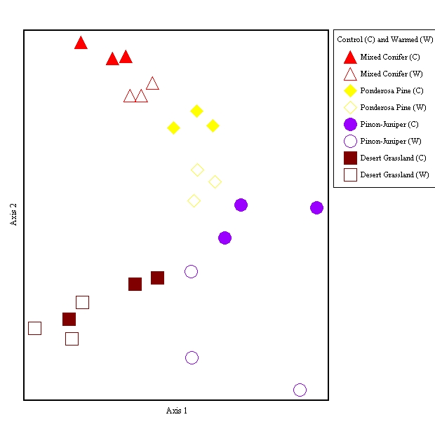
Experimental warming alters soil fungal communities
Mixed Conifer
Ponderosa
Pine
Piñon-Juniper
Two Way perMANOVA
Source | SS | F | p
Ecosystem | 3.0127 | 7.1 | 0.0002
Transplant | 0.2866 | 2.0263 | 0.0316
Interac. | 1.0194 | 2.4024 | 0.001
Desert Grassland

Slide 9
Big Picture
Long-term warming causes a community shift in soil fungal communities.
Plant community composition has changed over 10 years (Wu et al. 2012).
Fungal communities responses to warming are consistent with plant responses and might be influencing each other.
Warming has created a niche for new fungal communities.
Changes in fungal taxa can have effects on ecosystem processes.

Slide 10


Acknowledgements
Dr. Hungate and Dr. Koch
Dr. Nancy Johnson
Andrew Krohn and EnGGen
Becky Mau, Theresa McHugh, and Ember Morrissey, Michaela Hayer, and Bo Stevens
The Center for Ecosystem Science and Society
Undergraduate Research Experience in Global Climate Change Science at Northern Arizona University
NAU NASA Space Grant

Slide 11
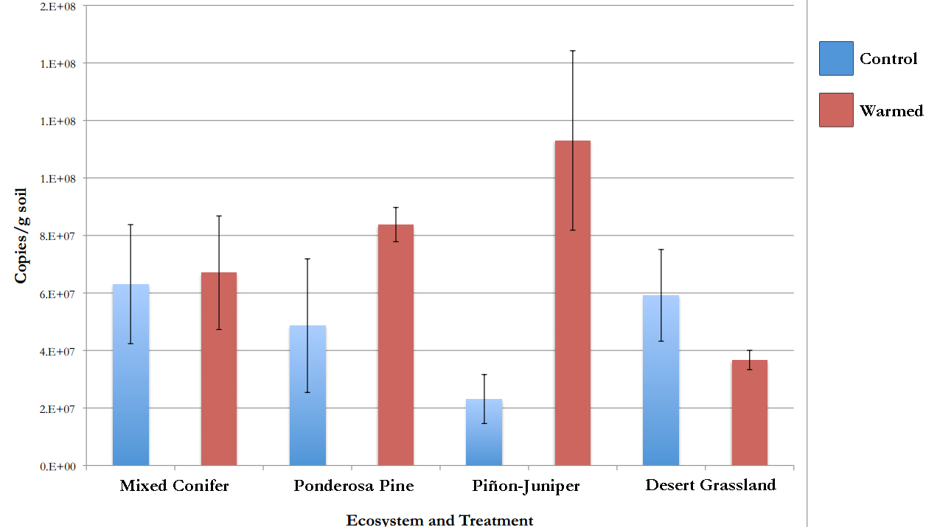
Fungal Abundance
Source | SS | F | p
Ecosystem | 1.57E+15 | 0.5164 | 0.6769
Transplant | 4.26E+15 | 4.1982 | 0.0572
Ecosystem*Treatment | 1.05E+16 | 3.4535 | 0.0416

