Slide 1
Effects of Lithologic Heterogeneity on Landscape
Evolution in the Canyons of the Colorado Plateau
Courtney Starling
Kelin Whipple
Andrew Darling
Arizona State University
Brian Clarke
2014-2015 Arizona Space Grant Symposium
April 18, 2015

Slide 2
Outline
Objectives: Characterize lithologic heterogeneity
Method: Seismic refraction study
Analyze field findings using seismic software
Compare p-wave field velocities to lab core sample velocities.

Slide 3
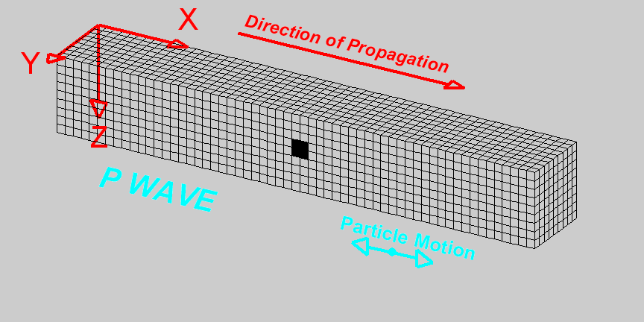
Seismic Refraction Field Study
  P-wave – Propagates parallel to particle motion.
Measure p-wave velocities using Geophones and seismographs.
Animation courtesy Larry Braile, Purdue University

Slide 4
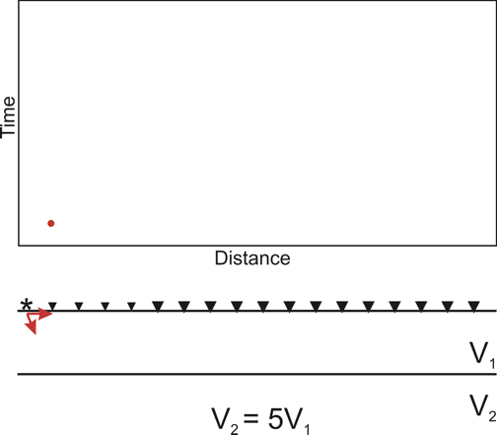
Geophones: 24 spaced ~2m for 48m
~9 shots, along entire length (~every 6m)
Seismic Refraction Time vs Distance
Animation courtesy of Craig Lippus, Geometrics Inc.

Slide 5
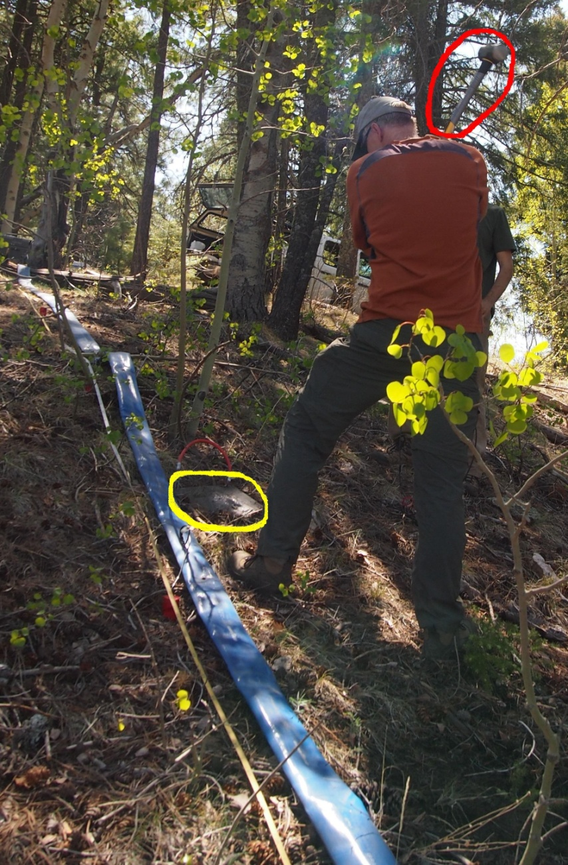
Field Set-up
Seismic Hammer
Seismic Plate
Geophones
Measuring Tape
Photo Courtesy of Marina
Bravo Foster, ASU

Slide 6
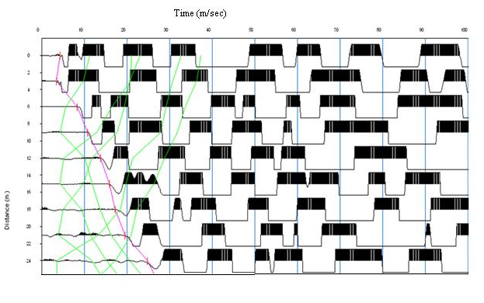
Find Field P-wave velocity
Use Seisimager software - Pickwin
Make first picks

Slide 7
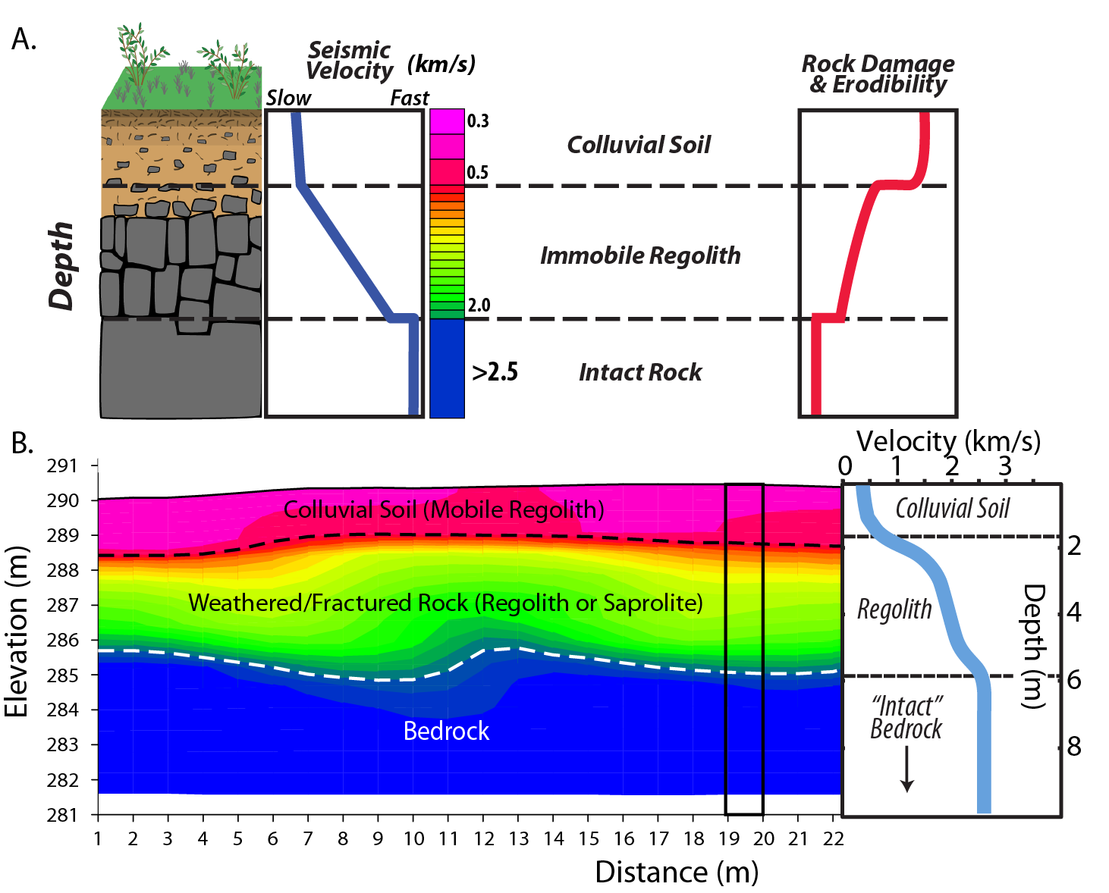
P-wave velocity at depth
As depth increases p-wave velocity increases
Figure courtesy of Brian Clarke

Slide 8
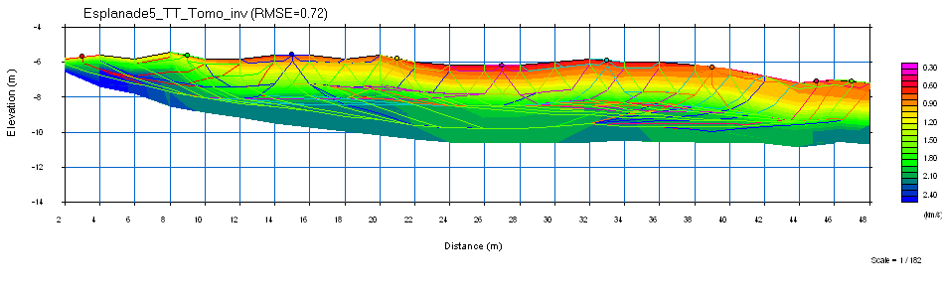
Esplanade 5 Formation
Ray paths from geophones
  Determines depth of model

Slide 9
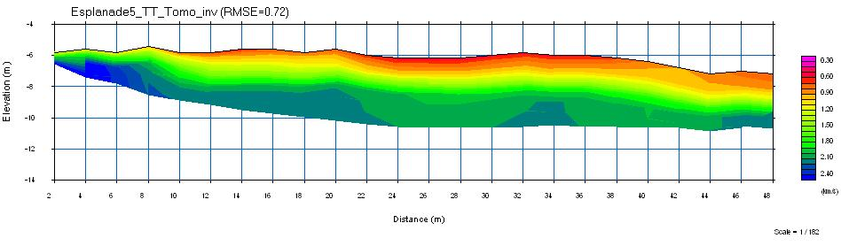
Esplanade 5 Formation
Surface Velocity: 0.6-0.9 km/s
  Weathered rock at surface to Soil
Velocity at Depth: 2.0-2.2 km/s

Slide 10
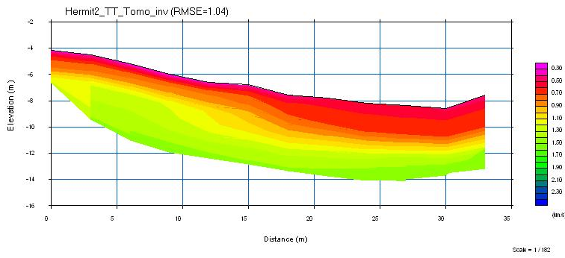
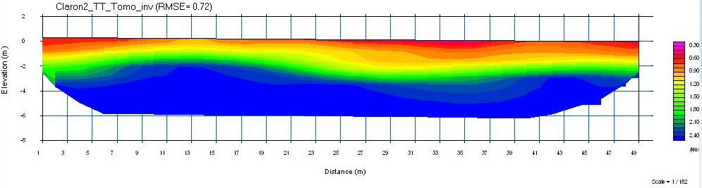
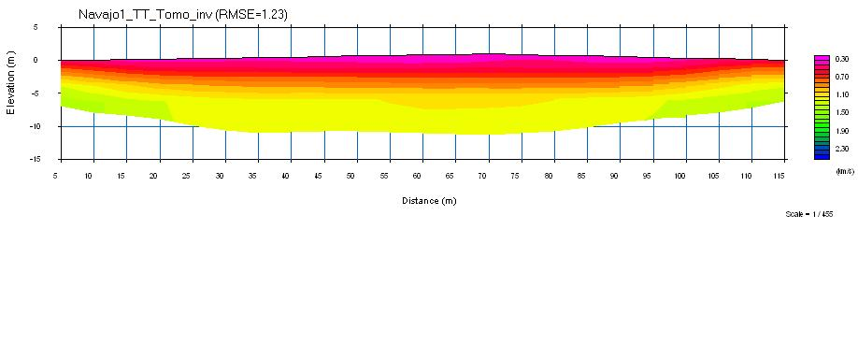
Other Tomographies
Hermit 2
-Elevated Formation
- Slow Velocities
Claron 2
-Fast Velocities
at Depth
Navajo 1
Longest
survey

Slide 11
Conclusions
Field Velocities confirm earlier observations
Formations with outcrops of bedrock- faster field velocities.
Future work – Compare Field to Lab Velocities
11

Slide 12
Thank You
Acknowledgements:
Dr. Kelin Whipple
Dr. Brian Clarke
Andrew Darling
Marina Bravo Foster

