Slide 1




Experimental Study of Sediment Transport in Vegetated and Meandering Channels
Jon Schmidt
Mentor: Dr. Jennifer Duan Department of Civil Engineering & Engineering Mechanics
Arizona Space Grant Symposium
Tempe, AZ
17 April 2015

Slide 2
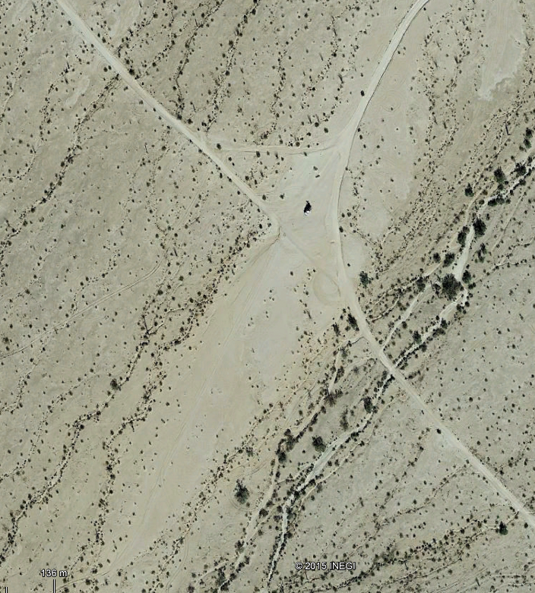
Temporal Geomorphology
Location: Barry M. Goldwater Air Force Range (BMGR)
Meandering Systems and Alluvial Fans
Devegetation → Erosion
5000m
300m

Slide 3
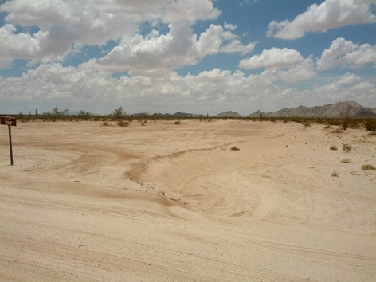
Objective
Conduct a temporal geomorphological analysis to forecast bed movement using remote monitoring and numerical methods in order to provide BMGR with rehabilitative and preventative road maintenance solutions.
Fig. 1 Area of interest showing channelization across road

Slide 4
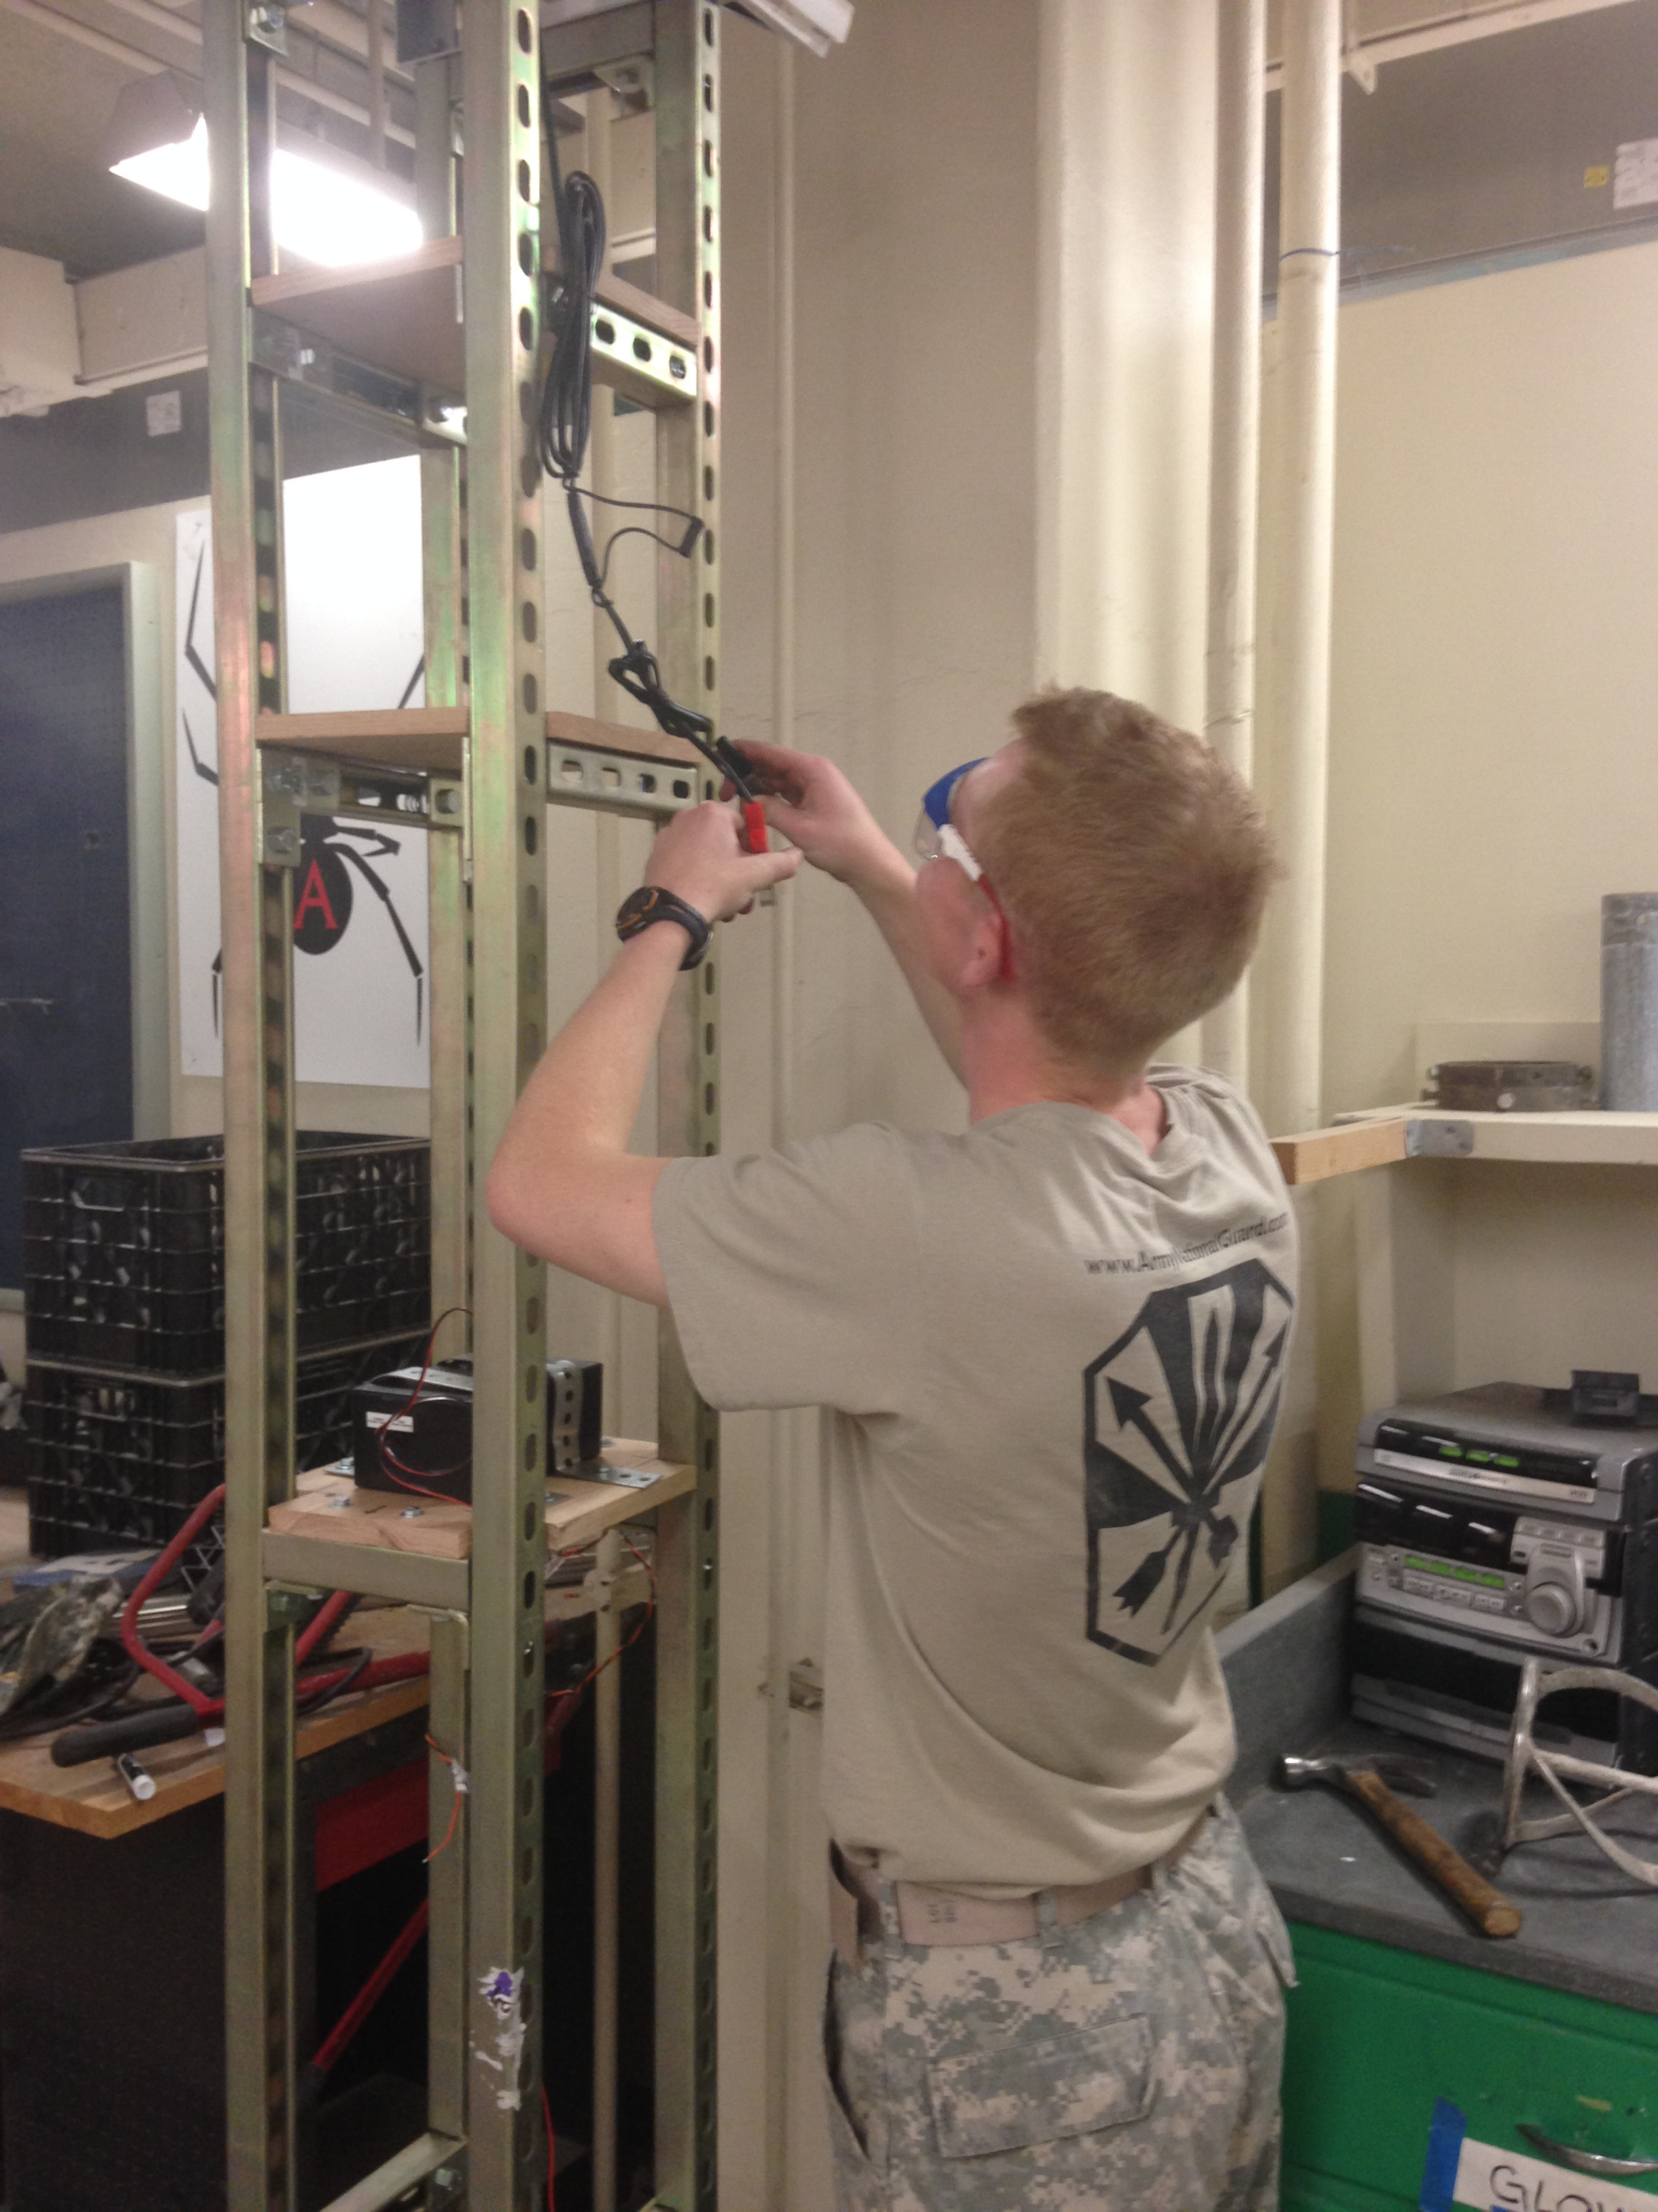
Our Response
Stereoscopic Digital Elevation Modeling (DEM)
Close and Long Range
Camera Theory
Pinhole Model/2D imaging of a 3D world
Figs 1-1, 12-5, OpenCV Learning, (Bradley & Kaehler)

Slide 5
Camera Apparatus
Weatherproof
Energy Efficient
Field of View
Camera Window
Access holes and Solar Panel

Slide 6
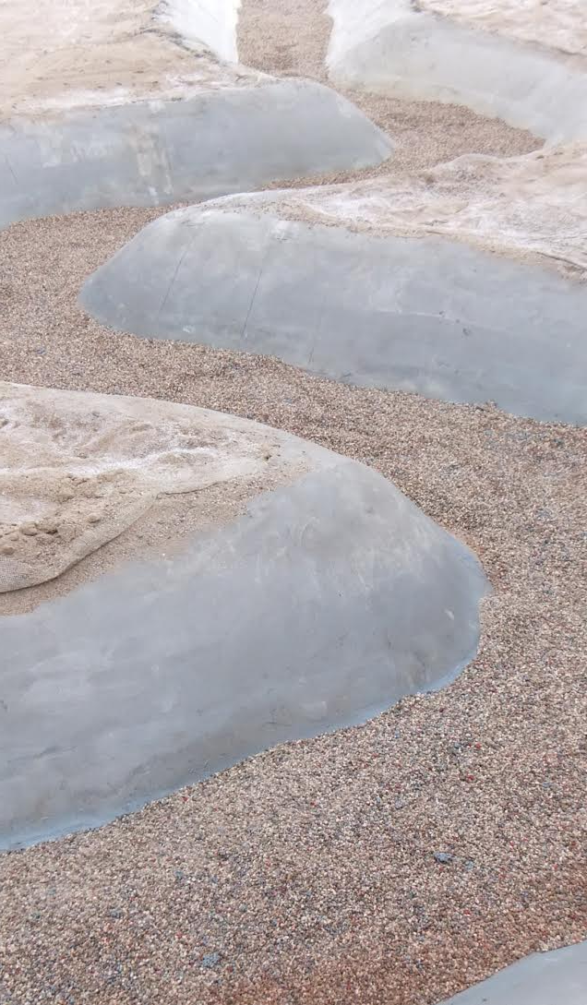
Disparity Mapping (Close Range)
+
Left
Right
L/R image pairs produce one disparity map representing
3D space
Disparity Map

Slide 7
Disparity Mapping (Long Range)
Excessive ‘noise’ due to:
Surface Roughness
Camera Quality

Slide 8
Conclusions & Future Work
Inverse proportionality of accuracy and range, and high-order indeterminacy due to camera parameters and distortions make extremely precise DEMs impractical for application on large spatial, and temporal, scales.
Interpolation using a physical grid of reference markers is adequate for our application and for projects with similar intents and parameters.

Slide 9

Acknowledgments
Susan A. Brew, Manager AZ Space Grant Consortium and UA Programs
and the UA Space Grant Staff
Mentor: Dr. Jennifer Duan
Team and Coaches: Chunshui Yu, Bai Yang, Jaeho Shim, Michael Potucek
AZSGC
Barry M. Goldwater Air Force Range

Slide 10
Sources
Bradski, Gary R., and Adrian Kaehler. Learning OpenCV: Computer Vision with the OpenCV Library. Sebastopol, CA: O'Reilly, 2008. Print.
Wu, Weiming. Computational River Dynamics. London: Taylor & Francis, 2008. Print.

Slide 11
Thank you!

