Slide 1
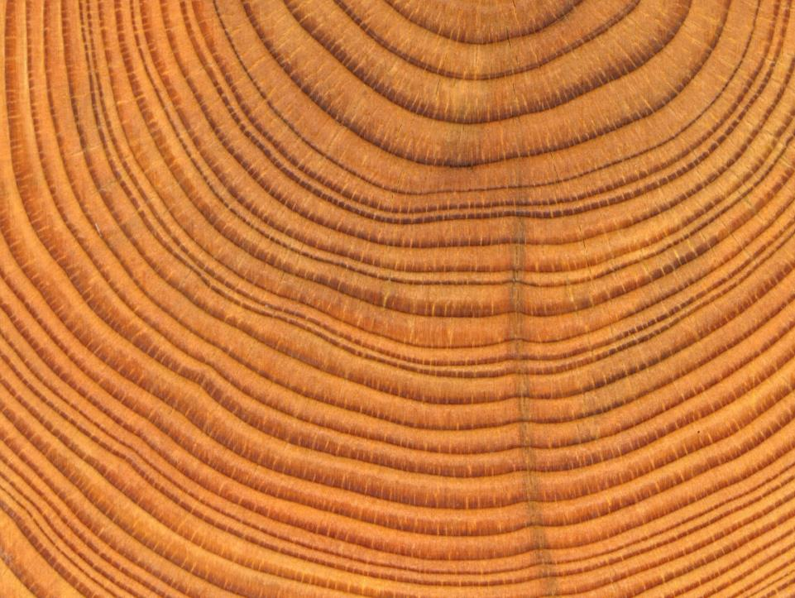




Micrometeorological Data for Analysis of Timing of Tree Growth
Arizona NASA Space Grant Symposium 2015
By: Mathilde Westermann
Acknowledgments: Dr. Malcolm Hughes, Dr. Kiyomi Morino, The U of A Laboratory of Tree Ring Research , & The Arizona NASA Space Grant Undergrad Internship Program

Slide 2
Introduction to the Study
Snapshot of growth: July 2, 2014 (Mt Bigelow)
1. Cambium
2. Enlarging
3. Cell-wall thickening
4. Mature

Slide 3
Problem
How do we get micro-scale temperature data?
Quarter
iButton™

Slide 4
Approach
Air Temp.
Bark Temp.
Hole from core sampling

Slide 5
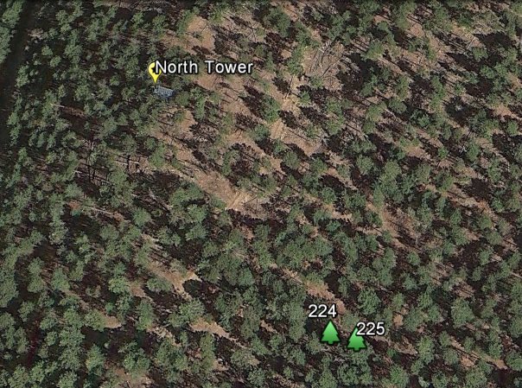

Site Map
30 Meters

Slide 6
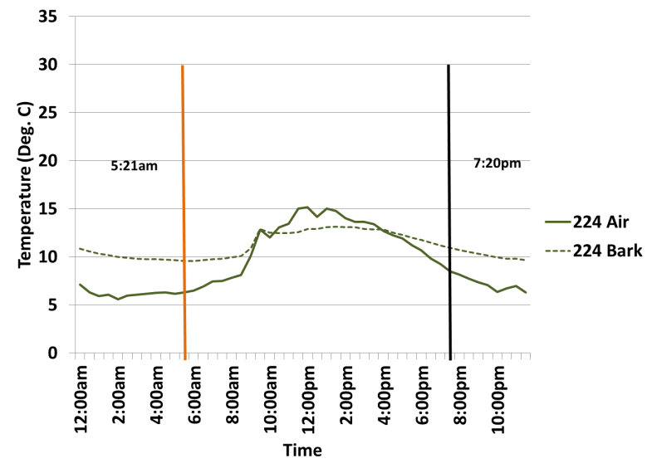
Tree 224 on May 23, 2014

Slide 7
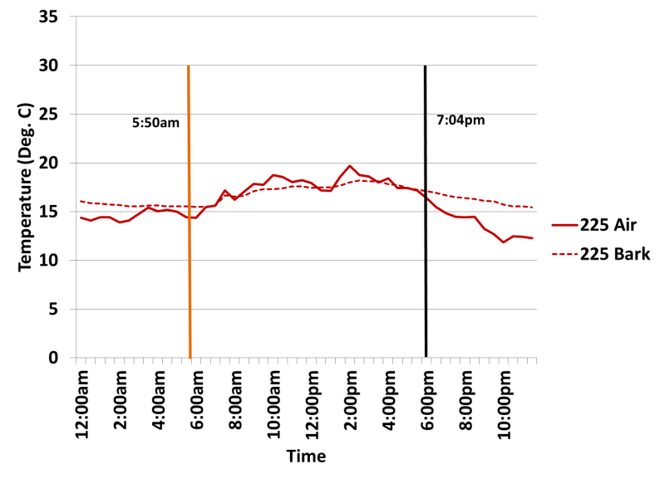
Tree 225 on August 18, 2014

Slide 8
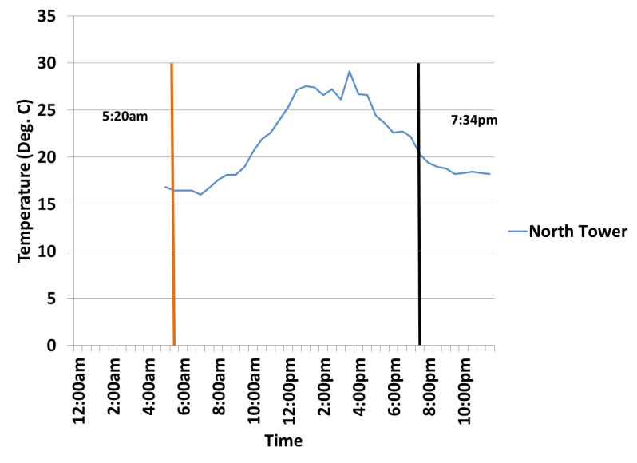
North Tower on June 30, 2014

Slide 9
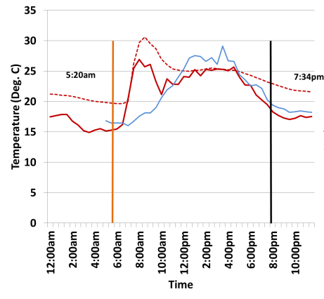
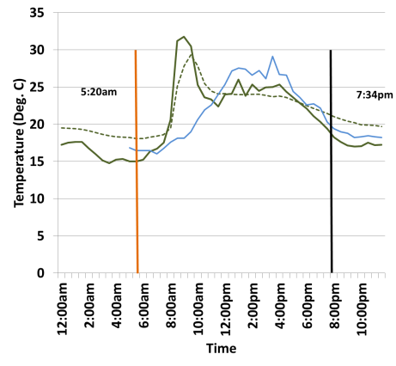


June 30, 2014
Tree 225
Tree 224

Slide 10
Function of nature
Glitch in device
?

Slide 11
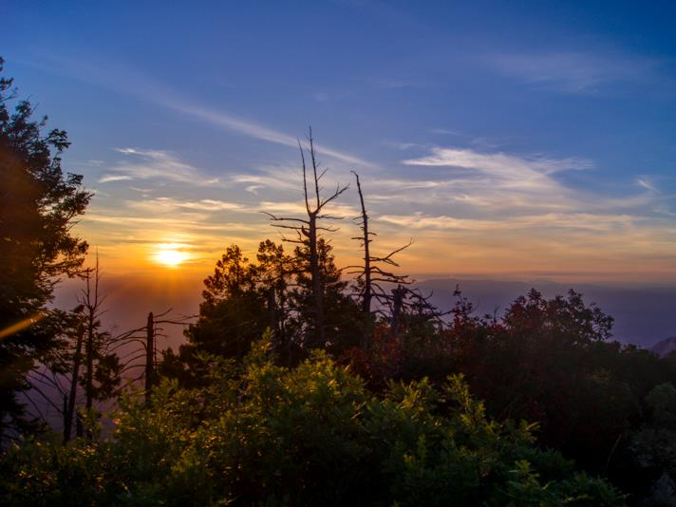
Is the temperature spike induced by direct sunlight?
http://blog.summithut.com/post/2013/07/26/Incinerator-Ridge-Trail-Kellogg-Trail-Mount-Bigelow.aspx
Notes:
photo from: http://blog.summithut.com/post/2013/07/26/Incinerator-Ridge-Trail-Kellogg-Trail-Mount-Bigelow.aspx
Sunrise from Kellogg Mountain

Slide 12
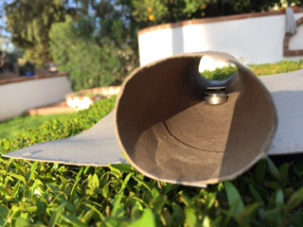
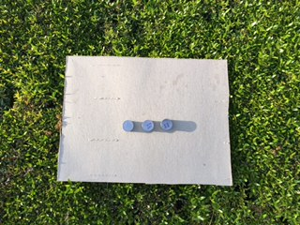
Experimental Design

Slide 13
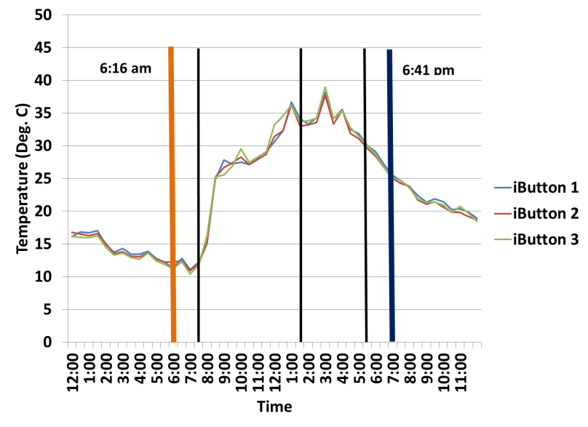
Results

Slide 14
Conclusion
Direct sun light does not appear to be the absolute cause of temperature spikes.

Slide 15
Next Steps
Continue looking at sun angle and seasonal variability of spike.
Conduct sapwood temperature experiment on Mt. Bigelow (perhaps related to morning sap flow in the tree?)
Why does the spike rapidly decline?
Does the spike affect tree growth??

