Slide 1


The Search for Atmospheric Oxygenation Prior to the Great Oxidation Event (GOE)
Chad Ostrander, Moutusi Roy and Ariel Anbar
Arizona State University
The Arizona Space Grant Undergraduate Research Symposium
April 18th, 2015

Slide 2
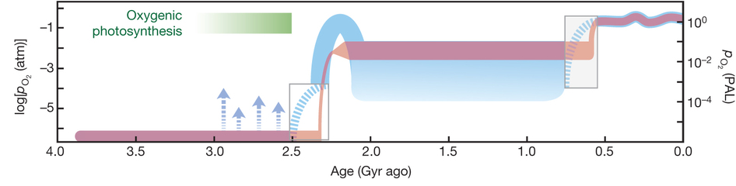
Problem: The timing of the first appearance of oxygen in the Earth’s surface environment is still ambiguous
Lyons, Reinhard and Planavsky, 2014

Slide 3
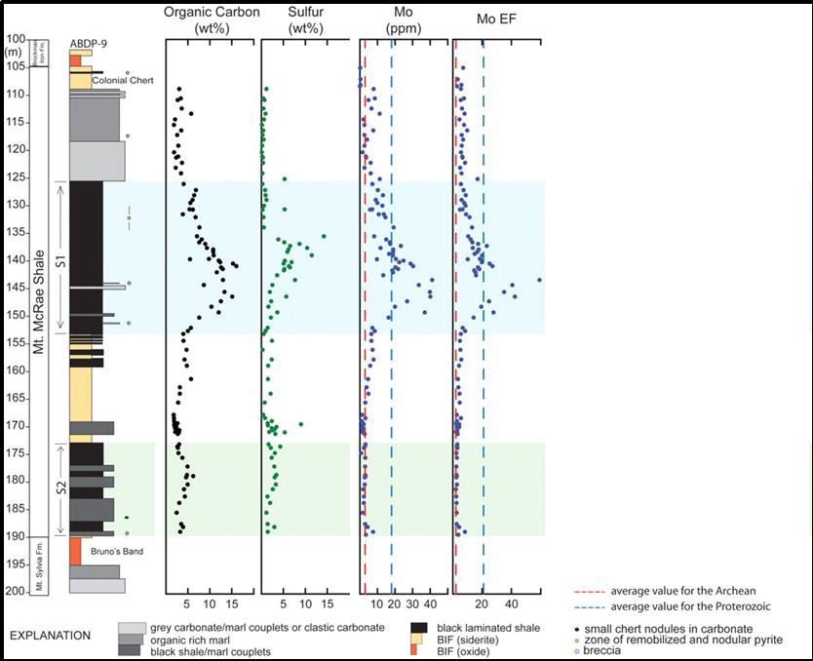

A Whiff of Oxygen Before the Great Oxidation Event?
Anbar et al., 2007
Molybdenum (Mo) enrichments in carbon-rich Mt. McRae Shale (~2.5 Ga)
Mo is mobilized by oxidative weathering of continental sulfides
In oxygenated waters, molybdate (MoO₄²⁻) has very long residence time of 800,000 years
In sulfide-rich, anoxic waters, molybdenum is readily removed from solution
40 ppm
Mo enrichment

Slide 4
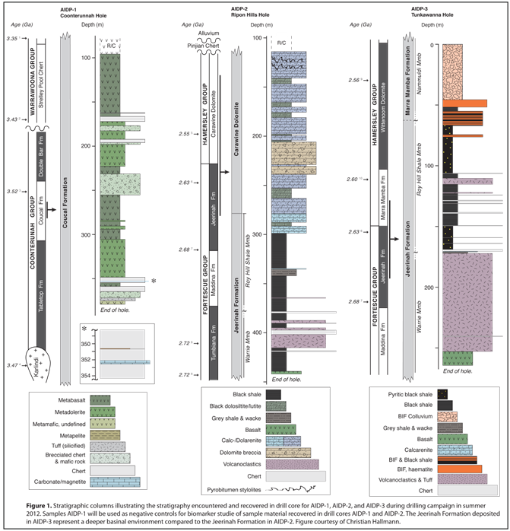
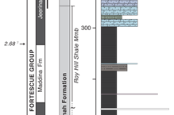
Agouron Institute Drilling Project (AIDP): 2012
AIDP-1: Greenschist facies
AIDP-2: Carbonate and Shale
AIDP-3: Offshore version of AIDP-2
Shale nearly 200 Myrs older than Mt. McRae!

Slide 5
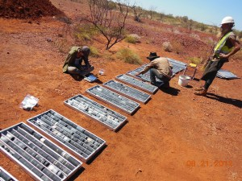
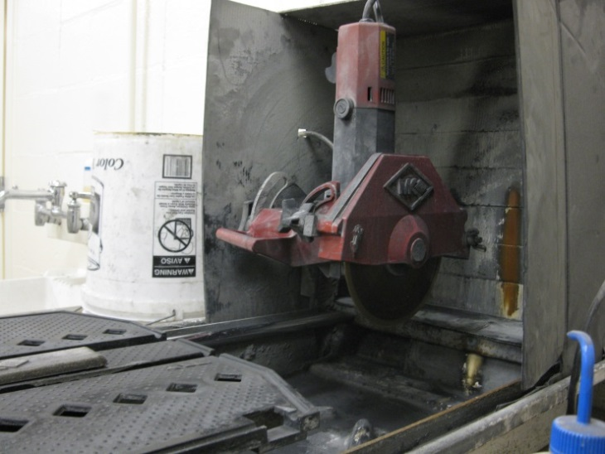
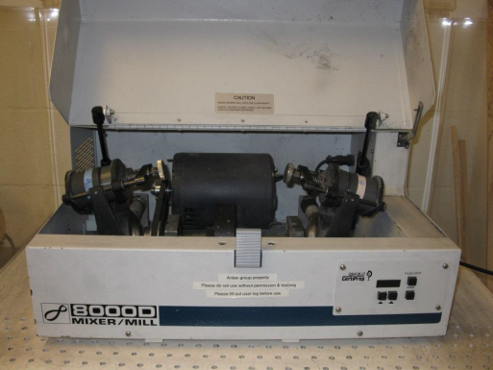
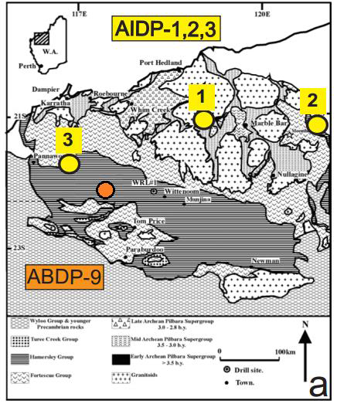
Core Drilling
Sample removal
Powdering
Core drilled Summer, 2012
Transported to ASU Summer 2013
Sampling workshop
Targeted samples extracted Summer 2013 – Spring 2014
Powdering of samples

Slide 6
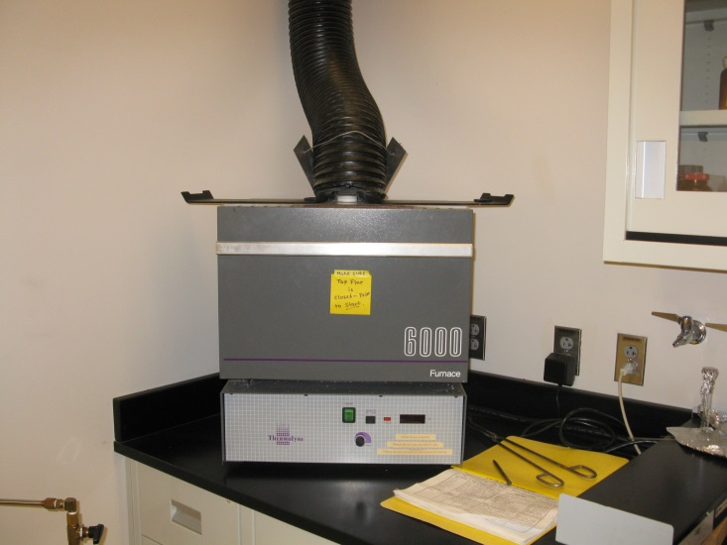
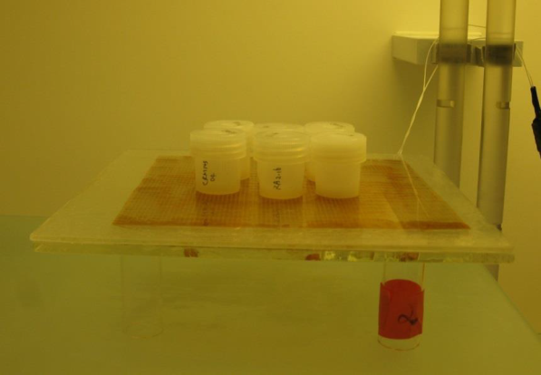
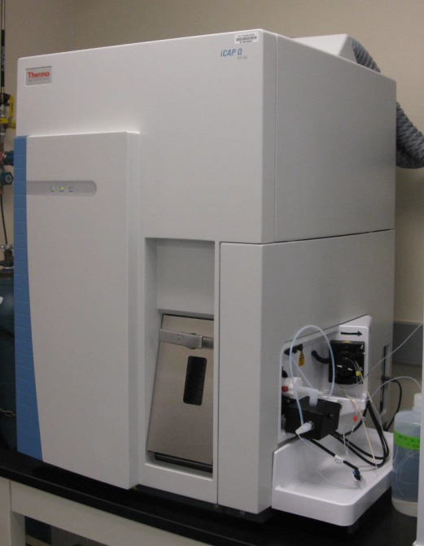
Ashing
Digestion
Analysis
Ashing and Acid Digestion Spring 2014 – Fall 2014
Combination of nitric acid (HNO₃),
hydrofluoric acid (HF) and hydrochloric
acid (HCl).
Trace Metal analysis Fall 2014 – Spring 2015
Inductively Coupled Plasma –
Mass Spectrometry (ICP-MS)

Slide 7
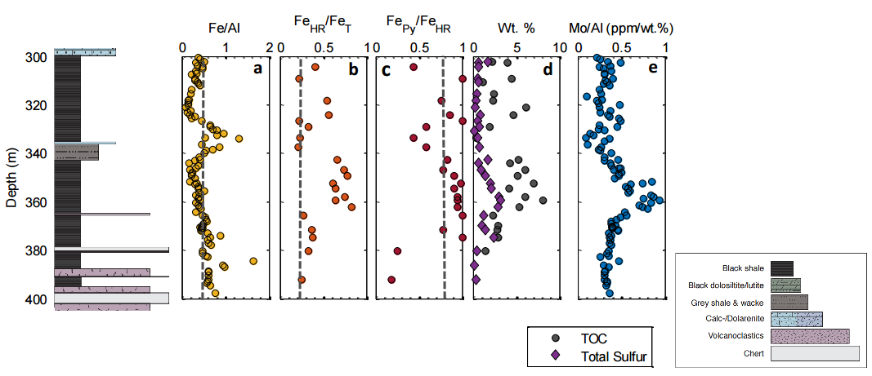
Preliminary Results
7 ppm
Mo enrichment
Modified from Olson, 2015.

Slide 8
Interpretation/Future Work
Enrichment possesses all hypothesized signals for oxidative weathering of continental crust and deposition during sulfide-rich oceanic anoxia.
Smaller “whiff” may be due to progressive atmospheric oxygenation.
How much O₂ is needed for Mo mobilization?
Data from coordinated strata in S. Africa (Griqualand and Transvaal Basins).
Mo isotope data from AIDP-2 enrichment interval may help tell story.

Slide 9
References
Anbar, A.D., Duan, Y., Lyons, T.W., Arnold, G.L., Kendall, B., Creaser, R.A., Kaufman, A.J., Gordon, G.W., Scott, C., Garvin, J., Buick, R.. 2007. A Whiff of Oxygen Before the Great Oxidation Event? Science, 317, 1903-1906.
Lyons, T.W., Reinhard, C.T., and Planavsky, N.. 2014. The Rise of Oxygen in Earth’s Early Ocean and Atmosphere. Nature, 506, 307-315.
Olson, Stephanie. University of California, Riverside. March 16, 2015. Personal Communication.
Acknowledgements
We thank ASU NASA Space Grant, Agouron Institute, and the National Science Foundation for supporting AIDP as well as Trevor and Jeffrey Martin for their assistance with sample processing.
For more information about Agouron Institute Drilling Project, visit:
https://agourondrillingproject.wordpress.com/

Slide 10
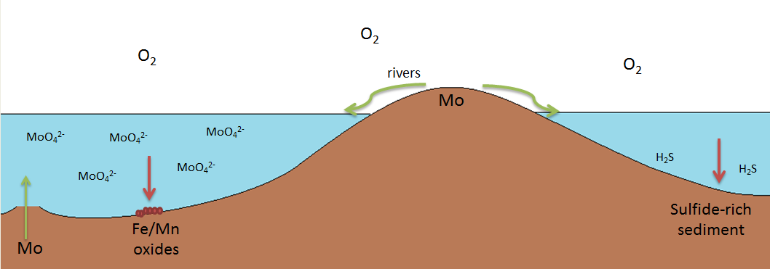
Modern molybdenum sources and sinks
In sulfide-rich, anoxic waters, molybdenum is readily removed from solution (i.e. Black Sea)
In oxygenated waters, molybdate (MoO₄²⁻) has very long residence time of 800,000 years
MoO₄²⁻
Chemocline
MoO₄²⁻
Fe/Mn oxides

Slide 11
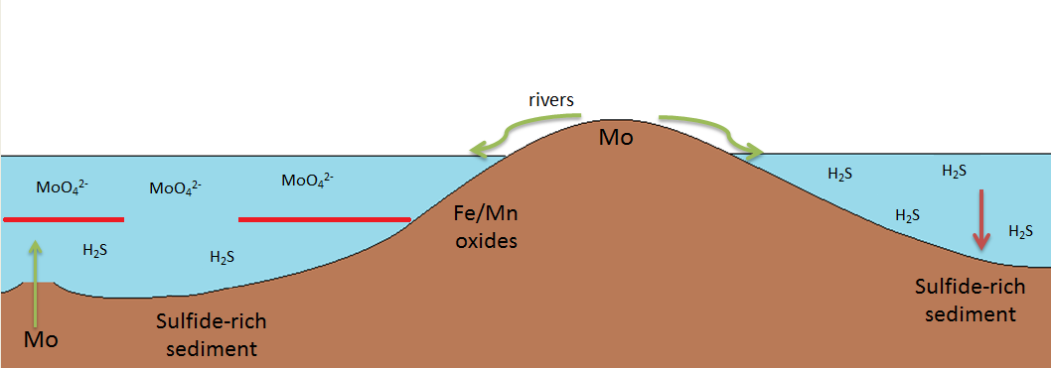
Dawn of GOE molybdenum sources and sinks
In sulfide-rich, anoxic waters, molybdenum is readily removed from solution (i.e. Black Sea)
In oxygenated waters, molybdate (MoO₄²⁻) has very long residence time of 800,000 years
O₂
O₂
Chemocline

