Slide 1
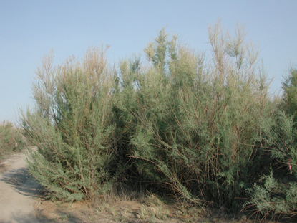


Tamarisk Change in
Glen Canyon
Rene Horne
Northern Arizona University
Mentor: Teki Sankey

Slide 2
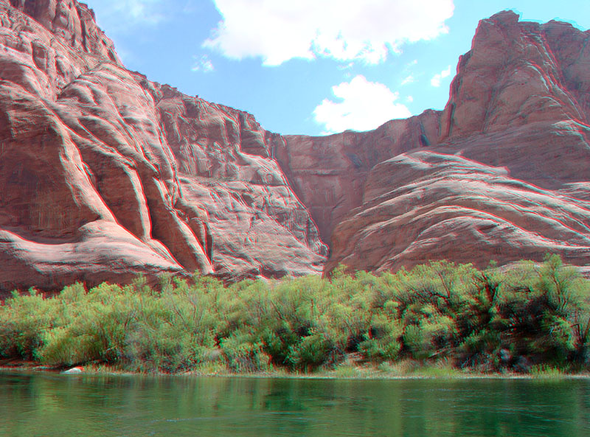
Purpose
  Tamarisk Mapping
    High resolution multispectral images
    Use of new technologies
  Estimate rate of Tamarisk defoliation
    Tamarisk Beetle

Slide 3
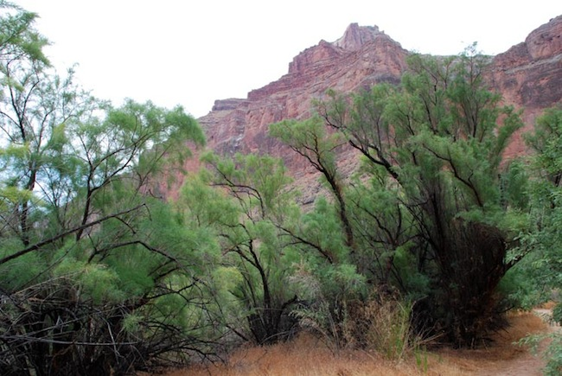
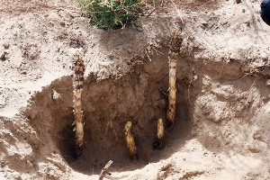
Tamarisk
(Tamarix spp.)
History
  In the US since 1800s
  Decorative species
  Invasive species
Biology
  Salt cedar
  Tap-root
Management
  Dominant in the Southwest
  Spread rate: 20 km/year
  Expensive mechanical control

Slide 4
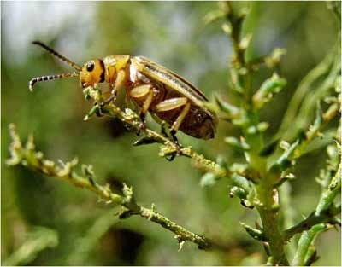
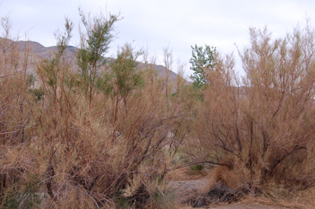
Bio-Control: Tamarisk Beetle
(Diorhabda carinulata)
Biology
  Natural predator of the shrub
  Eats the leaves
  Tamarisk defoliation
History of Introduction
  Asia
  Texas- early 2000s
  Utah- 2005
Found in Glen Canyon 2009
  Benchmark for data

Slide 5

Data and Method
Airborne Multispectral Images
  2009: Pre-beetle image
  2013: Post-beetle image
  2009:2013 (Pre/Post Comparison)
Computer Software
  ENVI
NDVI (Normalized Difference Vegetation Index)
  2009
  2013
  2009:2013
3D Lidar images
  2013
  Vegetation height
  Canopy volume and biomass density

Slide 6
Results

Slide 7
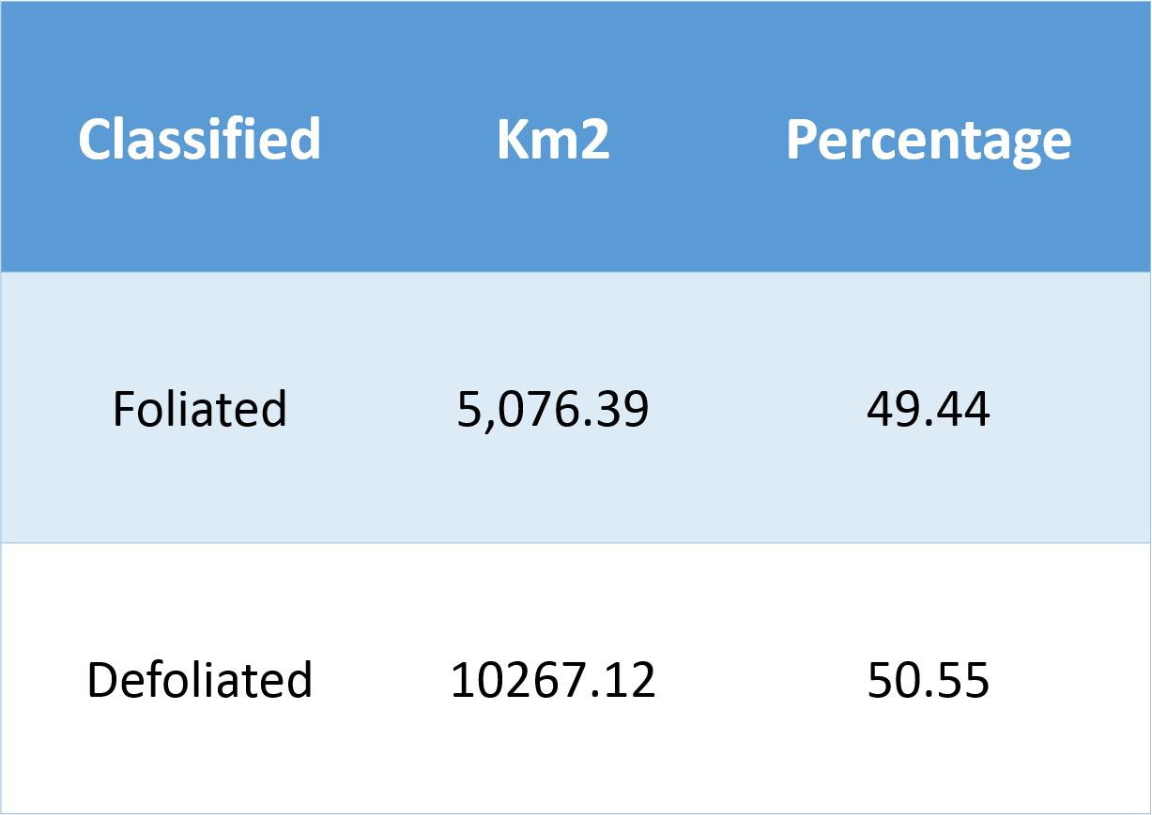

Slide 8
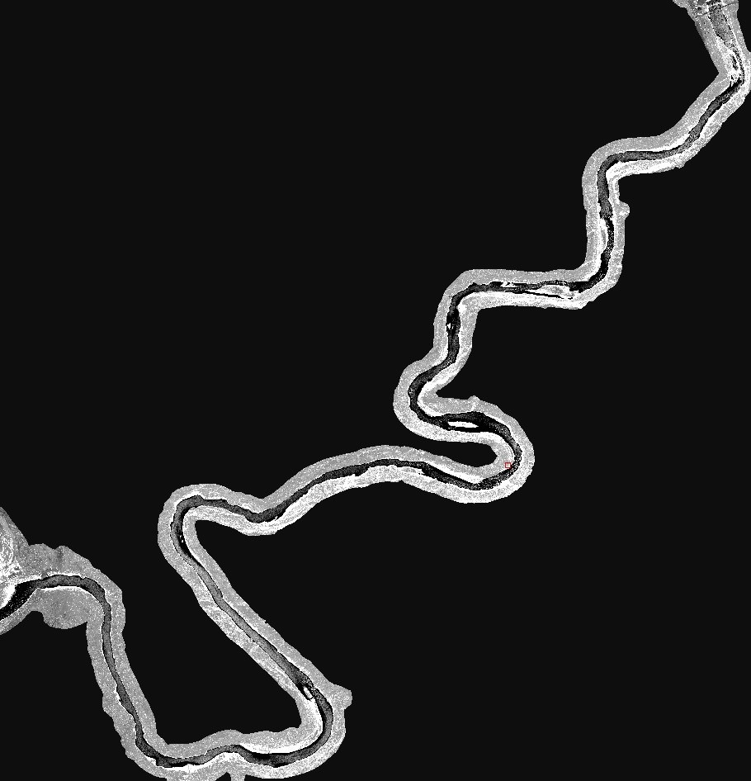
SO WHAT?
Mapping of invasive species
  Future management
Impacts on Ecosystem
  Erosion
  Wildlife
  Recreation

Slide 9

Acknowledgments
Teki Sankey: Mentor
NASA Space Grant
USGS, Joel Sankey
Graduate Students in the Computer Lab

Slide 10

Questions?
Thank you!

