Slide 1





Structure and Reactivity of Dissolved Organic Matter in the Critical Zone
Vicki Chu
Jon Chorover, Leif Abrell
Department of Soil, Water, and Environmental Science, University of Arizona, Tucson, AZ
UA/NASA Space Grant Consortium

Slide 2
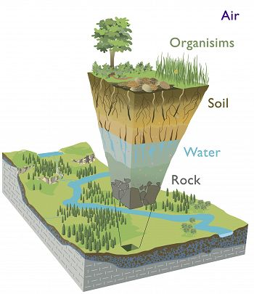
Introduction
The Critical Zone
A thin surface layer of vegetation, soil, and fractured rock at the earth’s surface
  ~Earth’s “outer skin”
artwork by R. Kindlimann
Notes:
Critical zone = where rock meets life
A biosignature is any substance – such as an element, isotope, molecule, or phenomenon – that provides scientific evidence of past or presentlife.[1][2][3] Measurable attributes of life include its complex physical and chemical structures and also its utilization of free energy and the production ofbiomass and wastes. Due to its unique characteristics, a biosignature can be interpreted as having been produced by living organisms
detection of biosignatures that might be used to find evidence for extant or past life on Earth, in extraterrestrial environments, or within samples returned from extraterrestrial sites.

Slide 3
Introduction
The Critical Zone
Critical Zone (CZ) of Earth still largely remains poorly understood
Fundamental research questions
  How does the Critical Zone form?
  How does it function?
  How will it change in the future?
Answering these questions informs us about finding life elsewhere
Notes:
Critical zone = where rock meets life
Answering these questions informs us about finding life elsewhere
because then we might know WHAT to look for and HOW conditions came to be on those said planets
Geochemical weathering – used to determine the general composition of sedimentary rocks and natural waters.
The interplay of weathering and freshwater chemistry, combined with subsequent chemical and biological deposition from the oceans, illustrates the linkage of the rock and water cycles from rainfall to weathering to transport of dissolved solids to deposition to evaporation, and thus to the resumption of the cycles (http://www.gly.uga.edu/railsback/Papers/WeatheringJGEpaper.pdf)

Slide 4
Introduction
The Critical Zone
What we know
  Constantly infused with fresh water & gases that support biological activity and weathering processes
    Geochemical weathering = breaking down of rock, soil, minerals
  Activity leaves “biosignature” in the weathering profile
    Used to find evidence of existing or past life
Notes:
Weathering is the breaking down of rocks, soil and minerals
Biological processes + geochemical weathering of rock → Leaves biosignature
biosignatures that might be used to find evidence for extant or past life on Earth, in extraterrestrial environments, or within samples returned from extraterrestrial sites.
A biosignature is any substance – such as an element, isotope, molecule, or phenomenon – that provides scientific evidence of past or presentlife.
Due to its unique characteristics, a biosignature can be interpreted as having been produced by living organisms;
Critical zone = where rock meets life
Ranges from tops of trees to bottom of the groundwater
In this range, the environment is composed of rock, soil, water, air, and living organisms
This activity transforms rock and biomass into the central component of the Critical Zone – soil

Slide 5
Introduction
The Critical Zone
Dissolved Organic Matter (DOM)
  Derived from decay of terrestrial vegetation, algal biomass, and anthropogenic sources such as treated wastewater
  Macromolecule components: Lignins, sugars, peptides
    Indicators of source of DOM
Notes:
Within the CZ – is DOM
Anthropogenic = resulting from human activity
Ligand = an ion or molecule attached to a metal atom by coordinate bonding
IMPORTANT NATURAL EVOLUTION OF GROUNDWATER QUALITY
BECAUSE
DOM = principal electron donor in subsurface redox reactions [2, 3] as well as the evolution of the weathering profile, b/c DOM comprises ligands that form stable complexes w/ rock-derived metals
Lignins (plants/trees), Sugars, & Peptides (microbial)
Geochemical weathering – used to determine the general composition of sedimentary rocks and natural waters.
The interplay of weathering and freshwater chemistry, combined with subsequent chemical and biological deposition from the oceans, illustrates the linkage of the rock and water cycles from rainfall to weathering to transport of dissolved solids to deposition to evaporation, and thus to the resumption of the cycles (http://www.gly.uga.edu/railsback/Papers/WeatheringJGEpaper.pdf)

Slide 6
Previous Findings/Research Objective
Previously found:
  Existence of relationships between dissolved organic matter (DOM) and metals across a gradient of ascending and descending limbs of storms
Goal:
  To understand at the molecular scale, the nature of these DOM-metal complexes through looking at the specific structural features of DOM contributing to these relationships
Notes:
DOC = 50% – 60% by mass of DOM
Directly proportional to DOC concentrations and stream flow
Inversely proportional to dissolved inorganic carbon (DIC) stream flow
Covariance = relationship
Complexation = formation of complex
Complex = A structure consisting of a central
atom or molecule weakly connected to surrounding atoms or molecules.

Slide 7
Research Approach
DOM will be characterized across ascending and descending limbs of summer monsoon storm discharge
  Water samples collected from Marshall-Gulch weir at the Santa Catalina CZ Observatory
Notes:
TOC (by high temperature combustion and infrared detection of CO₂ on a Shimadzu TOC-V CSH TOC/TN analyzer)
High-Resolution Liquid Chromatography-Triple Quadrupole Time of Flight Mass Spectrometer
Previous research = Reemtsma, T
High resolving power of both instruments serves to separate tightly packed spectral signals from one another in a typical DOM mixture
Lends more confidence to structural determinations based on exact mass measurements

Slide 8
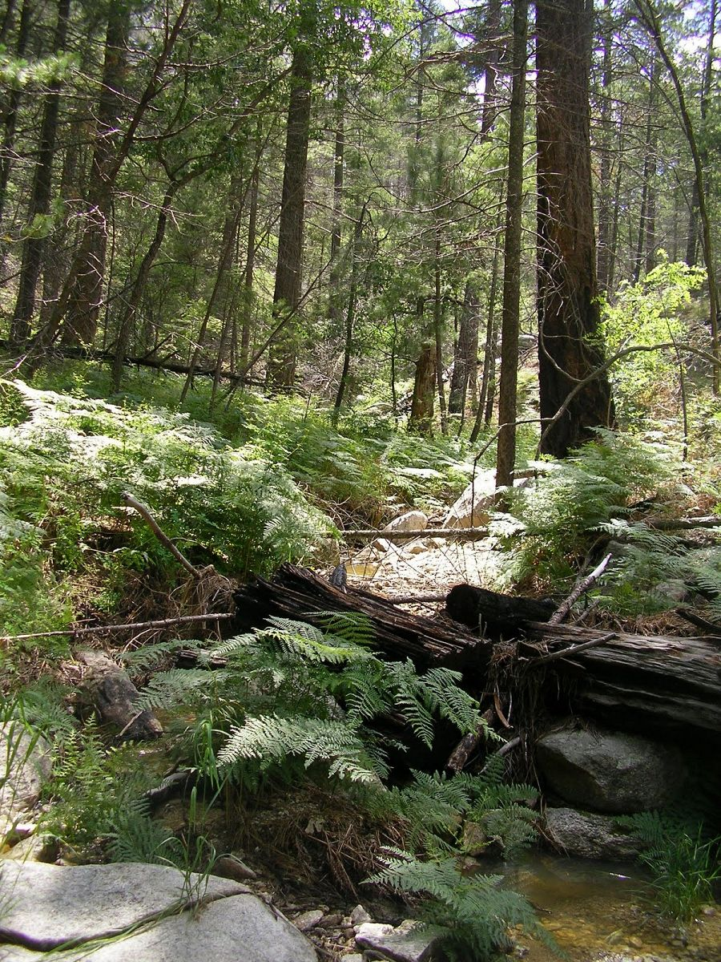
Research Site
NSF-funded Santa Catalina CZ Observatory
Marshall-Gulch weir
  Provides high proportion of water that sustains growing urban populations
http://criticalzone.org/

Slide 9
Methods
Automated ISCO Sampler at MG-Weir
Stream discharge collected from MG-Weir over a hydrograph
Obtain DOM structural data through high resolution full scan mass spectrometry (MS)
  By infusion
Total Organic Carbon (TOC)
  By high temperature combustion and infrared detection of CO₂
Notes:
HDPE = high density polyethylene
Automated sampler can sample according to pressure changes or depth of river
Set a temporal rate in order to avoid erroneous sampling because of barometric pressure changes.

Slide 10
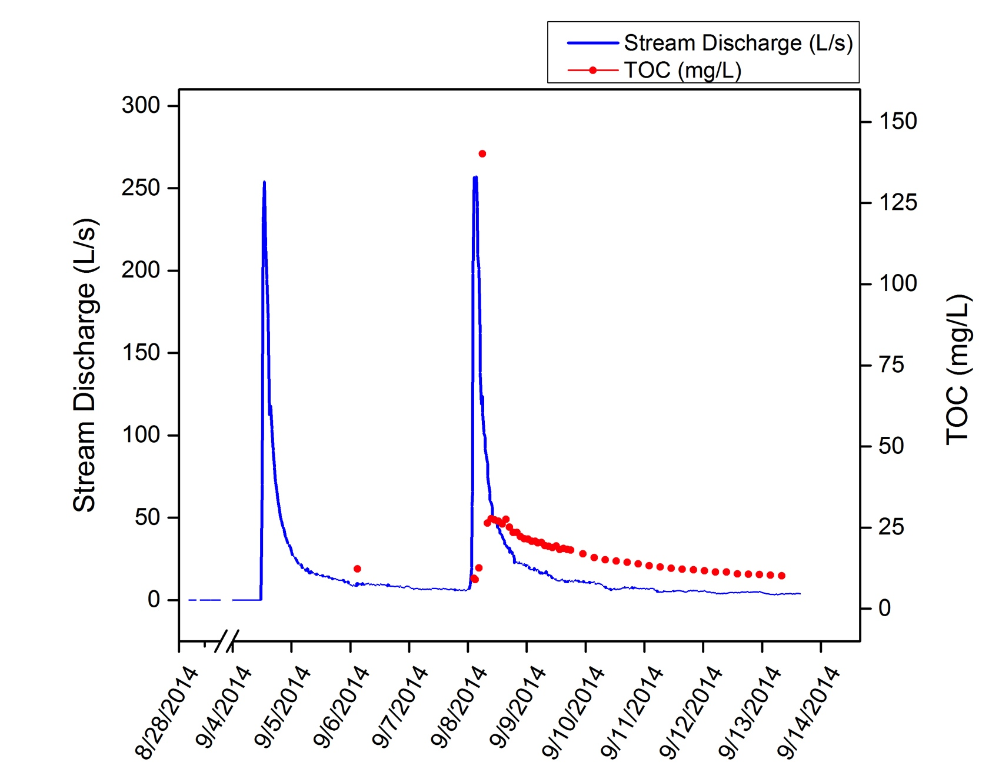
Results
Hydrograph overlaid with sample TOC concentrations
Notes:
Molecular formulae lists were generated by analysing individual molecular ions and searching within the criteria of C(70)H(140)O(50)N(1)S(2) and with accuracy of less than 4.0 ppm from full scan mass spectra.
For example Figure 4 shows only the molecular formulae assigned to peaks within the mass range 349.0 to 352.0.

Slide 11
Results
Selected regions of full scan QToF mass spectrum with assigned molecular formulae from CZO-004 (peak of storm)

Slide 12
Results
Plot from mass range 340 – 380 Da of O/C and H/C ratios

Slide 13
Results
Table 1: Success of assigning Molecular Formulae to different CZO samples
Samples | TOC (ppm) | Average # Molecular Formulae per unit mass | Average error assignment (ppm) | Average Peak Pick lower threshold (cps) | Number of scans
CZO Samples | 9.32 - 140.13 | 2.00 | 1.52 | 1.2 | 6548 - 85124

Slide 14
Conclusions
A magnitude difference in sample concentration could be overcome by running an infusion experiment longer
Number and quality of molecular formulae assigned varied little between samples of varying TOC concentration
Direct injection with high enough resolving power is enough to separate tightly packed signals from one another in the DOM mixtures (e.g. 349.0650 vs. 349.1280)
Notes:
A magnitude difference in sample concentration could be overcome by running an infusion experiment longer (up to 85,000 scans or more) for the most dilute water sample tested
Direct injection with this generation’s mass spectrometers have high enough resolving power to separate tightly packed signals from one another in the DOM mixtures (e.g. 349.0650 vs. 349.1280) and allow us to extract reasonable molecular formulae

Slide 15
Future Direction
Evaluating bulk of molecular formulae as a group (rather than just selected regions) for characteristic ratios: C/H and C/O
  Use ratios to explore correlations between DOM and metals along the ascending and descending limb of a storm
  Help indicate the sources of DOM and thus how to use biosignatures as indicators of existing/past life

Slide 16
Acknowledgments
Special thanks to:
Mentors Dr. Jon Chorover and Dr. Leif Abrell
Nate Abramson, Shawn Pedron
NASA Space Grant Consortium
ALEC-Chorover Lab group
SWES Department

Slide 17
Thank you for listening!

