Slide 1
Tempe Town Lake Fall 2014
Giovanni Pieve and Hilairy Hartnett
School of Earth and Space Exploration
Arizona State University

Slide 2

Overview
Two miles long
Holds 3.7 million liters of water
Water is contained between inflatable dams at each end of the lake
Water sources:
  The Salt and Verde Rivers
  Rain runoff from the Indian Ben Wash
  Local runoff

Slide 3
Goals
Tempe Town Lake Project was initiated in 2005 with the goal of monitoring basic water chemistry
  Emphasis on Dissolved Organic Carbon (DOC)
Why DOC?
  It is both a food source for bacteria and a product of photosynthesis. It provides information about biological processes.
Understand how DOC in the lake responds to environmental processes
  We focus on effect of rainfall
Notes:
I can verbally mention here the importance of DOC in systems

Slide 4
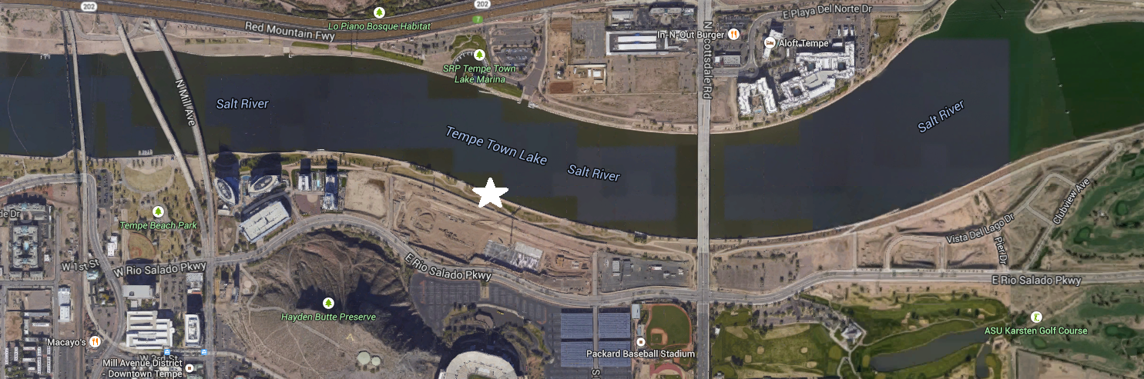

Sampling and Analysis
Tempe Town Lake is sampled twice per week
Temperature is measured in situ
pH, and conductivity are measured in the lab
Samples are filtered in the lab (0.2μm to remove bacteria)

Slide 5
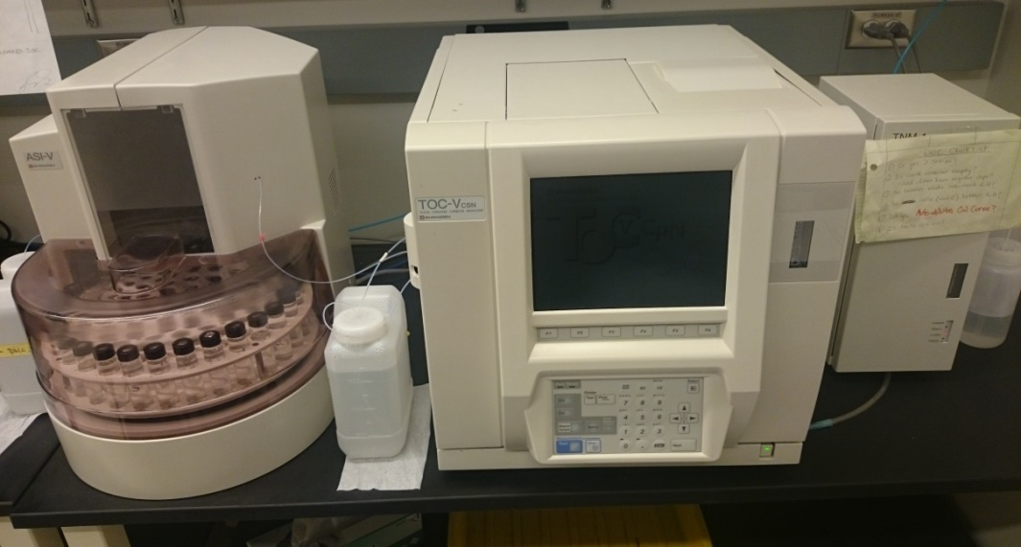
Dissolved Organic Carbon Analysis
Dissolved means anything that passes through a 0.45μm filter
Analysis of Dissolved Organic Carbon took place in the Carbon and Nitrogen Dynamics (CaNDy) Lab.
Measurements made through High-Temperature Combustion
  DOC -> CO₂

Slide 6
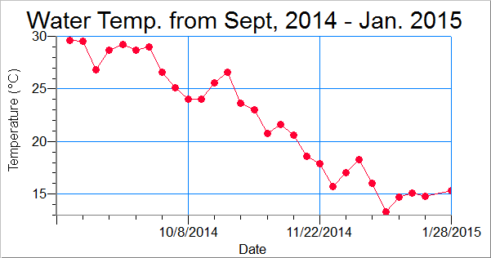
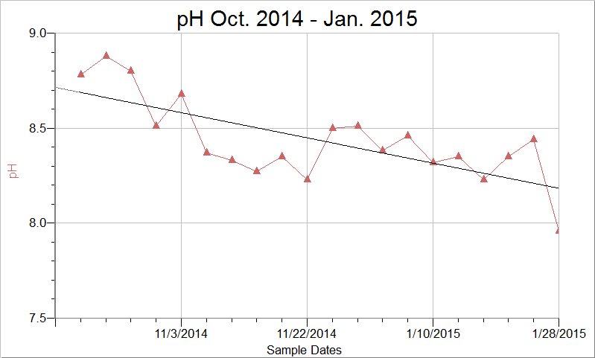
2014/15 pH and temperature
Water temperature follows a typical trend.
Higher temperatures in summer, decreasing to as low as 13.3°C in the winter.
Somewhat decreasing trend shown

Slide 7
Decreasing pH trend
Lower temperatures during late fall/winter leads to a lower rate of photosynthesis
Rate of respiration remains constant
Result is higher CO2 which reacts with water to form Acids
  CO₂ (aq) + H₂O ↔ H₂CO₃ (aq)

Slide 8
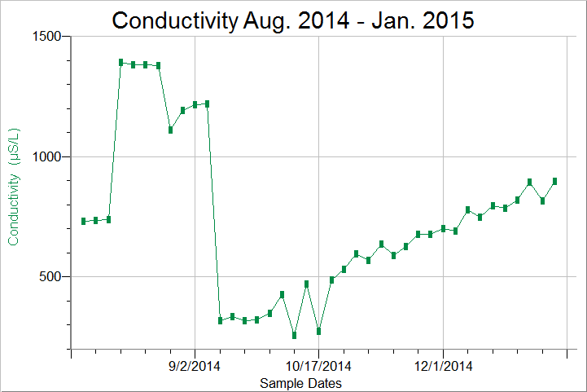
2014/15 Conductivity
Conductivity is a measure of the ions in solution.
Conductivity was relatively high until a sudden drop occurred due to a major rain event

Slide 9
Record Rainfall and effects on Conductivity
Occurred on Sept. 8 2014
3.70 inches (9.40 cm) measured in Tempe
Caused a steep drop in conductivity from 1219 µS/L to 320 µS/L.
Conductivity drop due to dilution of ions in water

Slide 10
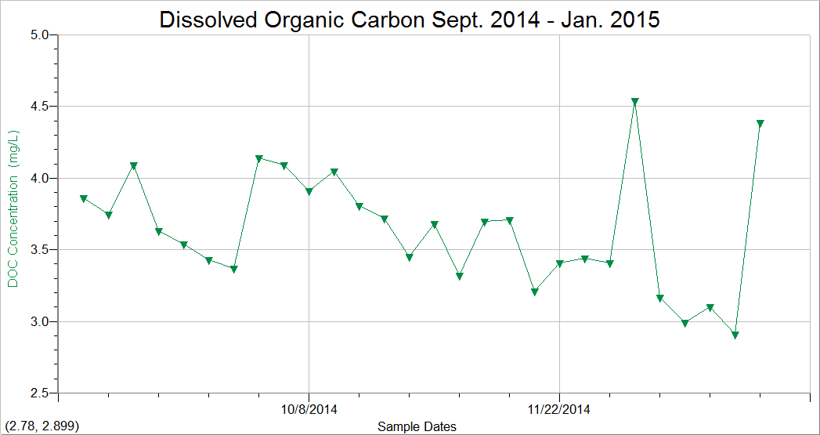
2014/15 Dissolved Organic Carbon
Average DOC = 3.65 mgC/L

Slide 11
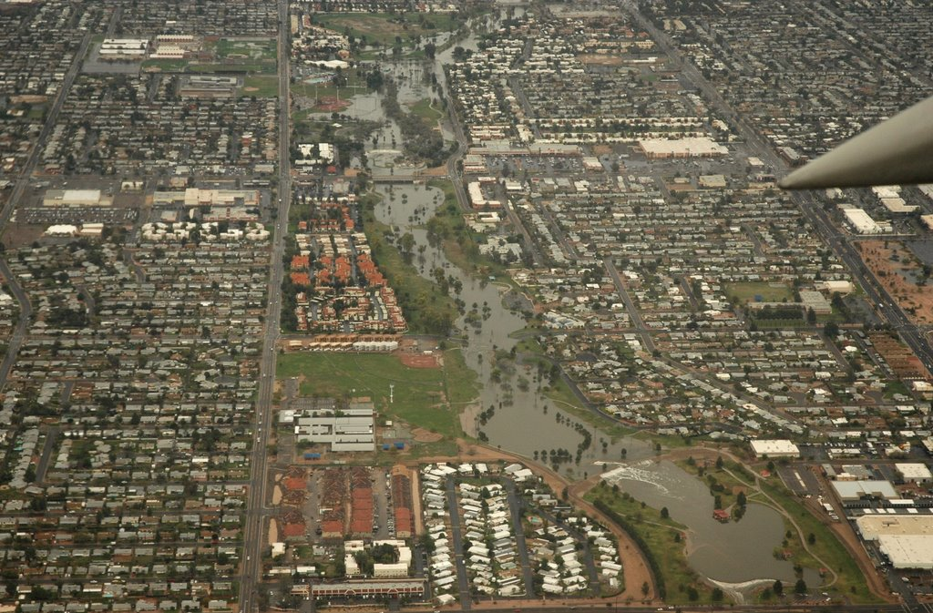
Record Rainfall, effects on DOC
DOC increased from 3.75 to 4.09 mgC/L*
Increase be attributed to two sources, rainfall itself and local storm runoff.
Annual avergae rainfall can total DOC concentrations of 1.392 mgC/L. (Wiley et. al 2000)
*measured day after the storm
Notes:
Here I would mention the two possibilities and then talk about rainwater and say that it was the most probabale source of the increased DOC in the water

Slide 12
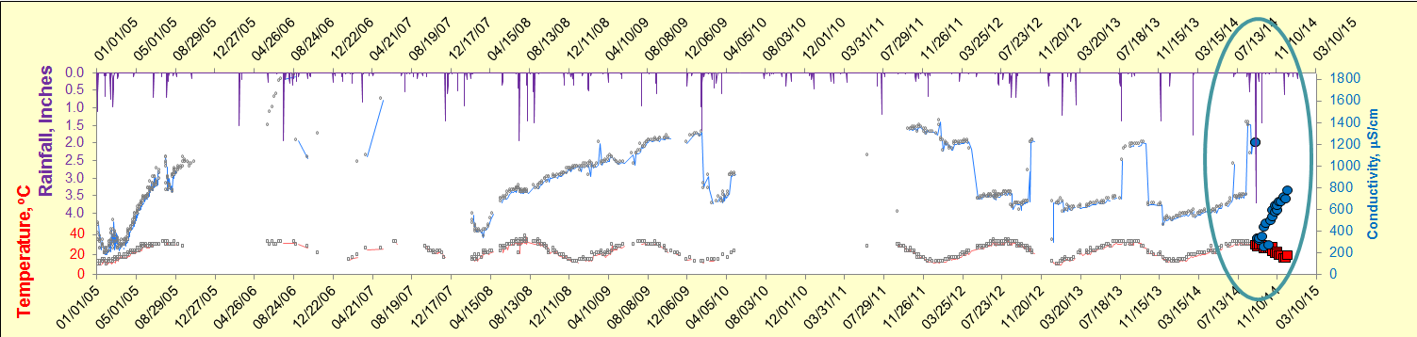
Long Term Trends
Our Tempe Town Lake data follows the long term trend

Slide 13
Summary and acknowledgements
pH tends to decrease during the late fall/winter.
Record rainfall event had a massive impact on the Lake.
Conductivity and DOC were both very affected by the Record Rainfall event.
Tempe Town Lake responds to environmental changes
Thanks to Maggie Bowman, Zach Smith, Stephanie Bone, Josh Nye, and James Leong for help in the lab and help with sampling.

