Slide 1
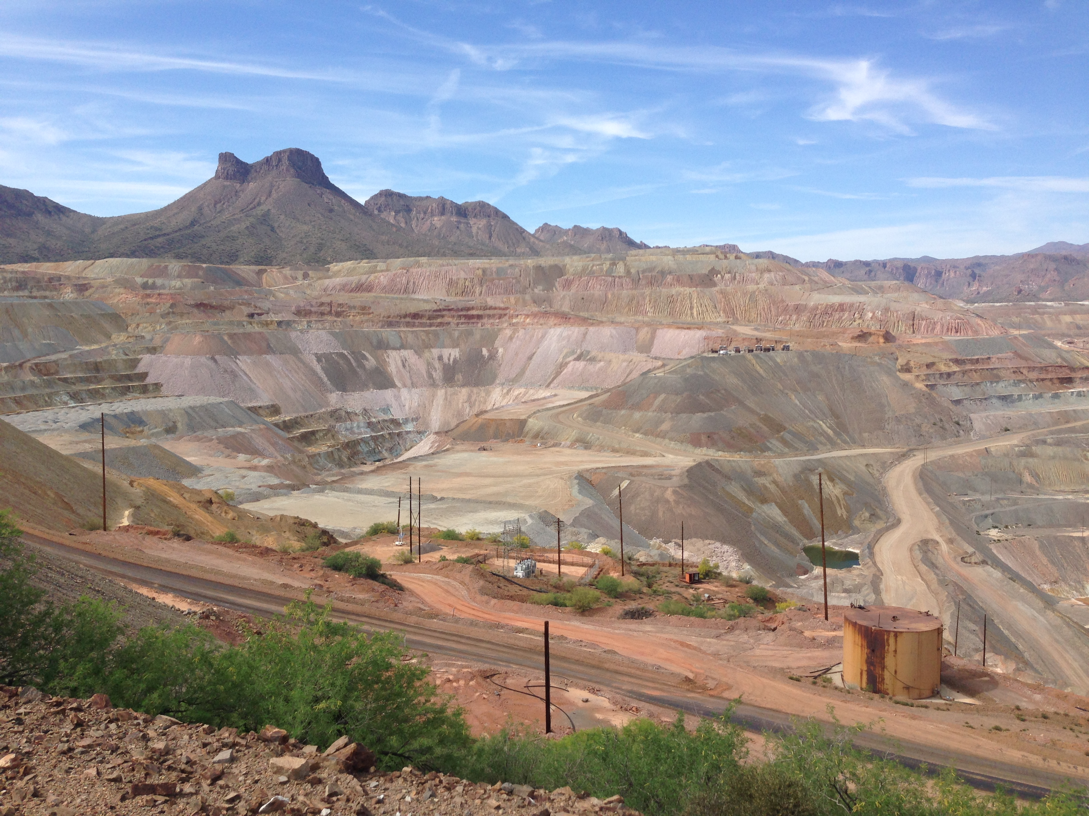

Analysis of Water-Soluble Airborne Particulate Matter Collected in Southern Arizona
Presenter Victoria Raught
Mary Jones, Solianna Herrera, Kyle Rine, Matthew King, Michael Stovern,
Eric Betterton, PhD., Eduardo Saez, PhD
The 24th Annual Arizona/NASA Undergraduate Research Symposium, Tempe, AZ, April 18th, 2015
Notes:
Title first, then authors
Location of presentation, date, name of conference, at bottom
Conference name and date middle?

Slide 2
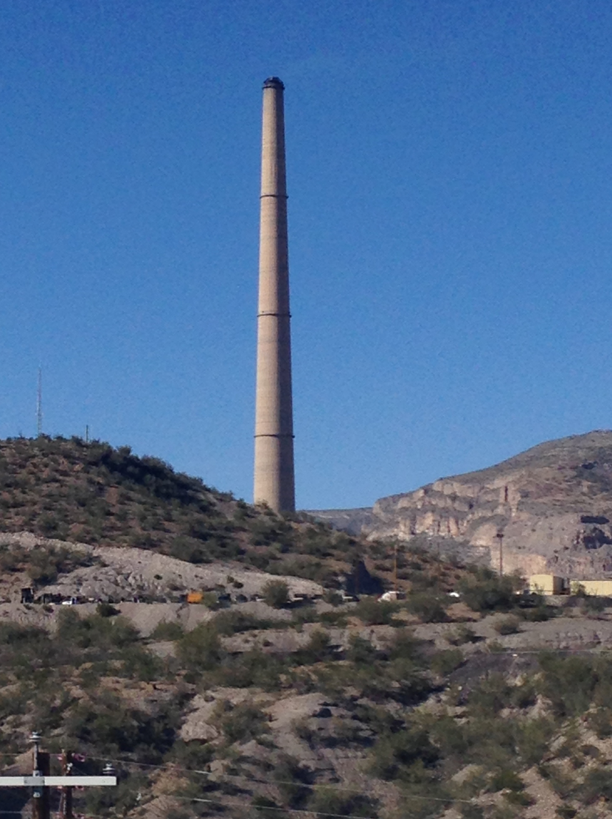
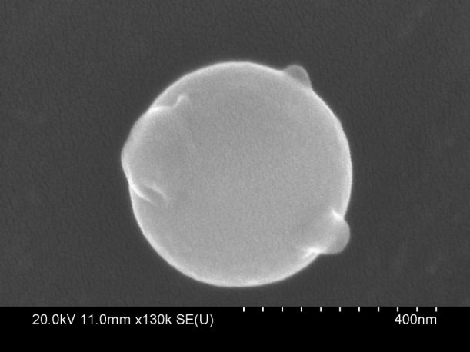
Background
Smelting and chemical processing of metal ore lead to the release of airborne contaminants such as lead and arsenic
ASARCO Smelter
Hayden, AZ
Notes:
Smelting and chemical processing “such as arsenic and lead”
Limit to phrases. Too many words
Copper mining operations in Southern Arizona have been a major industry since the 19th century
Smelting and chemical extractions of ore lead to release of airborne contaminants

Slide 3
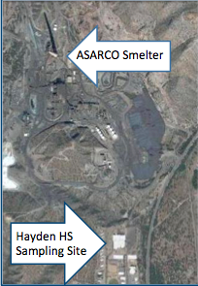
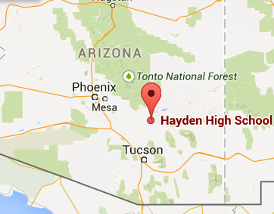
Purpose of the Study
Assessing a diurnal cycle of sulfur and water soluble ion airborne particulate matter
1.0 mi
Notes:
Put a map of hayden
Less words.
First bullet… remove. Expand third bullet. Contaminants transported by aersols
Day/night cycle … trying to confirm it
Completely stay awsay from any discussion of public health study
Make figure bigger if possible
Add scale to map?
0.8 miles

Slide 4
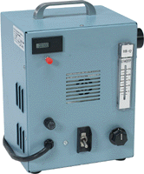
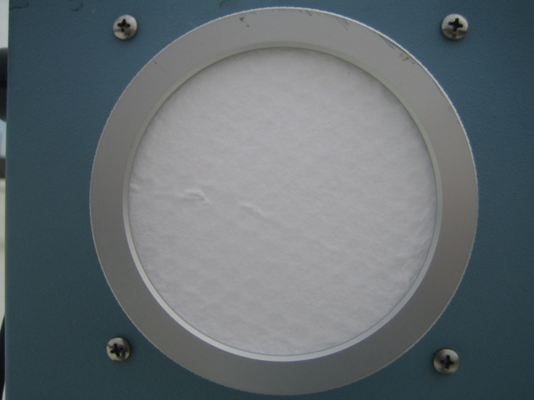
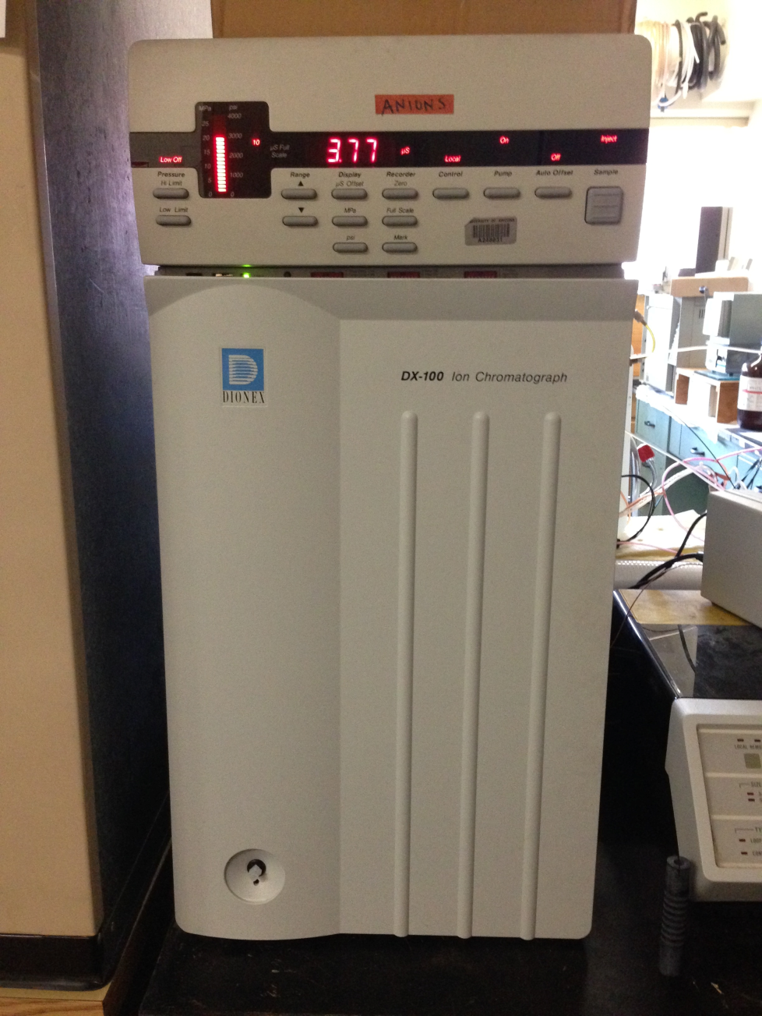
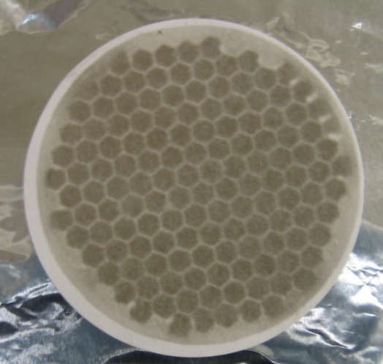
Methods and Procedures
Clean Filter
TSP
Dirty Filter, “Sample”
Ion Chromatography
Notes:
Make picture bigger
Get pictur of TSP machine itself
Volumetric flow rate and collection time. Give times
Delete “were used”
Sub bullet point: hayden, tucson
Cut words
Provide a brief discription of what a TSP is (VERBALLY)
Should I make any mention of AR?
Label it is a filter
Extracted DI water
Analyzed by Anion chromatogrphy
Scaling – quarter?

Slide 5
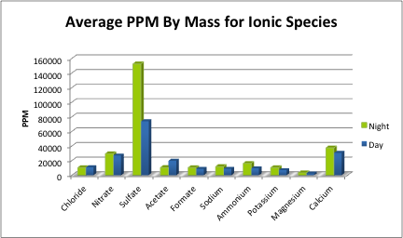
Results
Summer 2014 Preliminary Study

Slide 6
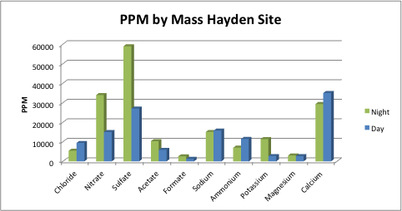
Spring 2015 Study
Notes:
difference in meteorogical conditions
humidity – helped sulfate production. (secondary aersole)

Slide 7
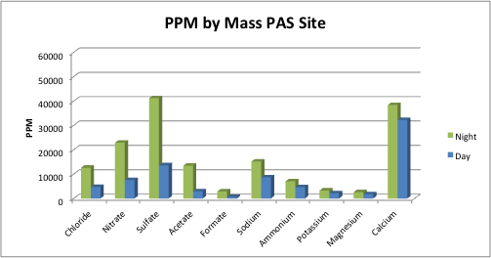
Spring 2015 Study

Slide 8
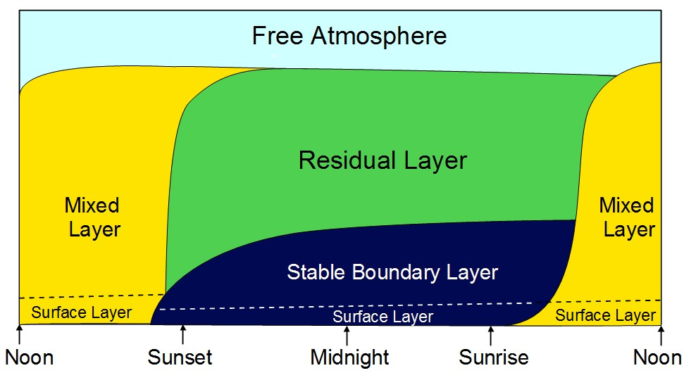
Conclusion
Atmospheric compression
Smelting operations
A combination?
Notes:
Go back and make sure you mention that the filters are weighed before and after
Drop spring study bullet once you include the spring data
Atmospheric compresses
The gravimetric analyses of the daytime and nighttime filters showed more particulates collected during the daytime
Sulfate concentrations were higher at nighttime

Slide 9



Questions?
Thank you
NASA Space Grant
Susan Brew
The Entire Dust Group
Notes:
What other logos would you like me to include?
Superfund
Possible drop “Questions?”
Talk to matt about potential explanations for higher sulfate and other conclusion
Product of smelting
Change to a light background

