Slide 1







Mesoscale Simulation of a Convective Frontal Passage
Travis Swaggerty, Dorothea Ivanova and Melanie Wetzel
Department of Applied Aviation Sciences
Embry-Riddle Aeronautical University, Prescott, Arizona

Slide 2
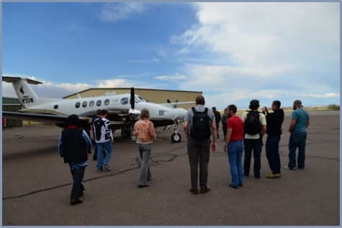
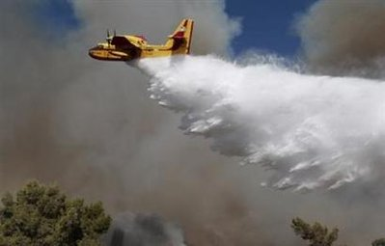
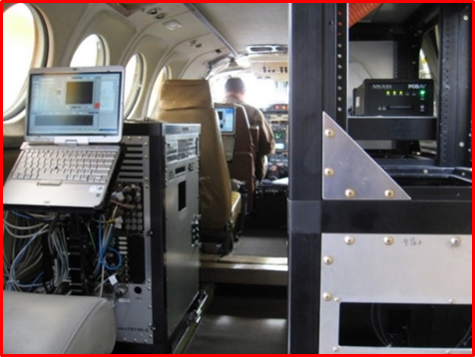
Objective
To more accurately predict convective frontal passages for…
Aviation
Emergency Response
Demonstrate the use of Aircraft Data Verification
Model Simulation Accuracy
University of Wyoming King Air B200T (UWKA).
Application to Emergency Response Aviation.
King Air on-board computer systems and instrument racks.

Slide 3
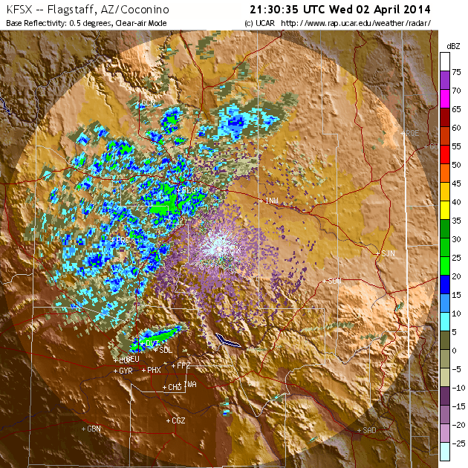
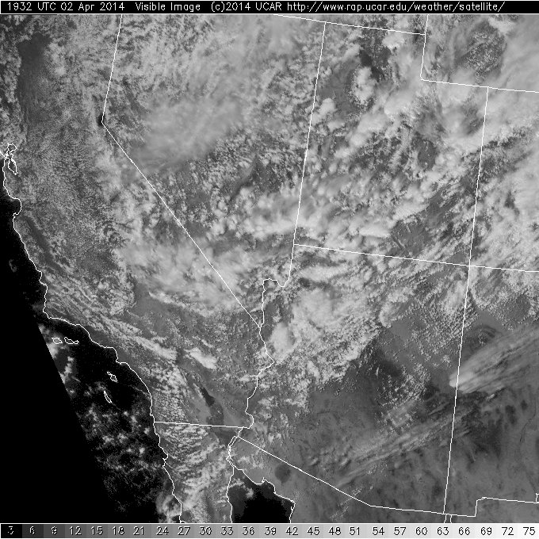
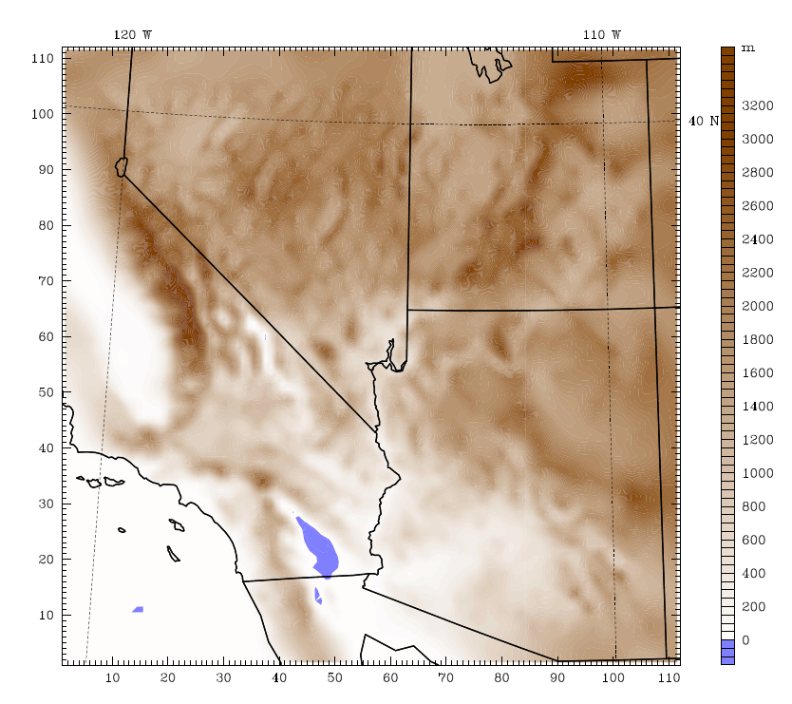
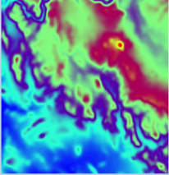
Case Study for April 2 – 3, 2014
KFSX Radar reflectivity (dBZ) at 2130 Z.
GOES Satellite Visible Image showing radar scan area and WRF model inner nest (domain 3).
Topography within model Domain 2 and inset of domain 3.

Slide 4
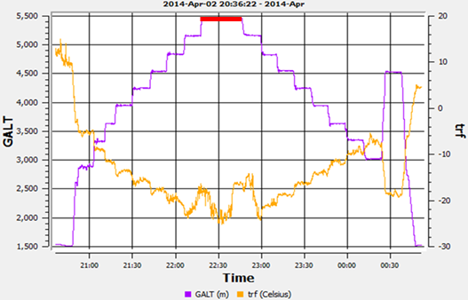
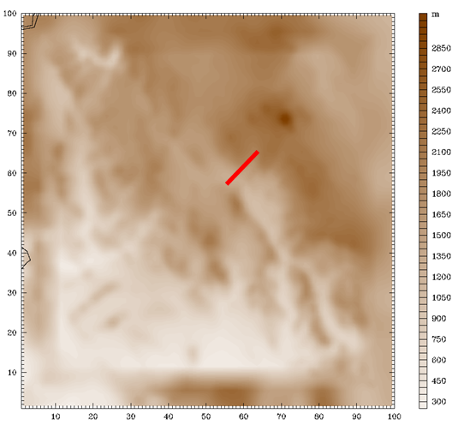
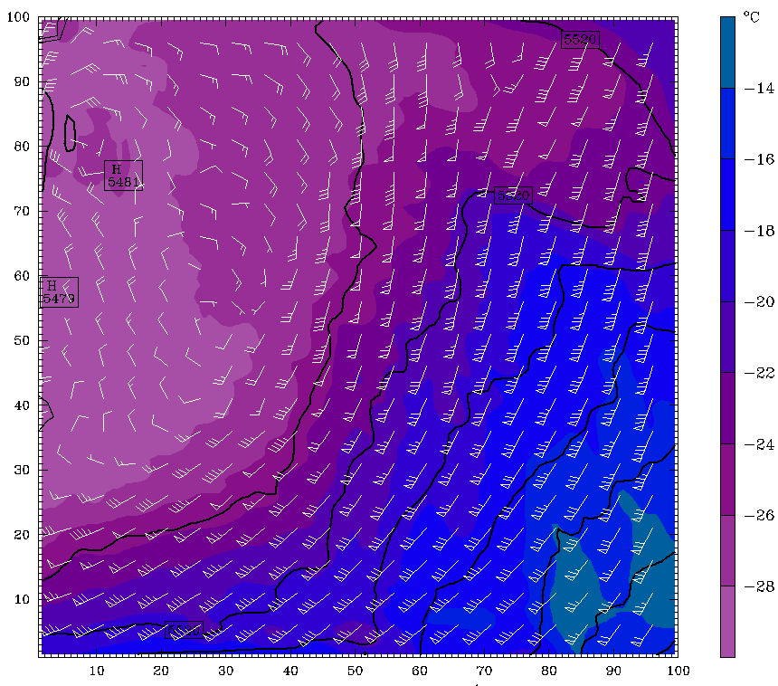
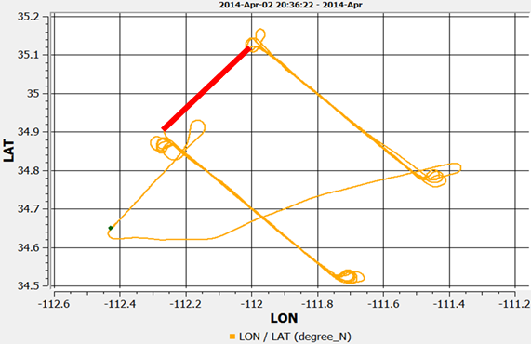
Mesoscale Dynamic Influences on Temperature
Aircraft altitude and temperature time series
WRF domain 3 topography. Red Line indicated flight leg between two transects
WRF forecast 500mb temperature, wind and geopotential height
Aircraft flight track with parallel transects

Slide 5
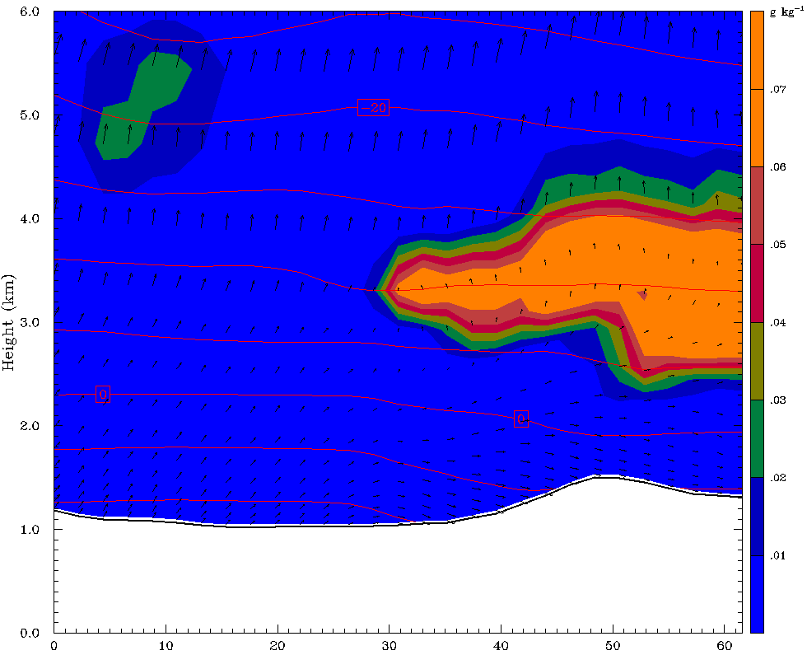
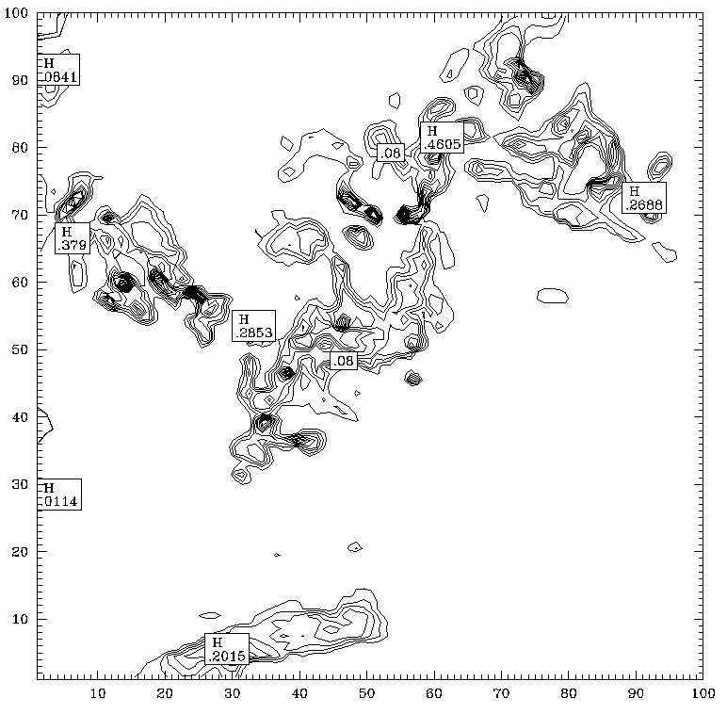
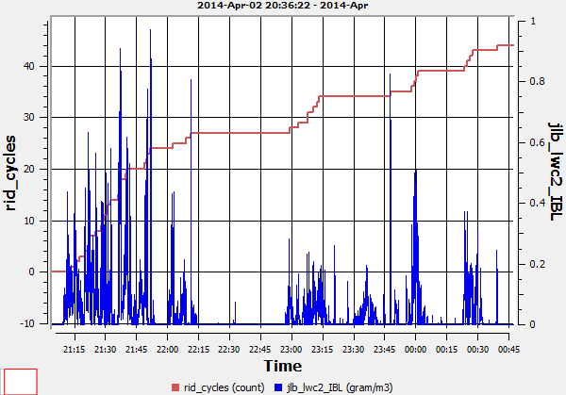
Cloud Structure and Icing Applications
WRF forecast vertical cross section of cloud mixing ratio (g kg⁻¹), temperature (˚C) and horizontal winds at 00Z on April 3, 2014
Model distribution of Total Cloud Mixing Ratio (g kg⁻¹) for 00 Z at 700mb.
Time series (21 Z 02 April – 01 Z 3 April) for Rosemount Icing Detector (trips, red) and liquid water content (g m⁻³) along aircraft track.

Slide 6
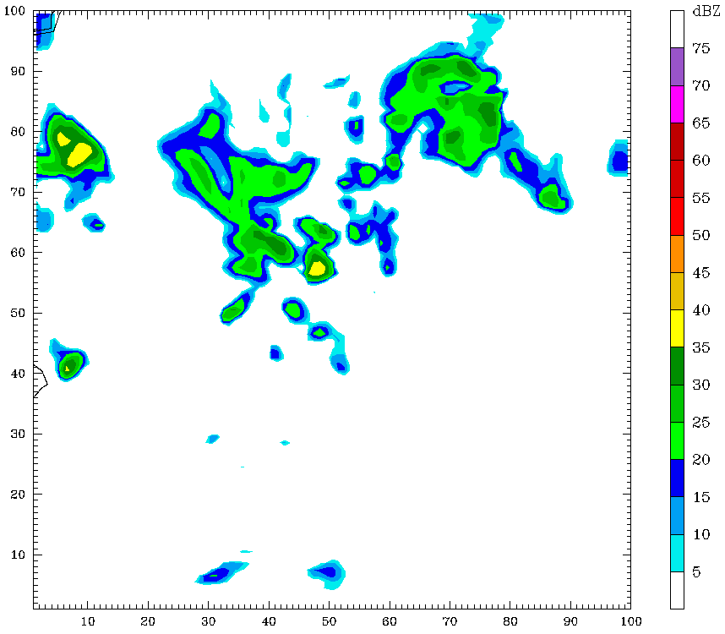
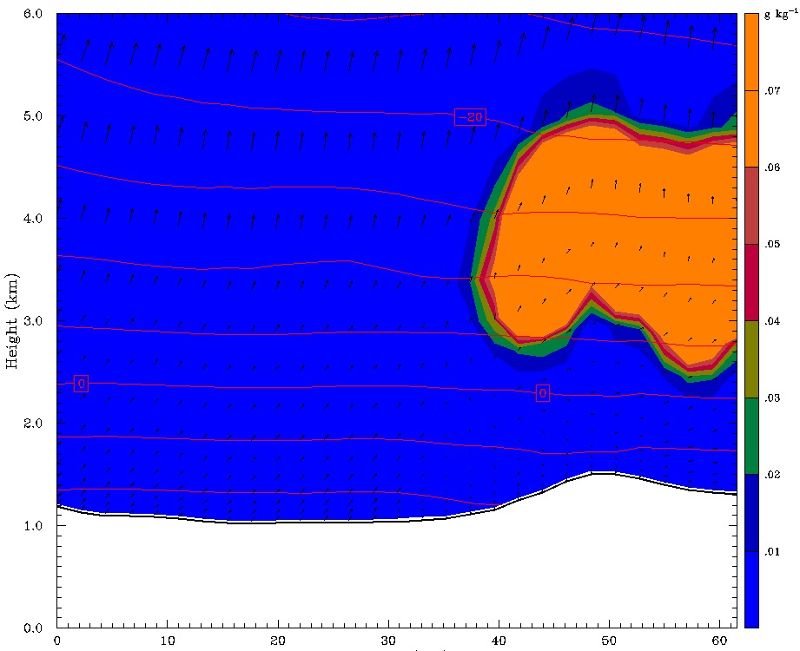
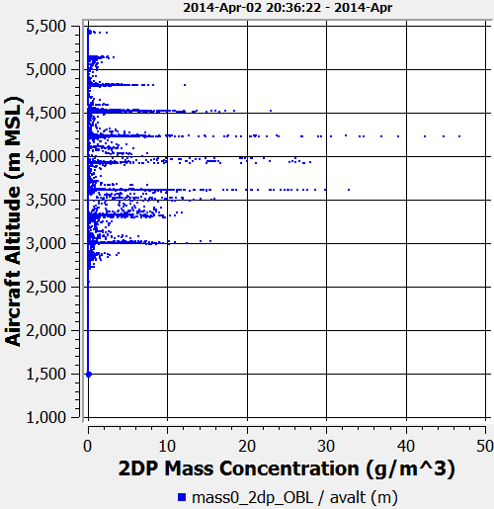
Forecasting Precipitation Distribution
Model Domain 3 simulated reflectivity. Red line is UWKA transect beginning 2245 Z.
Cross-section of precipitation mixing ratio along transect in Domain 3.
Aircraft vertical profile of cloud/precipitation mass concentration.

Slide 7
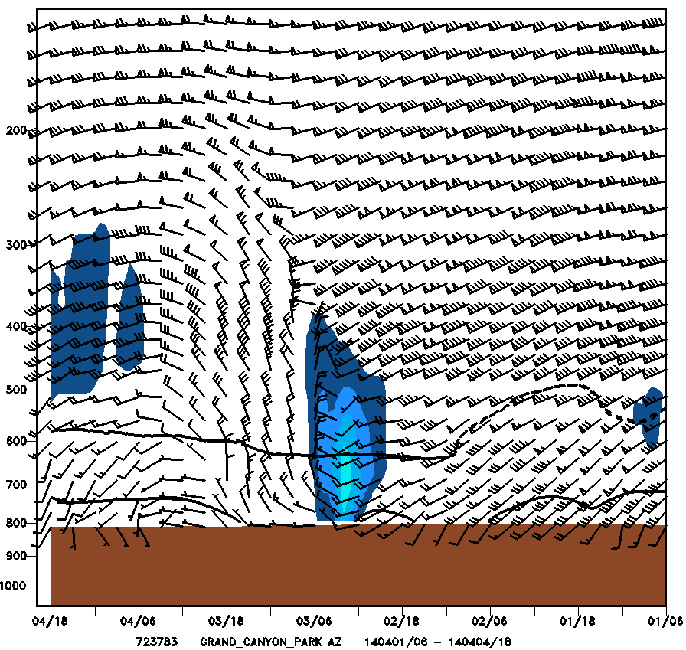
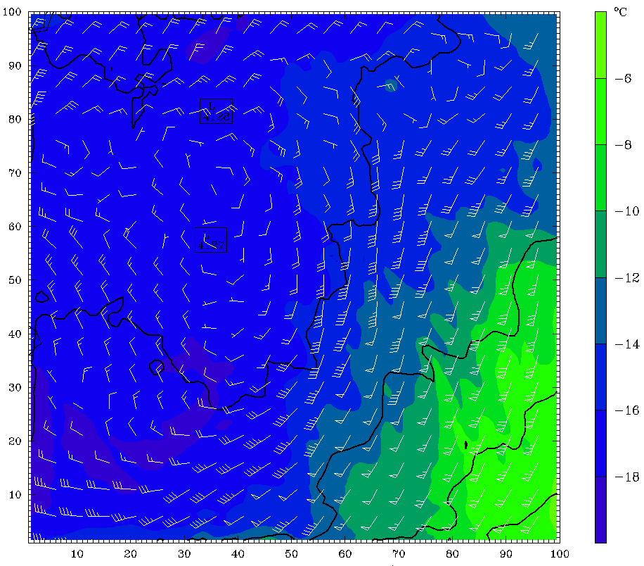
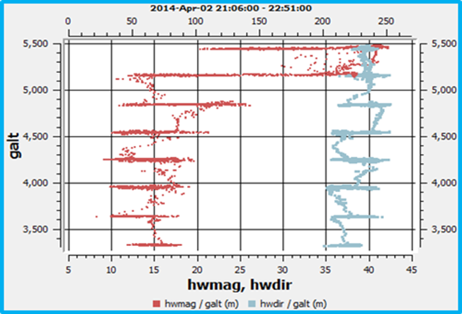
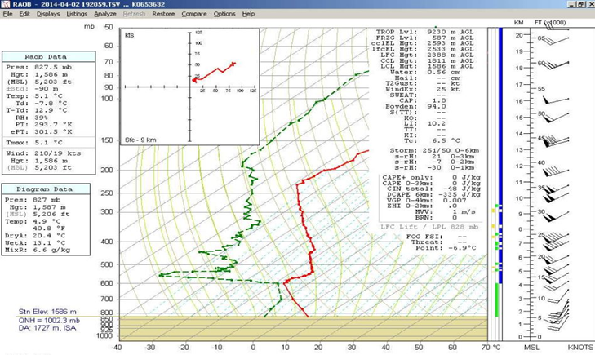
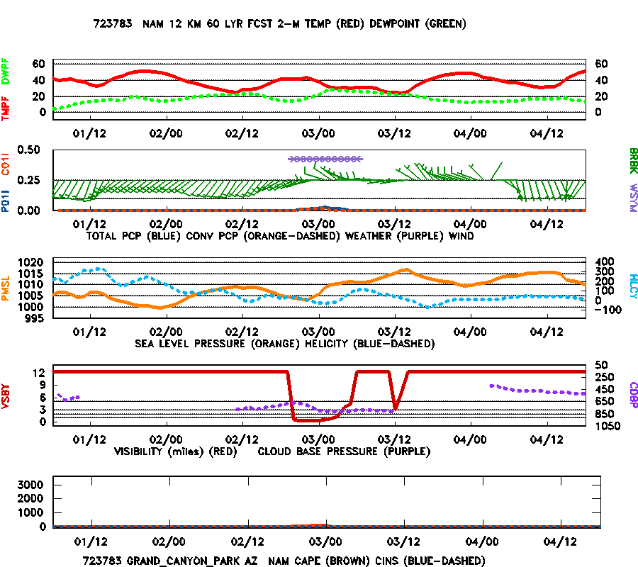
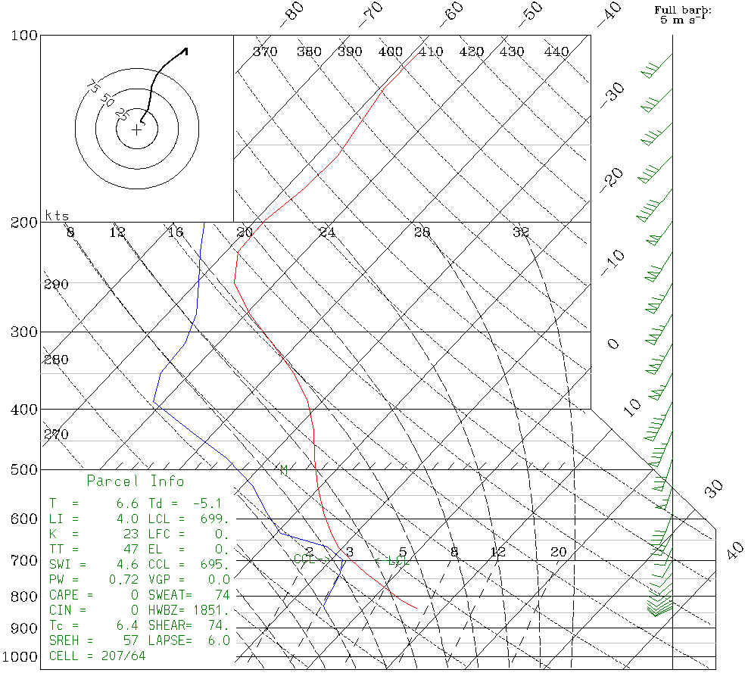
Verification of Wind Patterns
NCEP forecast Cross-section
WRF forecast of 600mb temperature, wind & geopotential height
Aircraft vertical profile of wind speed and direction along flight transects
Radiosonde launched at Embry-Riddle Campus
NCEP forecast meteogram
WRF simulated sounding

Slide 8
Conclusions
Aircraft measurements of cloud mass mixing ratio correspond to distribution indicated in model domain 3 (3km resolution).
Model vertical profile of supercooled cloud structure matches convective distribution observed along sampling transects.
Radiosonde and aircraft profiles of wind velocity agree with simulation of wind patterns.
Mesoscale dynamics associated with Mogollon Rim are represented in forecast results.
Model produced reliable simulations of icing conditions.
swaggert@my.erau.edu

