Slide 1



DOE MURI HOT Fluids Project: Spectrometry of Variable-Thickness Participating Media
Megan McHugh
Dr. Cho Lik Chan and David Leister
24th Annual Arizona Space Grant Consortium Symposium
UA/NASA Space Grant
April 17-18, 2015

Slide 2
Introduction
Department of Energy (DOE) Multidisciplinary Undergraduate Research Initiative (MURI) High Operating Temperature (HOT) fluids division project
  Development of concentrating solar power applications
  High-temperature heat transfer fluids
Goal: Design a method to obtain unique radiation signatures for participating media.
  Participating media was various semi-transparent liquids

Slide 3
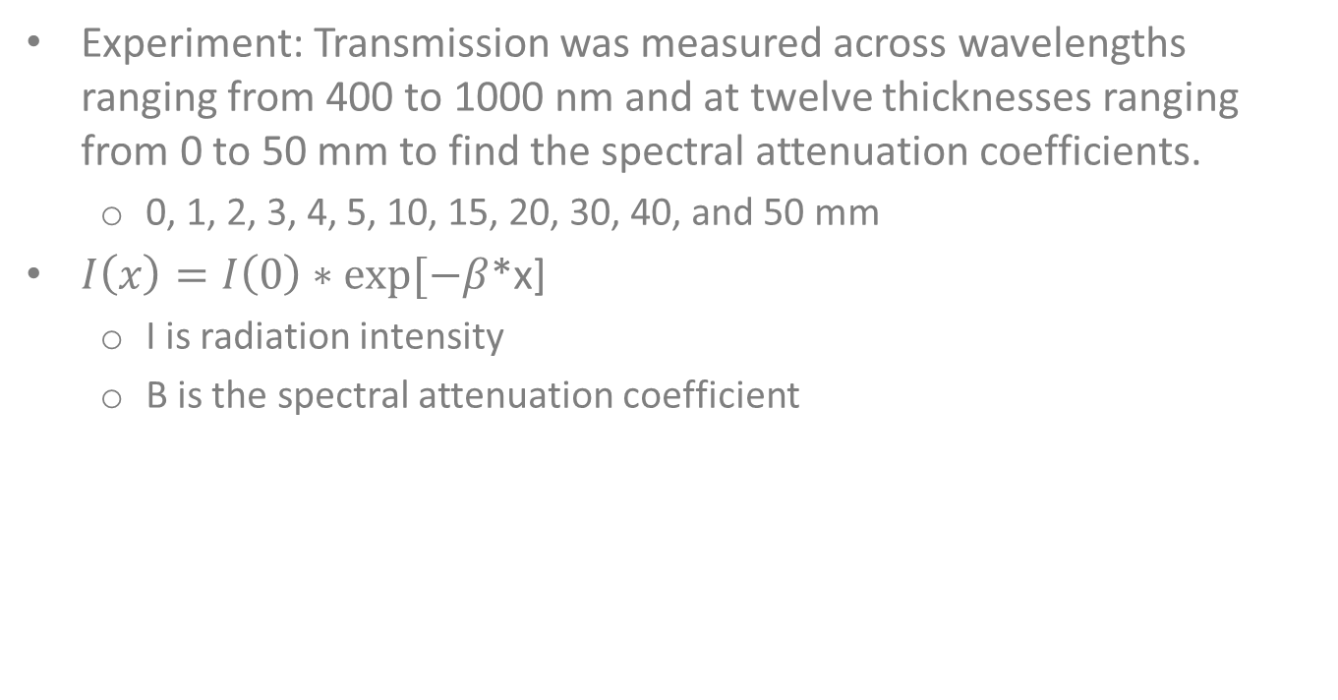
Introduction, cont.
Experiment: Transmission was measured across wavelengths ranging from 400 to 1000 nm and at twelve thicknesses ranging from 0 to 50 mm to find the spectral attenuation coefficients.
  0, 1, 2, 3, 4, 5, 10, 15, 20, 30, 40, and 50 mm
$I\left(x\right)=I\left(0\right)∗exp⁡[−β$*x]
  I is radiation intensity
  Β is the spectral attenuation coefficient

Slide 4
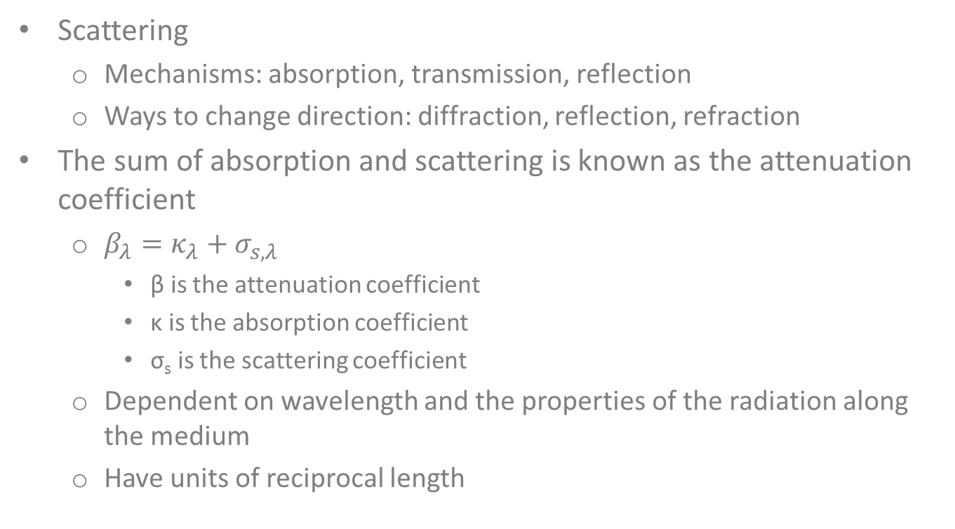
Background
Scattering
  Mechanisms: absorption, transmission, reflection
  Ways to change direction: diffraction, reflection, refraction
The sum of absorption and scattering is known as the attenuation coefficient
  $β_{λ}=κ_{λ}+σ_{s,λ}$
    β is the attenuation coefficient
    κ is the absorption coefficient
    σ_{s} is the scattering coefficient
  Dependent on wavelength and the properties of the radiation along the medium
  Have units of reciprocal length
Notes:
After: * ways to change direction
There are three processes resulting of the interception of radiative energy and any object: absorption, transmission or reflection. So, of the photons traveling through the medium there are three different mechanisms of which they can change their direction either: diffraction which is when there’s changing in the path of a photon without collision, reflection which is when colliding with a particle a photon can be reflected from it, and refraction which is where there’s changing of direction due to a change in the medium.
After: * σ_{s} is the scattering coefficient
Defined as the change of direction of the radiation along a medium.
After: * Dependent on wavelength and the properties of the medium
Such as temperature, pressure, and the composition of the material
After: * Have units of reciprocal length
Because physically they represent the penetration of the wave through the medium and they are called linear or volumetric coefficients.

Slide 5
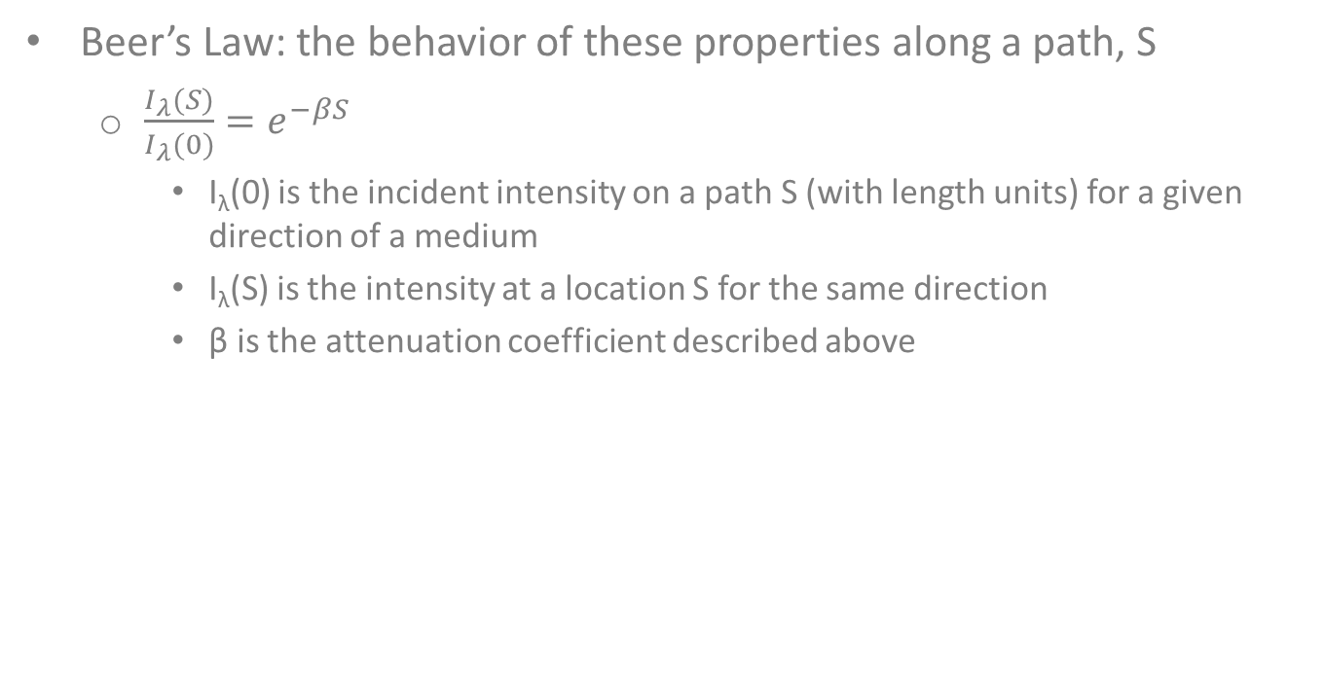
Background, cont.
Beer’s Law: the behavior of these properties along a path, S
  $\frac{I_{λ}(S)}{I_{λ}(0)}=e^{−βS}$
    I_{λ}(0) is the incident intensity on a path S (with length units) for a given direction of a medium
    I_{λ}(S) is the intensity at a location S for the same direction
    β is the attenuation coefficient described above

Slide 6
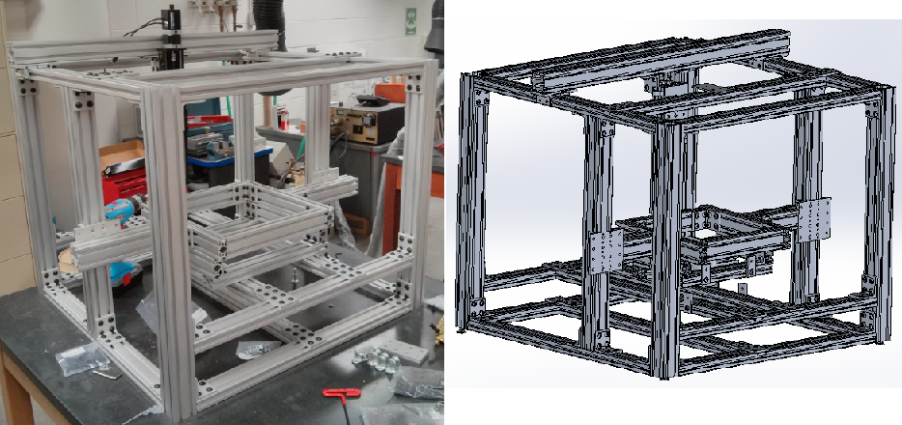
Setup
Fig. 1: The structure of the device made from T-Slots. (Photo by Rafael Yari Cabanillas Gonzalez)
Fig. 2: SolidWorks model of the device.

Slide 7
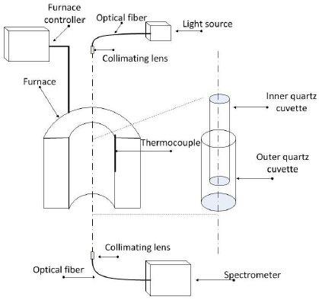
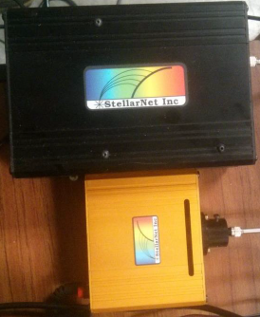
Fig. 4: Spectrometer (top) and light source (bottom). (Photo by Rafael Yari Cabanillas Gonzalez)
Fig. 3: Design of the device including parts for heat application. (Source: Cabanillas Gonzalez, 2014)

Slide 8
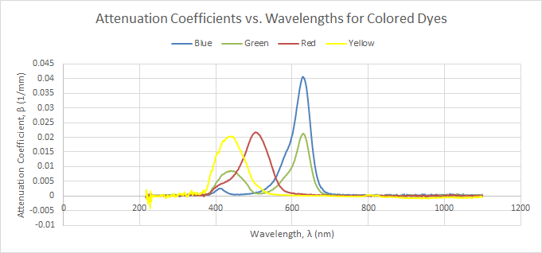
Colored Dyes Attenuation
content

Slide 9
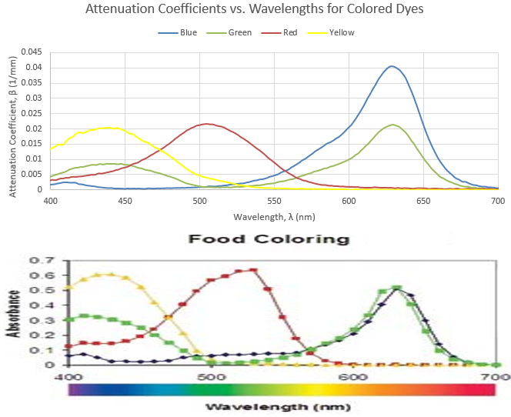
Colored Dyes Comparison

Slide 10
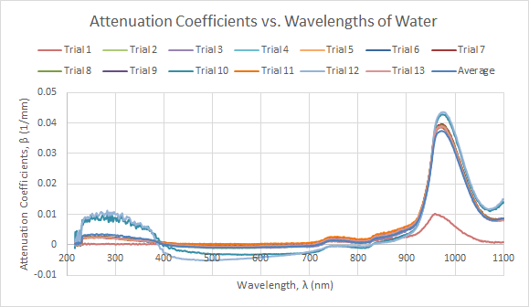
Water Attenuation
content

Slide 11
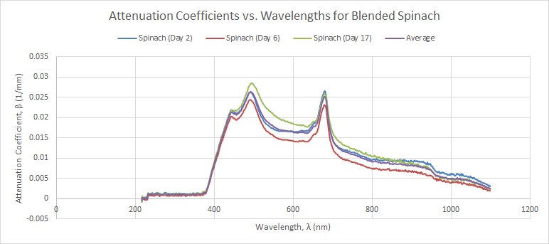
Spinach Attenuation
content

Slide 12
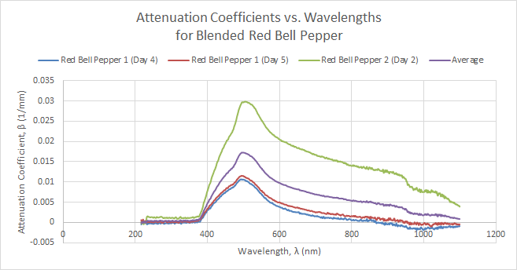
Red Bell Pepper Attenuation
content

Slide 13
Future Directions
Perform the same procedure with leaves for remote mapping.
  The radiation coming through tree tops can have the parts below the roots reconstructed.
  Dr. Ganapol has developed transport theory to perform this remote sensing.
  Attenuation data is necessary to make the predictions.
Characterize high-temperature fluids for concentrating solar power applications.

Slide 14
Thank you!
With special thanks to Barron Orr and Susan Brew, my mentor, Dr. Cho Lik Chan, and my research partner, David Leister.

