Slide 1
Secondary Control Interface for Underwater Remotely Operated Vehicle
Brittany Nez
Key Acknowledgements: Ryan Meuth, Joseph Mattern
Sheraton Phoenix Airport Hotel
April 18, 2015

Slide 2
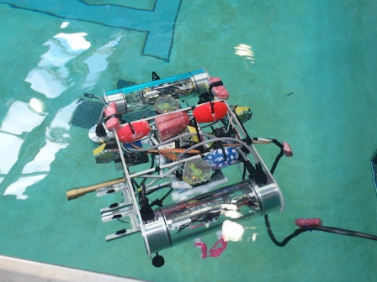
A Brief Summary…
NASA Space Grant Robotics will participate in international MATE competition
Team was in need of a secondary control unit for extra module space

Slide 3
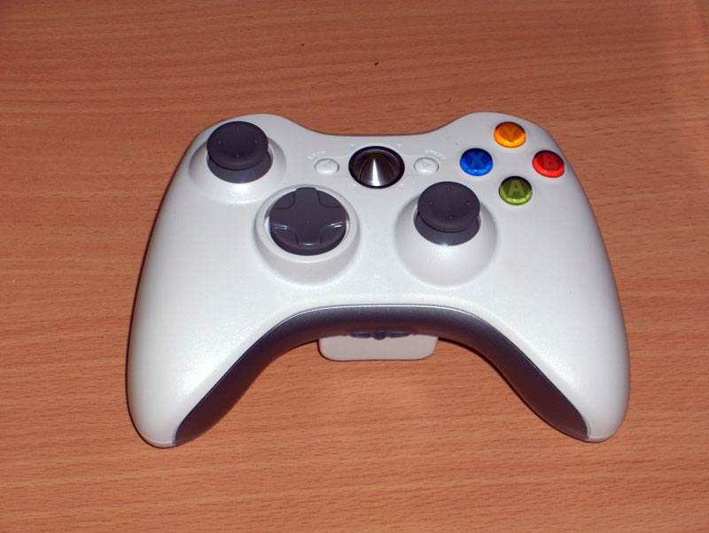
Initial System Complications
Access to necessary controls and modules limited
Small motor control variability on initial control system
Single interface placed all control on one single team member

Slide 4
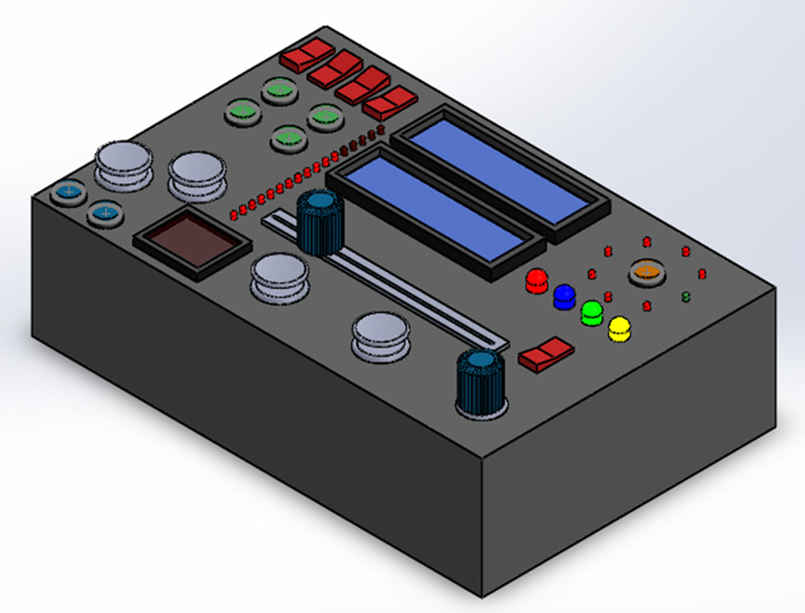
Project Objective
Create a secondary control unit that would:
  Provide necessary space for essential modules
  Allow for rapid-position movement of robot
  Reduce Primary Driver Workload

Slide 5
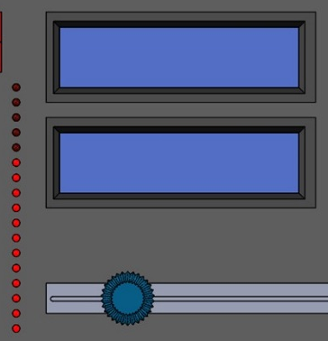
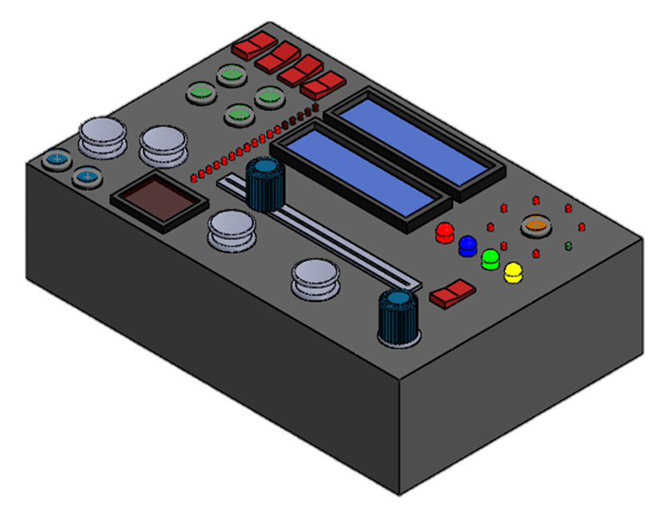
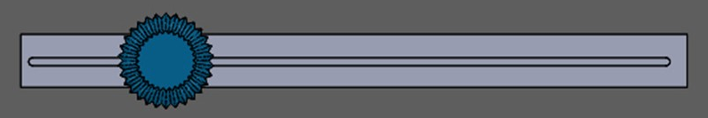
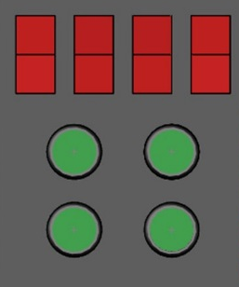
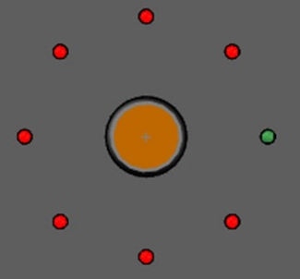
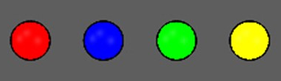
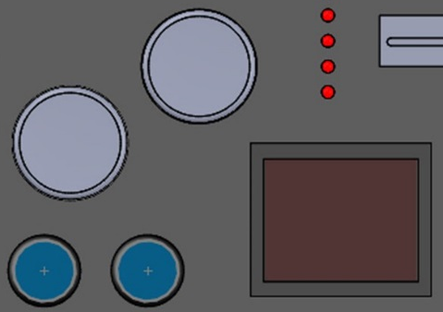
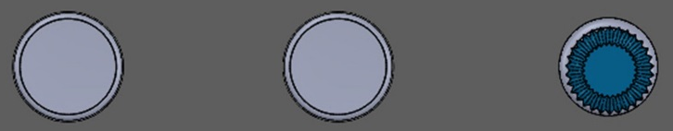
Component Functions
General Controls
Data Display
Navigation System
Camera Controls
Variable Motor Controls

Slide 6
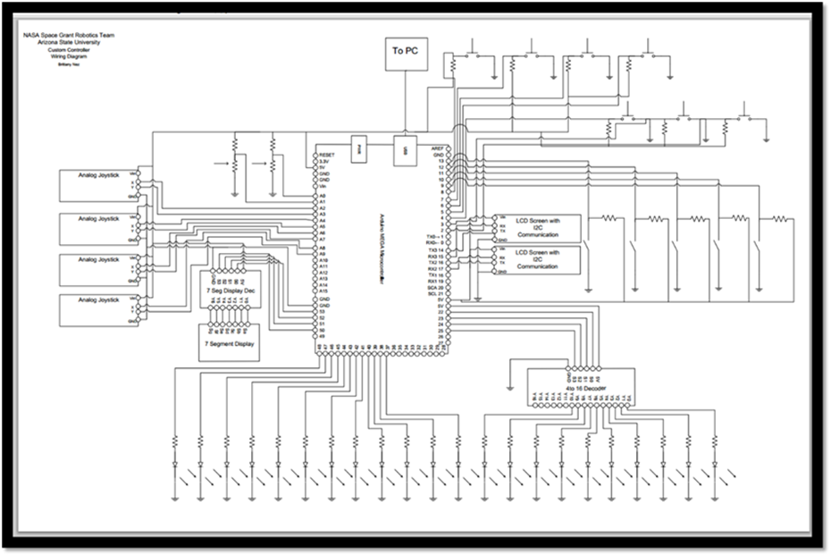
Design and Progress
Design process and control programming complete
Testing will take place in near future
Control system should be fully functional and tested by MATE competition

Slide 7
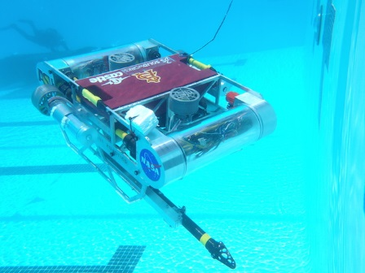
Future Utilization
Additional console has given team option to enhance robot with more components
MATE Tasks and Missions are altered every year
  Control interface is easily modified
  Can be used for subsequent ROVs

Slide 8
Acknowledgements
Ryan Meuth (Mentor)
Joseph Mattern
ASU/ NASA Space Grant
NASA Space Grant Robotics
THANK YOU

