Slide 1


ASU NASA Space Grant Robotics Leadership
Joseph Mattern
Mentor: Ryan Meuth

Slide 2
NASA Space Grant Robotics
The NASA Space Grant Robotics Club is an undergraduate club that focuses on building and competing with underwater robots
Give students the opportunity to gain hands on experience with robotics
Give back to the community through outreach
MATE (Marine Advanced Technology Education) competition
St. John’s, Newfoundland, Canada : June 25th – June 27th

Slide 3
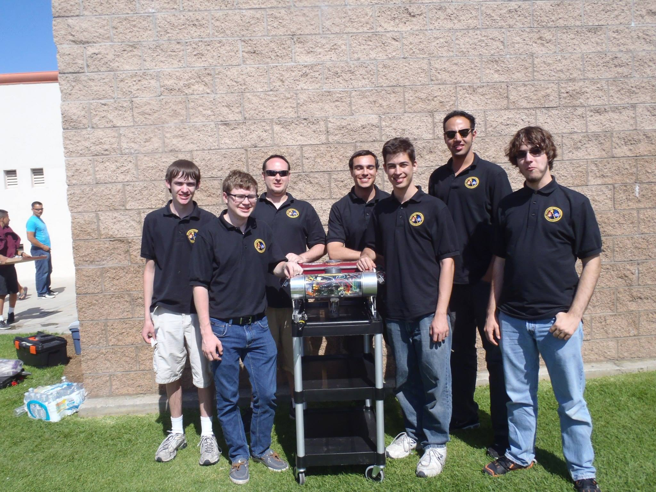
MATE Competition
International Competition that simulates real world Oceanographic Study
2015 Focus: Oceanography in Antarctic
Three Tasks
Science Under the Ice
Subsea Pipeline Inspection and Repair
Offshore Oilfield Production and Maintenance

Slide 4
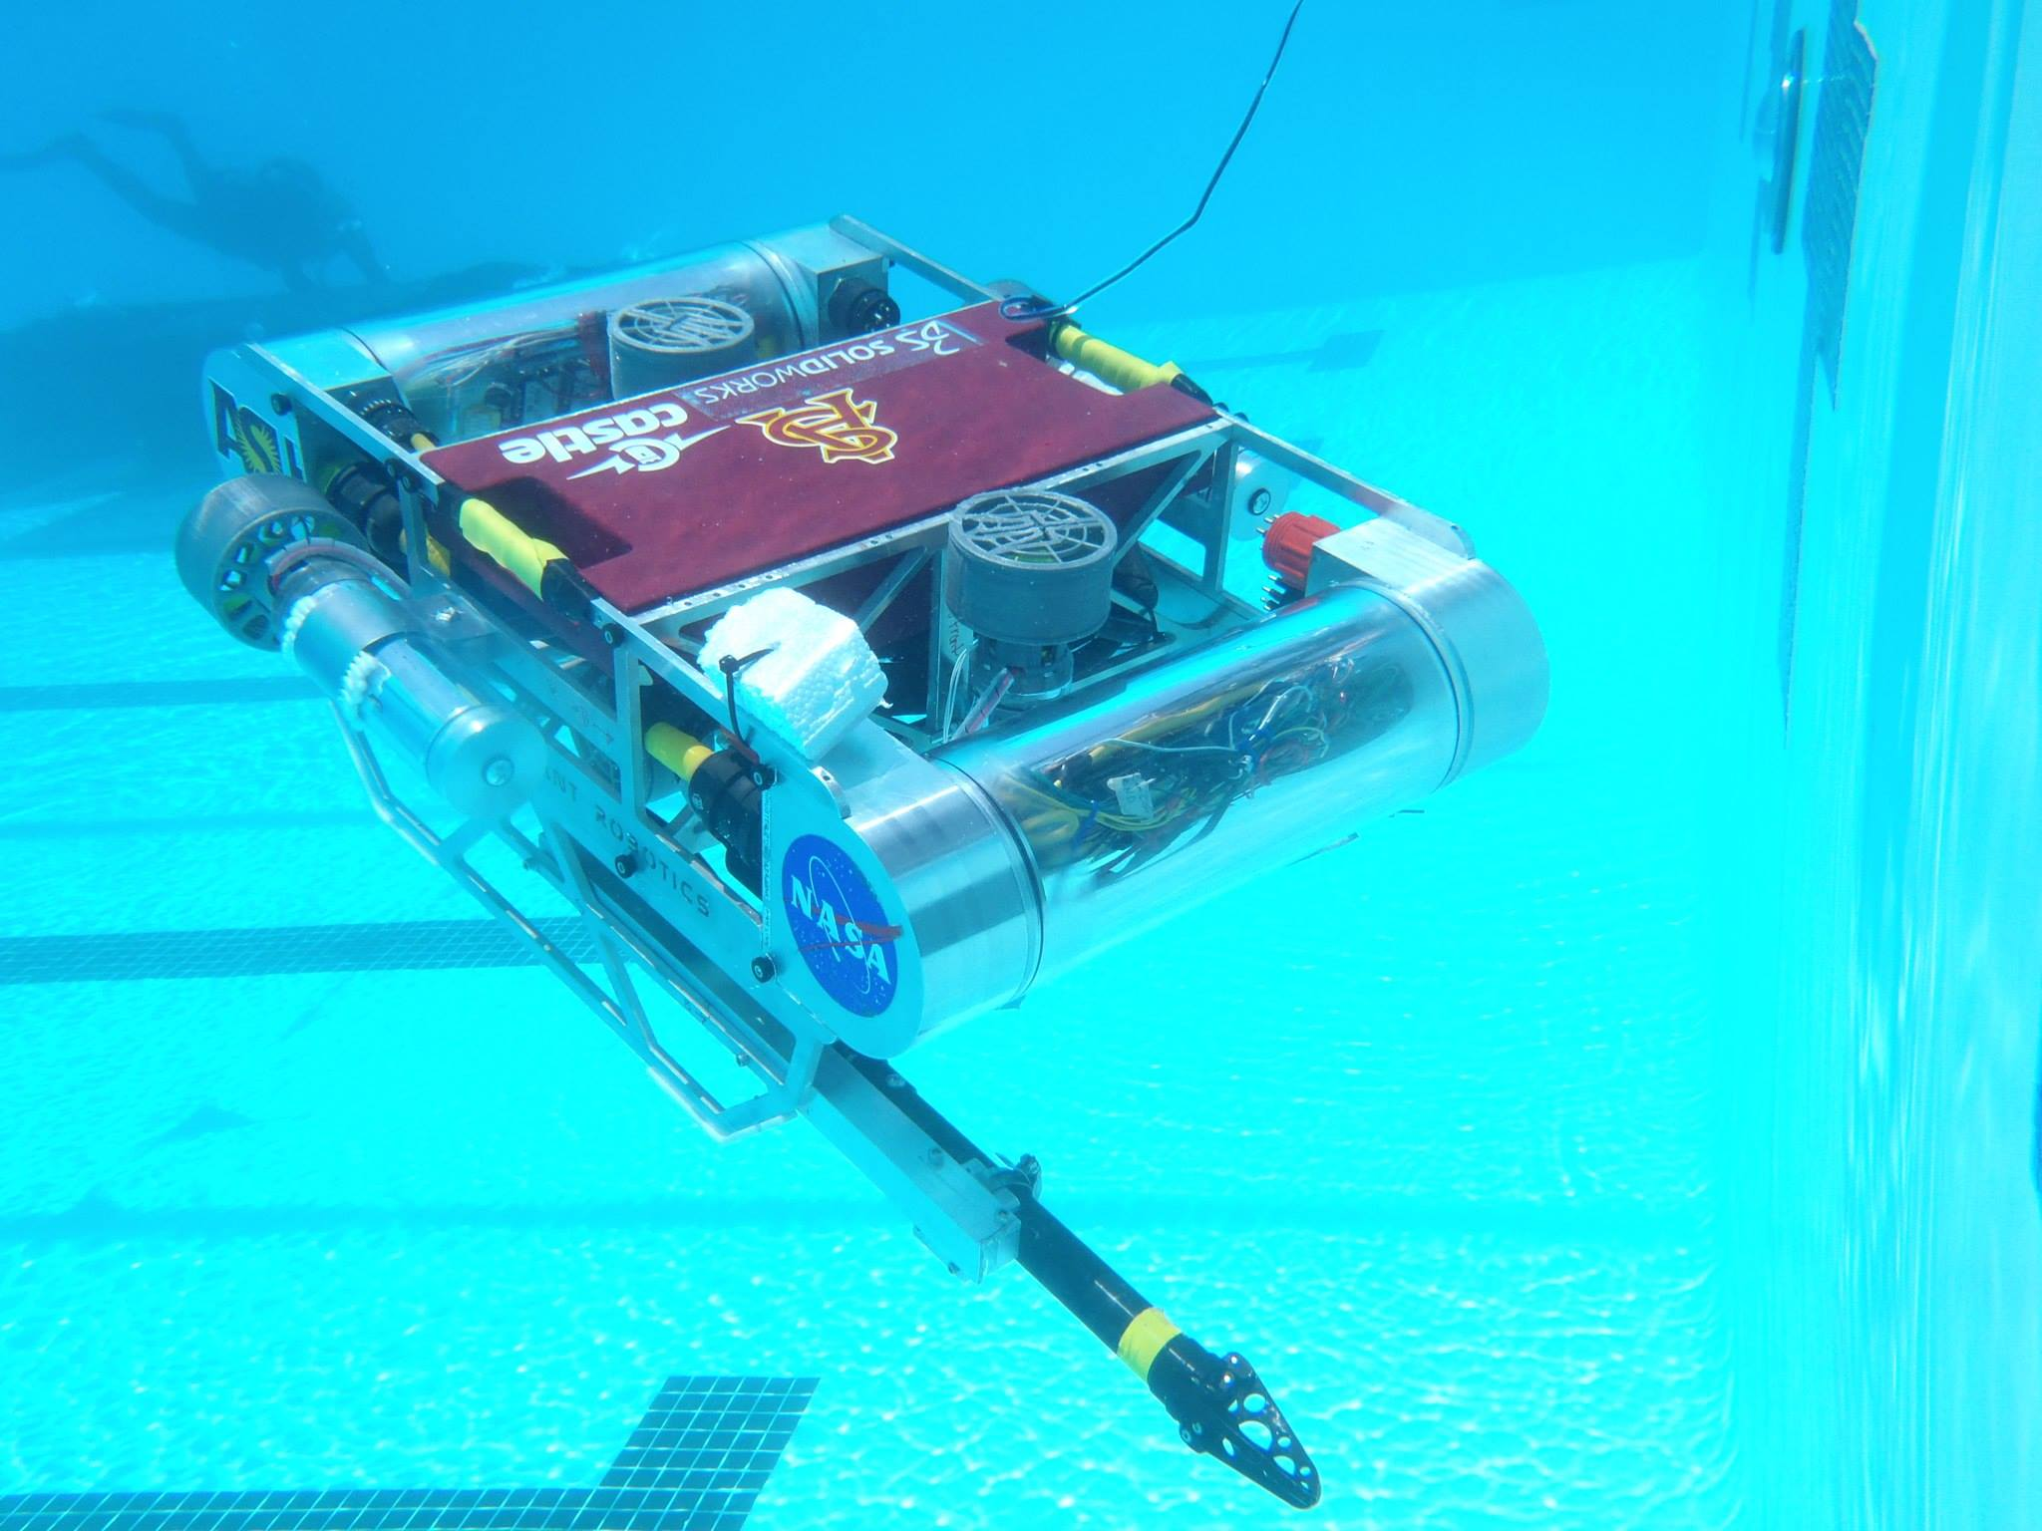
Koi III
Modular Focused Design
Intuitive Control System
Powerful Computing System
Robust Safety Systems
Compact Tether

Slide 5
Computer and Control System
Two Computer Setup
One onboard and one on surface
Multiple Controllers
Standard Xbox Controller
Complimentary Control System
Robot Operating System (ROS) implemented graphics processing
Two Onboard Microcontrollers for Motor and Sensor control

Slide 6
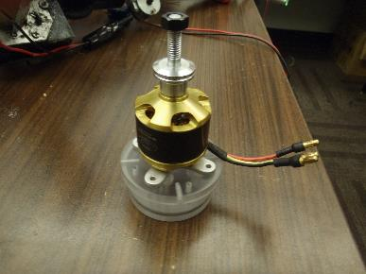
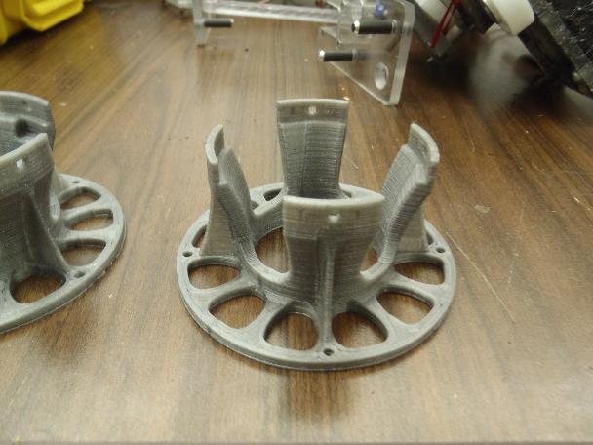
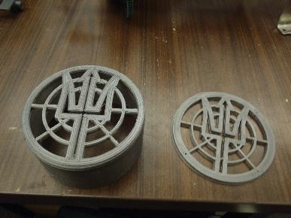
Custom Built Motor Systems

Slide 7
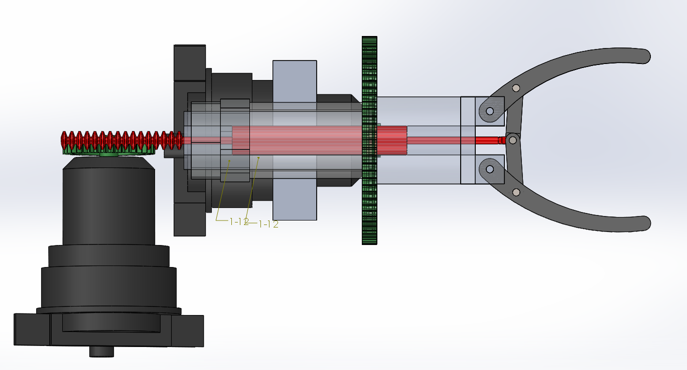
Other Modules
Extendable Small Diameter Claw
Flow Rate Sensor
Not Attached
Simple sensor system
External Camera
Valve Motor

Slide 8
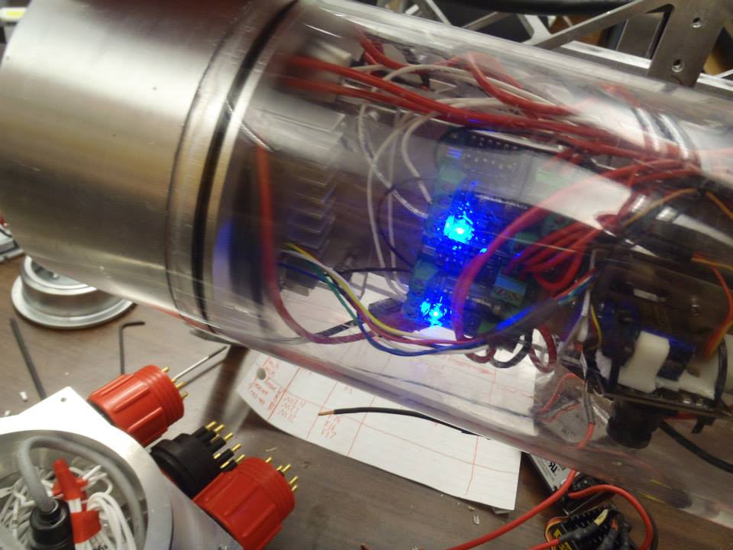
Waterproofing
Large Enclosures
O-Ring Seals
Pressure Valves
Motors
O-Ring Seal
Gasket Screws
External Wiring
Scotch Cast
Safety Measures

Slide 9
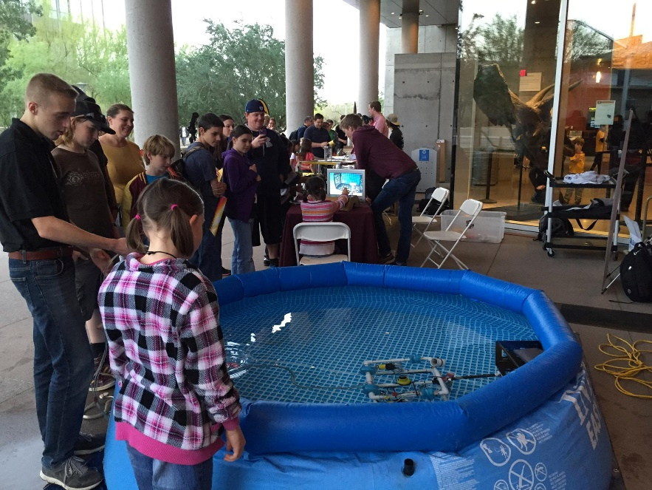
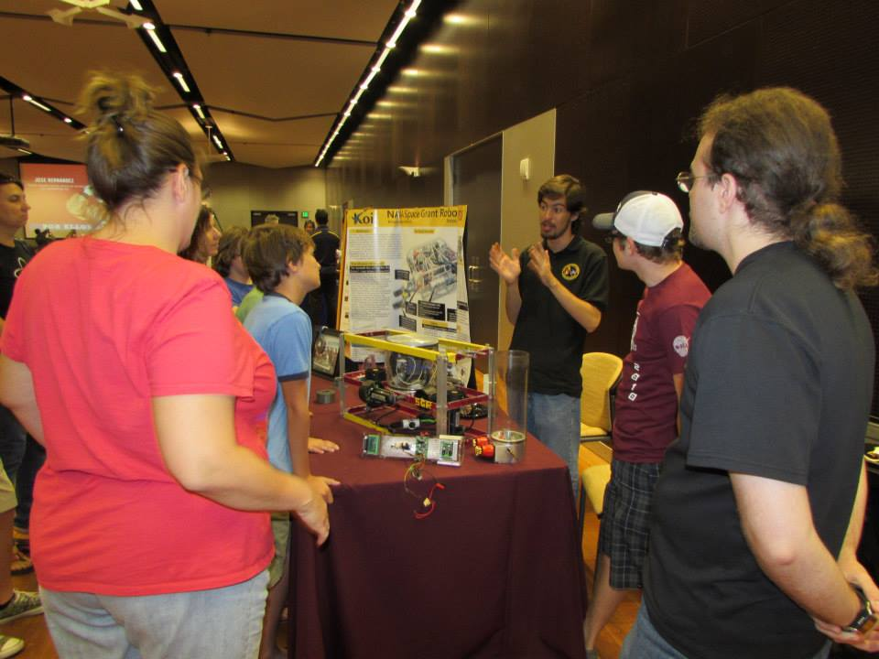
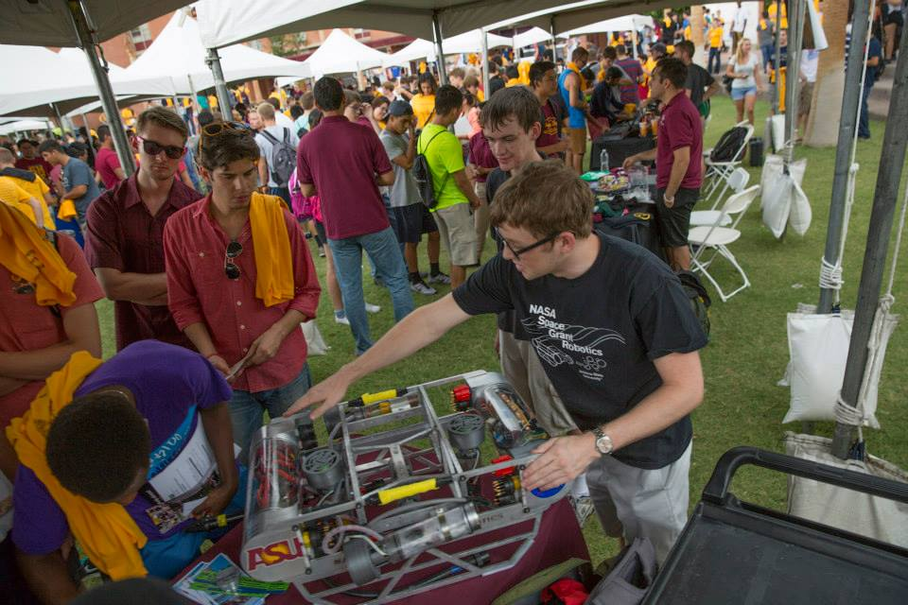
Outreach

Slide 10
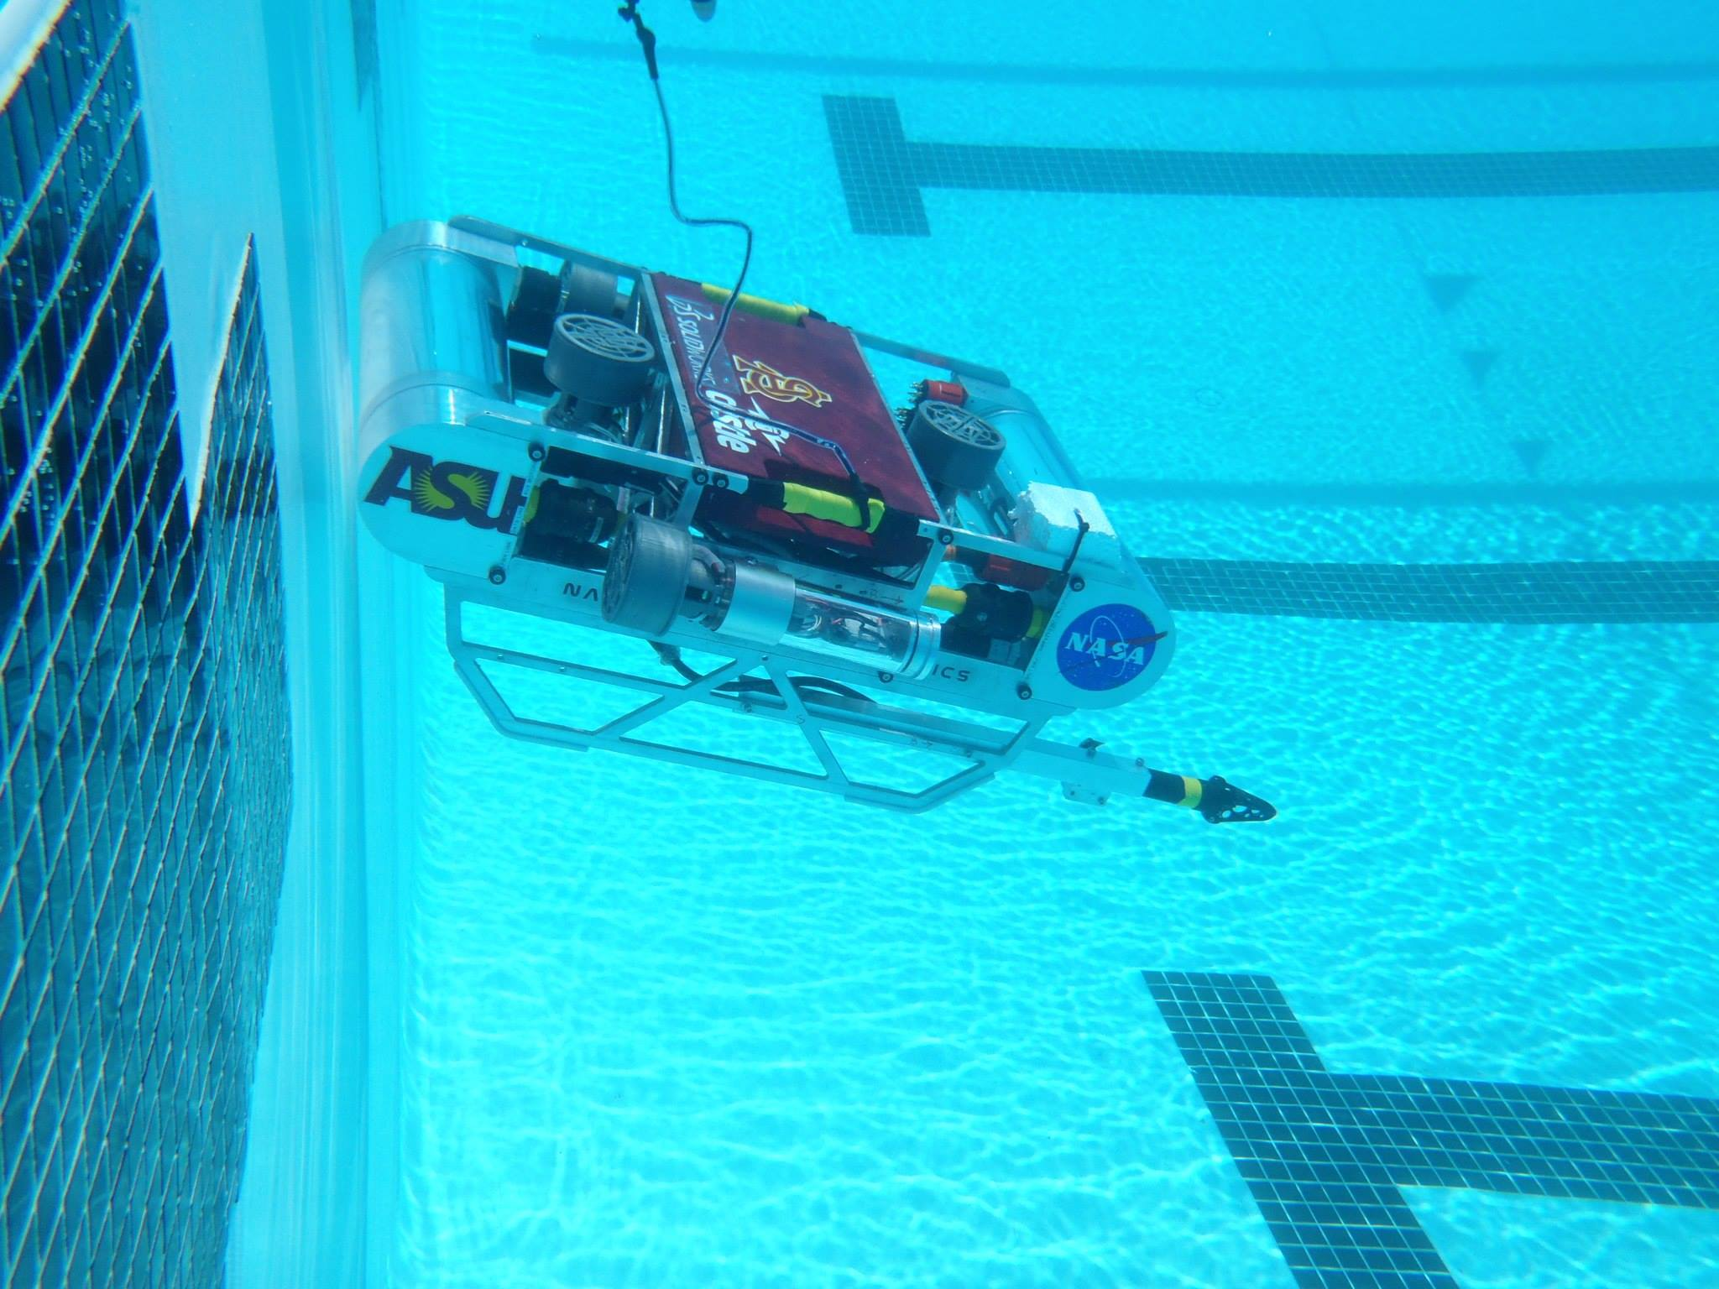
Questions?

