Slide 1




Chaotic Robotics
A Study of Analog Robots and their Nonlinear Behavior
Callie Branyan
Mechanical Engineering
Arizona Space Grant Symposium
April 18, 2015
Tempe, Arizona

Slide 2
Purpose
Develop an analog circuit that displays nonlinear behavior in order to analyze its ability to out perform it’s digital counterpart
Develop more robust robots for autonomous exploration

Slide 3
Relevance
Explorative vehicles are still struggling with basic problem solving
Robots should be adaptable
Analogy circuitry provides a certain level of instinctual responses

Slide 4
Background: Analog vs Digital
Analog
  Use of simple components to create complex behavior
  No programming
  Allows for levels between high and low
    Dimmer vs. Light switch
Digital
  Usually the use of a microcontroller
  Machine language structure
  Rigid high and low levels

Slide 5
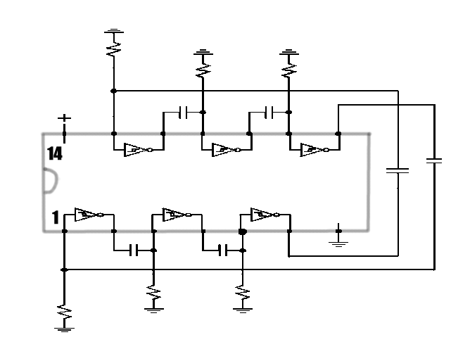
Background: Nonlinear Circuits
Neuron Core
  The Microcore
Nervous Net
  Interfaces with
  Sensors and
  servos
Circuit Diagram of Basic Microcore
Input from
Sensors
Nervous Net
Neuron Core
Output to
Servos

Slide 6
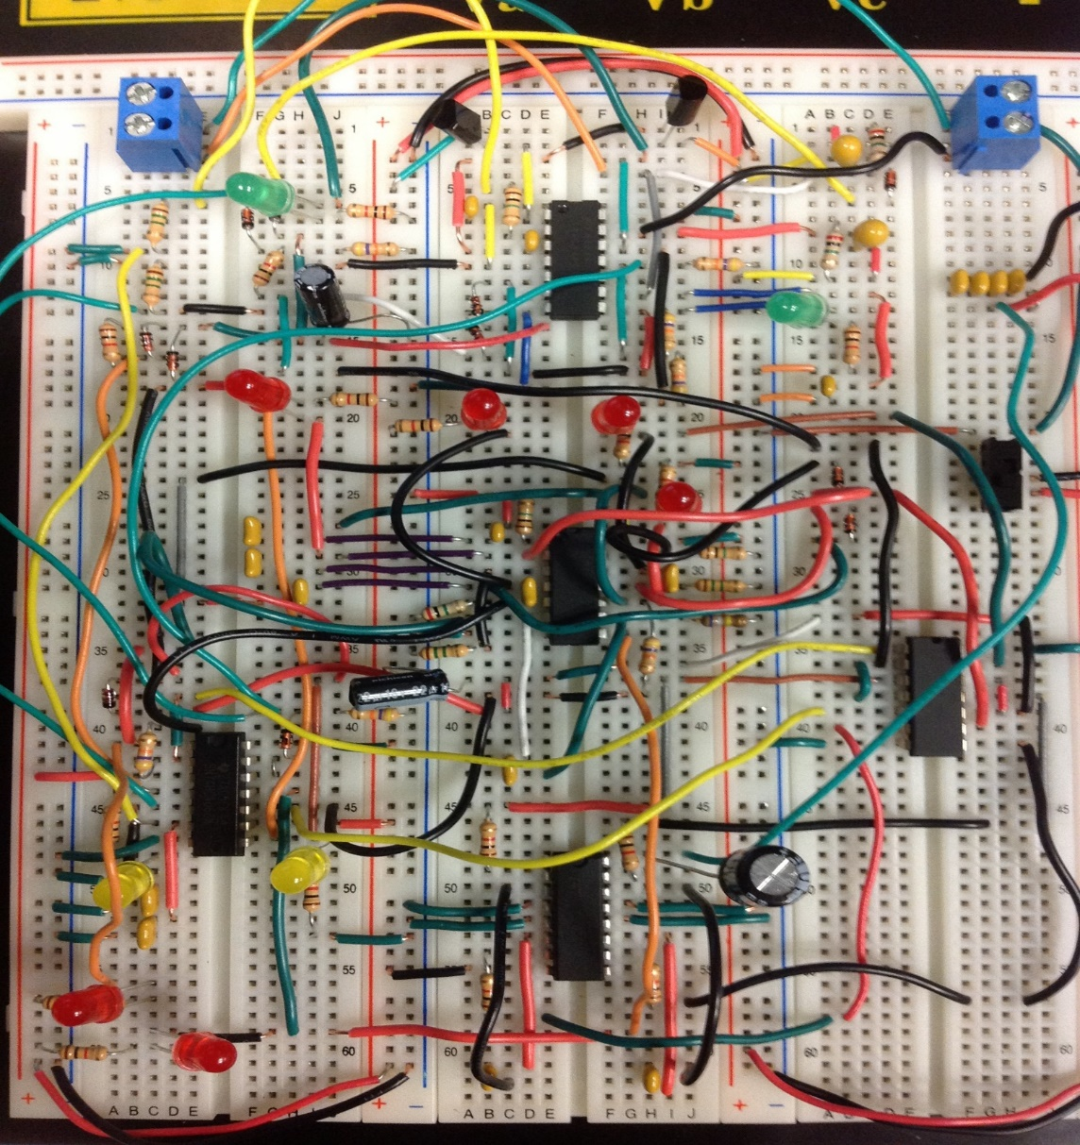
The Circuit
Photo taken of Prototype Circuit

Slide 7
The Circuit
Microcore
Walking Loop
Components
Photo taken of Prototype Circuit

Slide 8
The Circuit
Antenna
Touch
Sensor
Antenna
Touch
Sensor
Infrared
Sensors
Nervous Net
Photo taken of Prototype Circuit

Slide 9
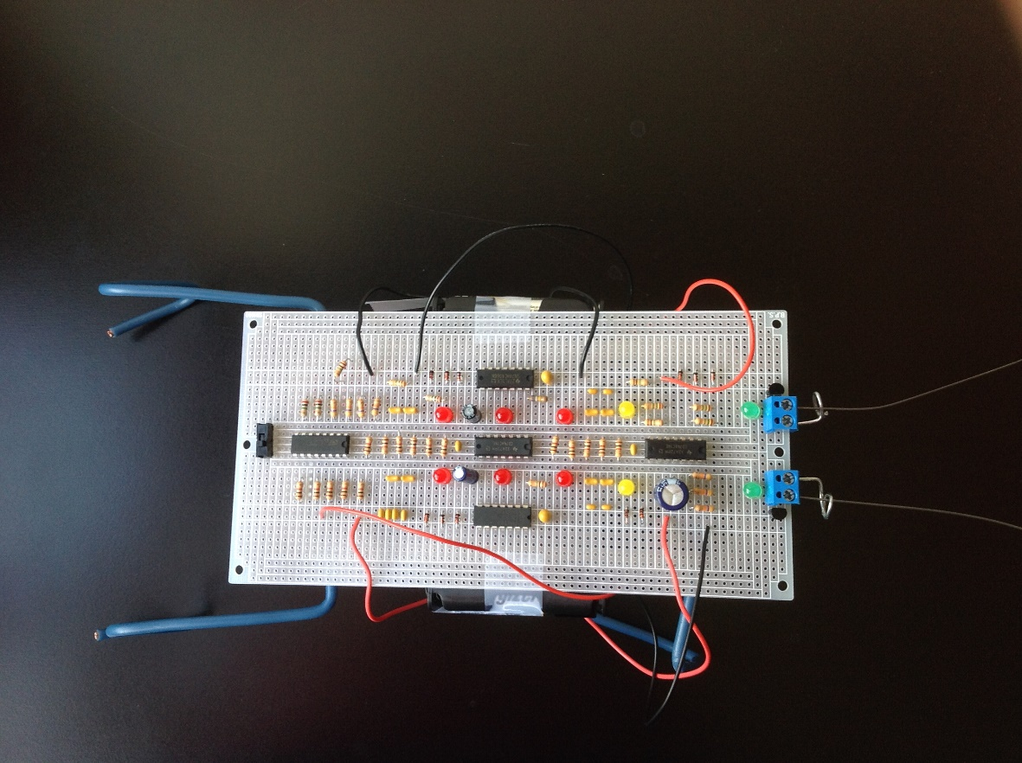
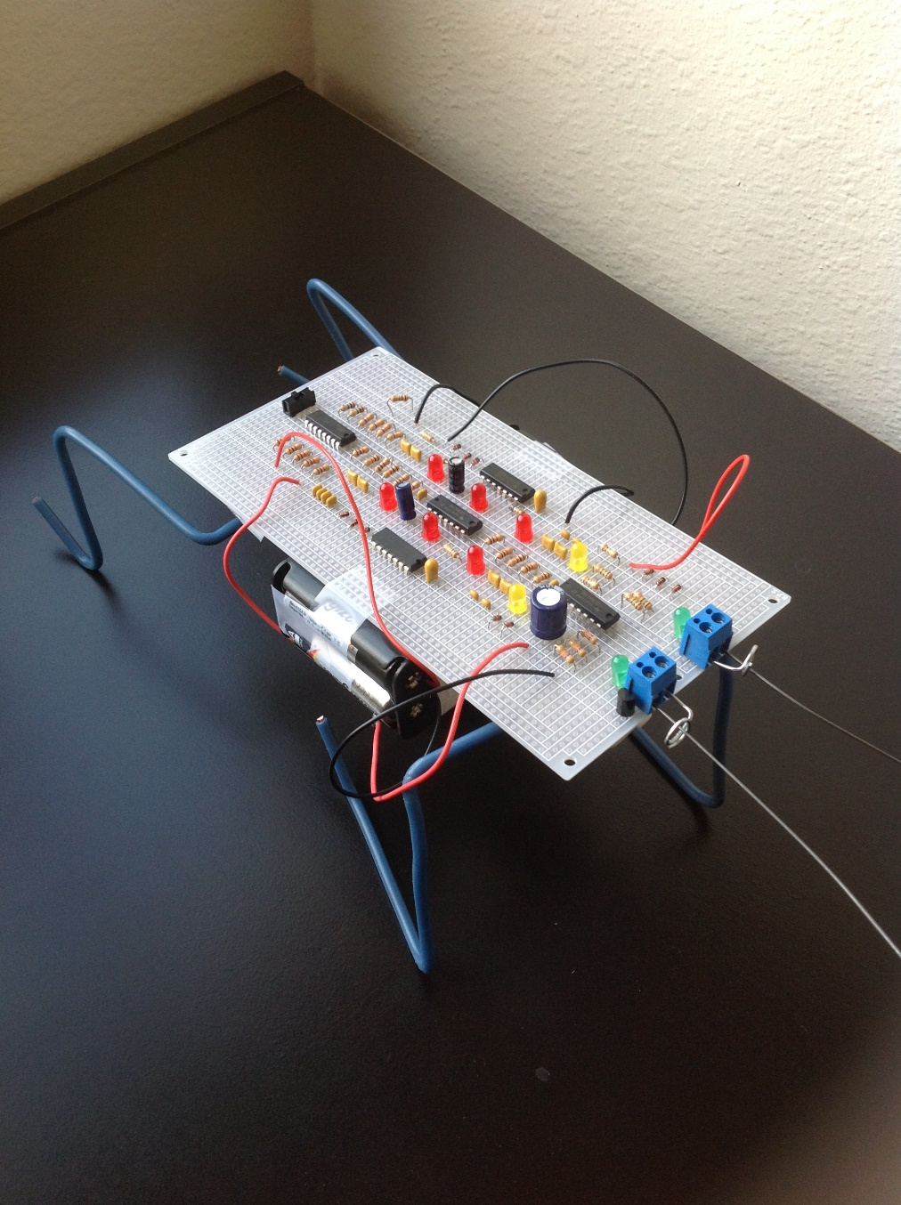
The Robot
Photos taken of prototype
Prototype 1

Slide 10
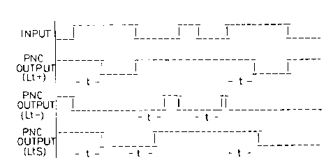
Expected Results
Robot is adaptable to complex environments
Develops a form of decision making and behavior
Timing Diagram for Pulse Modulation from Neuron Core
Tilden Patent

Slide 11
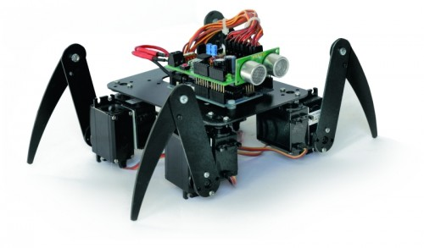
Future Work
Test robot’s decision making
Build a model to determine decision making points using Chaos Theory
Horse and Rider Configuration
"Robots Now Have an Arduino Shield." Embedded Projects from around the Web. 30 July 2012. Web. 4 Apr. 2015. <http://www.embedds.com/robots-now-have-an-arduino-shield/>.

Slide 12
References
Hasslacher, Brosl, and Mark Tilden. "Living Machines." Robotics and Autonomous Systems15 (1995): 143-69. Print.
Kuhns, Marcos. "Chaos at the Core of Intelligence." Analog Robotics. Web. 2 Dec. 2014.
Rigter, Wilf. "The Servocore 2-motor Walker Circuit." BEAM Robotics. 17 Dec. 2003. Web.
Tilden, Mark W. Adaptive Robotic Nervous Systems and Control Circuits Therefor. Patent 5,325,031. 28 June 1994. Print.

Slide 13
Acknowledgements
Special Thanks to
  Peter Smith, PhD: Lunar and Planetary Laboratory
  Arizona Space Grant Consortium
    Susan Brew: Manager Arizona Space Grant Consortium and University of Arizona Programs
  NASA

Slide 14
Thank You!

