Slide 1
Using Model-Based Systems Engineering at Osiris-ReX
Stephania Vasilieva
University of Arizona
Advisor: Roberto Furfaro
Assistant Professor, Department of Systems and Industrial Engineering, University of Arizona
Arizona Space Grant Symposium
April 18th, 2015

Slide 2
Background
Osiris-Rex
  Ground Systems
Systems Engineering
  Requirement management
  System-modeling
CORE

Slide 3
Objectives
Ameliorations
  Flow of information
  Consistency between teams

Slide 4
Methods
Flow of information
  Use CORE throughout organization
  Import and export requirements from/into CORE
Consistency between teams
  Inter-team logic diagrams

Slide 5
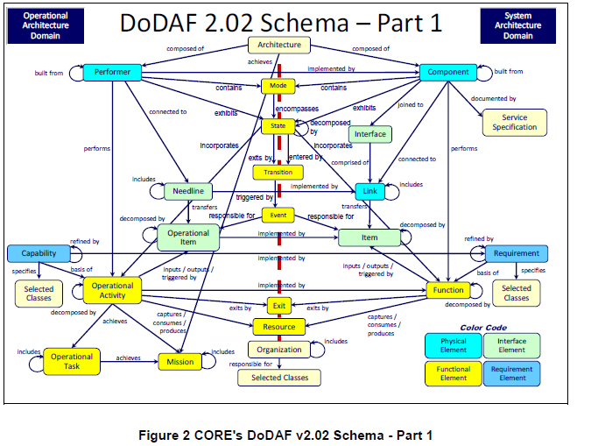
"CORE's DoDAF V2.02 Schema - Part 1.
" Architecture Definition Guide.
Blacksburg: Vitech Corporation, 2014.
N. pag. Print.

Slide 6
Impact
Updated requirements
  Compare requirements from science team
System modeled
  Logic diagrams implemented
    Software Team
      Instrument data

Slide 7
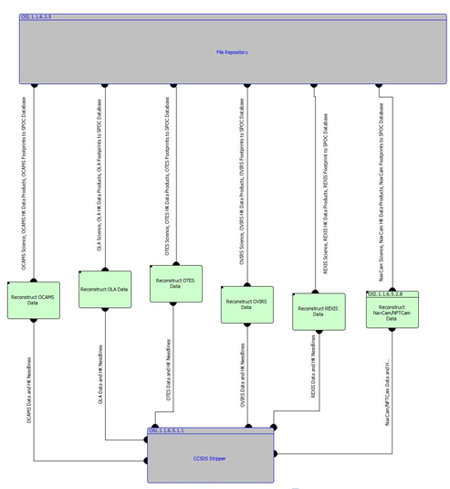

Slide 8
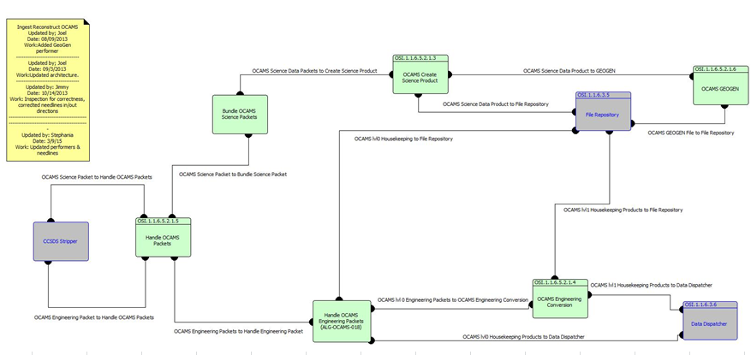

Slide 9
Conclusion
Requirements captured
Ground System modeled
Greater understanding
  Project better recorded
  Teams’ involvement
  Collaboration

Slide 10
Next Steps
Never-ending
  Always need to update
  Model other parts of the system

Slide 11
Acknowledgements
NASA Space Grant Manager: Susan Brew
NASA Space Grant Symposium
Advisor: Roberto Furfaro
Graduate team:
  Dan Wibben
  Joel Mueting
  Sean Gellenbeck
Research group
  Lindsay Small

Slide 12
Thank you!

