Slide 1
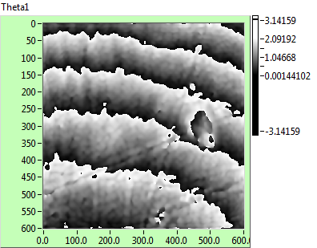


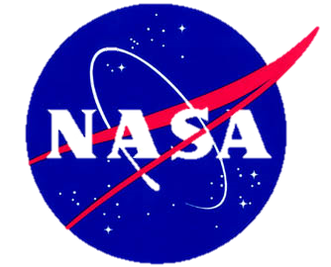
Real-Time Surface Profiling of Industrial Materials using Digital Holography
Tressa Mackin¹, Khalid Wabli¹, Benjamin Thiesing*,
Christopher J. Mann¹**
¹Optical Metrology Lab, Department of Physics and Astronomy,
Northern Arizona University, *Oak Ridge National Lab
NASA Space Grant Symposium
April 18, 2015

Slide 2
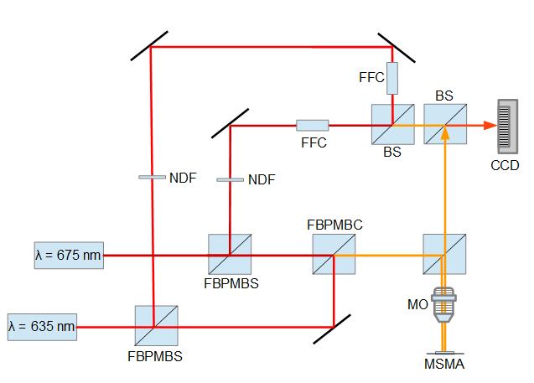
What is Multiple Wavelength Digital Holography?
Schematic of multiple wavelength holography setup

Slide 3
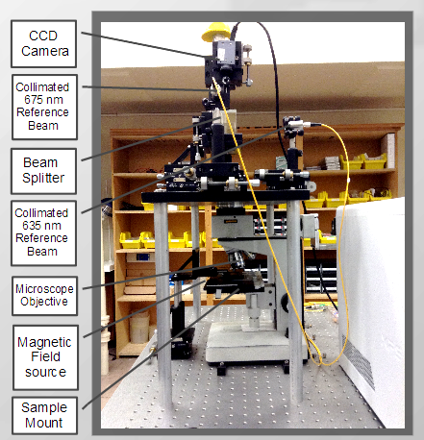
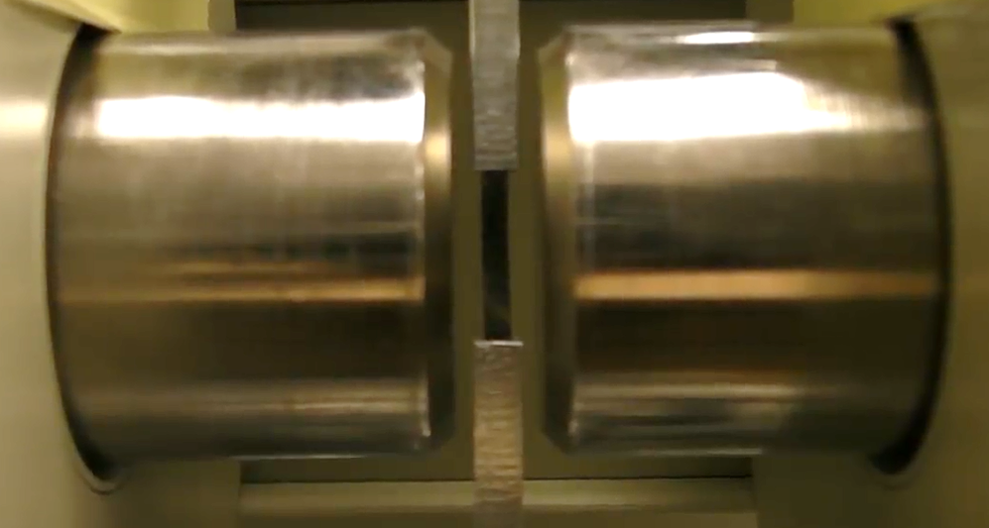

Slide 4
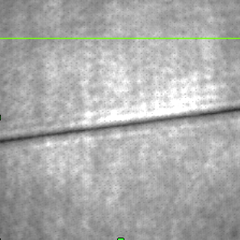
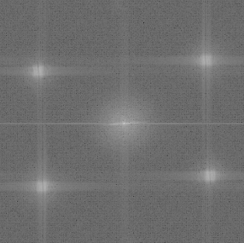
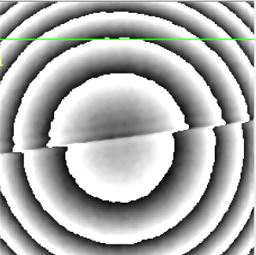
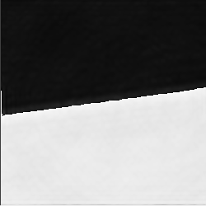
635 nm
675 nm
675 nm
635 nm
Hologram recorded with CCD
Fourier transform of hologram
Amplitude image of the hologram
Corrected dual wavelength image

Slide 5
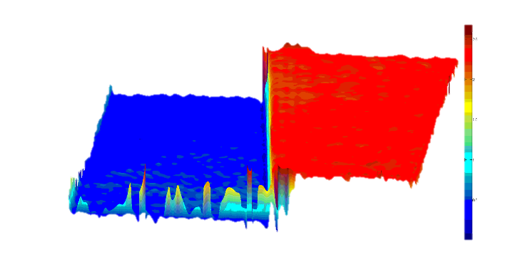
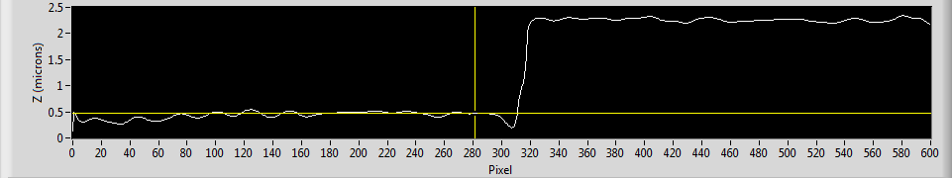
Three dimensional reconstruction.
Step Height Calibration Target, Image credit: T. Mackin
Cross section shows height values

Slide 6
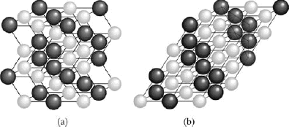
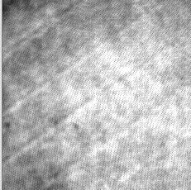
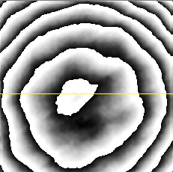
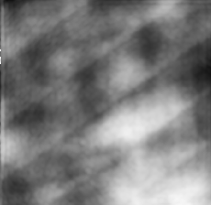
Magnetic Shape Memory Alloy
(NiMnGa)

Slide 7
Ni-38Al-6Pt *Image credit: B. Thiesing ORNL

Slide 8
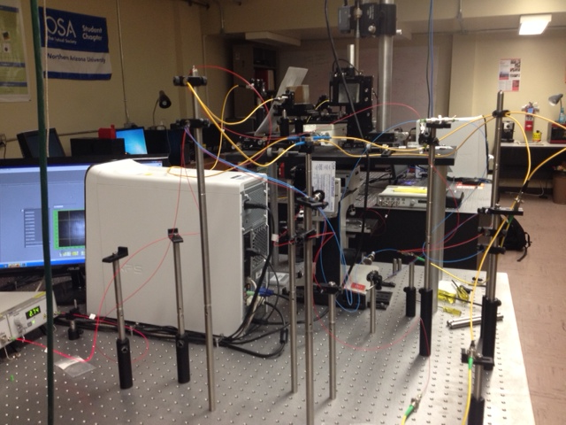
Future Work:
-Beam Optimization
-Animation
-Magnetic Cycling of MSMA

Slide 9
Acknowledgements:
Khalid Wabli¹, Benjamin Thiesing*,
Christopher J. Mann¹**
¹Optical Metrology Lab,
Department of Physics and Astronomy,
Northern Arizona University
*Oak Ridge National Lab
NAU Mechanical Engineering Department (MSMA)

Slide 10
QUESTIONS?

