Slide 1




Flight Testing Small Satellites Through High Altitude Ballooning
Presented by
Zach Henney
18 April 2015

Slide 2
Overview
HASP
Payload Development
Flight Results
Future Work

Slide 3
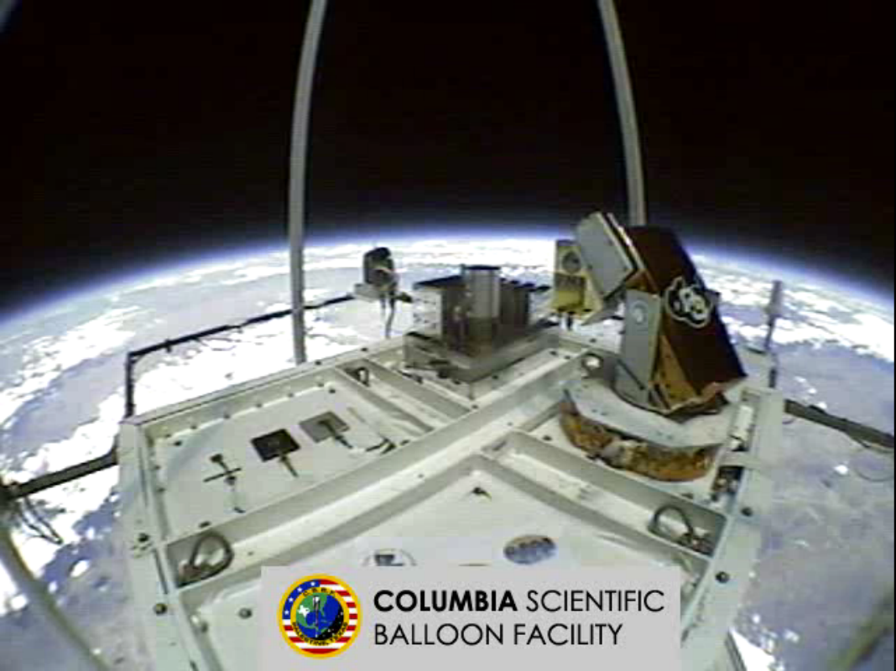
HASP
NASA’s High Altitude Student Platform (HASP) allows universities to fly annually on a NASA balloon
Altitude typically around 135,000 ft.
Duration ranges from 6 to 24 hr.
Launches in eastern New Mexico, lands in central Arizona

Slide 4
HASP Integration
Pre-flight Integration and Testing takes place at the Columbia Scientific Balloon Facility (CSBF) in Palestine, TX
  Thermal Vacuum
  Electrical Compatibility
  Command Compatibility
Reintegrated for flight at CSBF launch location in Ft. Sumner, NM
  RF Compatibility
  Pre-Launch Briefs

Slide 5
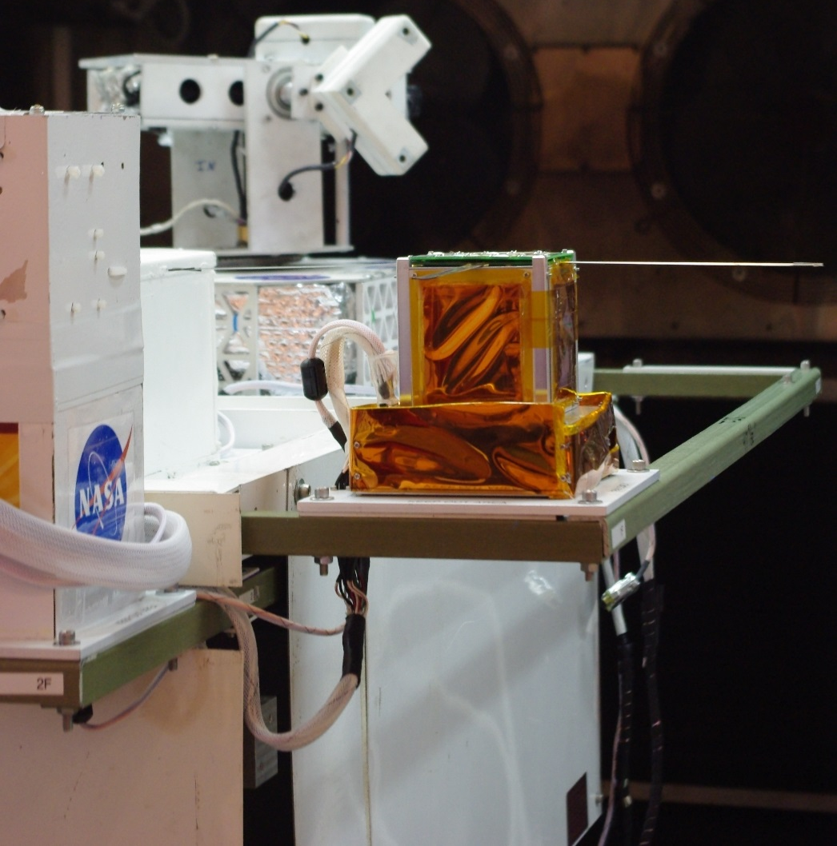
ERAU Payload Development
2013 marked first flight for ERAU team
Payload split into two distinct section: Phoenix and EagleSat
EagleSat was an early flight test article, tested transmitters, structure, and solar panels
Phoenix was designed to sample for smoke from highly energetic wildfires

Slide 6
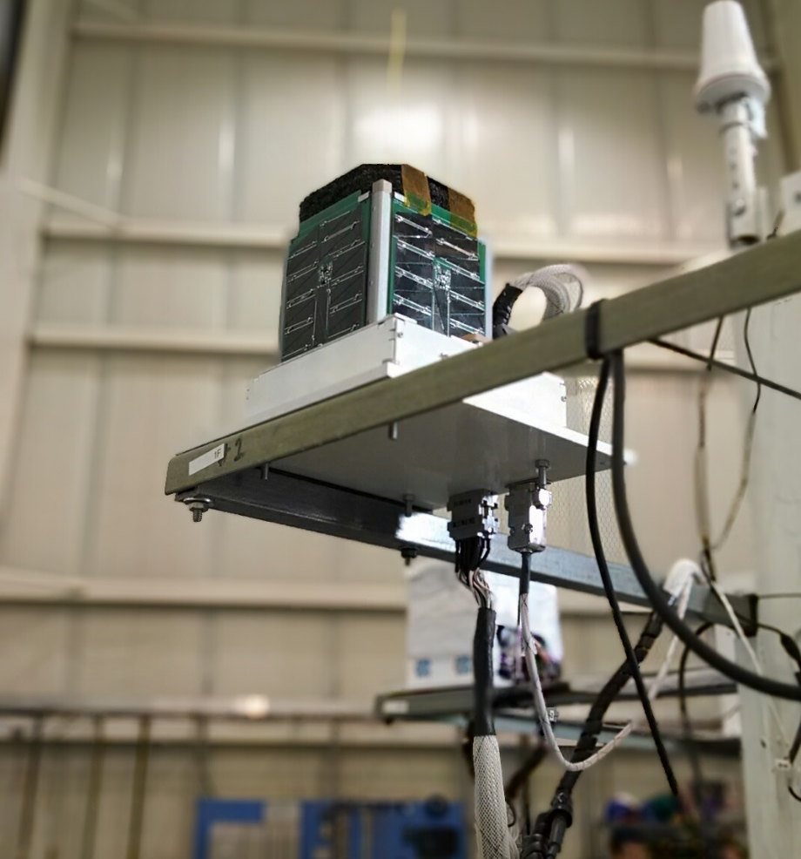
ERAU Payload Development
2014 saw the removal of the Phoenix experiment, was replaced with the Nest Integration Module
EagleSat was iterated upon to fly a more advanced test article
Flight maxed at 138,000 ft.
Flight time of only 6 hrs.
Landed outside Leupp, AZ, after trending towards the Grand Canyon

Slide 7
Flight Results
The 2014 HASP flight was a test of EagleSat’s radios, solar panels, and OBC operations
GPS data was used to record the position, speed, and altitude of the payload
Voltage and temperature data was recorded to monitor the state of the payload
Data records were simultaneously transmitted to HASP via serial and via the onboard radio

Slide 8
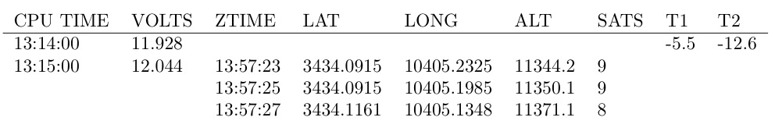
Flight Results
Data was recorded once per minute from EagleSat
  Voltage recorded at the minute
  3 GPS strings recorded once per minute
  Temperature recorded every ten minutes
  RSSI voltage recorded on request

Slide 9
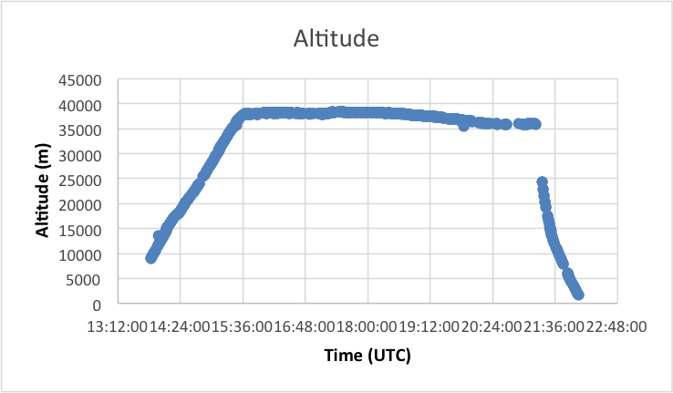
Altitude Data

Slide 10
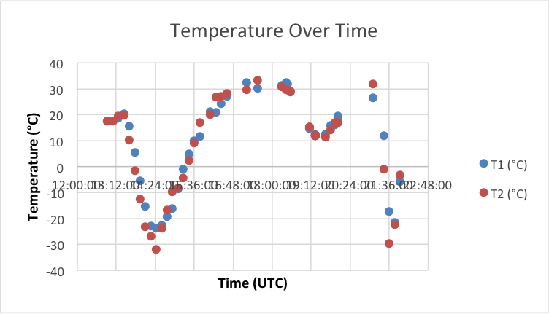
Temperature Data

Slide 11
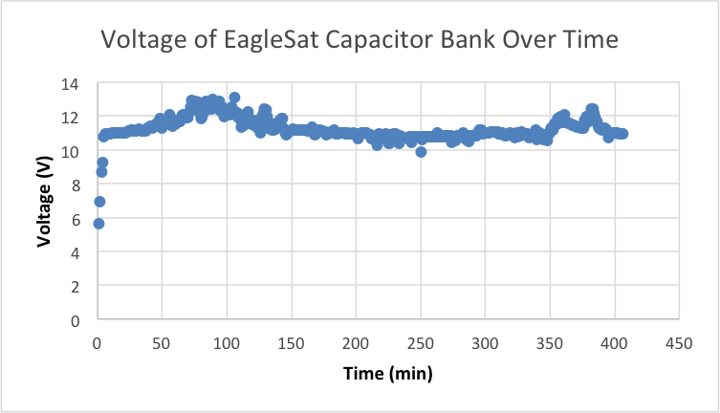
Voltage Data

Slide 12
Current Payload
The payload under development for the 2015 flight is once again a combination of Nest and EagleSat
EagleSat test article nearly complete
  All subsystems, boards accounted for
  Will be full test of ground station hardware and software
Nest module upgraded from 2014
  Still responsible for passing power and data between EagleSat and HASP
  Will include sensors to measure temperature, pressure, intensity of forces and vibrations during flight, and intensity of light experienced at float altitude

Slide 13
HASP 2015
Goal for flight is to have EagleSat remain as autonomous as possible
  Data downlink through HASP is crucial, but only in case radio malfunctions
  Power will be more dependent on EagleSat solar cells, rather than HASP power
  Nest will still be able to shut off EagleSat communications and power in case of malfunction

Slide 14
HASP 2015
Nest is being expanded to contain more instrumentation to gather information on HASP
  Pyranometer will measure the intensity of light from IR to UV
  Inertial Measurement Unit, consisting of accelerometers, gyroscopes, and GPS data, will give a detailed picture of the forces and rotation experienced by the payload
  Thermistors will measure temperature
  Pressure sensors will be used to match models to altitude data
Data will be stored onboard as EagleSat will be using the HASP serial lines

Slide 15
HASP 2015
Both parts of the payload are currently undergoing fabrication as systems are built or refurbished for this summer’s flight
Extensive testing will be conducted in advance of the 2015 flight
  Thermal vacuum tests will be conducted in refurbished chamber in AXFAB
  Rate table will be used to calibrate the Nest IMU

Slide 16
Questions?
Zach Henney
Aerospace Engineering, ERAU Prescott
Graduating December 2015
zach.henney@gmail.com
henneyz@my.erau.edu

