Slide 1
Imaging Scheme for Low Light Conditions from a Moving Robotic Vehicle
Eric Chang
Jekan Thanga
Arizona State University
April 18, 2015

Slide 2
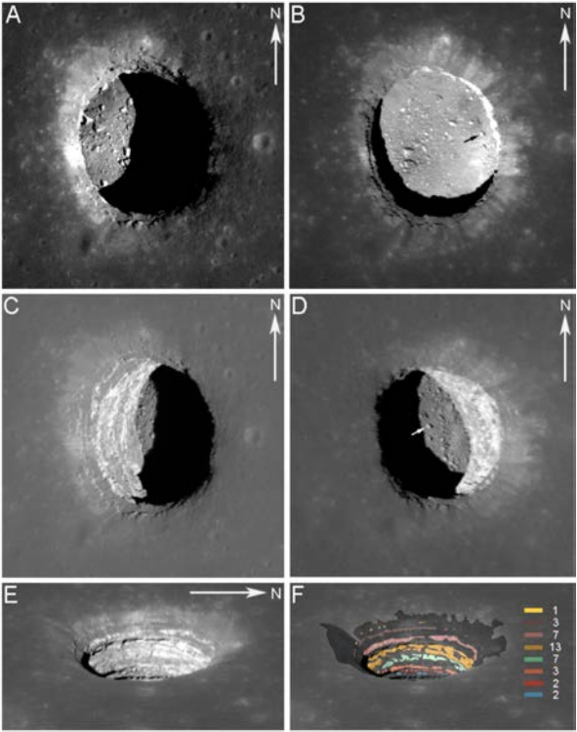
Motivation
Lunarean lava tubes have unknown lighting conditions/geometry
Return images of lava tube interior for science from flying pitbots
?

Slide 3
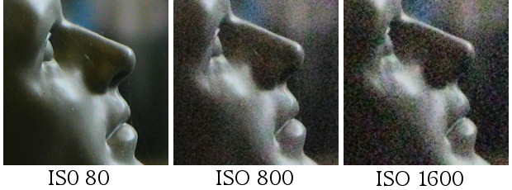
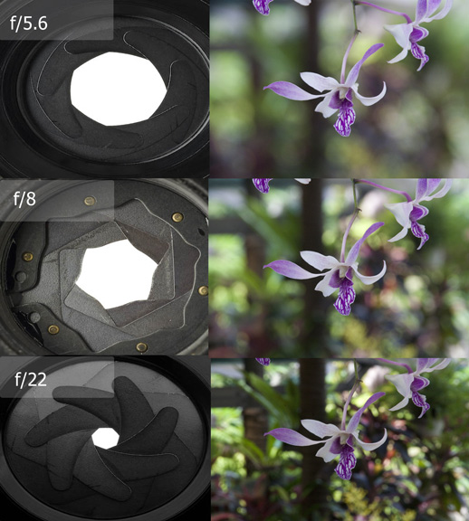
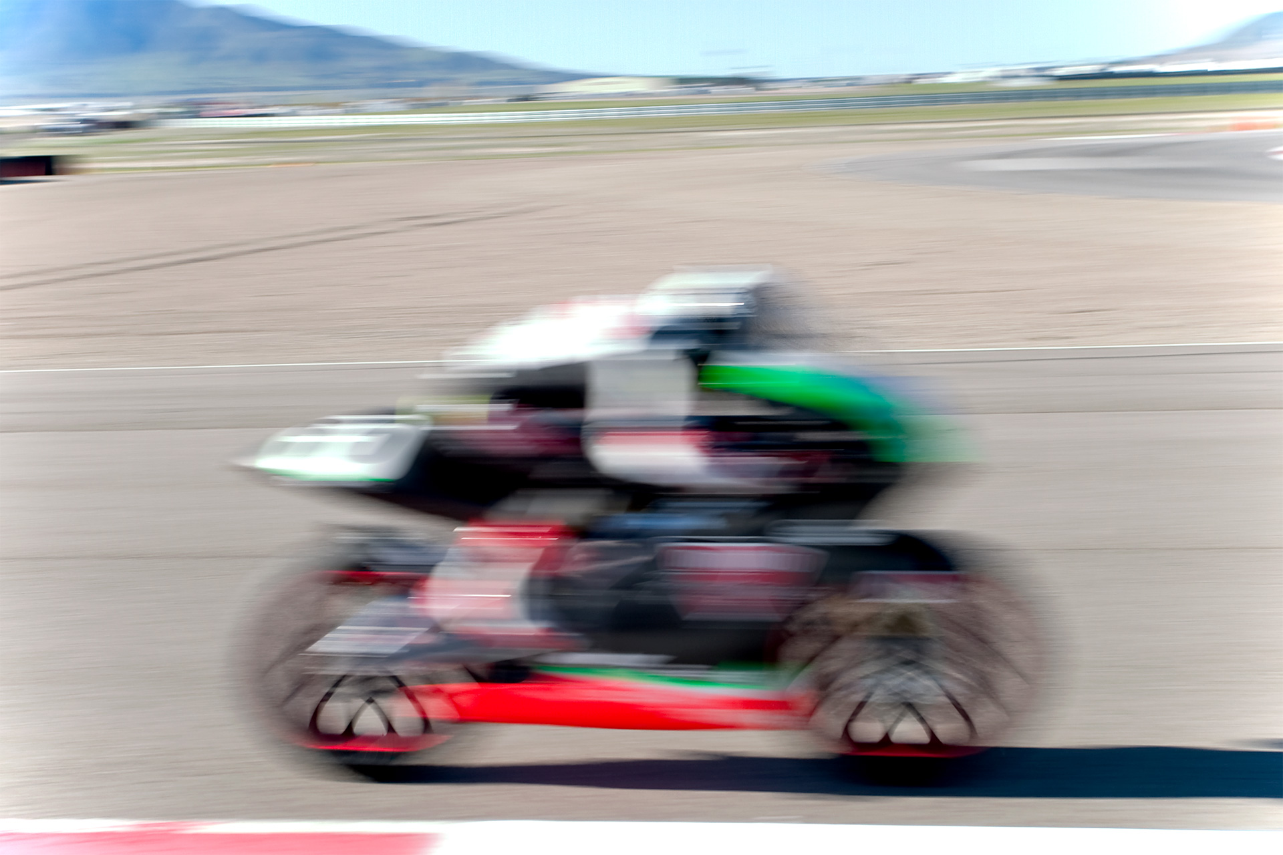
Challenges: Image Quality
Sensor Gain
Depth of Field
Motion Blur

Slide 4
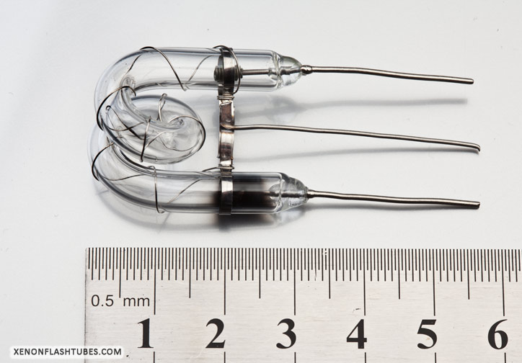
Approach: Flashtubes
Power consumption on the order of 10kW for < 1ms
Flash duration shorter than shutter duration – allows for simple exposure alignment
No wasted light output
Small profile
Feasible with more analysis

Slide 5
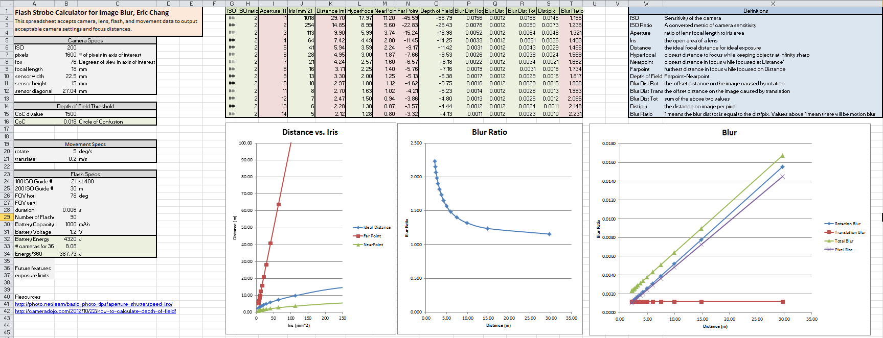
Parameter Calculator
Calculates exposure settings, motion blur, and power consumption

Slide 6
Depth of Field
Wide angle lenses at distances of interest have adequate depth of field.
Inputs: ISO 200, 76˚ FOV, 27mm sensor, 21 GN 100 ISO Flash

Slide 7
Motion Blur
Blur Ratio = # of offset pixels due to motion blur
Blur ratio can be maintained <1 for almost all conditions.
Inputs – 0.6ms flash duration, 76˚ FOV, 1600 pixels, 20 deg/s rotation, 1 m/s translation, ISO 200

Slide 8




Exposure Stability
How well do objects at different distances expose?
Exposure is acceptable at .5x and 2x the properly exposed distance.
target
2.5m
5m
7.5m
10m

Slide 9
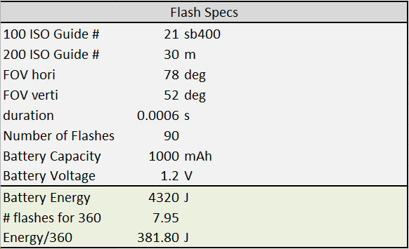
Power Consumption
For a sample case exposed to 30m (ISO 200), flashtubes consume 382 Joules per 360˚ exposure
For comparison, a AA battery has the capacity to capture 42 exposures.

Slide 10
Conclusion
Many methods improve imaging performance in low light, but they are insufficient for cave-like environments.
Flashtubes introduce the most light in small durations to address image quality concerns in a small physical and power footprint.

