Slide 1



Coexistence and Competition of Mirror Biospheres
Patricia Esch
School of Life Sciences, Arizona State University, Tempe AZ USA
Sara Imari Walker
School of Earth and Space Exploration, Arizona State University, Tempe AZ USA, Beyond Center for Fundamental Concepts in Science, Arizona State University Tempe, AZ USA, Blue Marble Space Institute of Science, Seattle WA USA.
Arizona Space Grant Undergraduate Symposium
April 18th, 2015

Slide 2
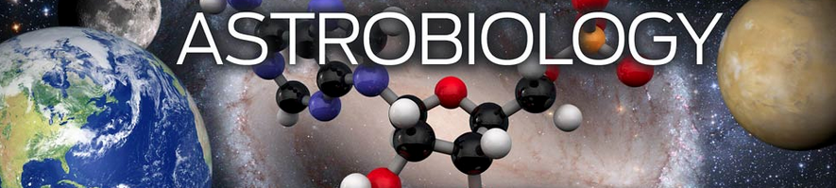
What is Astrobiology?
and the Origin of Life
http://origins.rpi.edu/wp-content/uploads/2012/07/homepagesplash-32.jpg
Notes:
What is astrobiology?
This may seem like a p

Slide 3
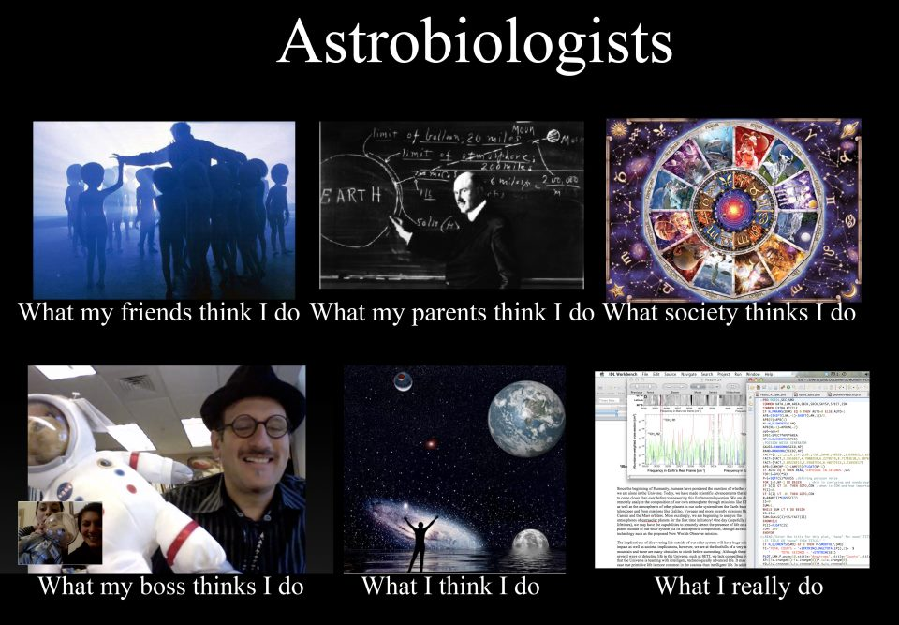
What is Astrobiology?
http://montessorimuddle.org/wp-content/uploads/2012/03/astrobiologists.jpg
Notes:
What is astrobiology?
The study of the origin, evolution, distribution and future of life in the universe: extraterrestrial life and life on Earth.

Slide 4
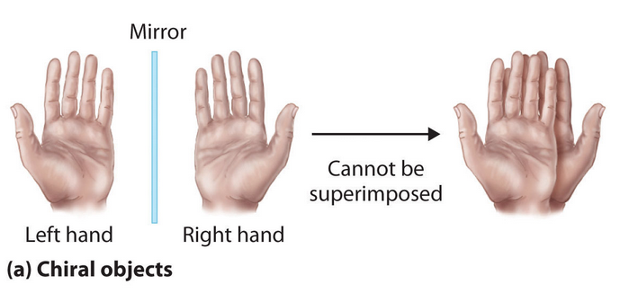
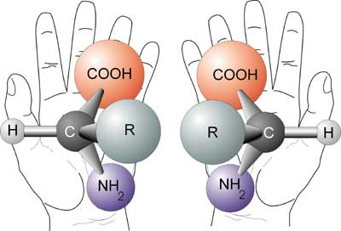
What is Chirality?
http://galleryhip.com/chirality.html
http://ibchemhltopicd.wikispaces.com/file/view/chirality.jpg/250978696/chirality.jpg
Notes:
Visualization challenge.
Chirality is a property that is seem in individual molecules.

Slide 5
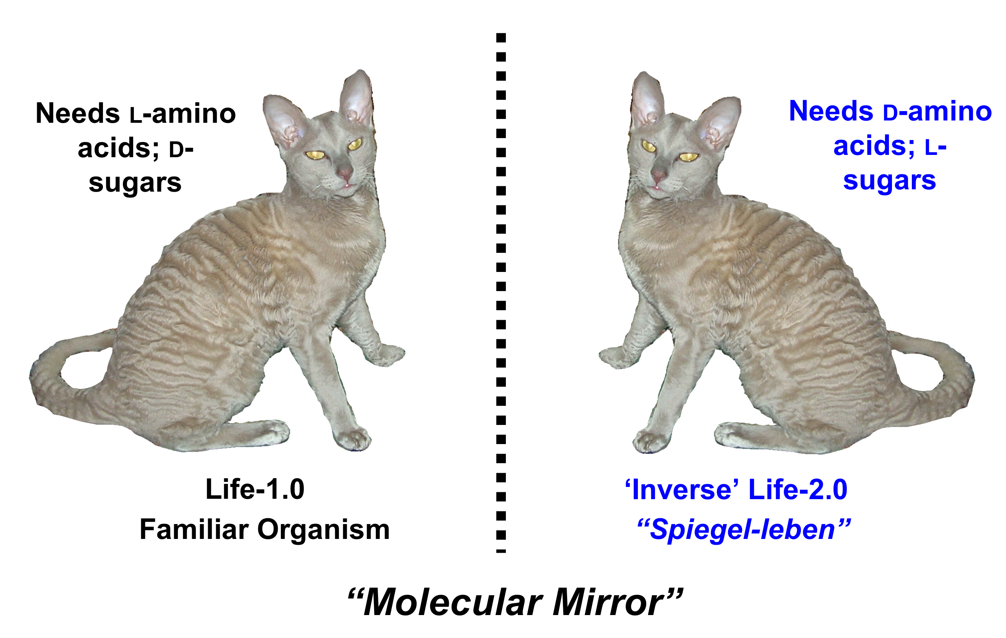
What is homochirality?
https://biopolyverse.files.wordpress.com/2011/04/chiralcat.png
Notes:
Enatiomers are two forms of a chiral molecule, which have identical physical and chemical properties. These properties are known as Left-handed or Levorotory and right handed or dextrorotary. However, their interaction with other molecules may be different. Much like a left handed glove interacting with a right hand. In life as we know it, chiral molecules exist almost exclusively as single enatiomers. This exclusivity is critical for molecular recognition and replication processes. Therefore homochirality occurs when all elements or units are molecules of the same chiral form. This is thought to be a prerequisite for life.
Why is life homochiral is not a question that has been answered. Many people believe that in order to answer this question we must first figure out how life became homochiral.

Slide 6
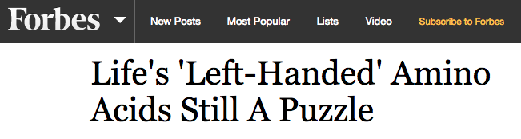
Why is life homochiral?
http://www.forbes.com/sites/brucedorminey/2013/06/29/lifes-left-handed-amino-acids-remain-astrobiological-head-scratcher/
Notes:
So again, why is life homochiral. This is the million dollar question that even Forbes is asking.
Why is life homochiral is not a question that has been answered. Many people believe that in order to answer this question we must first figure out how life became homochiral. Which is what our research was doing.

Slide 7
Our Model
How homochirality emerged as a product of competitive selection in early life forms
Built off recently published article: Racemization in Reverse - by Zhang and Sun
  Enatiomers can be converted to opposite chirality through racemase enzymes
Notes:
n this project, we take an alternative approach and ask how homochirality may have emerged not as a result of prebiotic processes, but instead as the product of competitive selection in early life forms. We build from recently published results identifying racemase enzymes that act to convert one molecular handedness into the other [4]. We hypothesis that if mirror image life forms co-existed in the past, or co-exist elsewhere, racemase enzymes might play a dominant role in the interaction between mirror image biospheres.
What sets our research apart from a lot of the research on homochirality (although there is not a whole lot of research right now) is the fact that we are using the knowledge that chiralities can be interconverted. So in an early earth environment
We have implemented agent based computational simulations, which include two mirror image chiral organisms that compete for food of the same and opposite chirality, and determine the conditions under which a homochiral biosphere emerges. Our model includes organisms (agents) that can best reproduce in the presence of the same chirality food, but also may reproduce with a slower metabolic efficiency by utilizing a racemase enzyme in the presence of food of the opposite chirality, as suggested by [4]. Our model thus includes four key parameters—rf: reproduction rate in the presence of the same chirality of food, rs: reproduction rate in presence of opposite chirality food, df: dispersal rate of individuals in the presence of the same chirality food, ds: dispersal rate of individuals in the presence of the opposite chirality food.

Slide 8
Our Model
Notes:
We have implemented agent based computational simulations, which include two mirror image chiral organisms that compete for food of the same and opposite chirality, and determine the conditions under which a homochiral biosphere emerges. Our model includes organisms (agents) that can best reproduce in the presence of the same chirality food, but also may reproduce with a slower metabolic efficiency by utilizing a racemase enzyme in the presence of food of the opposite chirality, as suggested by [4]. Our model thus includes four key parameters—rf: reproduction rate in the presence of the same chirality of food, rs: reproduction rate in presence of opposite chirality food, df: dispersal rate of individuals in the presence of the same chirality food, ds: dispersal rate of individuals in the presence of the opposite chirality food.

Slide 9
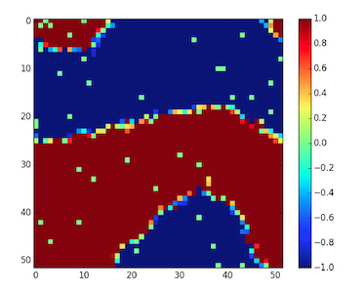
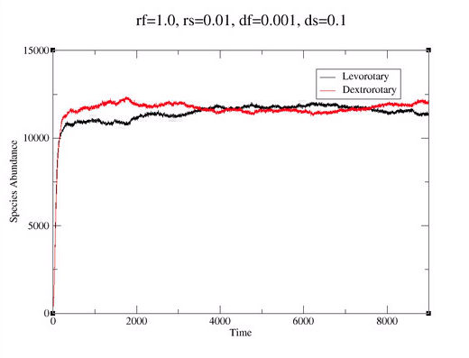
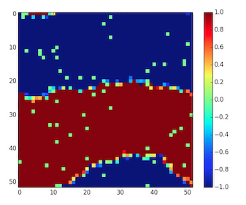
Results
Notes:
Our numerical simulations demonstrate regimes of coexistence of both mirror-image organisms or extinction of one, depending on the relative values of these model parameters, which would be tuned by evolution and environment in real systems. The data gathered suggests that we must be careful in using homochirali- ty as a biosignature due to the possibility of false nega- tives, as two homochiral life forms may co-exist in some planetary contexts. Interestingly, for cases where a homochiral biosphere emerges, the environment is converted to a homochiral state of the same signature on a timescale that lags behind biology due to finite resource constraints in our model (Fig 1.). This sug- gests that once a homochiral biosphere emerges, much of its evolutionary past will be erased by conversion of the planetary context to favor the winning chirality

Slide 10
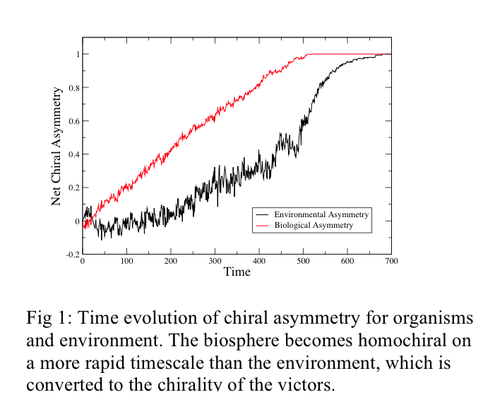
Results that pose further questions…
Notes:
Our numerical simulations demonstrate regimes of coexistence of both mirror-image organisms or extinction of one, depending on the relative values of these model parameters, which would be tuned by evolution and environment in real systems. The data gathered suggests that we must be careful in using homochirali- ty as a biosignature due to the possibility of false nega- tives, as two homochiral life forms may co-exist in some planetary contexts. Interestingly, for cases where a homochiral biosphere emerges, the environment is converted to a homochiral state of the same signature on a timescale that lags behind biology due to finite resource constraints in our model (Fig 1.). This sug- gests that once a homochiral biosphere emerges, much of its evolutionary past will be erased by conversion of the planetary context to favor the winning chirality

Slide 11
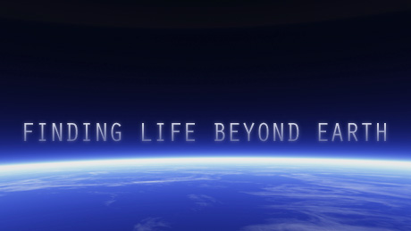
Significance of Results
Shed new light on processes underlying the origins of life’s homochirality
Possibility of false negatives since two homochiral life forms may co-exist
Better information in using homochirality as a biosignature for the search for life
Notes:
The results suggest a complex story of the interaction between mirror-image life and the environment, in cases where mirror-image life forms emerge in the same planetary context. In particular, our results shed new light on the processes underlying the origins of life’s homochirality, which may have arisen late in the early evolution of life as a result of competition of competing chiral life forms. A hypothesis consistent with the results reported observed features of the bio- sphere and the results reported here.

Slide 12
THANK YOU!
ASU/NASA Space Grant
Arizona Space Grant Consortium
BEYOND Center
Dr. Sara Imari Walker PhD

