Slide 1
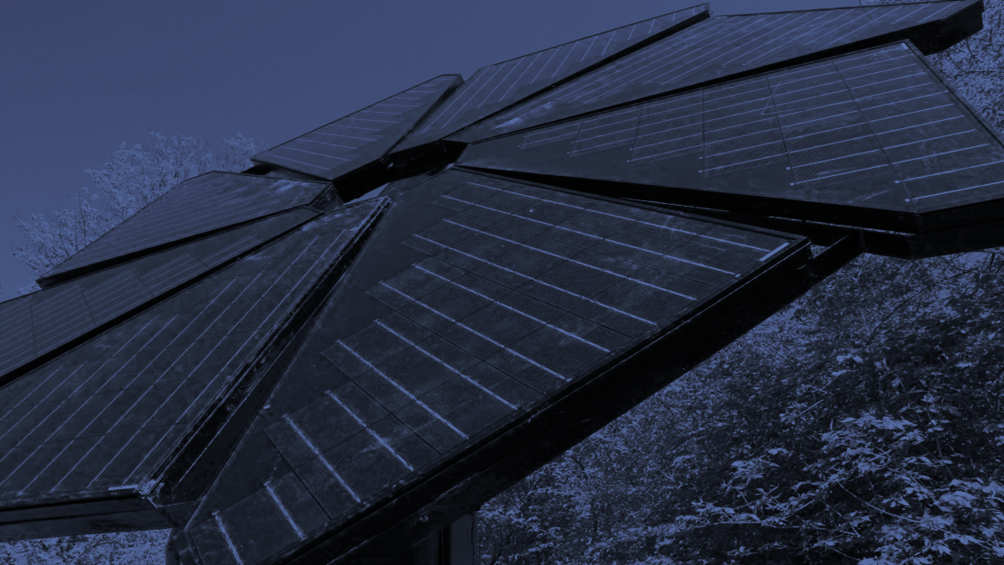



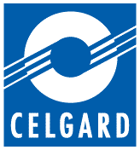
Agar-derived Carbon Aerogels
for use in structural EDLCs
Benjamin R. Luginbuhl
Mentor: Cindy Browder, PhD
Northern Arizona University
Department of Chemistry and Biochemistry

Slide 2
Electric Double-layer Capacitors (EDLCs)
supercapacitors
batteries
Quick to charge, quick to discharge
Cheap to produce
Long lifetime
High power density
Low energy density
capacitors
Toxic materials
Slow to charge
High energy density; low power density
Long lifetime
Can be overcharged
Quick to charge
High power density, low energy density
Short lifetime

Slide 3

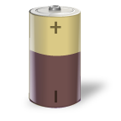
Electric Double-layer Capacitors (EDLCs)
Power!
anode
+ ion
cathode
- ion
electrolyte matrix
porous separator
"Electric double-layer capacitor (Activated carbon electrode - BOX type)" by Tosaka - Own work. Licensed under CC BY 3.0 via Wikimedia Commons

Slide 4
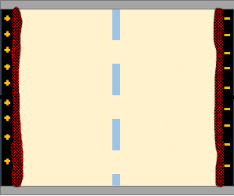
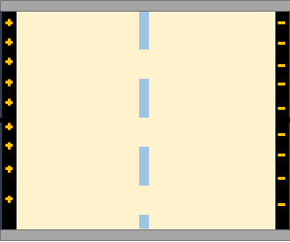
$$Capacitance=\frac{Charge}{Voltage}∝\frac{Electrode Area}{Distance Between Electrodes}$$

Slide 5
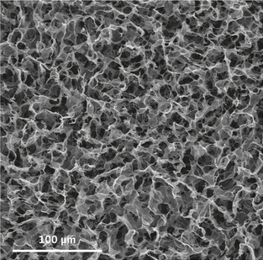
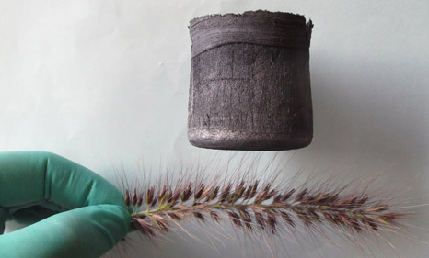
Carbon Aerogel
conductive
extremely high surface area
produced using a multi-step procedure, toxic chemicals, and very sensitive conditions
Ren and Cheng, Nature 2013

Slide 6
This Project:
Can we use an alternative material that is cheap, easy, and sustainable to make high surface area carbon aerogel?
Will this alternative carbon aerogel increase the capacitance of structural EDLCs?
structural : device is designed to provide mechanical strength in addition to storing electrical power
Composite material – layered carbon fiber
Solid-polymer electrolyte

Slide 7
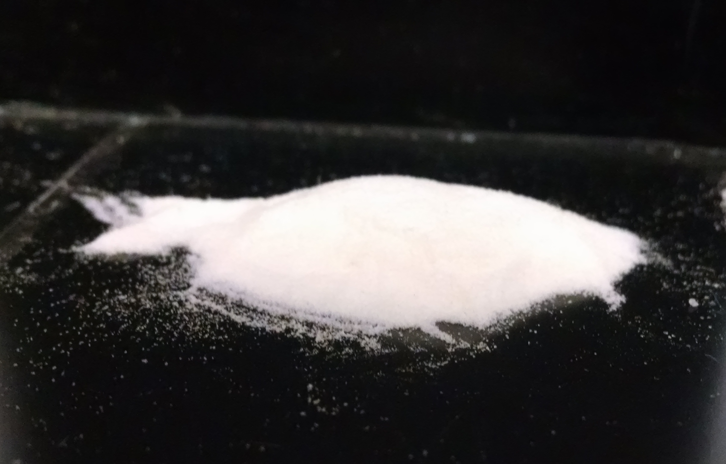
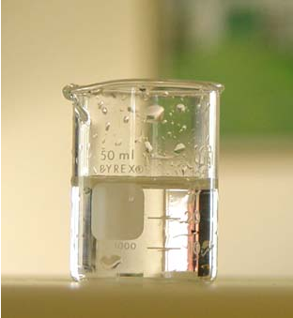
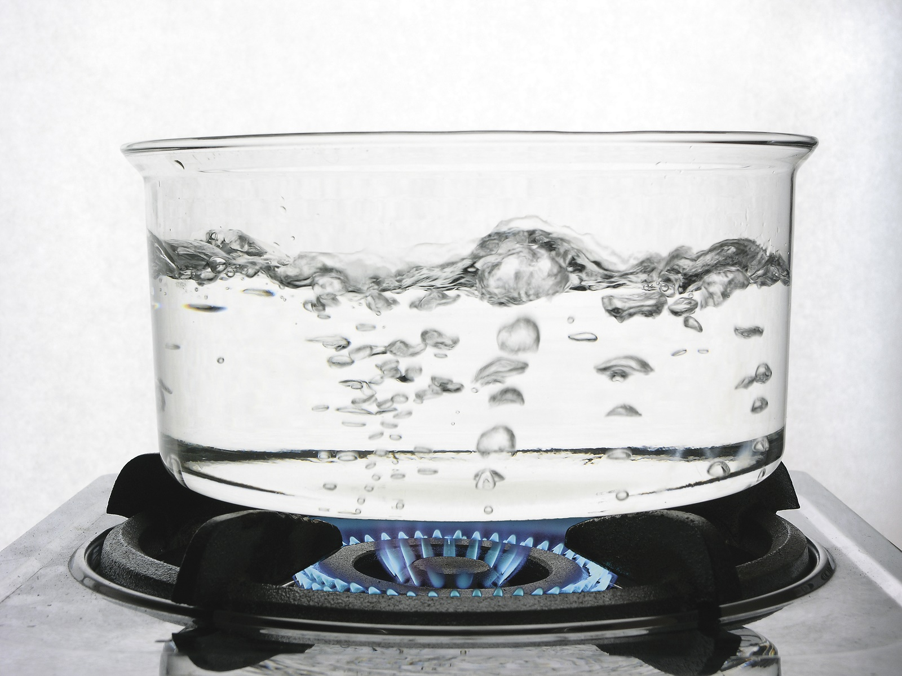
Biopolymer: Agar
+
+
powdered polysaccharide
water
heat
=
A Hydrogel
http://www.chemistryland.com/CHM107Lab/Lab5/WaterTest/Lab5Exp1water.html
Magnascan/bigstock.com; Check Man, Cross Man and Jump Man © ioannis kounadeas - Fotolia.com

Slide 8
Parameters
Concentration of Agar in water
Gelation time
Drying method Pyrolysis
2 %
3 %
4 %
2 h
3 h
5 h
10 h
Supercritical CO₂
600 °C in 5% H₂/Ar, 1.5 min
Lyophilization
900 °C in Ar, 30 min

Slide 9
lyophilize
cryogel
pyrolyze
carbon aerogel
hydrogel
aerogel
supercritical dry

Slide 10
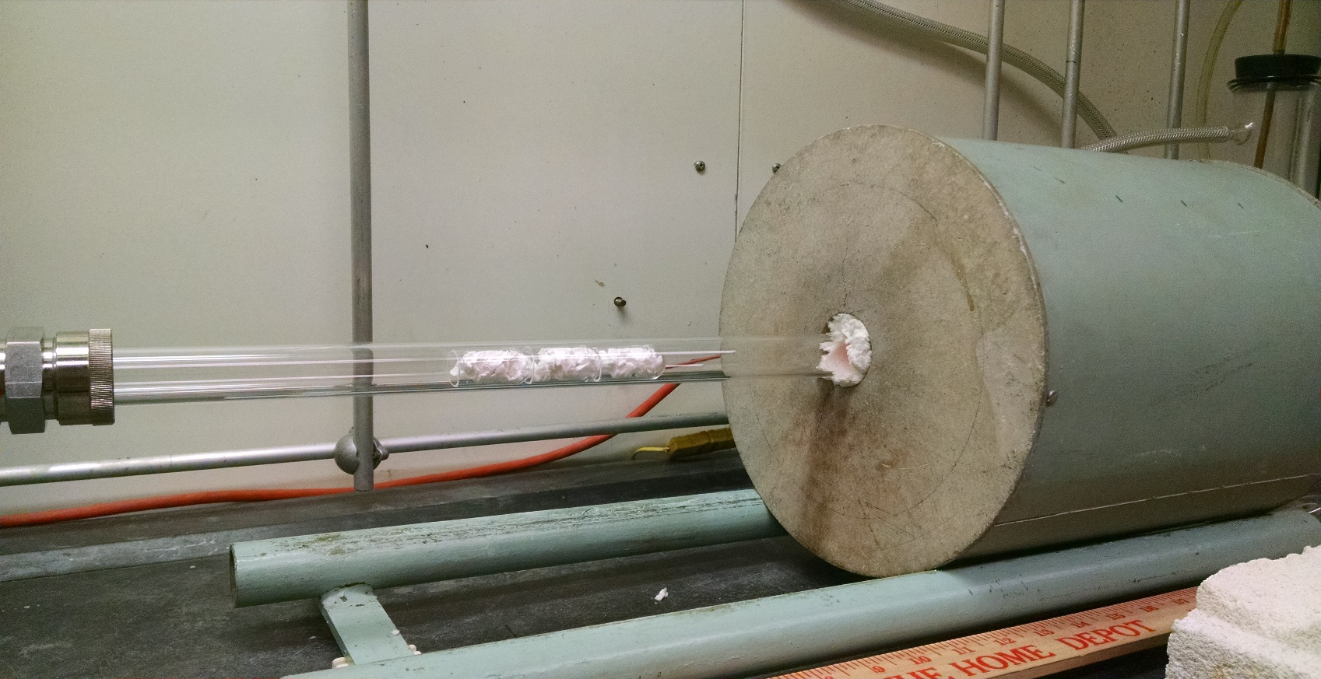
Pyrolysis
600 °C under 5% H₂/Ar for 1 min 30 sec
or
900 °C under Ar for 30 min

Slide 11
Characterization
Qualitative
Scanning Electron Microscopy (SEM)
Transmission Electron Microscopy (TEM)
Quantitative
BET Surface Area Analysis (SAA)
Cyclic Voltammetry (CV)

Slide 12
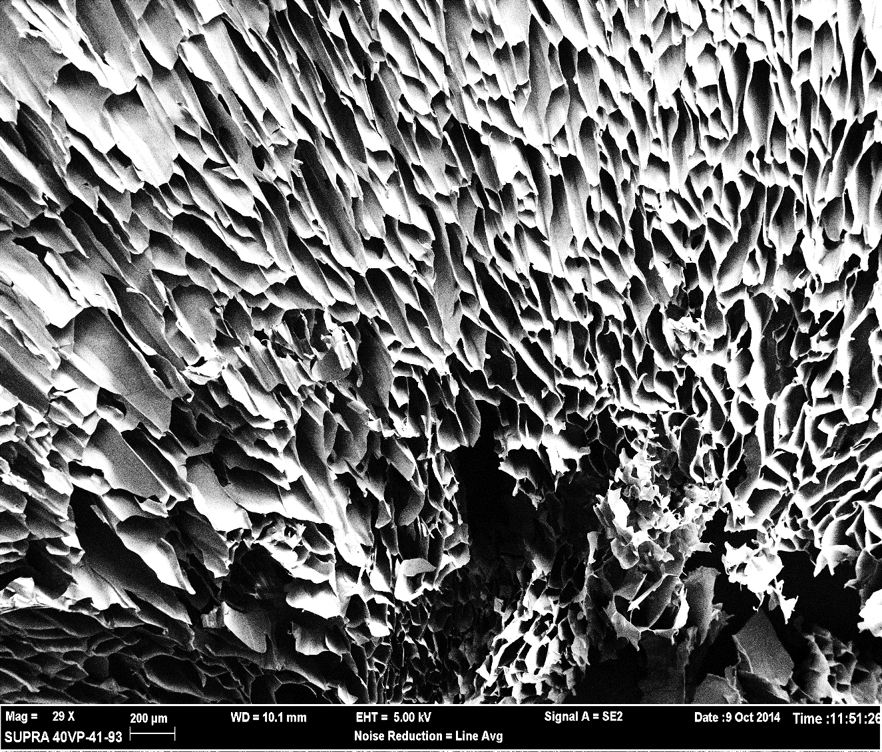
Cryogels (lyophilized)
Type | Surface Area (m²/g)
2 % | 11.0
3 % | -
4 % | 23.3
2 h | -
5 h | 51.8
10 h | 65.1
1 mm

Slide 13
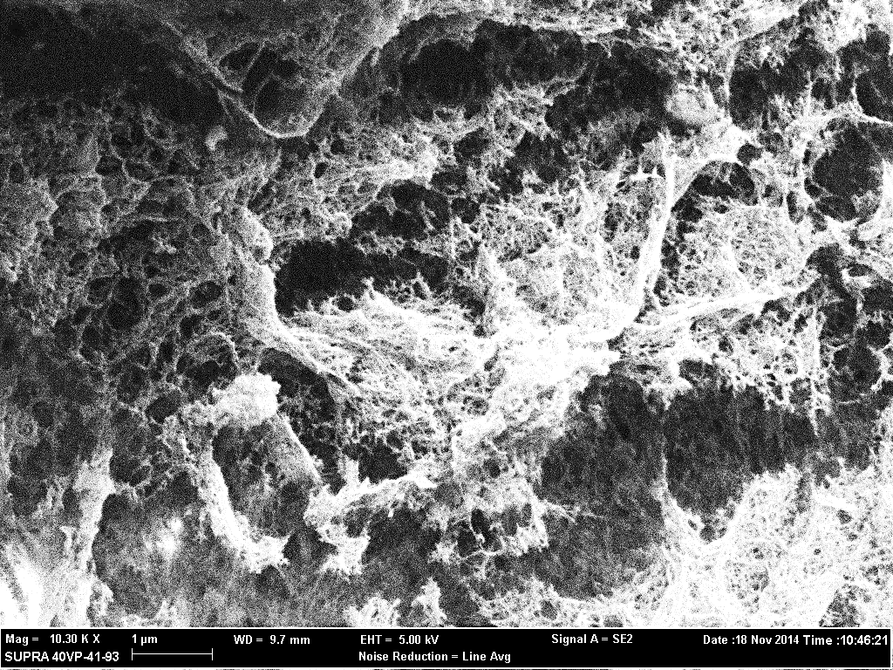
Aerogels (CPD)
Type | Surface Area (m²/g)
2 % | 241
1 μm

Slide 14
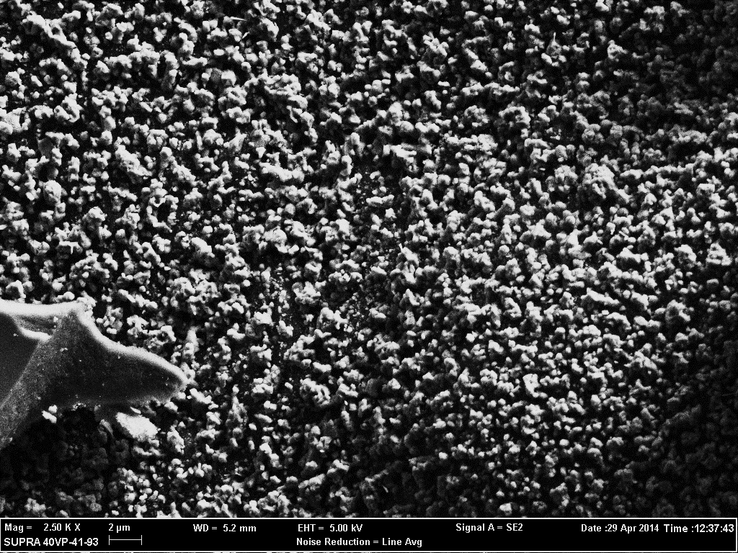
Carbon Aerogels
Type |  | Surface Area (m²/g)
2 % | Cpd | -
 | Lyo | 715*
3 % | Lyo | -
4 % | Lyo | -
2 h | Lyo | -
5 h | Lyo | -
10 h | LYO | -
6 μm

Slide 15
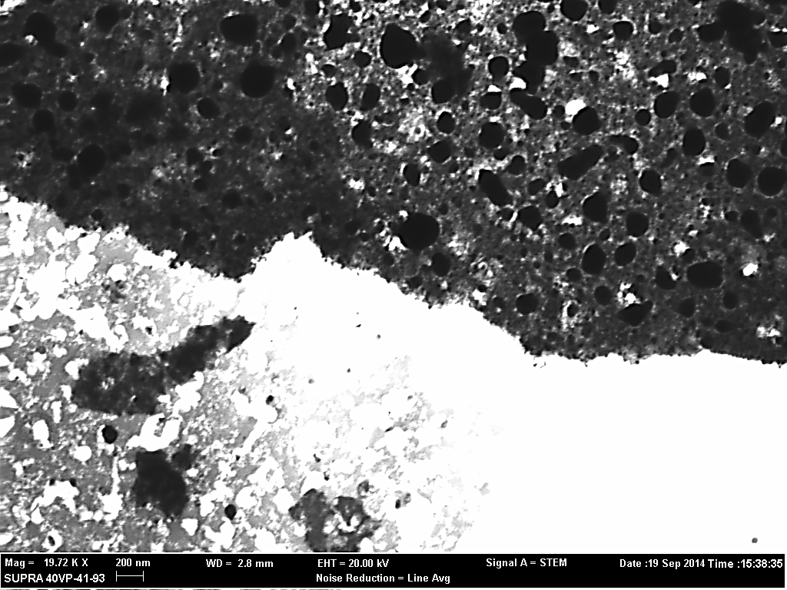
TEM Image of Carbon Aerogel
1 μm

Slide 16
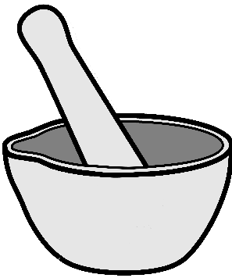

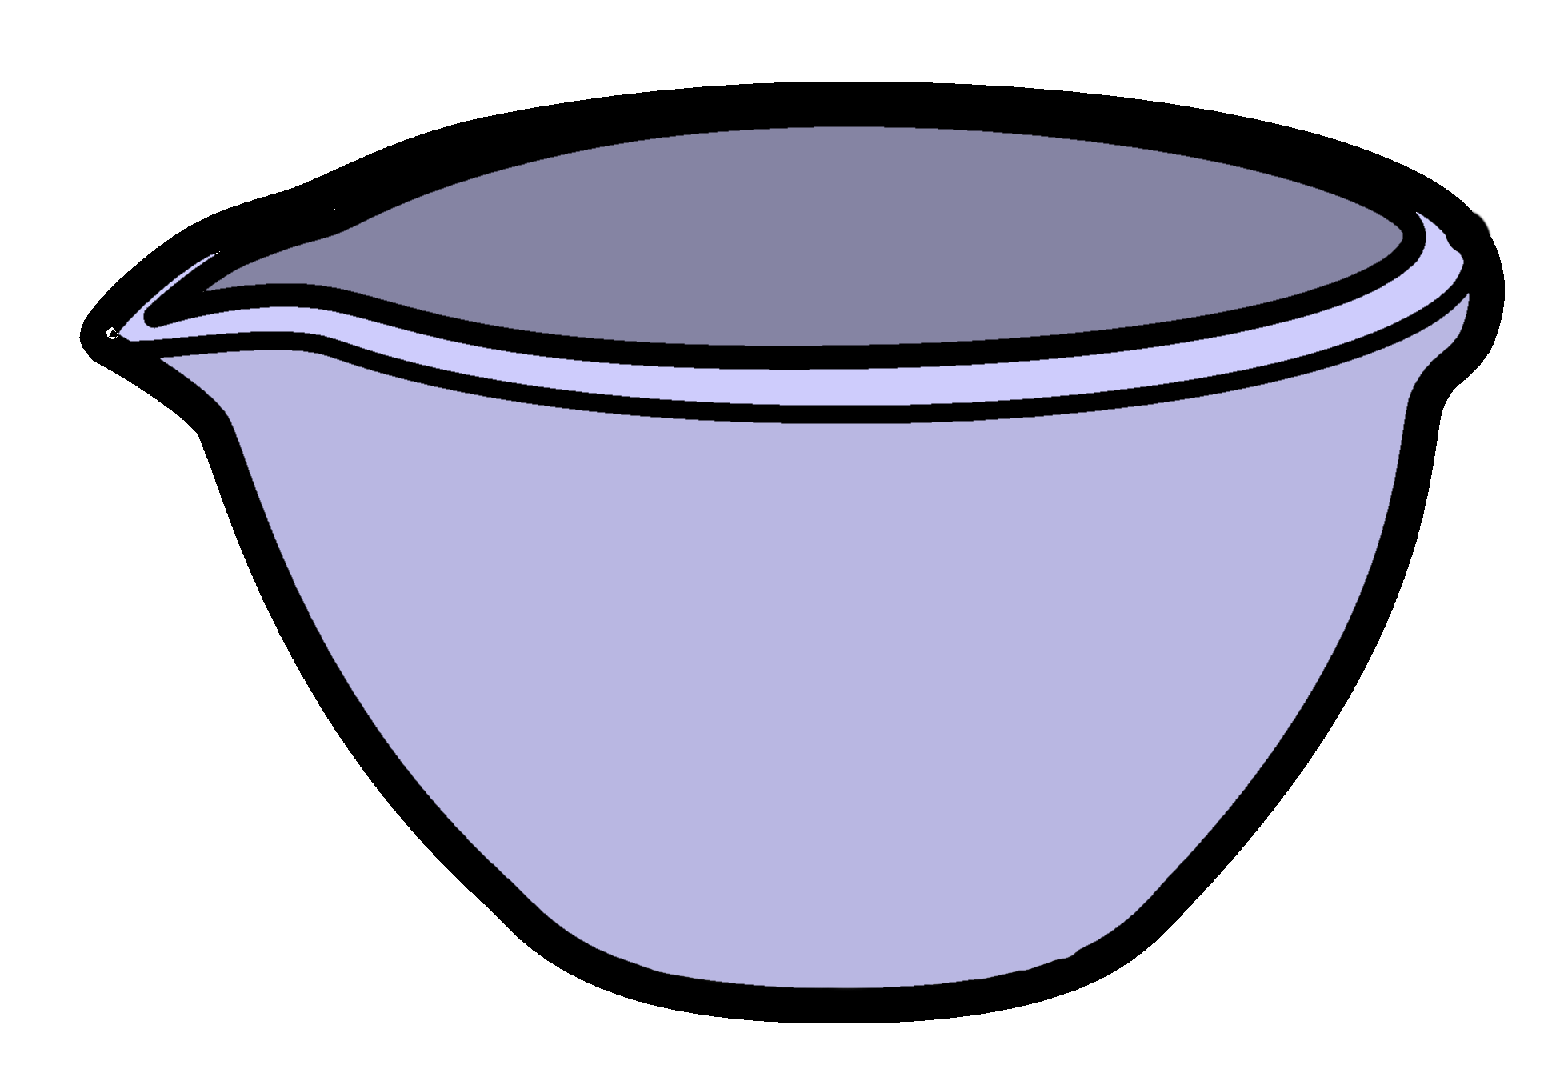
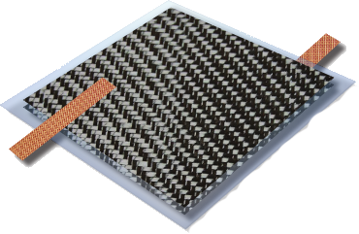
Incorporation Into Device
Electrolyte solution

Slide 18
Conclusions
Agar can be used to make high surface area carbon aerogel
There does not appear to be a relationship between the surface area of the cryo/aerogel and the surface area of the resultant carbon aerogel
Initial testing indicates a significant (approx. 10-fold) increase in capacitance when carbon aerogel is incorporated into structural EDLCs

Slide 19
Next Steps
Continue CPD trials to fill in data
Perfect incorporation method to minimize electrical shorting
Measure other electrical performance metrics (leakage resistance, power density, etc.)

Slide 20


Acknowledgements
Dr. Cindy Browder
Northern Arizona University
Department of Chemistry and Biochemistry
Brett Cutler
Dr. Nadine Barlow and Kathleen Stigmon
Northern Arizona University
Arizona Space Grant Consortium
Dr. MaryLynn Quartaroli
Northern Arizona University
Hooper Undergraduate Research Award
Aubrey Funke
Northern Arizona University
Imaging & Histology Core Facility
David Wright
Arizona State University
LeRoy Eyring Center for Solid State Science

Slide 21


