Slide 1

Mesh Ad-Hoc Networking Algorithms for Underwater Optical Sensors
Peter Tueller
Mentor: Dr. Cody Youngbull
Arizona Space Grant Symposium
April 18th, 2015

Slide 2
Overview
Sensing in an aquatic environment
Collecting data in a coherent manner from remote locations
Optical transfer of data and associated costs
Significant work needed for full-scale development and realization

Slide 3
Problem
Underwater Wireless Sensor Networks (WSN’s) exist in an extreme environment and gather valuable information
Costs of sending an underwater remotely operated vehicle (ROV) to retrieve the sensors are high
Wireless data transfer can be unreliable
Notes:
Extreme environment: susceptible to sensor loss, we want to keep as much data as possible
Describe the environment
Describe process of using an ROV

Slide 4
Objectives
Develop a robust communication system between multiple WSN nodes
Share sensor data among nodes
Adapt to a shifting environment and loss/introduction of nodes
Establish data transfer between two specific nodes

Slide 5
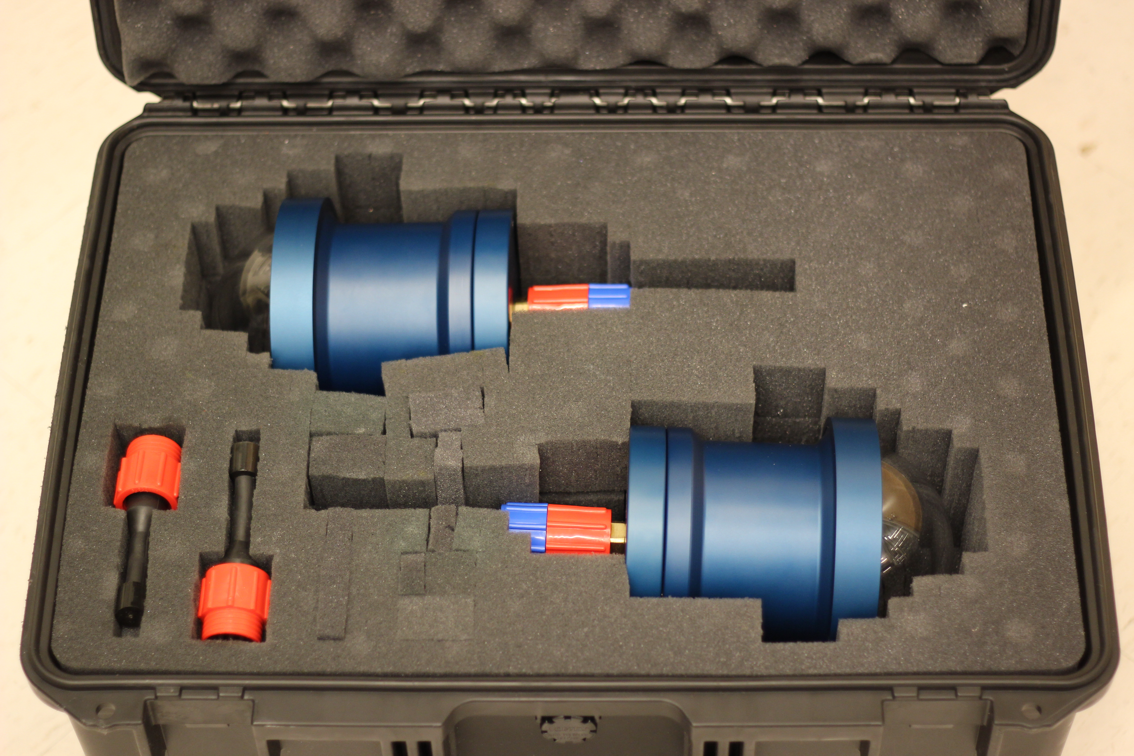
Methods
FPGA/microcontroller-based embedded system
In-air and underwater validation of communication
Simulation of Time Division Multiple Access (TDMA) using Network Simulator 3 (ns3)

Slide 6
Results
Successful data transfer from one node to another
  Arbitrary amount of data
In-situ statistical analysis of environmental channel noise and determining optimal receiver parameters
TDMA simulations were largely unused as the theoretical model has already been validated and the timing specifics of the embedded system have only recently been quantified
Simple ACK-NACK scheme for ensuring data validity and delivery

Slide 7
Interpretation
Validated optical communication in a variety of environments with ACK-NACK and addressing
  Arbitrary type of sensor
  Arbitrary number of nodes
  Arbitrary number of connections
  Adapt to shifting environment
A protocol exists that can be adaptable and ad-hoc
  The baseline levels have already been implemented and validated

Slide 8
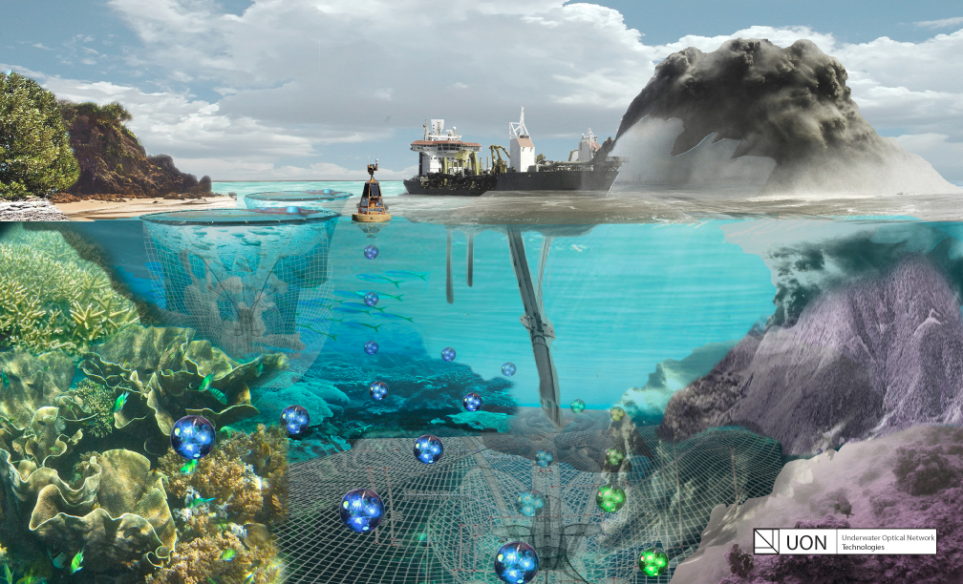
Closing
Long-term multi-dimensional sensor maps of extreme environments
Easier access to data collected underwater
Opens up the ocean to additional innovation and exploration
Notes:
Large on board storage

Slide 9
Questions?
Notes:
Large on board storage

