Slide 1


  Analog Circuit and Layout Design
Max Ruiz
Cody Youngbull, SESE

Slide 2


Motivation
Underwater Optical Communication System
Receiver Circuit
Printed Circuit Board

Slide 3
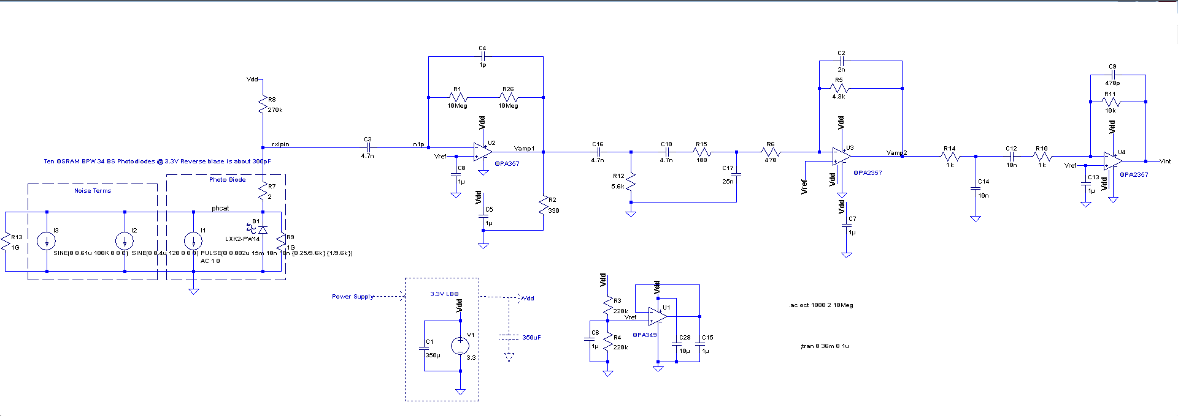
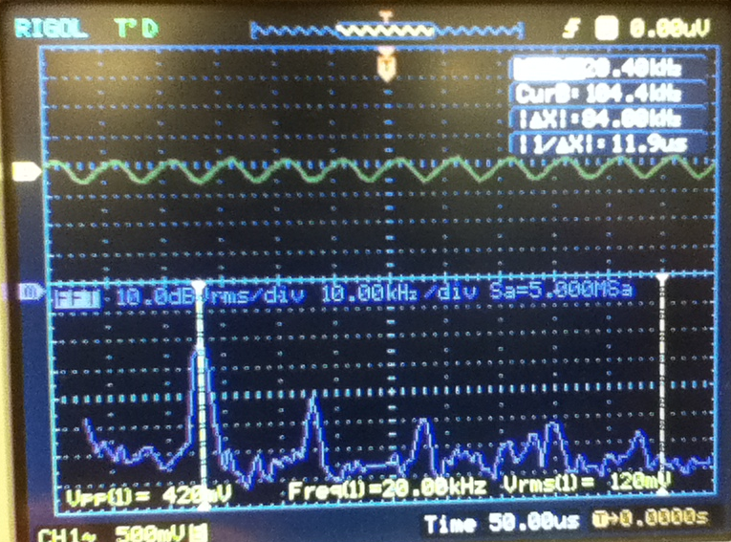
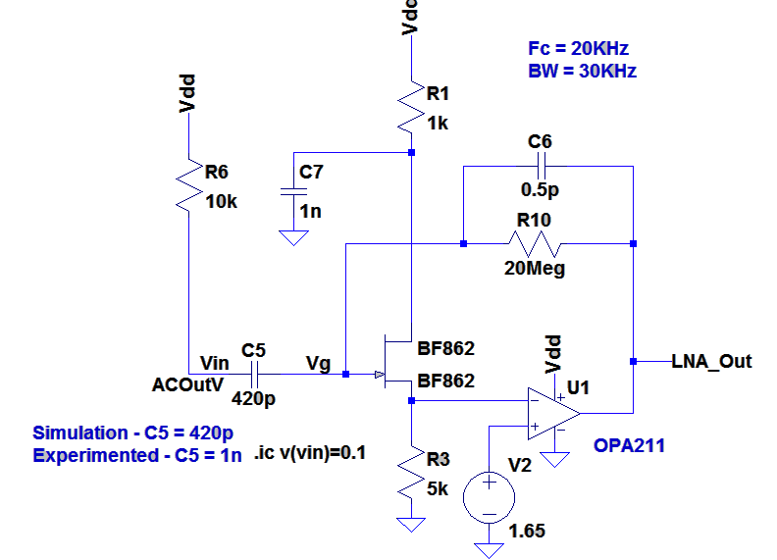
Receiver Circuit

Slide 4
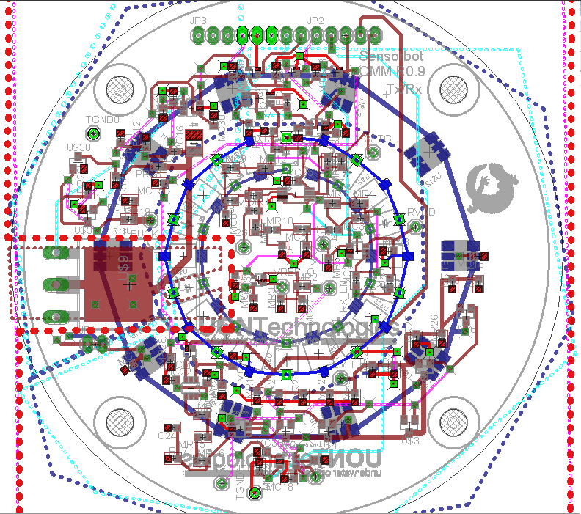
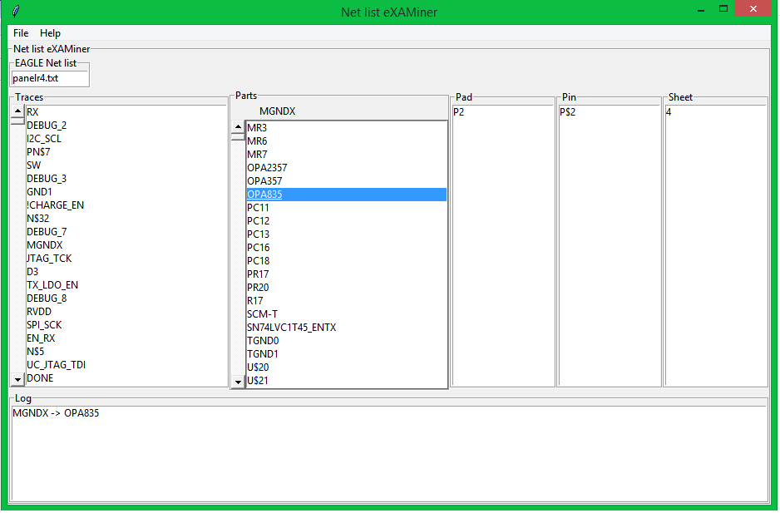
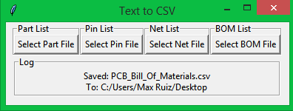
Board Design and Tools

Slide 5
Thank You
Questions?

