Slide 1
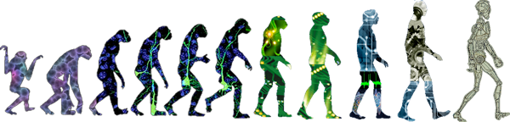



Myoelectric Control of a Small Quadcopter
Alison Gibson
Dr. Panagiotis Artemiadis
School of Engineering for Matter, Transport and Energy
Department of Mechanical and Aerospace Engineering
Arizona State University
Human-Oriented Robotics & Control Laboratory

Slide 2
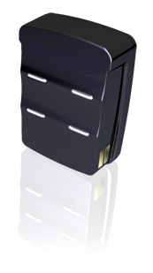
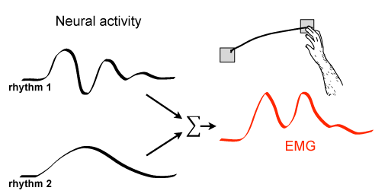
What is Electromyography (EMG)?
Non-invasive Surface Electromyography (sEMG)
-electrode detects electrical neural signals responsible for muscle contraction
EMG
electrode
Instrumentation
Amplifier
Band-Pass Filter
Data Acquisition System
HORC Lab

Slide 3
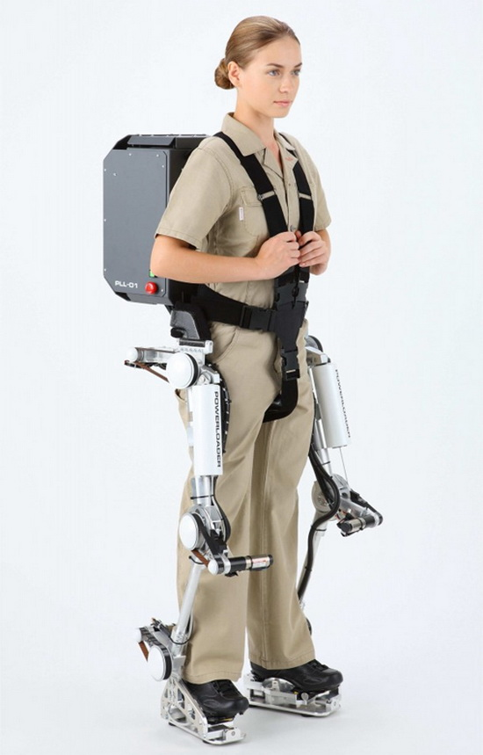
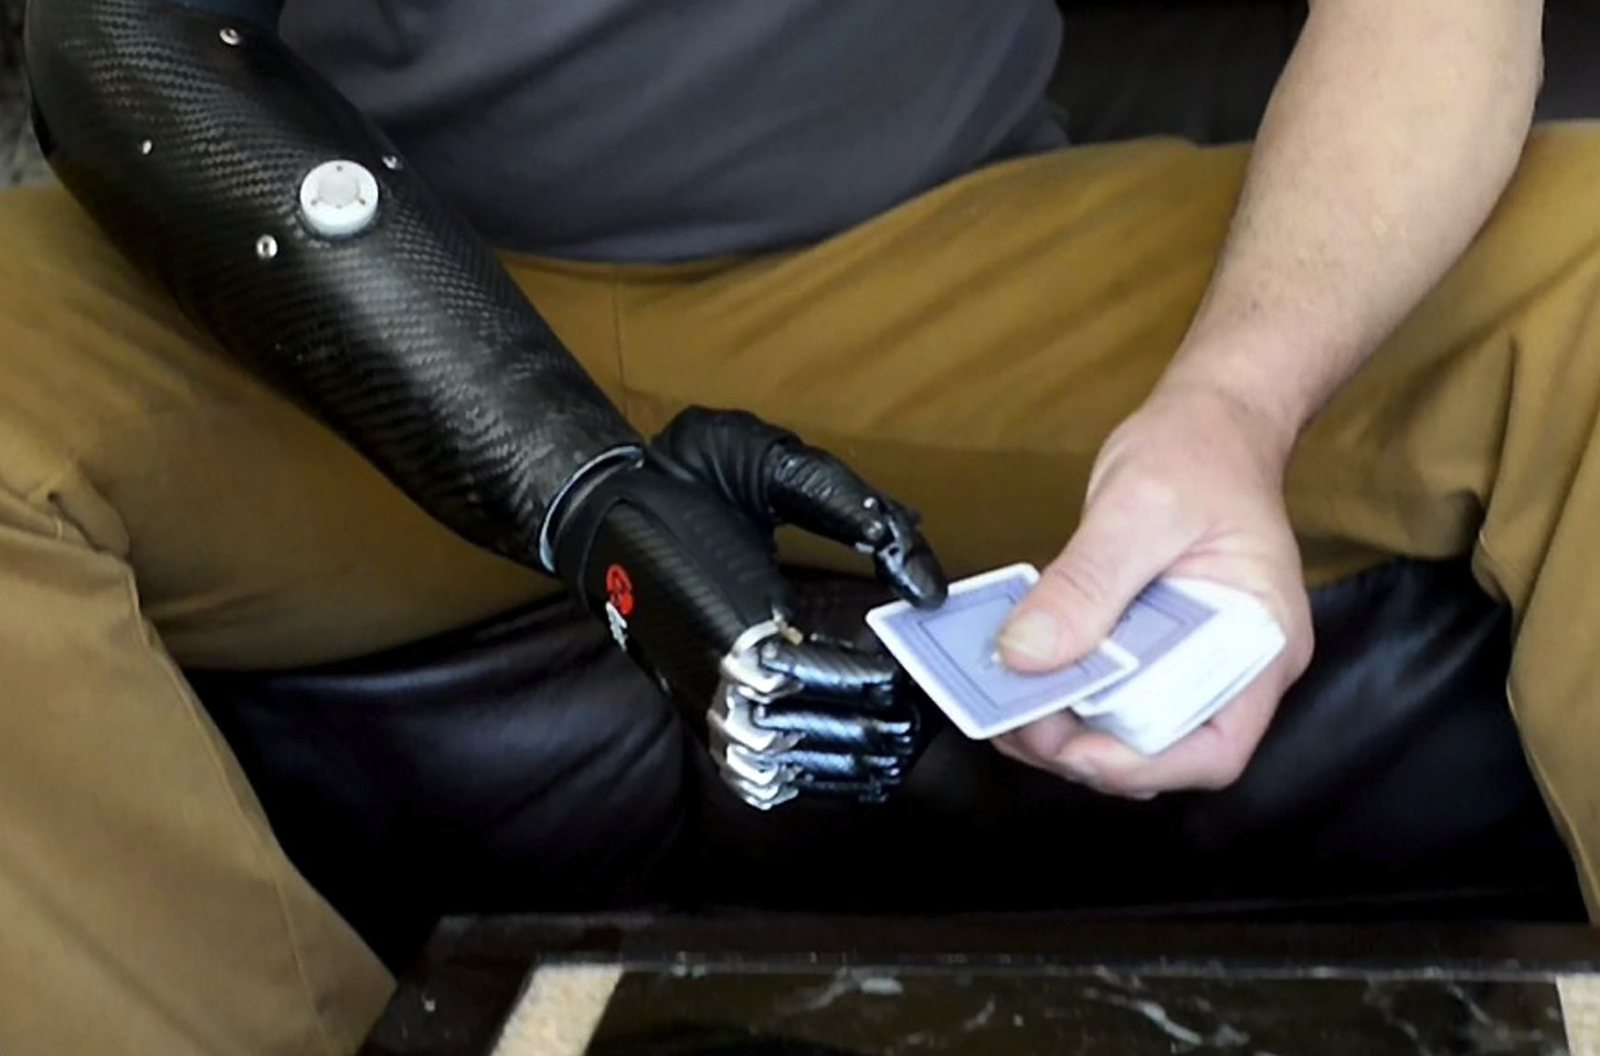
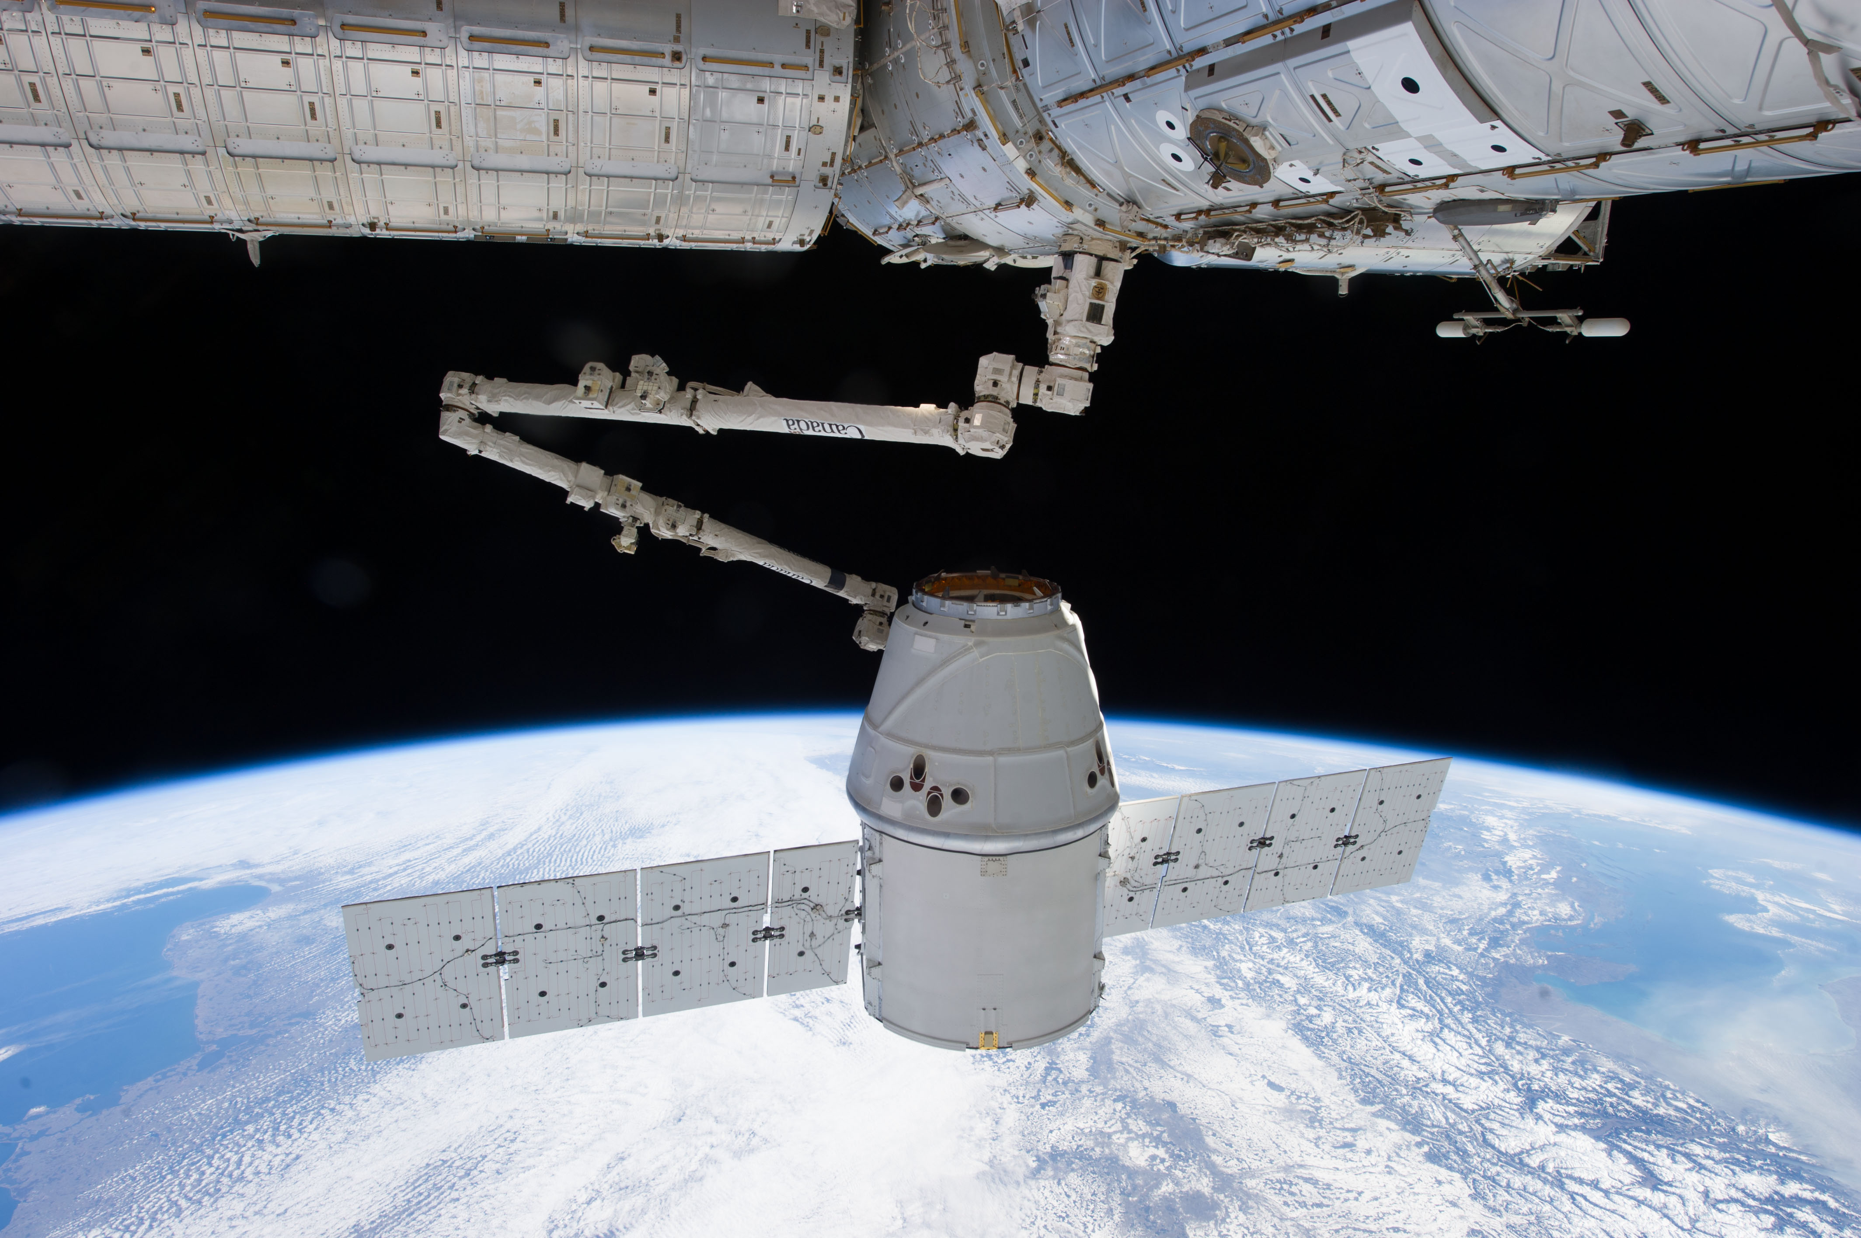
Brain-Machine Interfaces (BMI)
• Direct communication pathway between the brain
and an external device
• Assist, augment or repair human cognitive or sensory-
motor functions
neuro-prosthetics
exoskeletons
anthropomorphic control systems
HORC Lab

Slide 4
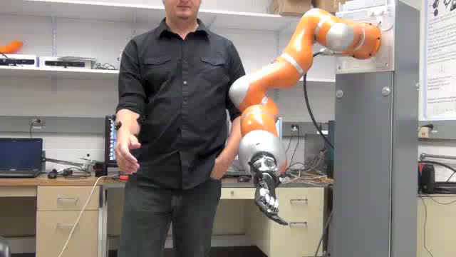
Myoelectric Control of a Robot
HORC Lab

Slide 5
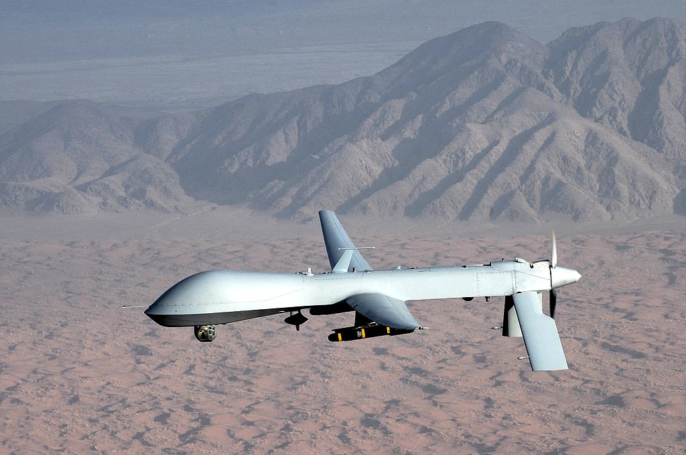
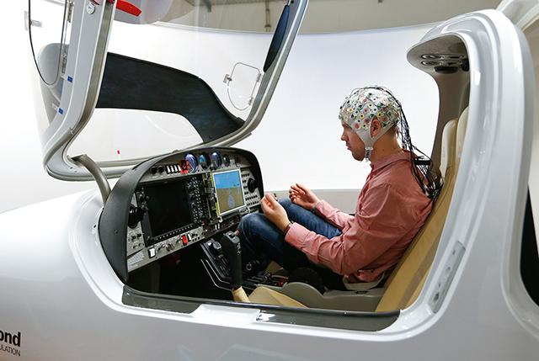
Background
BMI for Aerospace Applications: Aeronautics
Preliminary work in the Unmanned Tactical Aircraft (UTA) program found that the human-system interface was the most difficult technical issue
BMI technology can address massive pilot workload challenges in fighter aircraft or UAV ground control stations
The robustness of autonomous robotic systems to unanticipated circumstances is currently insufficient for use in the field. The many skills of a human user often fill this gap in robotic capability
HORC Lab
Notes:
In shared control, the intelligent controller relieves the human from low level tasks without sacrificing the cognitive superiority and adaptability of human beings, which are necessary for decision-making and acting in unforeseen situations.
-Perhaps a revolutionary breakthrough from BCI technology can be the ‘copiloting’ of aerial vehicles by multiple pilots including some who station at the ground. This copiloting not only reduces the stress (brain fatigue) of pilots, but also enhances the reliability and fault tolerance of aerial vehicles.
-The current Stanford HUMMINGBIRD human-robot interaction is much more bi-directional than before and operates more efficiently than completely autonomous operation. [Jones]

Slide 6
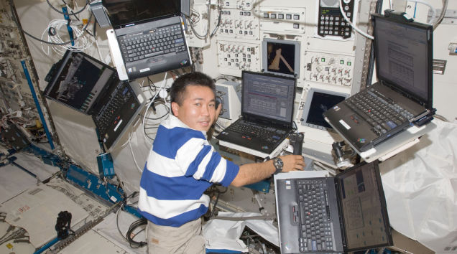
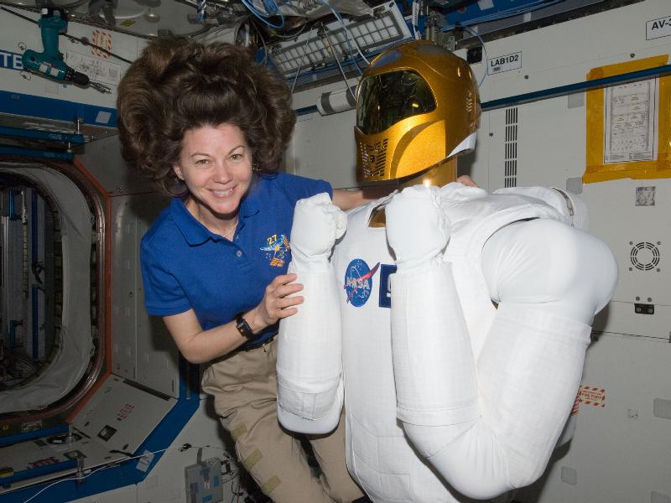
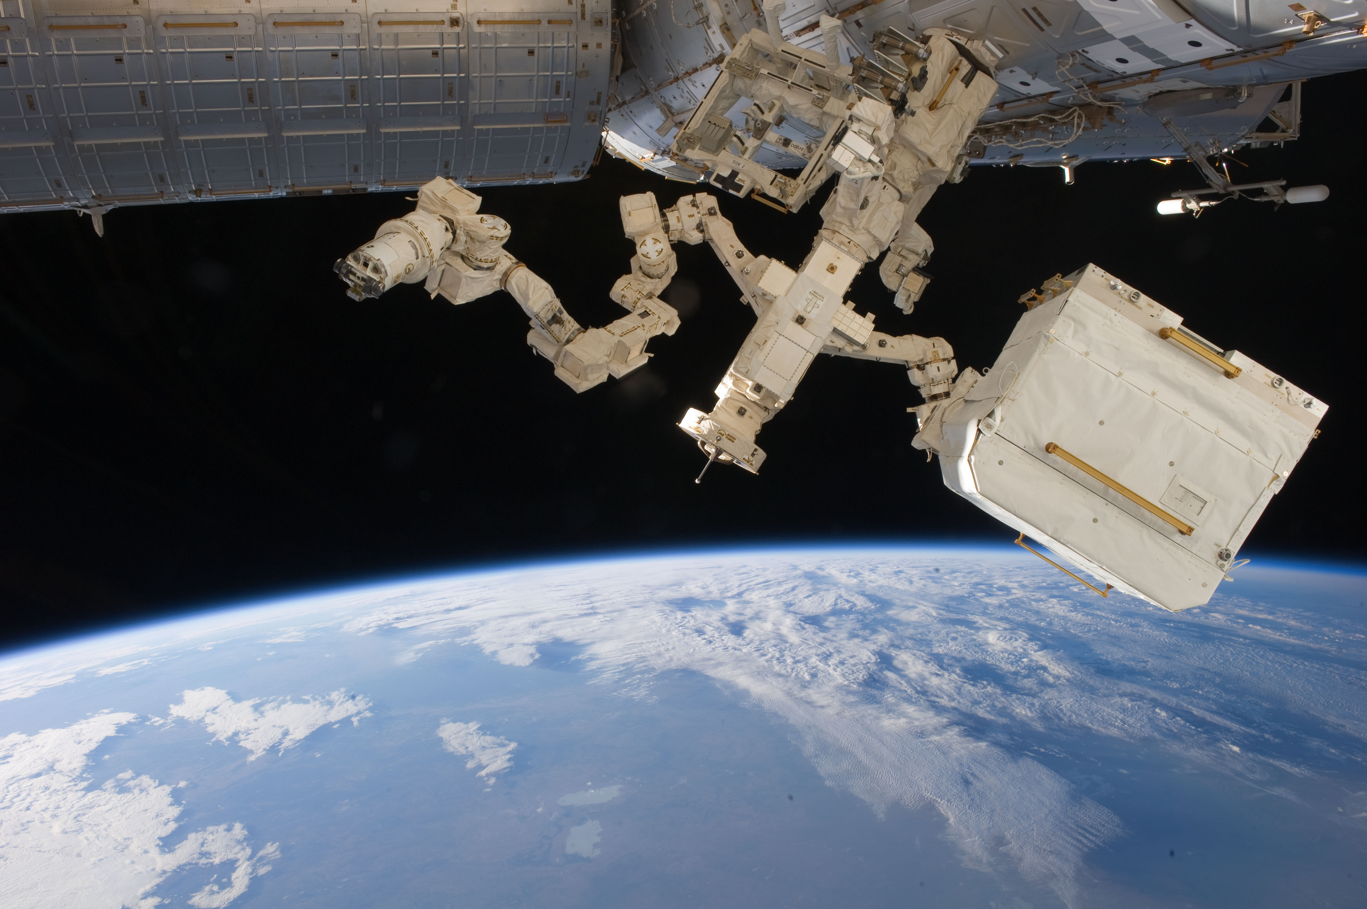
Background
BMI for Aerospace Applications: Astronautics
NASA says the future of space exploration is all about human and robotic cooperation. “One of the greatest robotic needs involve advances in human-robotic interactions” -Ambrose
It would be desirable to optimize the interface between astronauts and semi-automatic manipulators
Natural interfaces can enhance the communication and control abilities of humans in space, allowing them to fully focus on the task rather than on the interface use
HORC Lab
Notes:
Main anticipated advantages of BMI in space applications:
Reducing need for EVA
Allow multitasking
Enhance interfaces with AI during IVA
Augment operational capabilities of astronauts
-Rob Ambrose said at a keynote, chief of software, robotics and simulation division at NASA
-In human space flight, astronauts are the most precious “payload” and astronaut time is extremely valuable. Astronauts operate under unusual and difficult conditions since the absence of gravity makes some of simple tasks tedious and cumbersome [Rossini]
-Over the last decades, research efforts have been made to develop humanoid robots that could assist astronauts in performing space-related tasks. A robot for this purpose is expected to be as dexterous as a suited astronaut, and at the same time is envisioned to be able to collaborate with the astronaut, either autonomously or by tele-operation.
-The subsequent losses of performances (from microgravity) are so important that, from certain perspectives, humans operating in microgravity are in a similar situation to people affected by motor disabilities on earth: both have, for different reasons, a deficit in the performances required to accomplish their motor tasks
-Robotic systems that can be manually controlled from inside a spacecraft or from the ground using traditional interfaces such as joysticks and display screens are also used to reduce the need for EVAs and where EVAs are not possible. One such unit is the Special Purpose Dexterous Manipulator, a component of the ISS Mobile Servicing System which is capable of handling some of the delicate assembly, replacement, and repair tasks previously performed during EVAs. However, control of teleoperated manipulators remains complex, slow, and limited in applications.

Slide 7
Background
Object-Based Task-Level Control (OBTLC)
Three main tenets:
Modern technology cannot produce a substitute for human intelligence
Automatic feedback control is unaffected by any limits in human bandwidth, endurance or capacity to manage multiple tasks simultaneously
When humans and computers are insightfully integrated, the resulting robotic system is more effective than if either were used alone
“Object-Based”: the focus of human user’s attention
“Task-Level”: system-level goals
HORC Lab
Notes:
➔Rather than concentrating on how to control the robot by driving low-level actuation, the operator perceives the situation at hand and formulates what needs to happen to accomplish system-level goals (e.g. move left, follow red object)
Ideally, humans and machines would coexist in a unified system with the duties of each member optimized with respect to their inherent capabilities. Human intelligence is more capable of inferring information from scarce telemetry, setting goals and planning missions, and responding appropriately to unexpected situations. At the same time, computers are capable of the many chores necessary to control robots at a low level, such as controlling multi-input/multi-output systems or processing large amounts of sensed data.

Slide 8
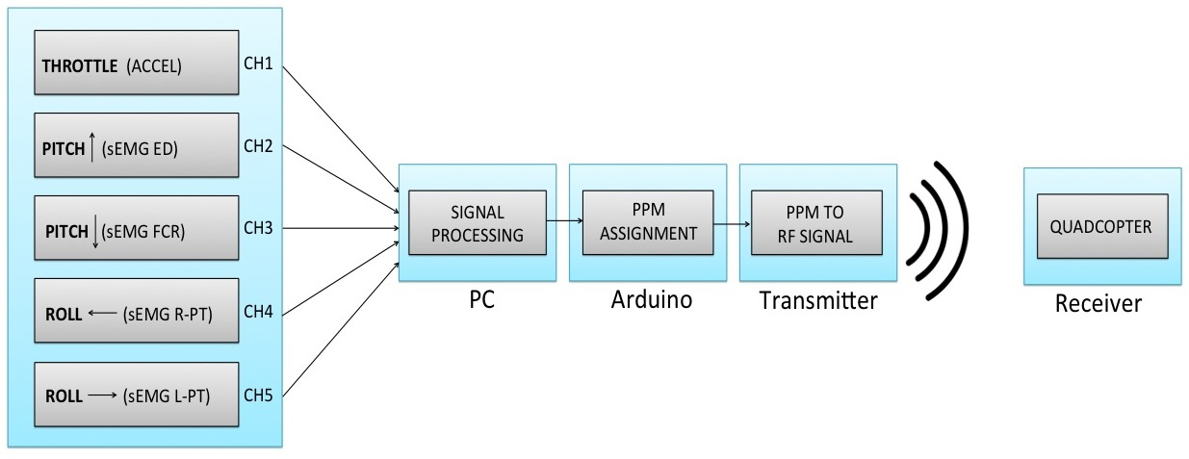
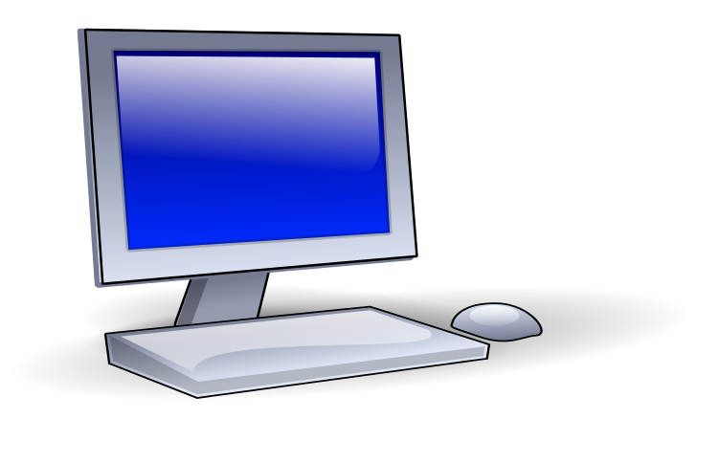
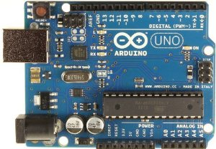
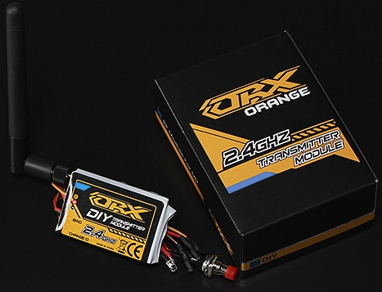
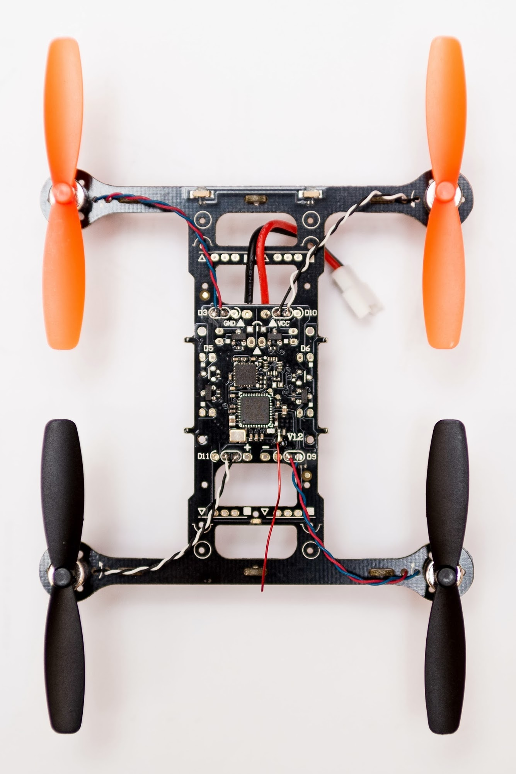
Communication System
HORC Lab

Slide 9
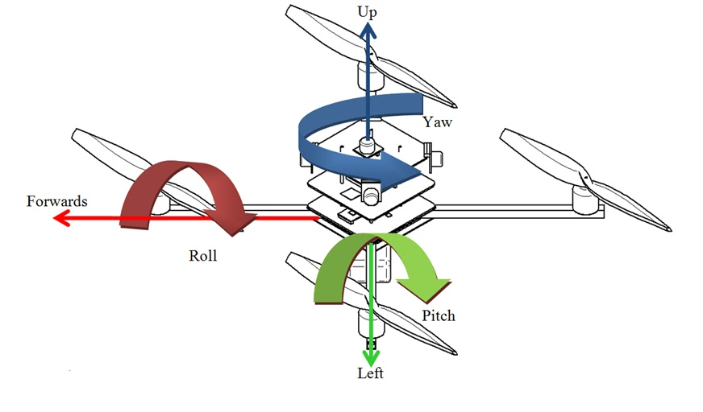
Communication System
HORC Lab

Slide 10
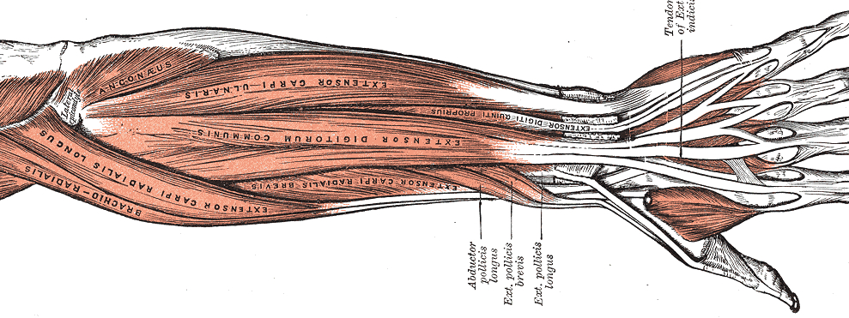
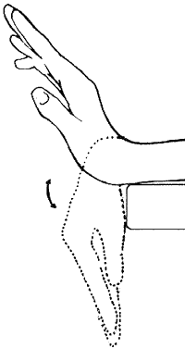
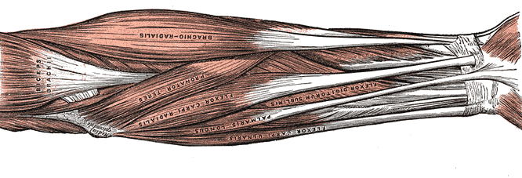
Communication System
sEMG Electrodes
Pitch up (R&L)
Posterior View
Extensor Digitorum
Pitch down (R&L)
Anterior View
Flexor Carpi Radialis
Pronator Teres
HORC Lab

Slide 11
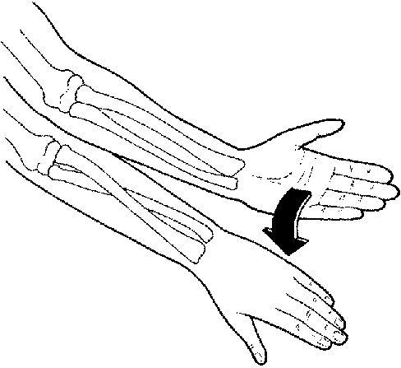
Communication System
sEMG Electrodes
Pitch up (R&L)
Posterior View
Extensor Digitorum
Pitch down (R&L)
Anterior View
Flexor Carpi Radialis
Roll Left (R)
Roll Right (L)
Pronator Teres
HORC Lab

Slide 12
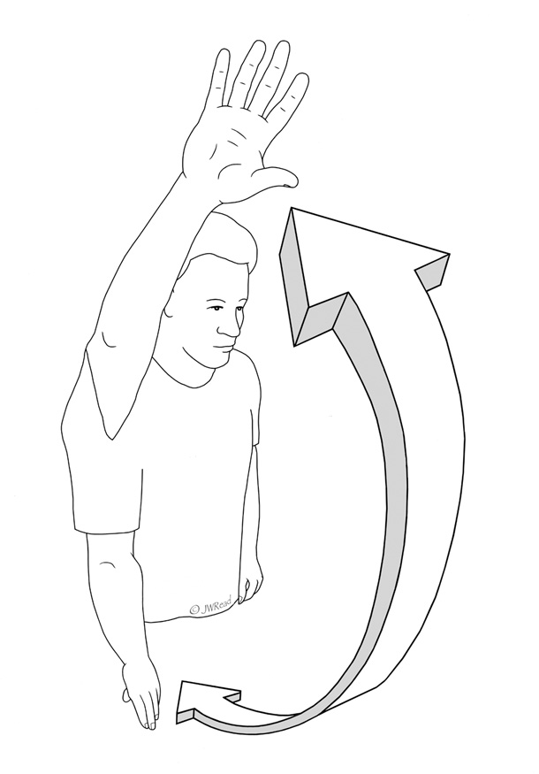
Communication System
sEMG Electrodes
Pitch up (R&L)
Accelerometers
Posterior View
Extensor Digitorum
Throttle
Pitch down (R&L)
Anterior View
Flexor Carpi Radialis
Roll Left (R)
Roll Right (L)
Pronator Teres
HORC Lab

Slide 13
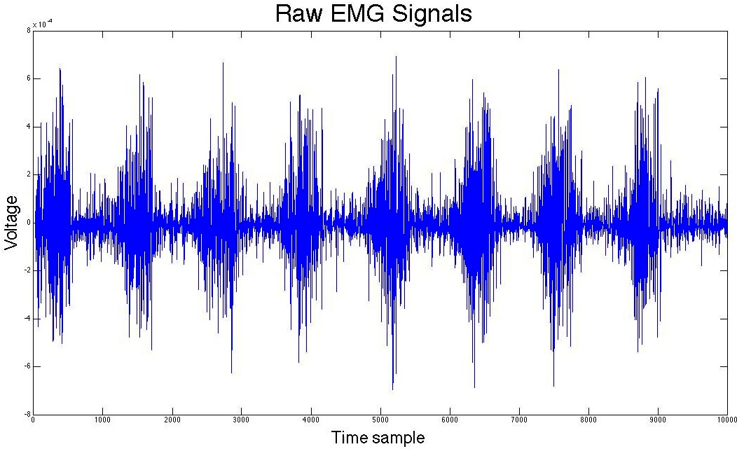
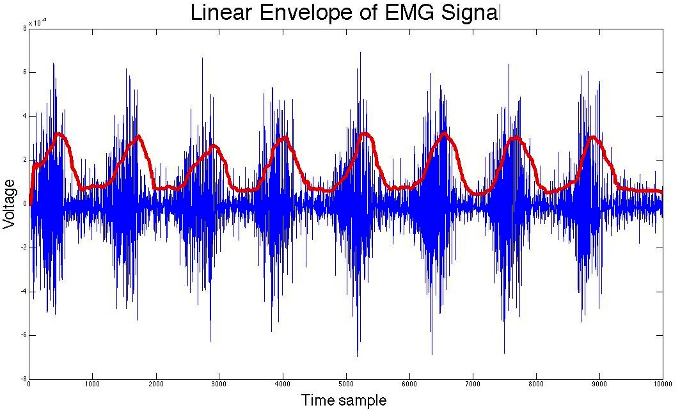
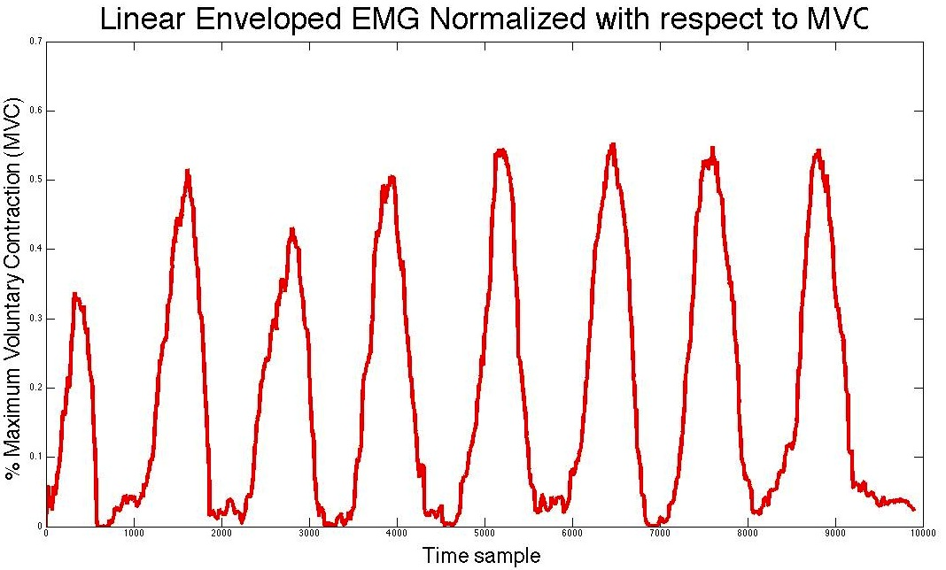
Communication System
Raw EMG Signals
Linear Envelope
- full-wave rectification
- low-pass filter (8 Hz cutoff f)
V_{max} Normalization
HORC Lab

Slide 14
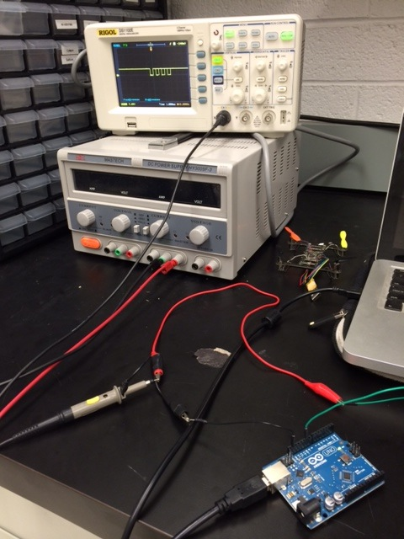
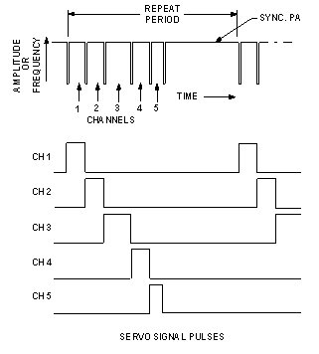
Communication System
PPM (Pulse Position Modulation)
• Can pack numerous channels of data into one 20 millisecond frame, whereas PWM can only contain one channel’s data in each 20 millisecond frame
HORC Lab
Notes:
• PPM stream uses gaps between pulses to define the pulse width for a channel, not the duration of the pulse itself

Slide 15
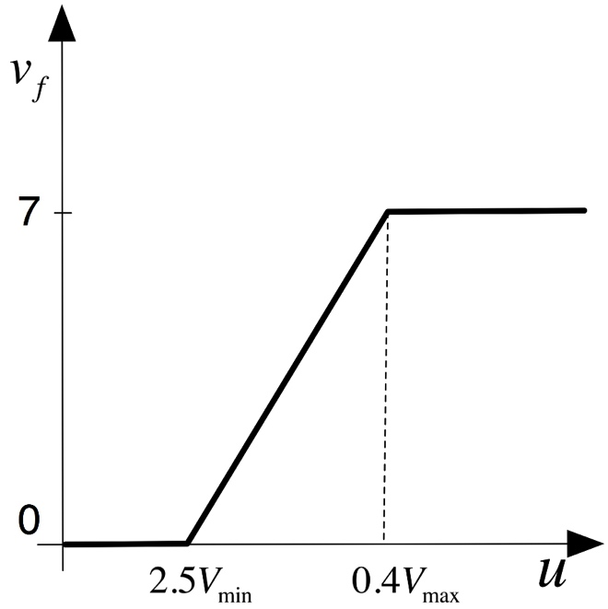
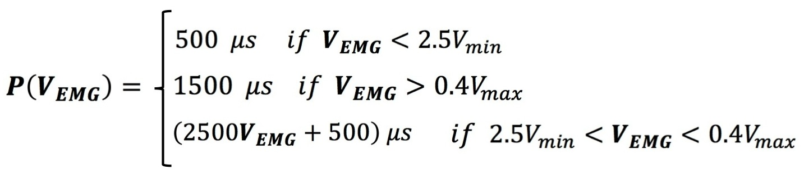
Communication System
PAUSE
1500 μs
• As muscle co-contraction increases, the pause between PPM pulses for the corresponding channels/maneuvers will increase
500 μs
V_{EMG}
HORC Lab

Slide 16

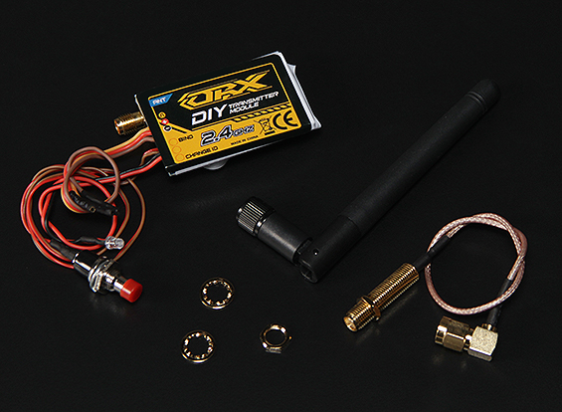
Communication System
• Connects to DSM2 receiver on quadcopter
• Converts PPM to RF
DC Power Supply
+
ORX 2.4 GHz DIY
Transmitter Module
-
Arduino
PPM
HORC Lab

Slide 17
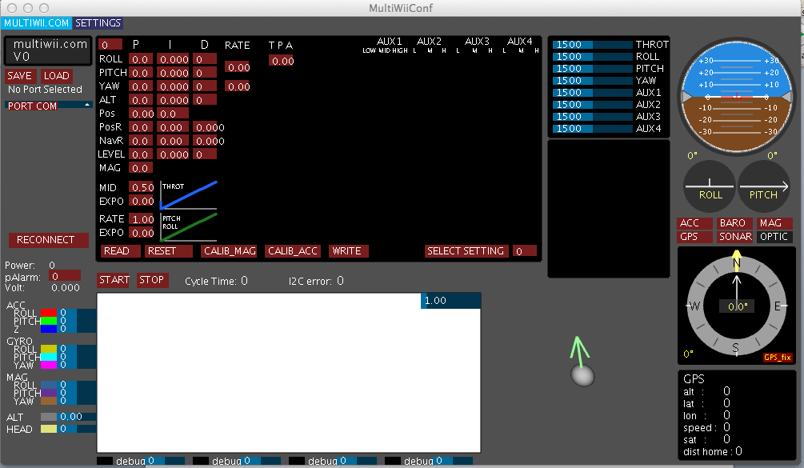
Communication System
Turnigy Micro-X Quadcopter
• Programmable through MultiWii
open source code or GUI
HORC Lab

Slide 18
Next Steps
Finalize/test the communication system
Add a level of autonomy to the quadcopter
Trainer capability with traditional handheld controller
Autopilot using Multiwii
Test with human users
Traditional RC controller vs. BMI controller
Which is easier to learn? Which is more intuitive (for novice users)? Does one offer better control?
HORC Lab

Slide 19
Thank you!
HORC Lab

