Slide 1



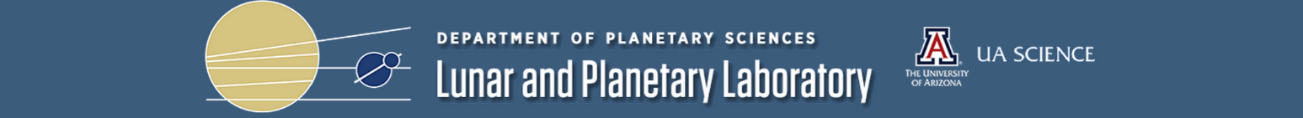
Automatic Detection of Volcanic Rootless Cones in Mars Satellite Imagery
Arizona/NASA Space Grant Consortium Statewide Symposium
April 18, 2015
Alexander Alvarez^{1,2}, Leon Palafox², Christopher Hamilton²
¹Biomedical Engineering, University of Arizona, Tucson, Arizona; ²Lunar and Planetary Laboratory, University of Arizona, Tucson, Arizona

Slide 2
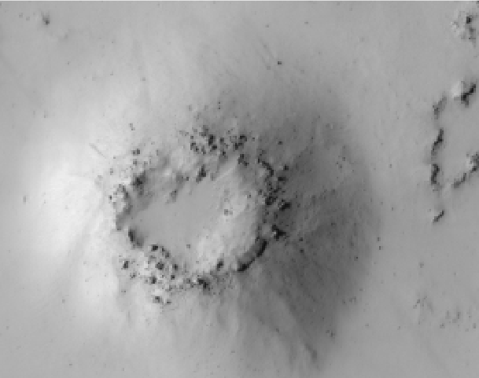
Introduction – Problem Statement
Problem Statement
Manual identification of VRCs in high-resolution images of the Martian landscape is inefficient and can be shrouded by equifinality
Objective
Develop a support vector machine algorithm to automatically detect and distinguish VRCs with high accuracy
Source: uahirise.org

Slide 3
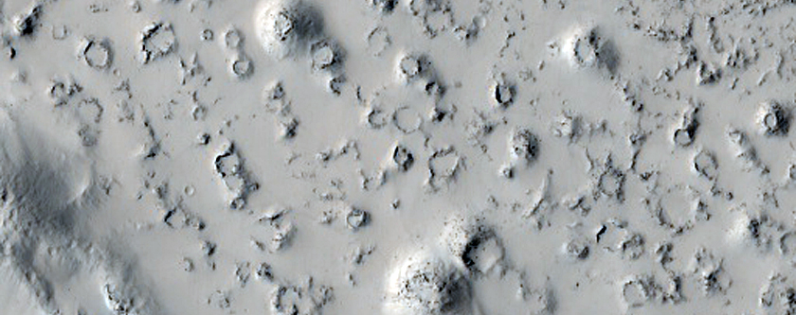
Introduction – Volcanic Rootless Cones
Result from explosive lava-ice interactions
Demonstrate when surface of lava flow moves
Distinguishing cones from craters is not always easy
Source: uahirise.org

Slide 4

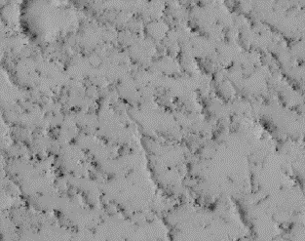
Introduction – Support Vector Machines
Task: Separate the Blue Triangles from the Yellow Circles

Slide 5
Methods – General Algorithm Structure
Read in Image
Manually Label Positive and Negative Examples
Extract Image Intensity Values from these pixels
Transform Features with Histogram of Oriented Gradients
Determine Principle Components
Train SVM and Extract Parameters
Use Parameters on Test Data
Map Results on Original Image

Slide 6
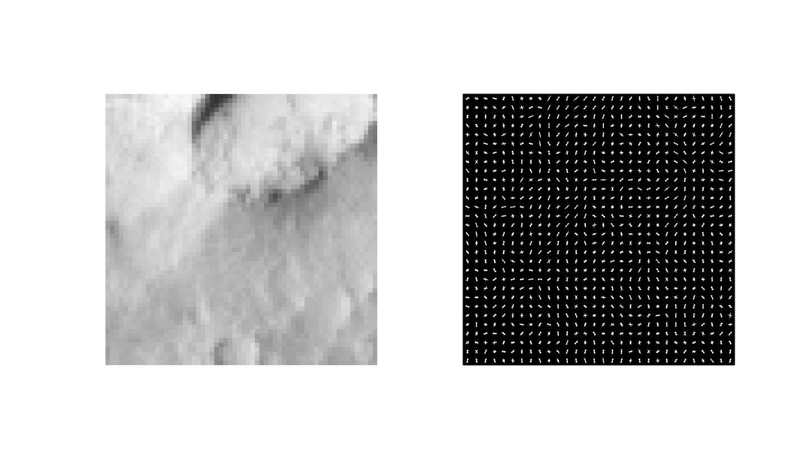
Methods – Histogram of Oriented Gradients
Original Image
HOG

Slide 7
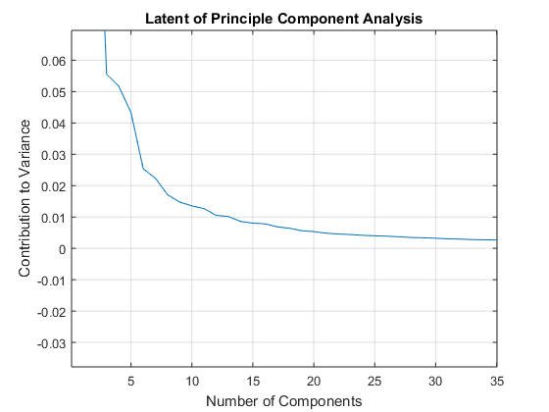
Methods – Principle Components Analysis
Method of reducing dimensionality in data
Find orthogonal component vectors that can describe the dataset
Determine number of components necessary using the variance explained by each component

Slide 8
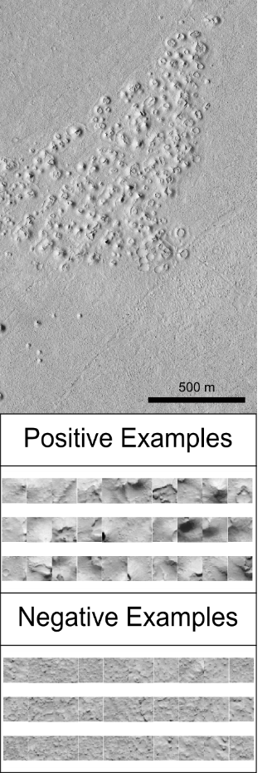
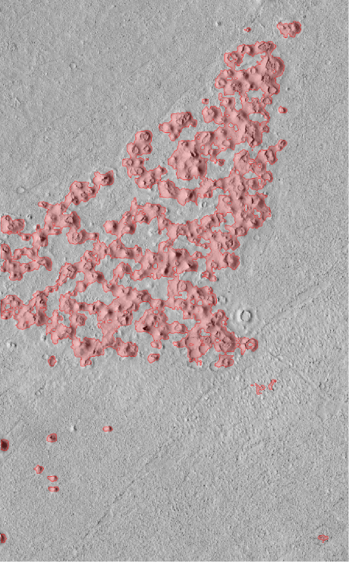
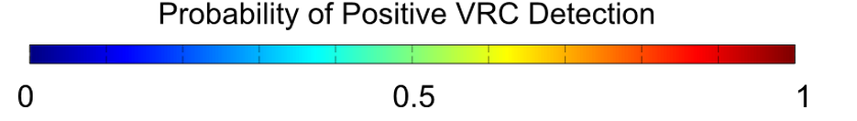
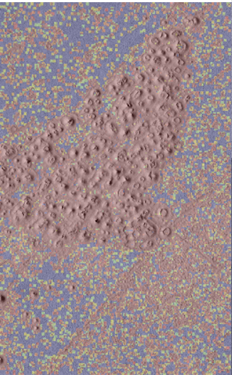


Results - Maps
Image: PSP_002292_1875_RED

Slide 9
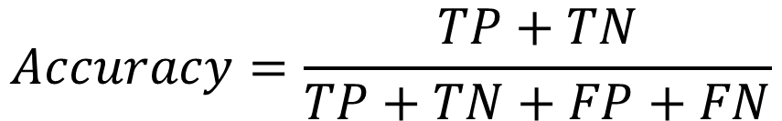
Results - Numbers
Accuracy of Prediction Using Different Sets of Features
Image and HOG | 0.9375
Image Only | 0.9
HOG Only | 0.725
PCA Only | 0.475
Image, PCA, and HOG | 0.475
PCA and Image | 0.4625
PCA and HOG | 0.45
$$Accuracy=\frac{TP+TN}{TP+TN+FP+FN}$$

Slide 10
Conclusions
SVMs on image data with HOG features identify Volcanic Rootless Cones with high accuracy
PCA is of little value to these data sets
We can now use this data to further study volcanic flow
In the future, we will further explore the equifinality problem
Acknowledgements
Work funded by NASA Mars Data Analysis Program (MDAP) Grant # NNX14AN77G
Susan Brew and the NASA/Arizona Space Grant Consortium
Christopher Hamilton
Leon Palafox

