Slide 1
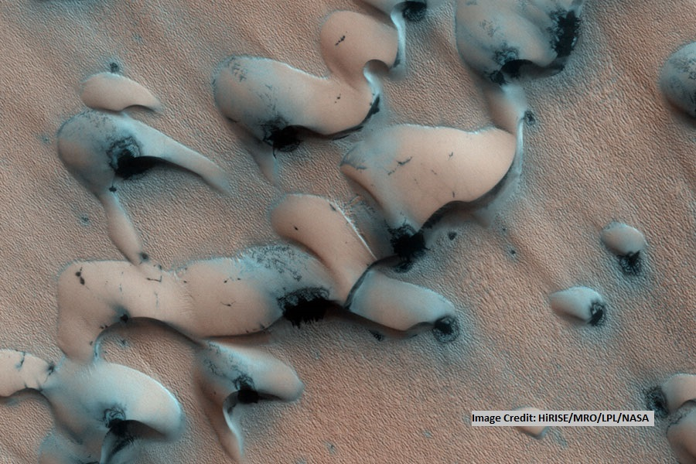
Feldspar Distribution in Dune Fields on Mars
Heather Charles
Dr. Timothy N. Titus (Mentor)
Northern Arizona University/USGS Astrogeology

Slide 2
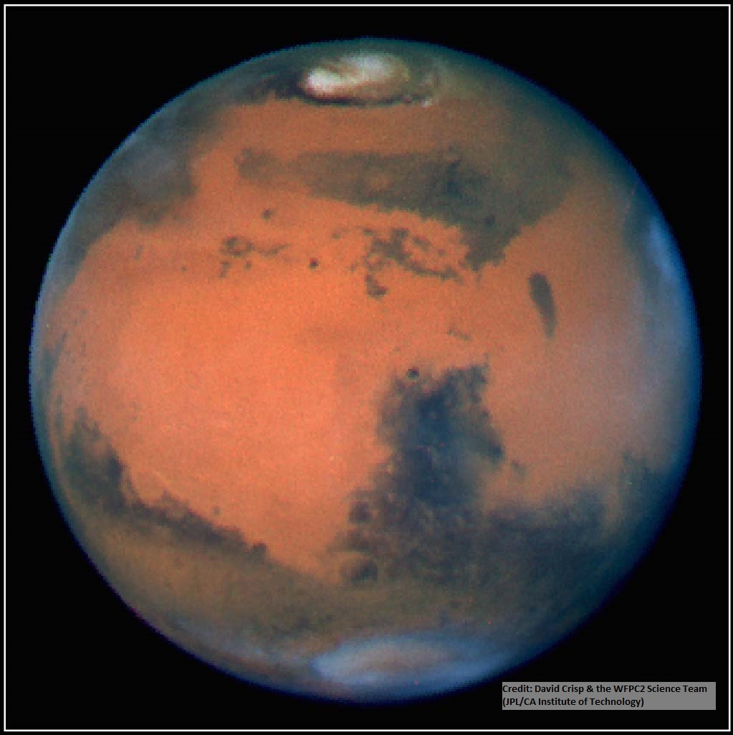
Why Study Dunes on Mars?
Aeolian environment
Interface between atmosphere and surface
Geological history

Slide 3
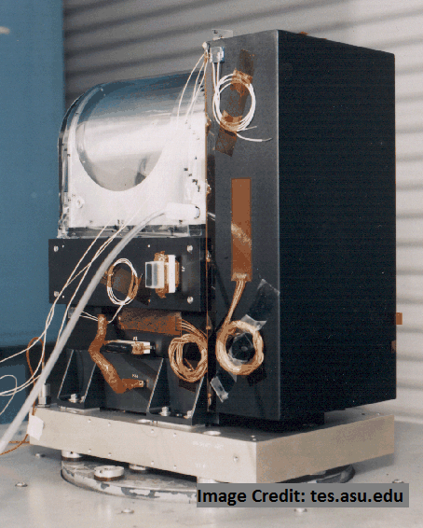
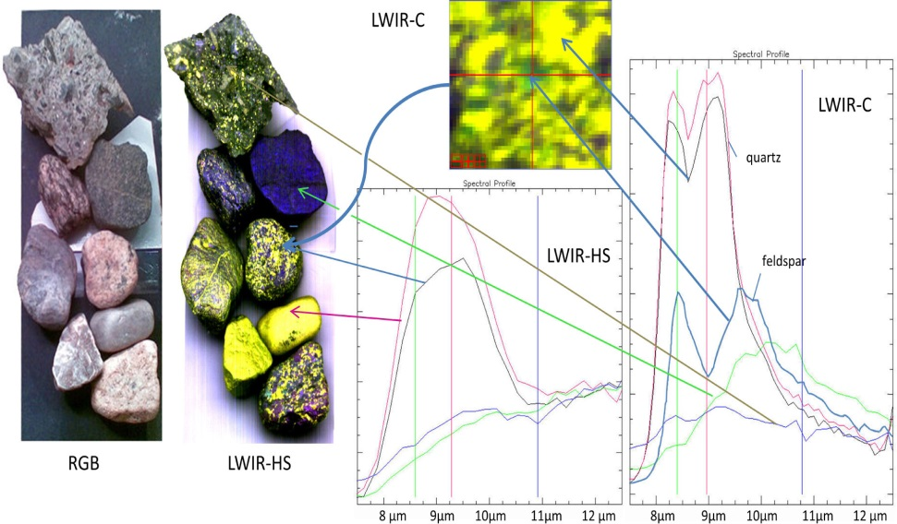
Identifying Minerals on Mars’ Surface
Emissivity: measure of infrared energy emitted
Different emissivities = different minerals
Mars Global Surveyor mission

Slide 4
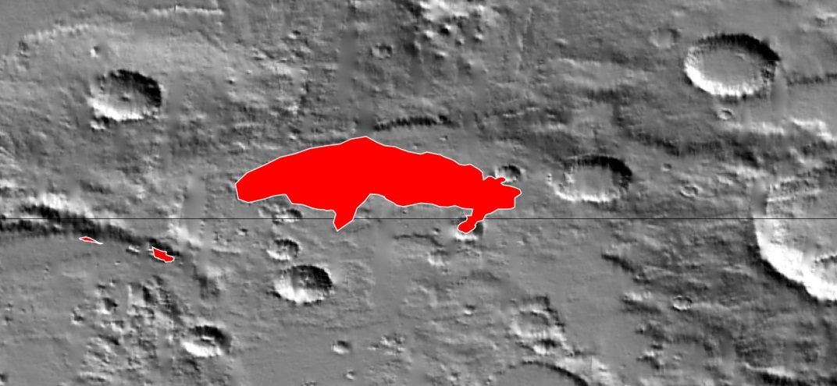
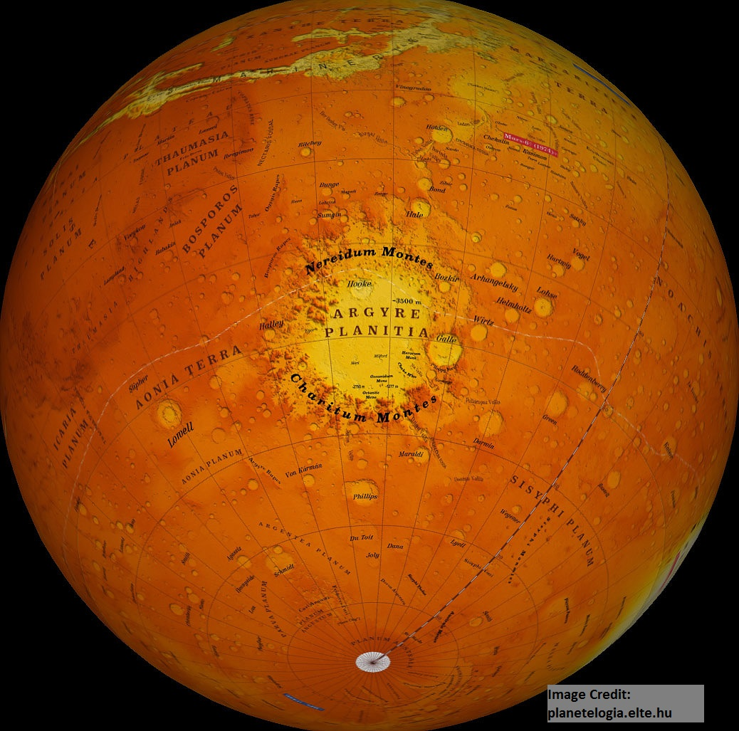
Dune Field 2938-497: Identifying minerals present
Subject of previous study

Slide 5
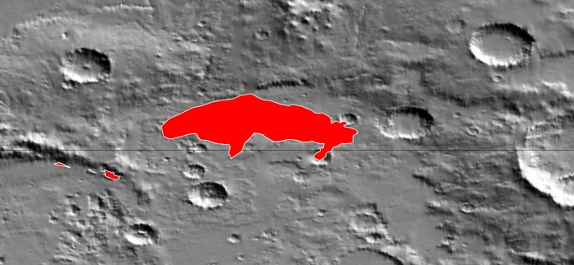
Hypothesis
Feldspar is present in dune field 2938-497
but is non-uniform.
Previous study suggested feldspar either absent
or non-uniform.

Slide 6
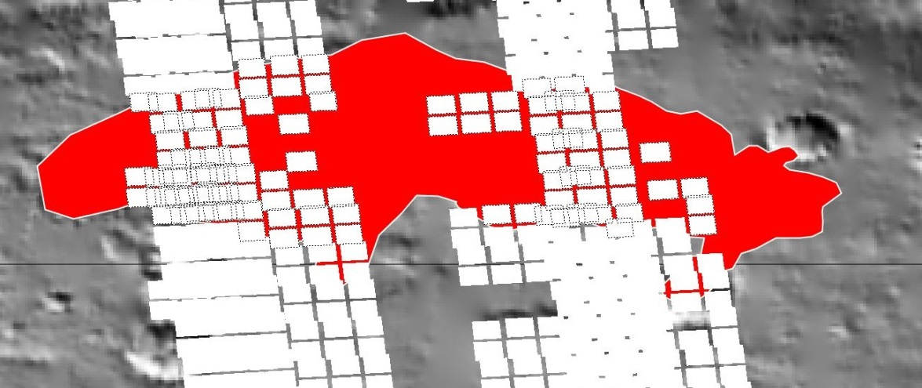
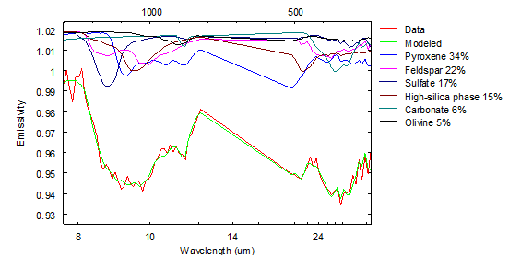
Data
JMARS – emissivity data
Orbital tracks in dune field selected
Spectral library
Davinci deconvolution
Mineral abundance percentages

Slide 7
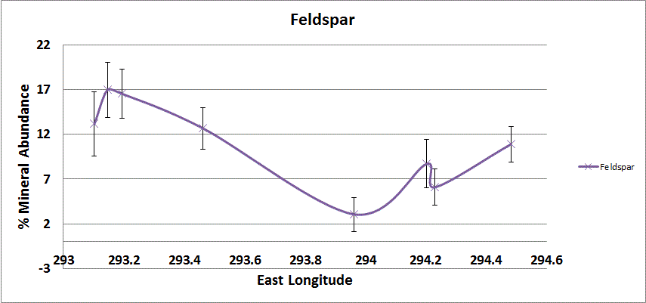
Analysis
Mineral abundance v. longitude
Trends from west to east
Compared trends from two analyses

Slide 8
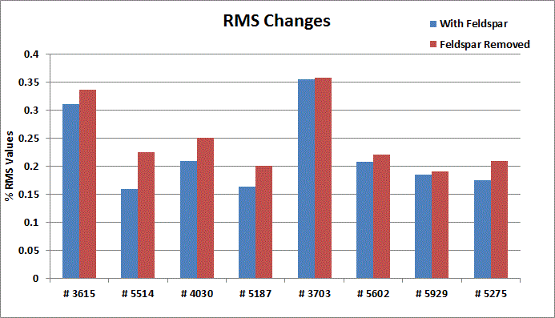
Conclusions
Worse results without feldspar
Change in abundance across field
Feldspar present and non-uniform

Slide 9
Acknowledgements
Dr. Tim Titus, mentor
Rose Hayward
Chris Edwards
NAU and the Space Grant Program

Slide 10
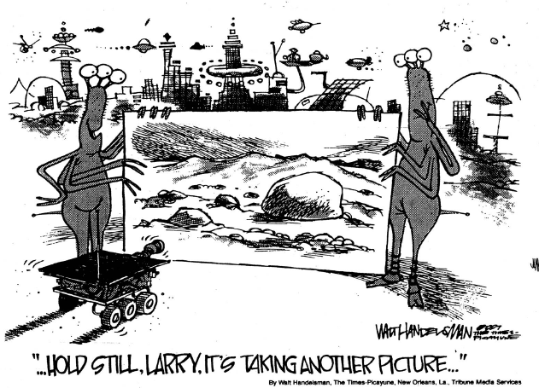
Any Questions?

Slide 11
Davinci Deconvolution
Atmospheric correction file
Removed dust, aerosols
Ran data through twice
Spectral mineral library
8 mineral groups, 44 endmembers

Slide 12
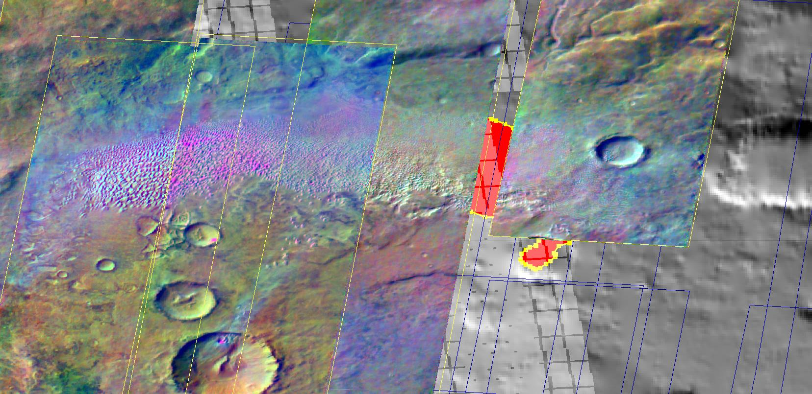
THEMIS

Slide 13
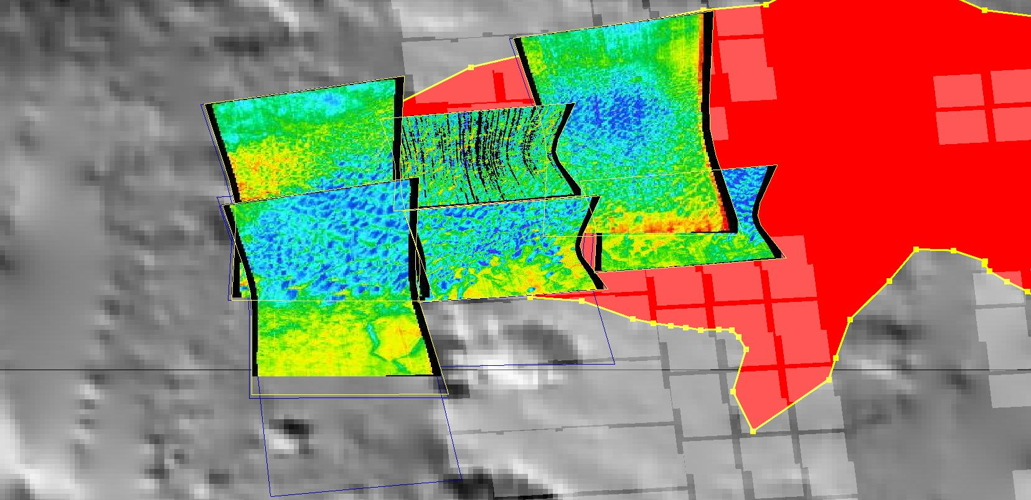
CRISM - Olivine

