Slide 1



Central Pit Craters on Saturn’s Icy Moons
Sierra Ferguson
Mentor: Dr. Nadine Barlow
Northern Arizona University

Slide 2
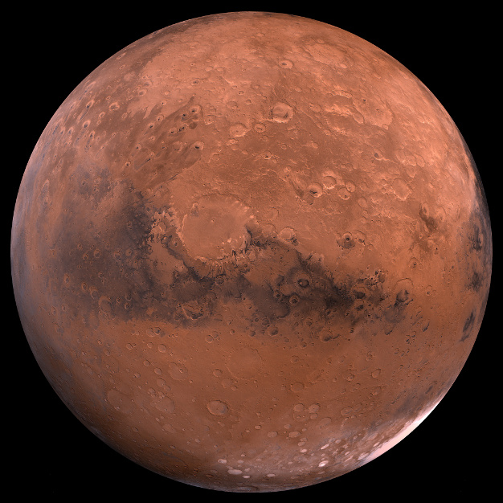
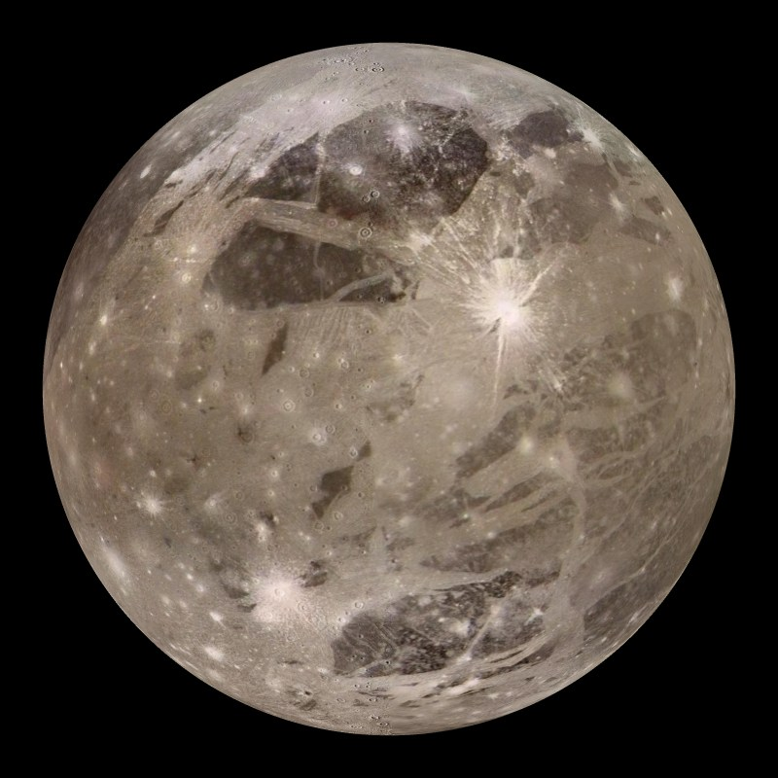
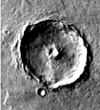
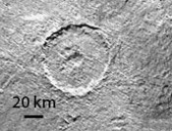
Introduction
Mars
g=3.711 m/s^2
d=6,799 km
Ganymede
g=1.428 m/s^2
d=5,268 km
Notes:
Big Picture: Central pit craters have been found for Mars and Ganeymede. Studies have been done to determine how the pits have formed and if there is any relation to the distribution of them around the body. Mars has pits that are able to be classified as either summit or floor pits, whereas ganymede doesn’t seem to these kinds of pits. Summit pits are those that form on top of peaks and floor pits are those that form on the floor of the crater
Ganeyemede g value of 1.428
Mars g value 3.711

Slide 3
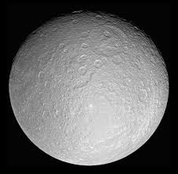
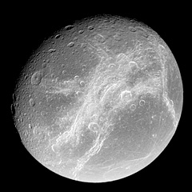
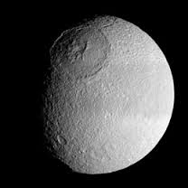
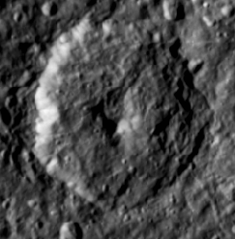
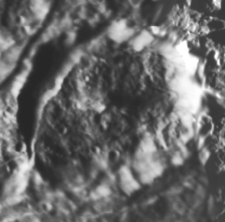
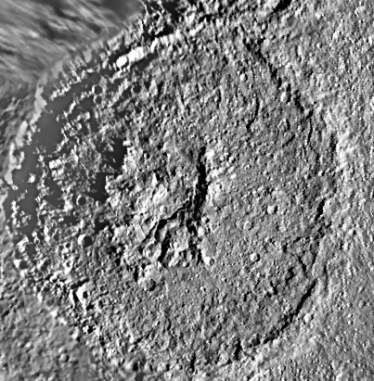
Introduction
Rhea
Dione
Tethys
g=0.265 m/s^2
d=1,528 km
g=0.233 m/s^2
d=1,123km
g=0.147 m/s^2
d=1,066km
40 km
36 km
250 km
Notes:
Smaller bodies like these three will allow us to determine if there is a relationship between low surface gravity and the formation of pits
Rhea surface gravity= 0.265 m/s^2 ¾ ice and ¼ rock thought to be a homogeneous mixture (ice seems to be mostly water)
Dione surface grav= 0.233 1/3 silicate rock core and rest ice (very hard so behaves like rock) , constantly bombarded by dust that comes off of encleadus
Tethys surface grav= 0.147 Mostly water ice with some rock behaves at like rock at -305 Fahrenheit

Slide 4
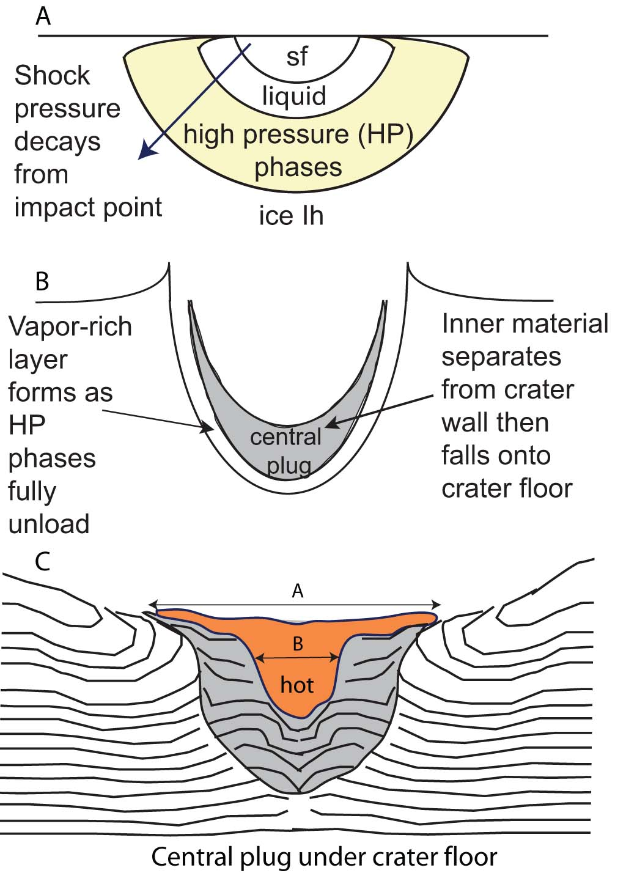
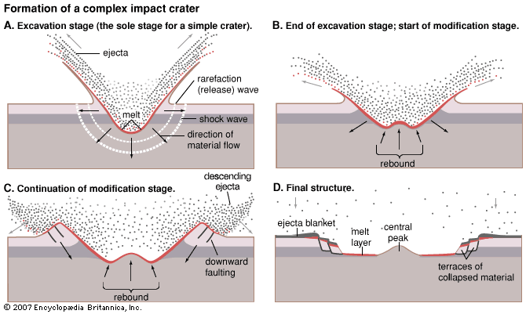
Formation Models
Melt-Drainage of Subsurface Ice
Collapse of Weakened Material
Impactor hits icy surface
Heat from impact melts the ice and leaves a pit
Crater originally has a peak
  Another model suggests that the collapse is from the weaker surface material
Weaker peak material collapses to form a pit
(Senft and Stewart, 2011)

Slide 5
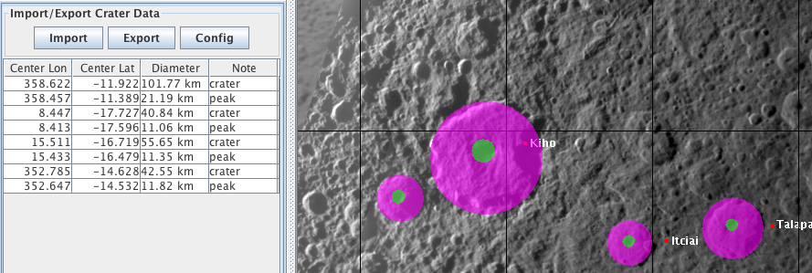
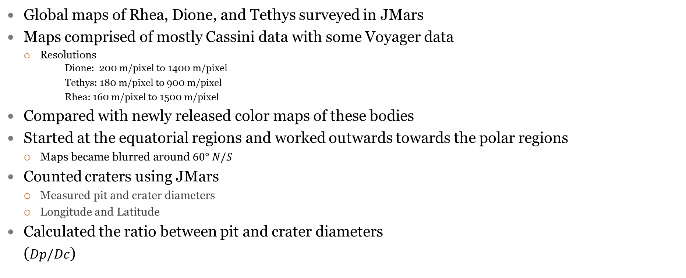
Data
Global maps of Rhea, Dione, and Tethys surveyed in JMars
Maps comprised of mostly Cassini data with some Voyager data
  Resolutions
  Dione: 200 m/pixel to 1400 m/pixel
Tethys: 180 m/pixel to 900 m/pixel
Rhea: 160 m/pixel to 1500 m/pixel
Compared with newly released color maps of these bodies
Started at the equatorial regions and worked outwards towards the polar regions
  Maps became blurred around $60° N/S$
Counted craters using JMars
  Measured pit and crater diameters
  Longitude and Latitude
Calculated the ratio between pit and crater diameters
  ($Dp/Dc$)
Notes:
Cassni and Voyager data
Rhea has 12 pits 32 peaks , Dione 12 pits 22 peaks, Tethys 13 pits and 29 peaks

Slide 6
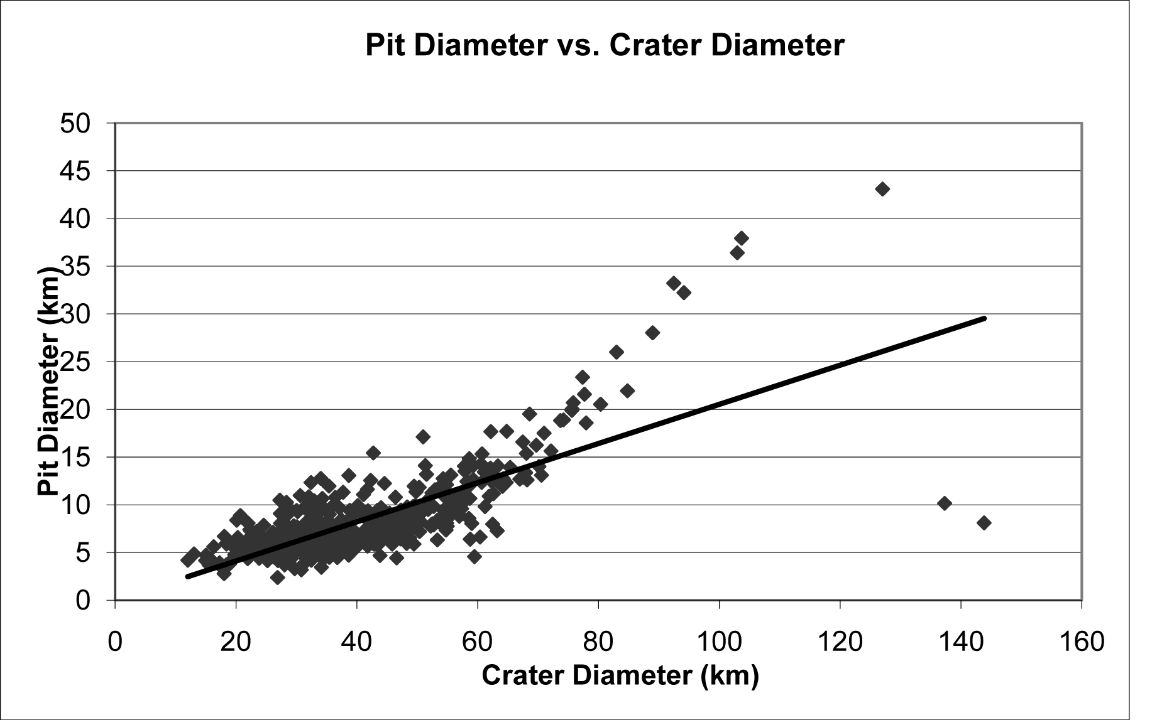
Analysis
Analysis
Dione
Ganymede
(Alzate and Barlow, 2011)
Notes:
All three moons have a linear relationship like mars does, were as Ganymede has a steep drop off at 140km and all three moons keep extending. No separation between summit and floor craters since there are very few summit craters in the total survey. Ganymede also displays these properties in that there are no distinctions made between pit types where as Mars has a clear distinction between summit and floor pits. Most pits are a variation of a domed pit. Ganymede has a turn off point in which the impactor would excavate into weaker surface material, allowing for larger pits to form.

Slide 7
Results

Slide 8
Results
Moon | Surface Gravity (m/s²) | # of pits | Dp/Dc median value | Crater diameter ranges (km) | Pit Diameter ranges (km)
Tethys | 0.147 | 13 | 0.175 | 20-60 | 3-12
Dione | 0.233 | 12 | 0.21 | 20-80 | 3-25
Rhea | 0.265 | 12 | 0.22 | 20-80 | 10-20
Ganymede | 1.428 | 471 | 0.19 | 10-90 | 4-43
Mars | 3.711 | 1604 | 0.13 | 5-90 | 2-23

Slide 9
Conclusions
As crater diameters increase, pits increase as well
No indication that latitude and pit distribution are related
Fewer pits found on smaller bodies
More pits were seen at smaller crater diameters
Larger Dp/Dc ratios support the melt drainage model
  Rhea: 0.22
  Dione: 0.21
  Tethys: 0.17
Notes:
Pit frequencies all peak between 30 and 40km
Majority centered around equatorial regions with few in polar regions
Median value for dp/dc on rhea: .22 dione: .21 tethys:.175 Mars median (.13) ganymede median of .19
Higher dp/dc= melt drainage due to more melt of the ice happening during impact

Slide 10
Future Work
Results will be incorporated into a larger survey of central pit craters throughout the solar system including :
  Mercury, Mars, Ganymede, Callisto, and the moon
Results will be used to further constrain the formation models for central pits

Slide 11
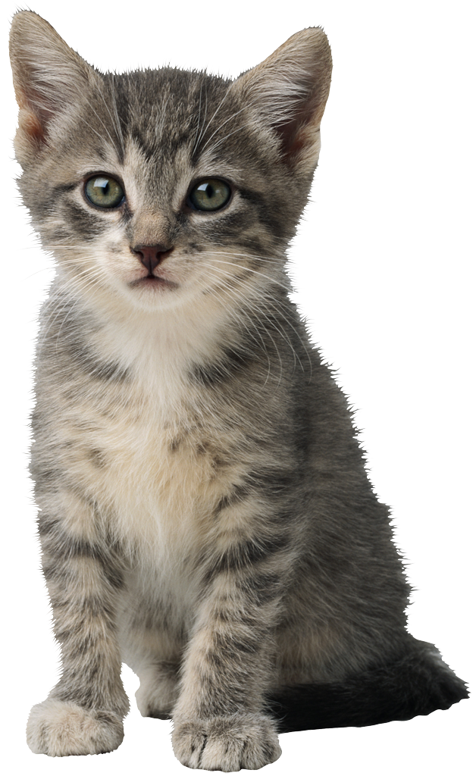
Acknowledgements
Dr. Barlow
Kathleen Stigmon
NAU/NASA Space Grant
NAU
ASU
JMars
Cassini team

