Slide 1
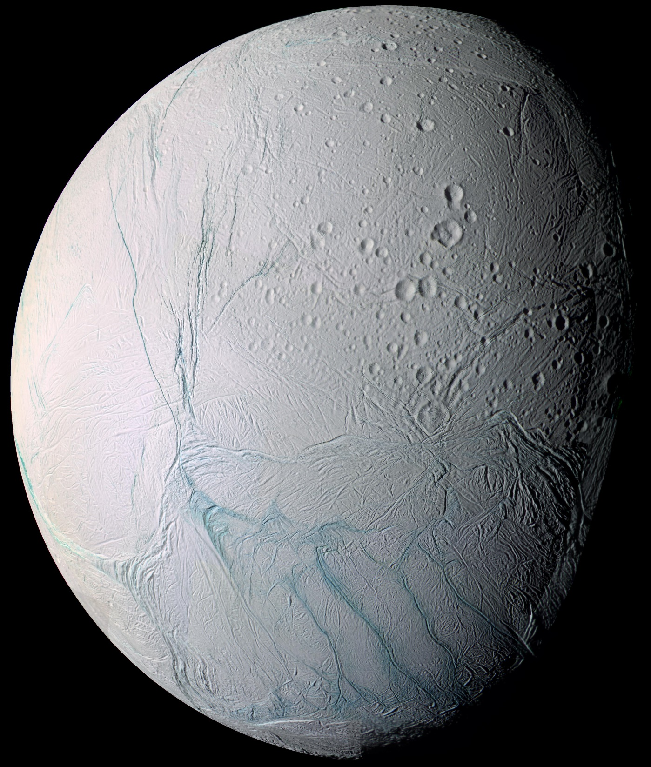



Modeling Tiger Stripes Heat Transfers on Enceladus
Daniel Raggio, Oleg Abramov

Slide 2
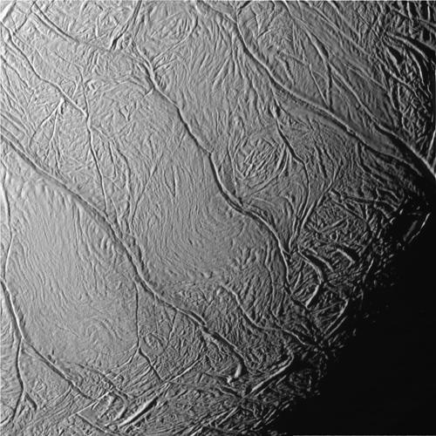
Introduction
Tiger Stripes discovered by Cassini
  Observed since 2005
Geologically active and young
Thermal Emissions
Possible theories on thermal activity.
  Tidal heating
Activity with liquid H₂O
  Vapor Plumes
Image Credit: NASA/JPL

Slide 3
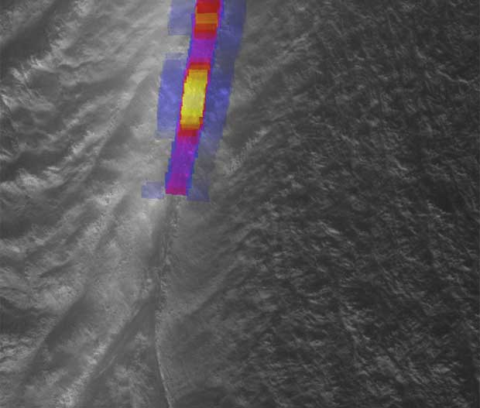
Introduction
Specific observations from CIRS and ISS of the Tiger Stripes
Modeling temperature transfers from the fractures over a surface
Determining the ideal temperature of tiger stripes
Using spacecraft geometry for modeling
Consider the topography of Enceladus into models
  Currently models over a flat surface.
Image Credit: NASA/JPL/SWRI

Slide 4
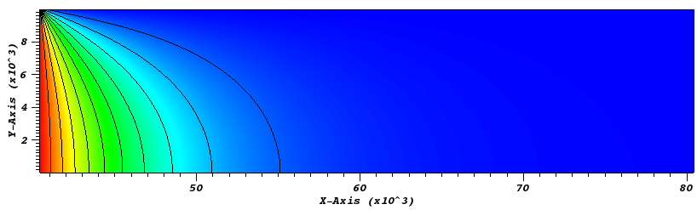

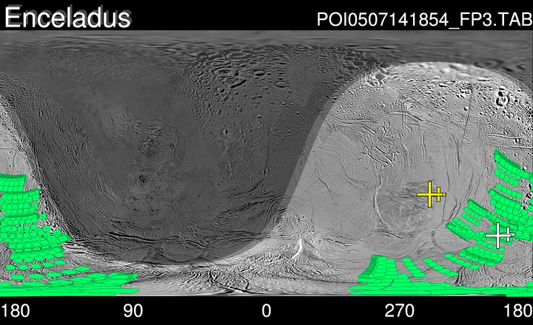
Data
Distance (km)
Consists of HEATING 7.3 Models
  Flat models, Digital Elevation Models (DEMs)
Modeled temperature and amount of regions
  Slight variation in temperature over distance
CIRS observations from PDS
  Allowed for spacecraft geometry to be determined
  CIRS footprint ~10 km (6.2 miles) for best results
Distance (km)

Slide 5
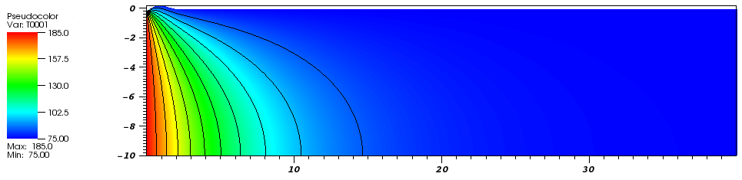
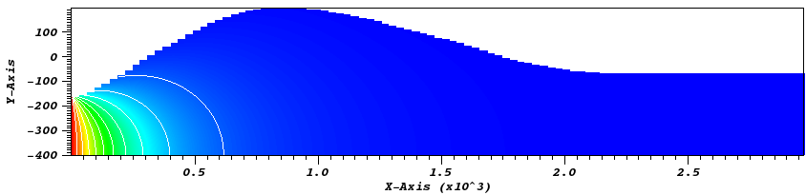
Analysis
Distance (km)
Distance (km)
Distance (km)
Distance (km)
Cross sectional heating models

Slide 6
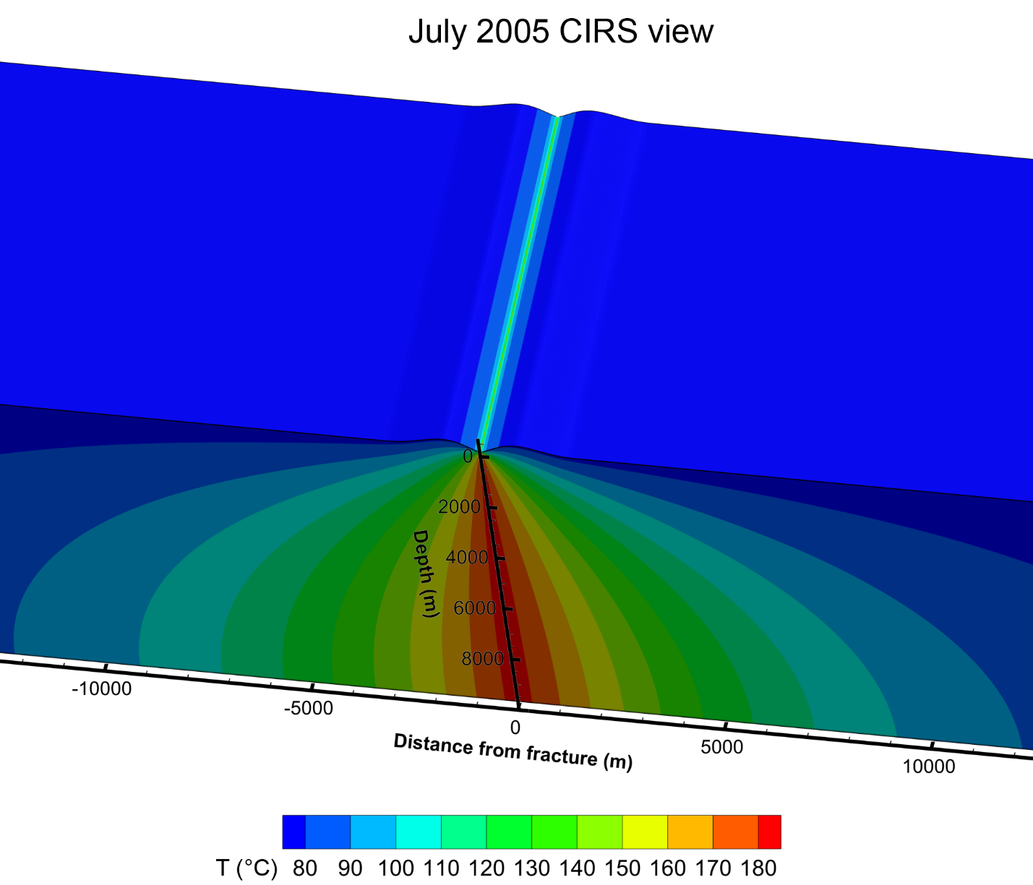
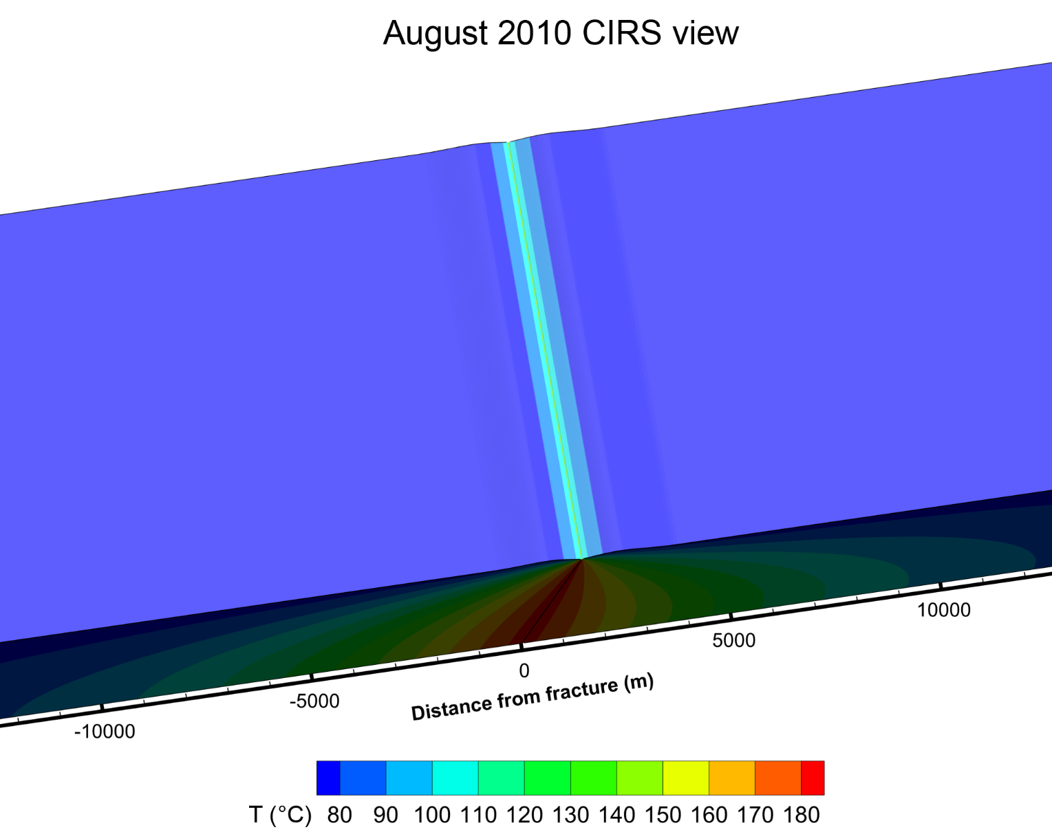
Analysis
Heating models with spacecraft geometry added.

Slide 7
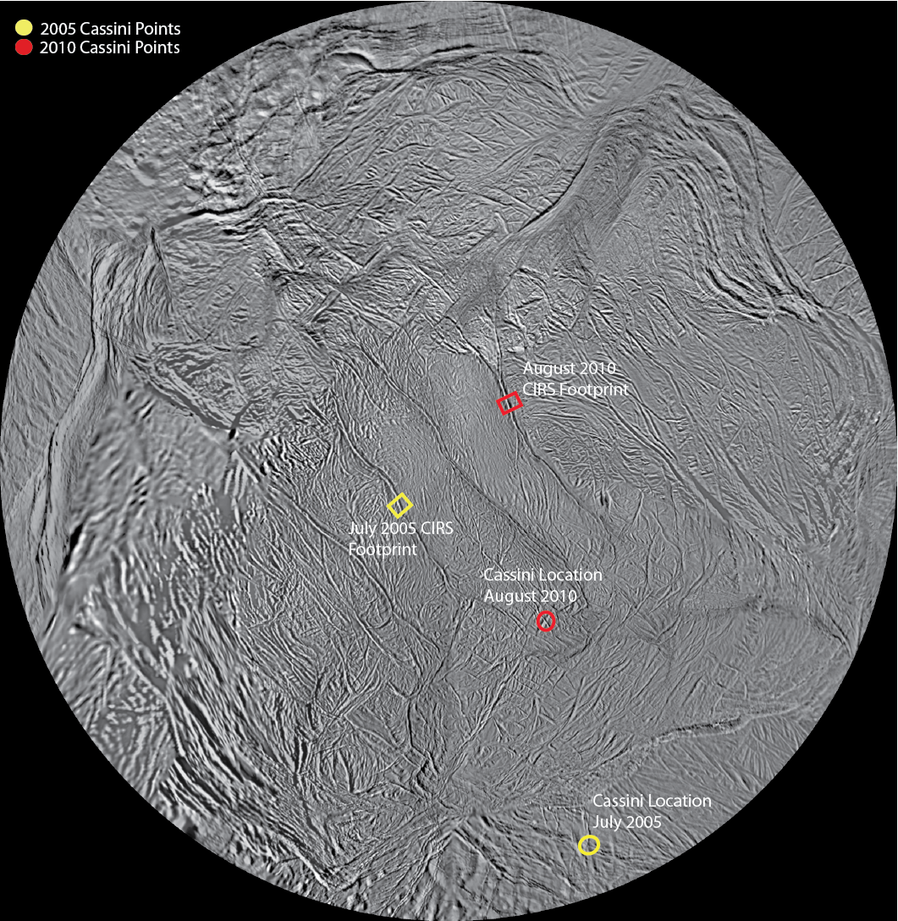
Conclusion
Future models will include spacecraft geometry
Modeling with average topographic profile of fractures continuing
  3D Modeling to consider spacecraft geometry as well
Consider sublimation of water ice from the surface into heating models in the future.

Slide 8
Acknowledgements
Arizona Space Grant Consortium
NAU and NAU NASA Space Grant
USGS and NASA
Dr. John Spencer, Southwest Research Institute
Dr. Paul Schenk, Lunar and Planetary Institute
Kathleen Stigmon
Dr. Oleg Abramov – Mentor

