Slide 1


Titan’s Haze Uncertainties and their Effects on Derived Surface Albedos
Tymon Khamsi, Caitlin Griffith, Lyn Doose, Jake Turner, Paulo Penteado

Slide 2
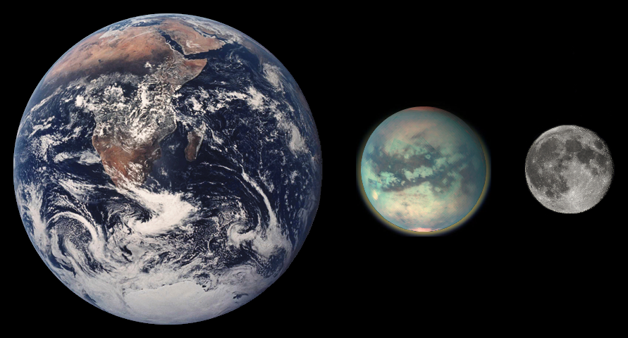
What/Where is Titan?

Slide 3
Why Study Titan’s Atmosphere?
Simpler model of earth
Single circulation cell
Methane cycle: analogous to Earth’s water cycle
Unexplained Methane
Age of atmosphere unknown
Without constant supply, liquid & atmospheric methane will break down within million years
Formation vs. recent volcanism

Slide 4
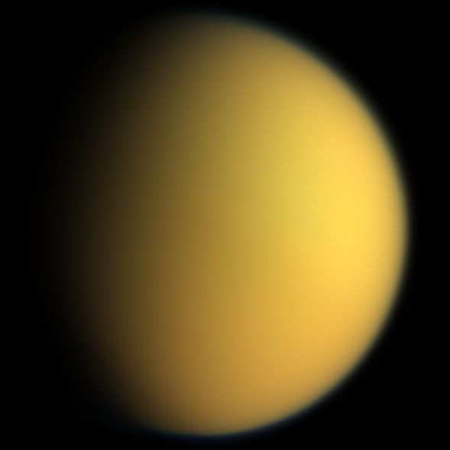
Titan’s Atmosphere
9.48% nitrogen 1.6% methane
Methane photolysis forms hydrocarbon haze
Responsible for orange appearance
Possible prebiotic source
Opaque to visible, near-IR wavelengths

Slide 5
Approach
Radiative Transfer spectra model (Griffith et al, 2011)
Model parameters measured in situ by Huygens Probe (2005)
Single Scattering Albedo
Ratio of scattering to total extinction
Optical Depth
Low optical depth = high visibility (low chance of interaction)
Haze Scaling Factor (hfac)

Slide 7
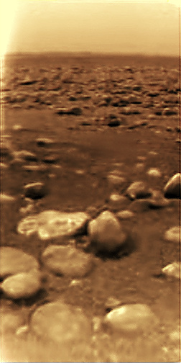

Slide 8
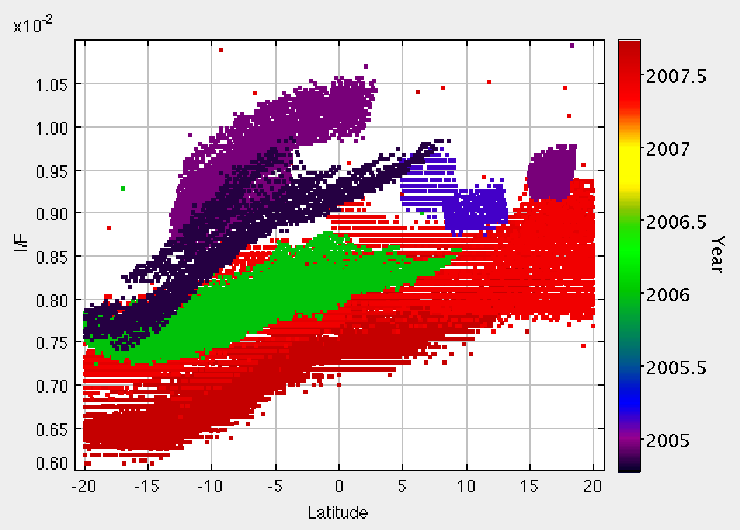
Results
Consistent with seasonal atmospheric circulation described in Rannou et. at. 2006

Slide 9
Results/Analysis
Possible explanation: haze physical properties are changing

Slide 10
Results/Analysis
Tried: increasing model’s single scattering albedo parameter
Question: what could cause more scattering and less extinction?

Slide 11
Conclusions
Increase in mean atmospheric particle size from 2005 – 2007
Current models do not account for this
Possible explanation: selective circulation

Slide 12
Acknowledgments
Dr. Caitlin Griffith
Paulo Penteado
Robert Zellem
Arizona Space Grant Consortium
NASA
The University of Arizona

