Slide 1
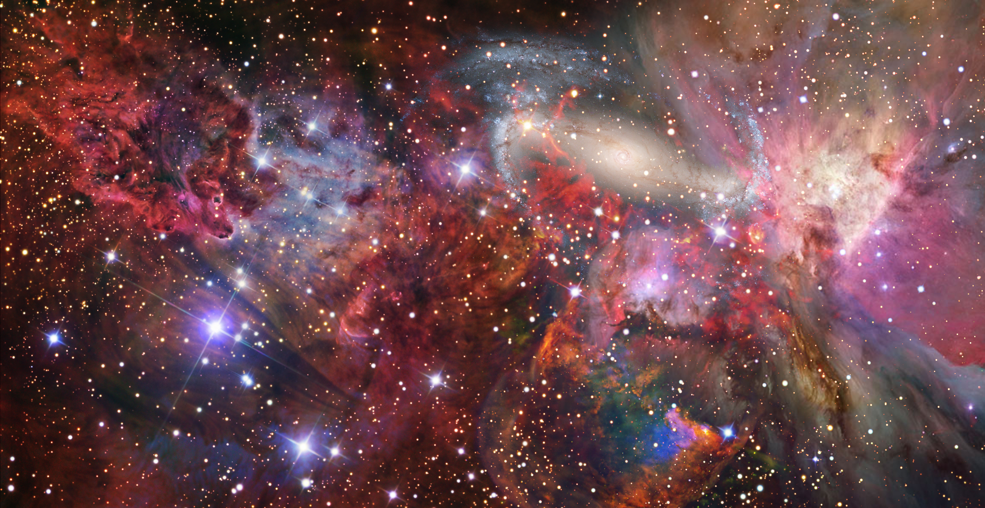
On the Mass and Radius Relationship for Rocky Exoplanets
Alejandro Lorenzo^{[1]}, Steven Desch^{[1]}, S.H. Shim^{[1]}, Dillon Nys^{[1]}
School of Earth and Space Exploration, Arizona State University

Slide 2
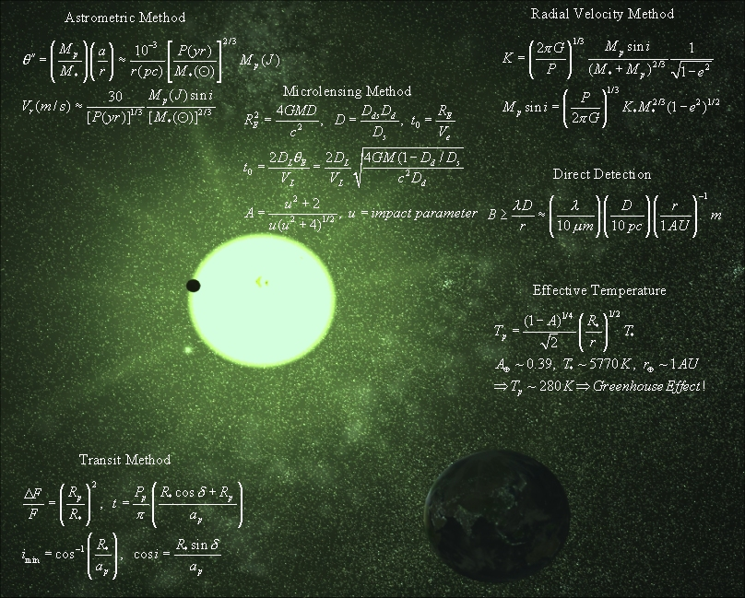
How to Find a Planet
Transit Method (Tess,Kepler,CoRoT)
Detect variations in host star brightness
Astrometric Method (Hipparcos, Gaia)
Detect periodic stellar astrometry
Microlensing
Planets found in lensing star system during microlensing event
Direct Imaging
Finds planets around young stars or giant planets around cool stars

Slide 3
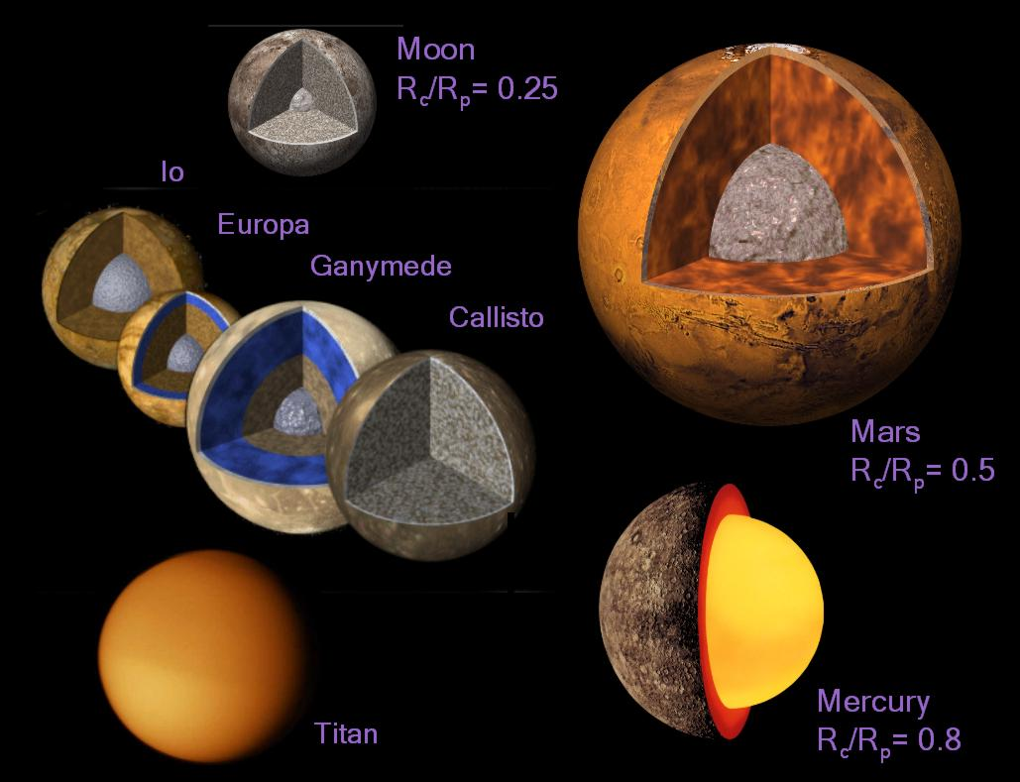

Next Steps
Questions:
Planet composition?
Interior structure?
Magnetic Field?
Atmosphere?
Habitability?
Life?

Slide 4
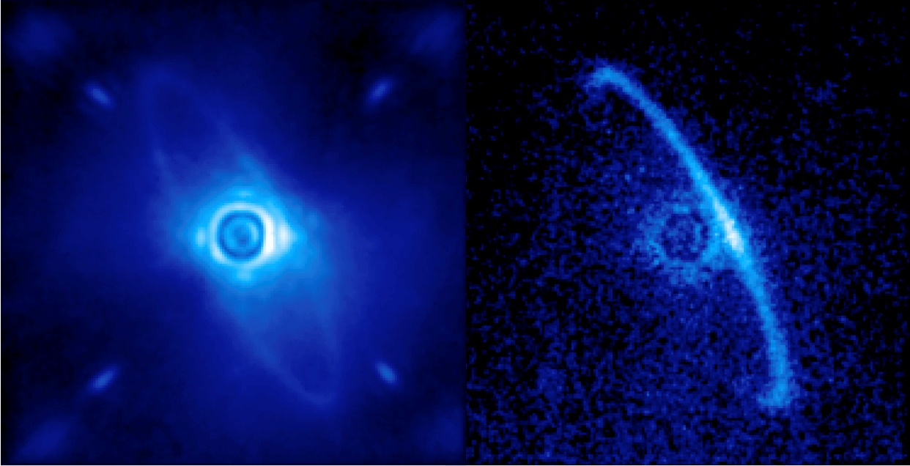
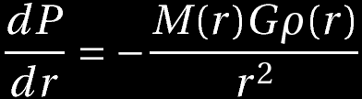


Methods
Numerically integrate equation of H.S.E, to find pressures at depth
Use inverted Third order BME or modified polytrope to find new densities
credit:GPi
Adjust layers to conform to new densities, iterate to convergence

Slide 5
Methods
Iterate through layers

Slide 6
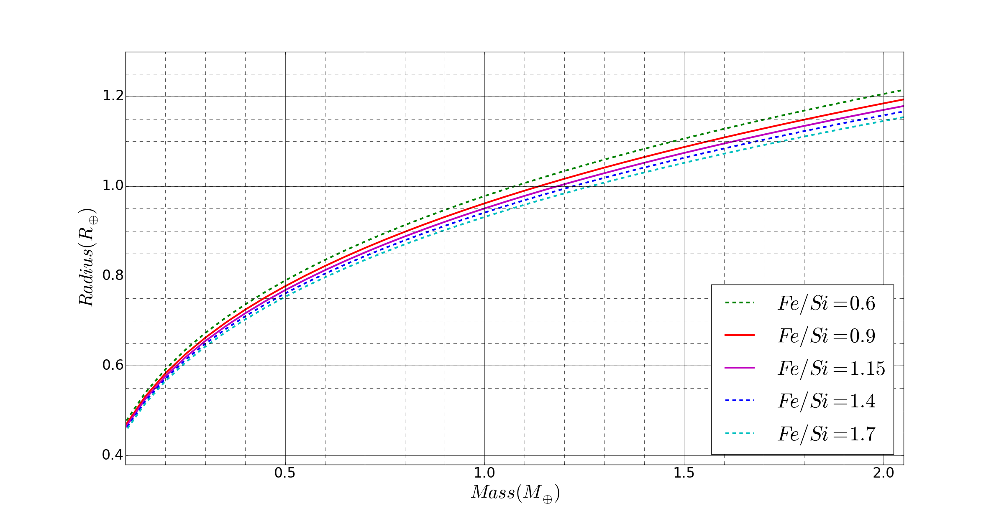



Results
Mass v Radius for 0.1-2.1 MEarth Planets
Core- ϵ-Fe ; Mantle: SiO₂ ,(Mg,Fe)O, (Mg,Fe)SiO₃

Slide 7
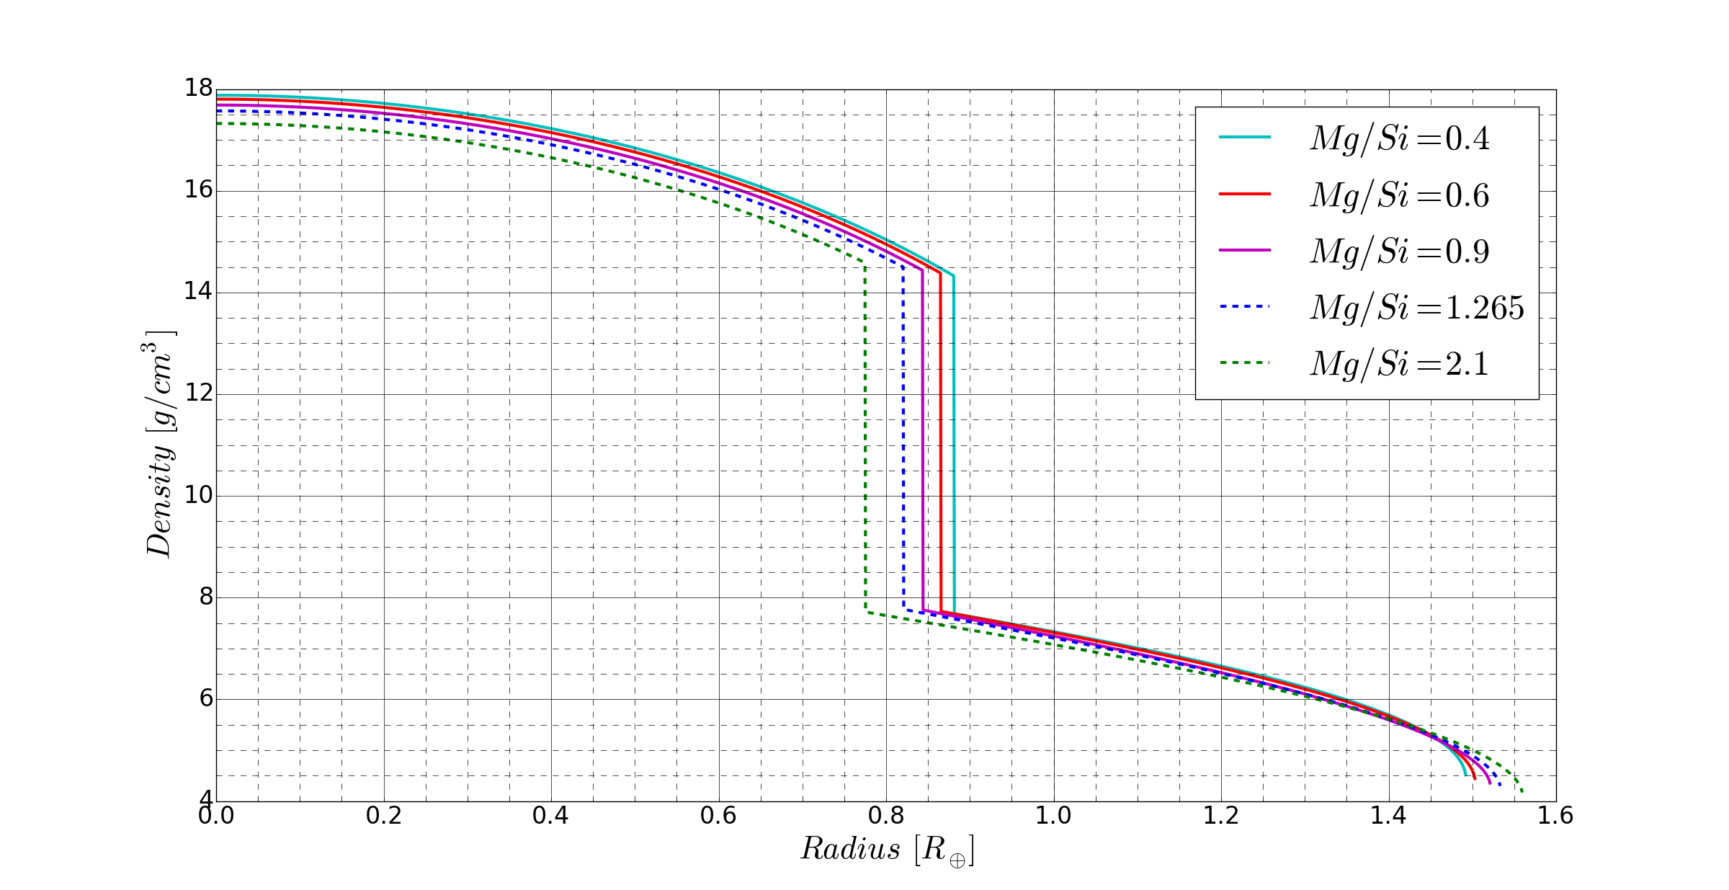
Results
Task:
-vary composition and structure
-relate observables to theoretical models
(Fe/Si, Mg/Si ect.)
Goals:
-test the sensitivity of the final radius to these permutations
Radius v Density for 5 MEarth Planets

Slide 8
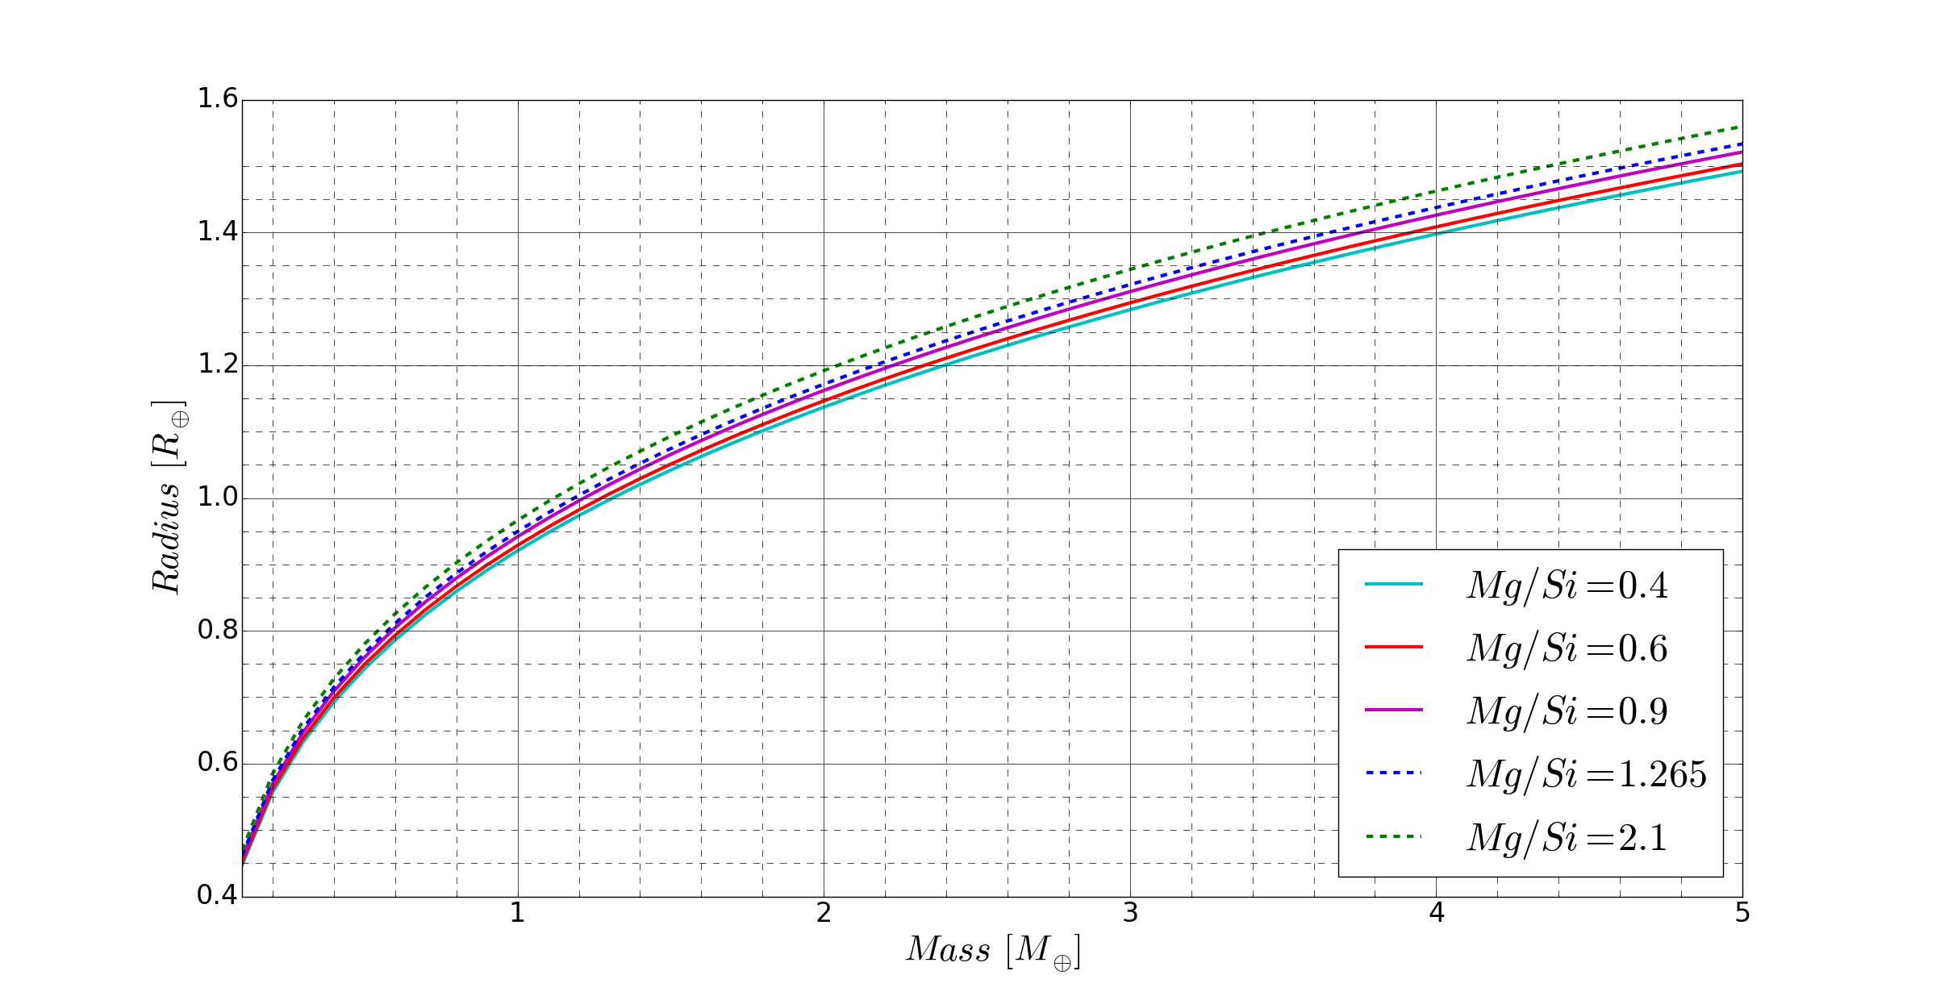
Results

Slide 9
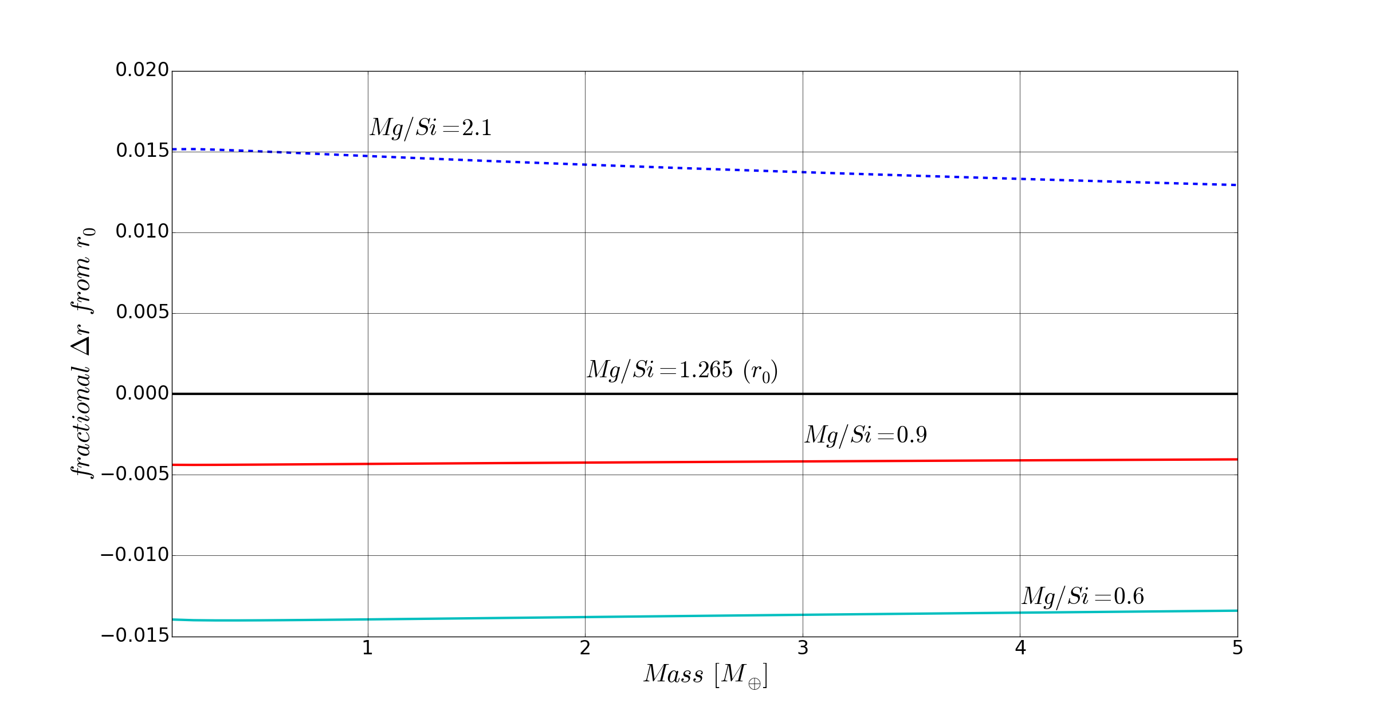
Results

Slide 10
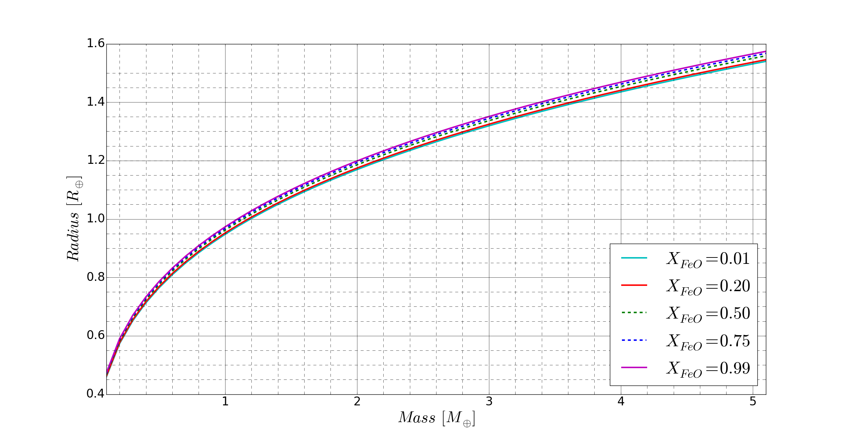
Results

Slide 11
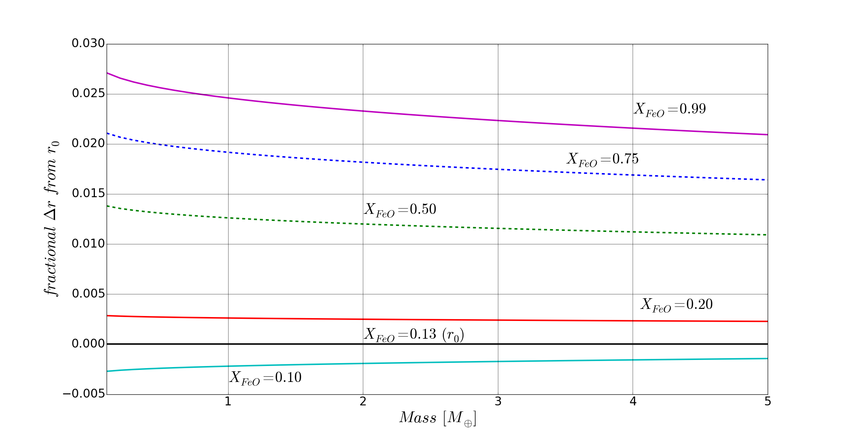
Results

Slide 12
Conclusions
By reasonably extrapolating equations of state, we have calculated for the compression of materials within a planet using a regime that takes into account dense polymorphs and differentiated layers.
We have built a user friendly program in Python to carry these calculations.
With this program we may consider many models and put constraints on plausible observations.
We are developing a game using the Unity 3D game engine that will provide the animations to this model
  We are working on eventually adapting it into ASU’s Habitable Worlds course

Slide 13
But wait, There’s More
Exobuilder!

Slide 14
