Slide 1
Avoiding Planetary Rover Damage by Automated Path Planning
Michael Flammia
Mentor: Dr. Wolfgang Fink
Tempe, AZ
April 18th, 2015
Notes:
Add where it is, when it is the date

Slide 2
Outline
Introduction
Rover Traverse-Optimizing Planner (RTOP)
Generating Terrain Data Maps
Simulation Setup
Results
Conclusion and Outlook

Slide 3
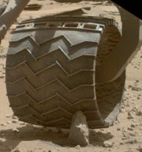
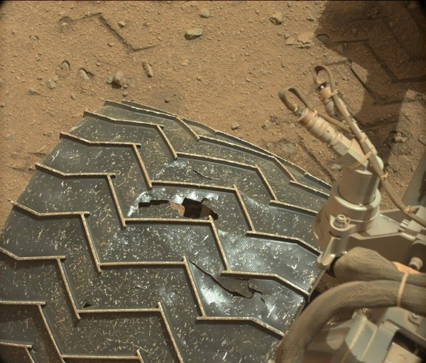
Introduction
Orbital mapping of terrain for path planning.
After 3 km. images showed wheel damage.
Planetary scientist use terrain data to laboriously plot ideal path to Mount Sharp.
Curiosity arrived at mount sharp and readies to ascend the mountain.
[Image Credits: NASA/JPL-Caltech/MSSS]
Notes:
Cite Photo on the right

Slide 4
Rover Traverse-Optimizing Planner (RTOP)
Rover Traverse Optimizing Planner (RTOP).
Automated system to rapidly generate optimal rover traverses.
Uses Stochastic Optimization Framework (SOF; Fink 2008).
Accounts for less defined and changing real world environments.
Minimized traverse length while optimizing user-defined mission constraints.

Slide 5
SOF as applied to RTOP
In case of traverse path optimization, SOF minimizes Euclidian distance, but lets the path wander while optimizing for user-defined mission constraints.
Generated traverses are compared against the constraints and optimization is reiterated a user-defined number of times.

Slide 6
Generating Terrain Data Maps Terrain Roughness
Generated in MATLAB.
Starts from a matrix of “random white noise”.
Expands pixel of white noise to adjacent and diagonal pixels.
Runs a user defined number of times.

Slide 7
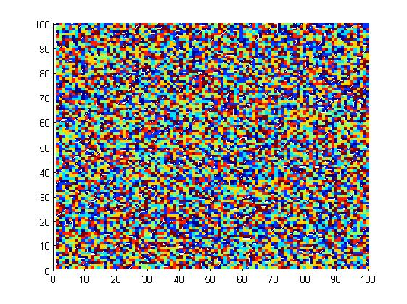
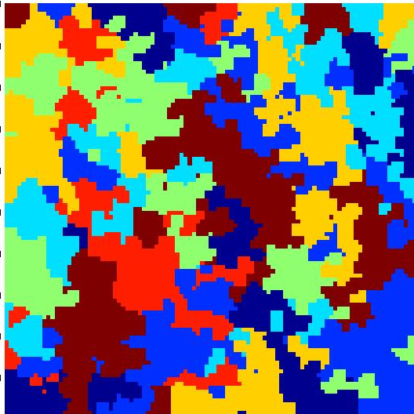
Generating Terrain Data Maps Terrain Roughness cont.
Seed: Iteration #0
Final: Iteration #100,000

Slide 8
Generating Terrain Data Maps Altitude Generation – Random Averaging
Approach #1:
Start with a matrix randomly populated user defined numbers.
A random point in matrix and set that point equal to the average of its diagonals.
Set the points above, below, left of, and right of the center to the average of the values vertical to or horizontal to the element.
Runs user defined number of iterations.
(1)
(2)
(3)

Slide 9
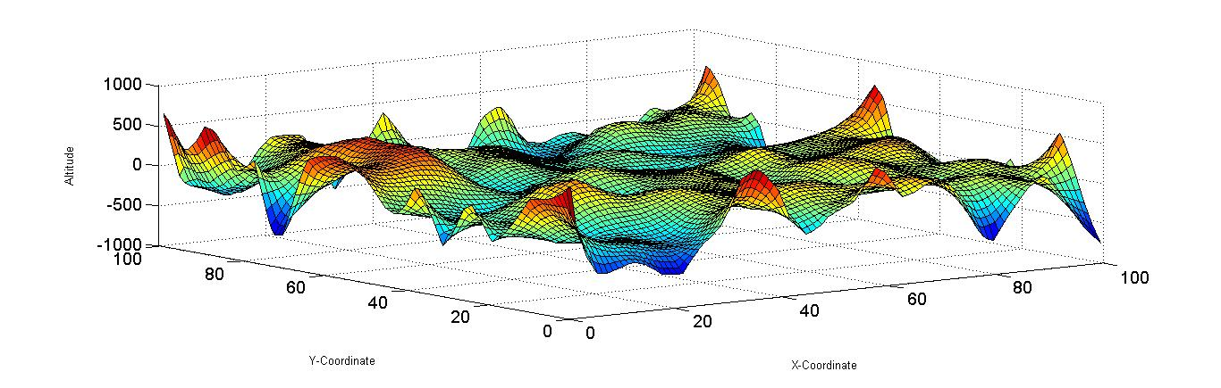
Generating Terrain Data Maps Random Averaging – Final Altitude Map

Slide 10
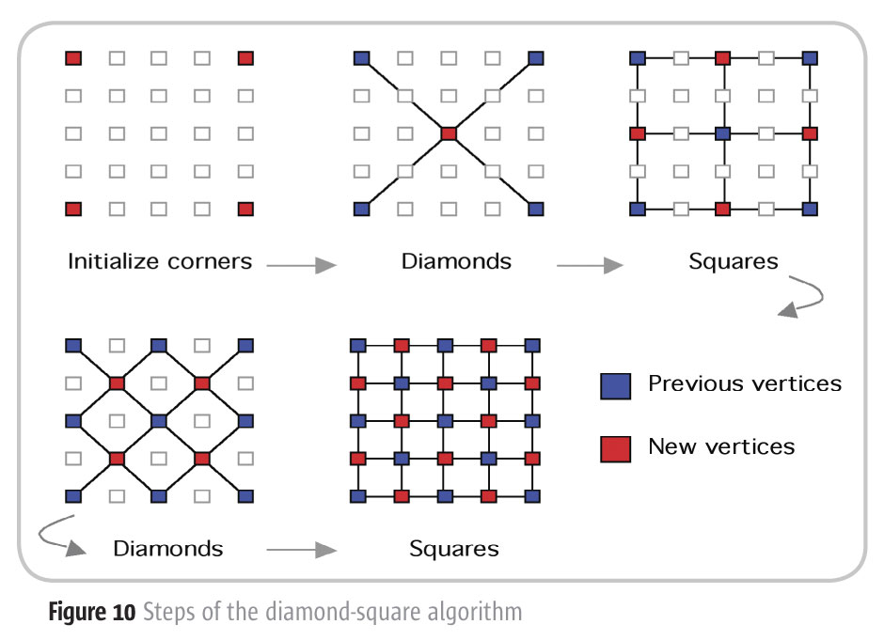
Generating Terrain Data Maps “Diamond Square” Algorithm (Fournier 1982)
Approach #2:
Figure Credit:https://java.sys-con.com/node/46231/print

Slide 11
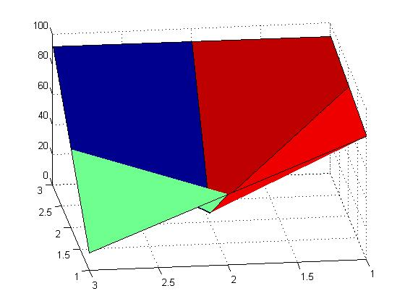
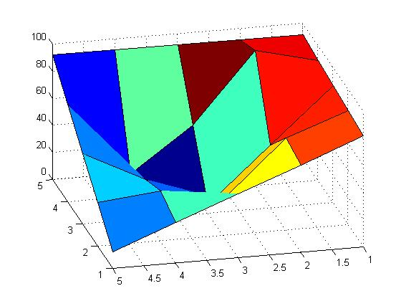
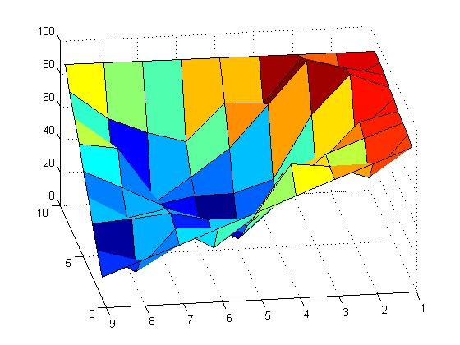
Generating Terrain Data Maps “Diamond Square” Iteration Number
(1)
(2)
(3)

Slide 12
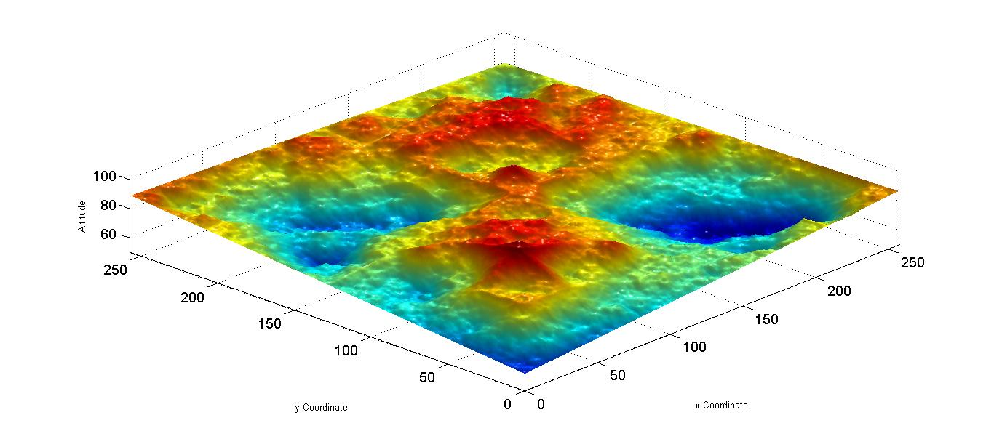
Generating Terrain Data Maps “Diamond Square” – Final Terrain

Slide 13
Generating Terrain Data Maps Comparison Between Algorithms
Random Averaging
Diamond Square
Less complicated and larger code (~80 lines)
Very slow to run..
Generates smooth terrains
No limits to matrix side length.
More complicated code but smaller (~50 lines)
Much faster to run.
Generates more realistic terrains.
Limited to a matrix with (2^n) + 1 sides.

Slide 14
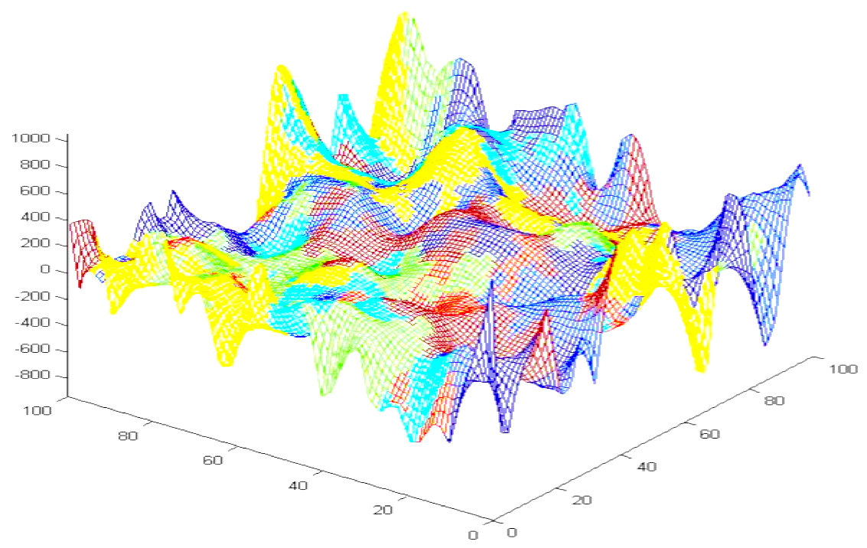
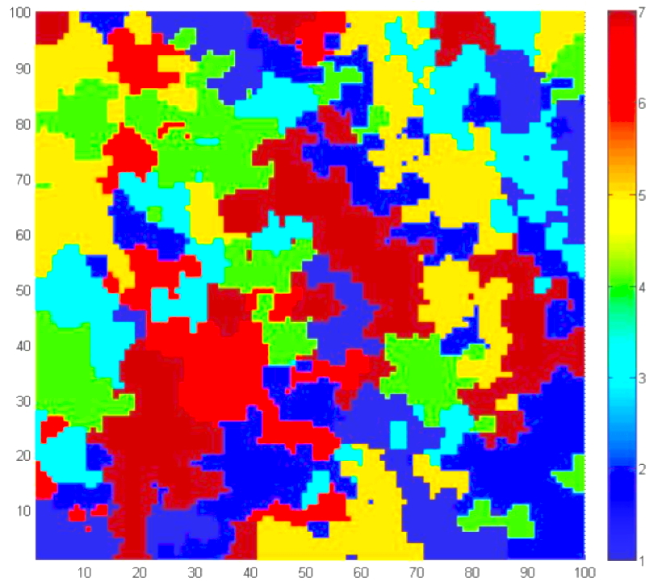
Simulation Setup
3D Terrain Map with Altitude/Slope Data
Associated 2D Terrain
Roughness/Traversability Map

Slide 15
Simulation Setup
We optimized rover traverses for six possible constraints:
#0: No mission constraints;
#1: Minimum traverse length;
#2: Minimum average terrain roughness;
#3: Maximum average terrain roughness;
#4: Minimum average terrain slope;
#5: Maximum average terrain slope.
All traverses have same start/end coordinates.
To optimize scenarios #0–#5, 100,000 iterations of RTOP were executed, respectively (~85s on MacBookPro 2.8 GHz Intel Core 2 Duo).

Slide 16
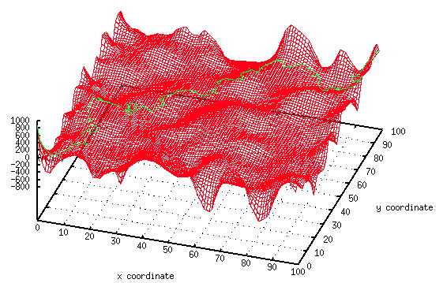
Results:
Scenario #1: Shortest Traverse Length

Slide 17
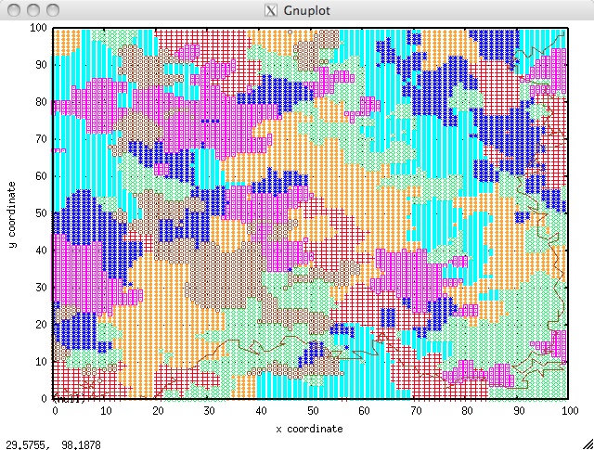
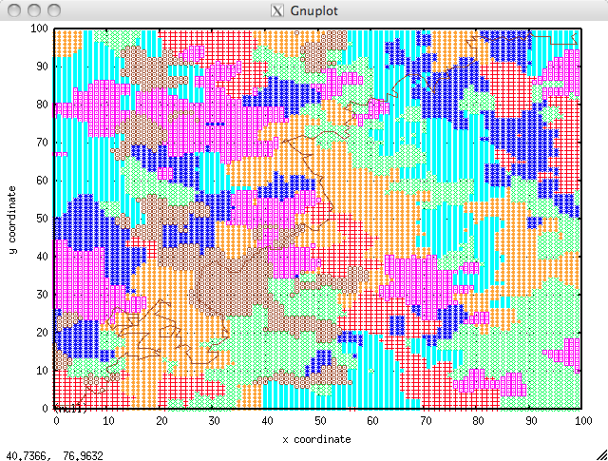
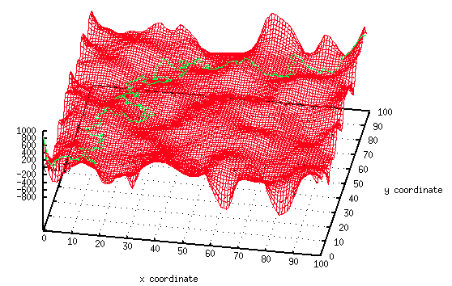
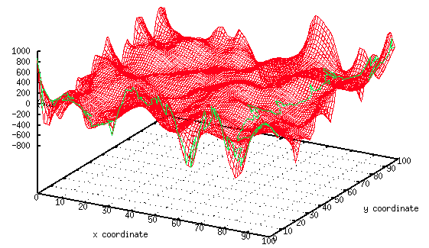
Results:
Scenarios #2-5: Minimum vs. Maximum Average Terrain Roughness
Minimum average terrain roughness
Maximum average terrain roughness
Minimum average terrain slope
Maximum average terrain slope

Slide 18
Results:
Scenarios #4-5: Minimum vs. Maximum Average Terrain Slope
Minimum average terrain slope
Maximum average terrain slope

Slide 19

Results:
Scenarios #2-3: Min. vs. Max. Average Terrain Roughness
Minimum average terrain roughness
Maximum average terrain roughness

Slide 20
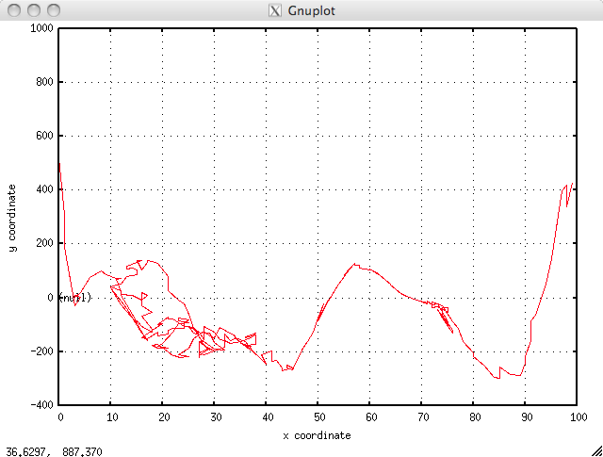
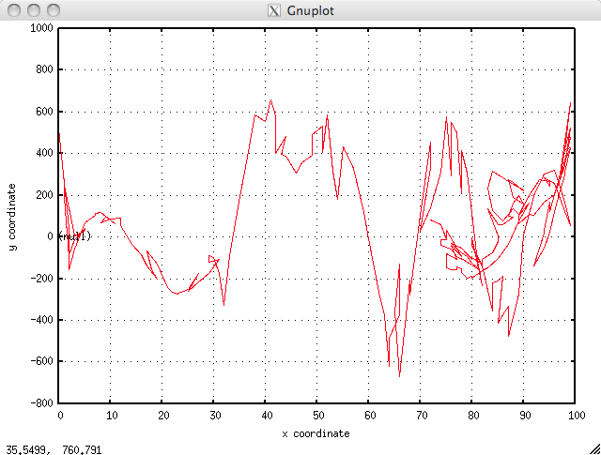
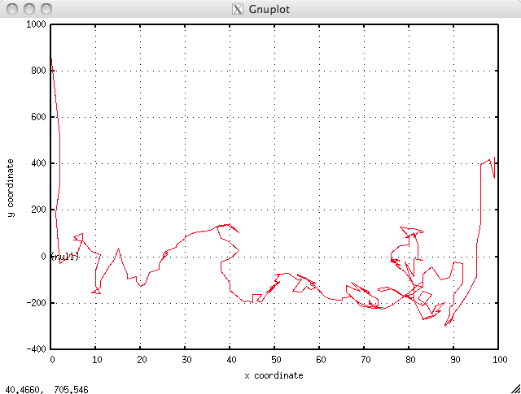
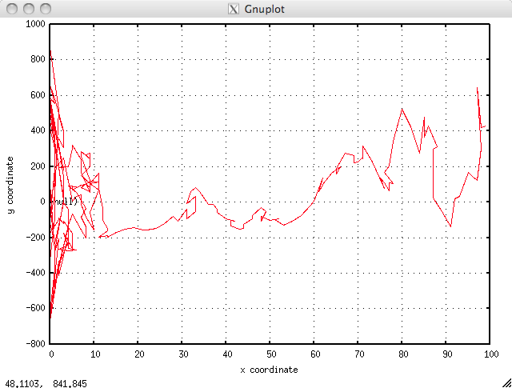
RTOP Results:
Scenarios #4/5: x/z-plane and y/z-plane traverse profiles
Minimum average terrain slope
x/z-plane traverse profile
Maximum average terrain slope
x/z-plane traverse profile
Minimum average terrain slope
y/z-plane traverse profile
Maximum average terrain slope
y/z-plane traverse profile

Slide 21
RTOP Results:
Summary of Simulation Results for Scenarios #0-#5

Slide 22
Conclusion and Outlook
RTOP can optimize for several different user-defined mission constraints simultaneously.
Main traverse path can be split into several segments, each with its own goal/scenario.
Frequent mission replanning can occur based on terrain data gathered in-situ.
Apply RTOP to real Mars topographic and associated terrain roughness/traversability data.
Compare RTOP-results to traverses chosen by mission planners.

Slide 23
Acknowledgements
U of A Space Grant Consortium
Dr. Wolfgang Fink and the Visual and Autonomous Explorations Systems Research Laboratory at Caltech and the University of Arizona
UA Space Grant Intern Advisors

