Slide 1
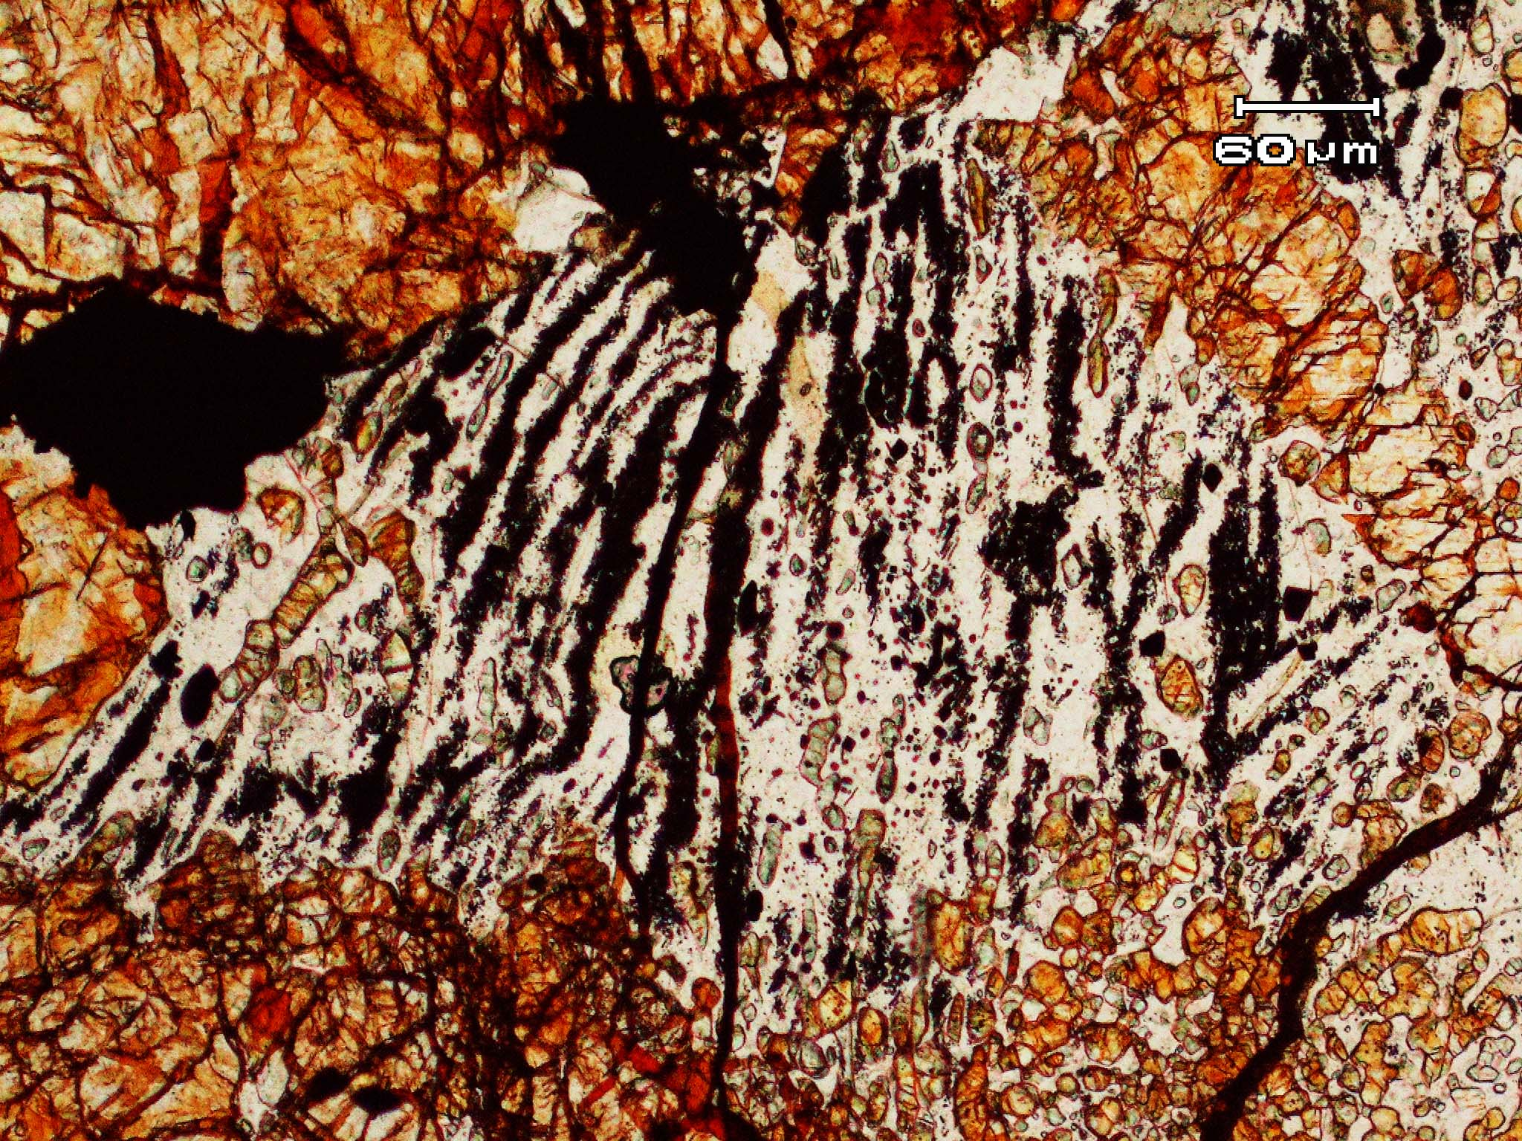
ACFER 040 Maskelynite With Disseminated Chromite
B. Walker, J.Hu, T.G. Sharp

Slide 2
Introduction
Meteorites are fragments of asteroids and planets.
Shock metamorphism is common in some meteorites.
    shock classification S1-S6
    records the impact history of meteorite parent bodies.
Deformation and transformation features, including high pressure minerals (S6).
Plagioclase-Chromite assemblages have been proposed to be common shock feature in chondrites (Rubin, 2003)

Slide 3
Plagioclase-Chromite
Interpreted to survive post-shock annealing (Rubin, 2003)
    High pressure minerals do not survive high post-shock temperatures.
Rubin did not describe highly shocked S6 chondrites.
We are investigating plagioclase-chromite assemblages in highly shocked chondrites (S6) to understand their origin.

Slide 4
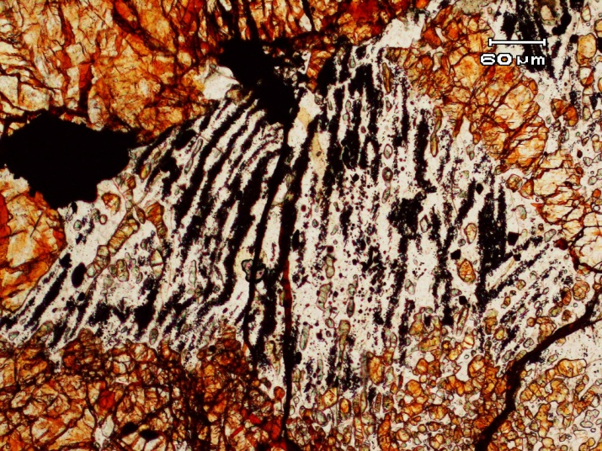
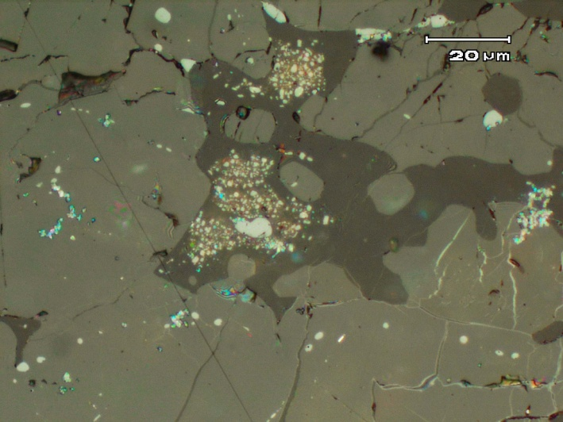
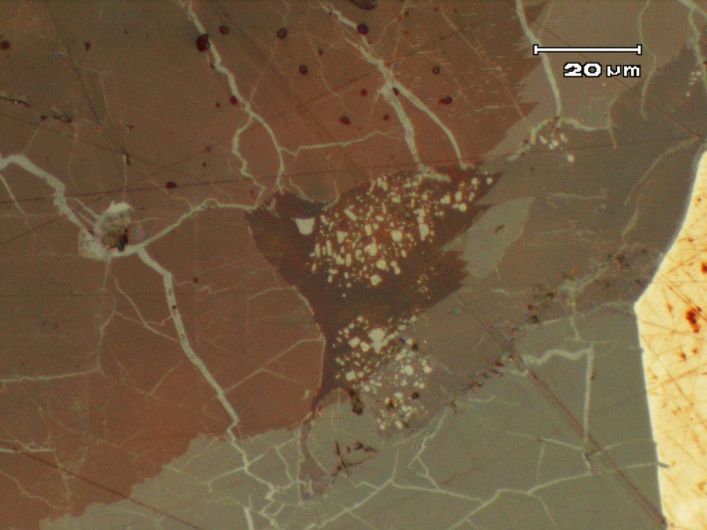
Samples and Methods
A unique relationship of plagioclase with disseminated chromite observed in multiple samples:
  ACFER 040
      Strongly shocked meteorite shock stage 6
  NWA 757
      LL6 meteorite shock stage S4-S6
  RC 106
      Strongly shocked meteorite shock stage 6
Methods include; polarized and reflected light microscopy and EDS-SEM
Notes:
Make note that maskelynite that was transformed from plagioclase during metamorphism

Slide 5
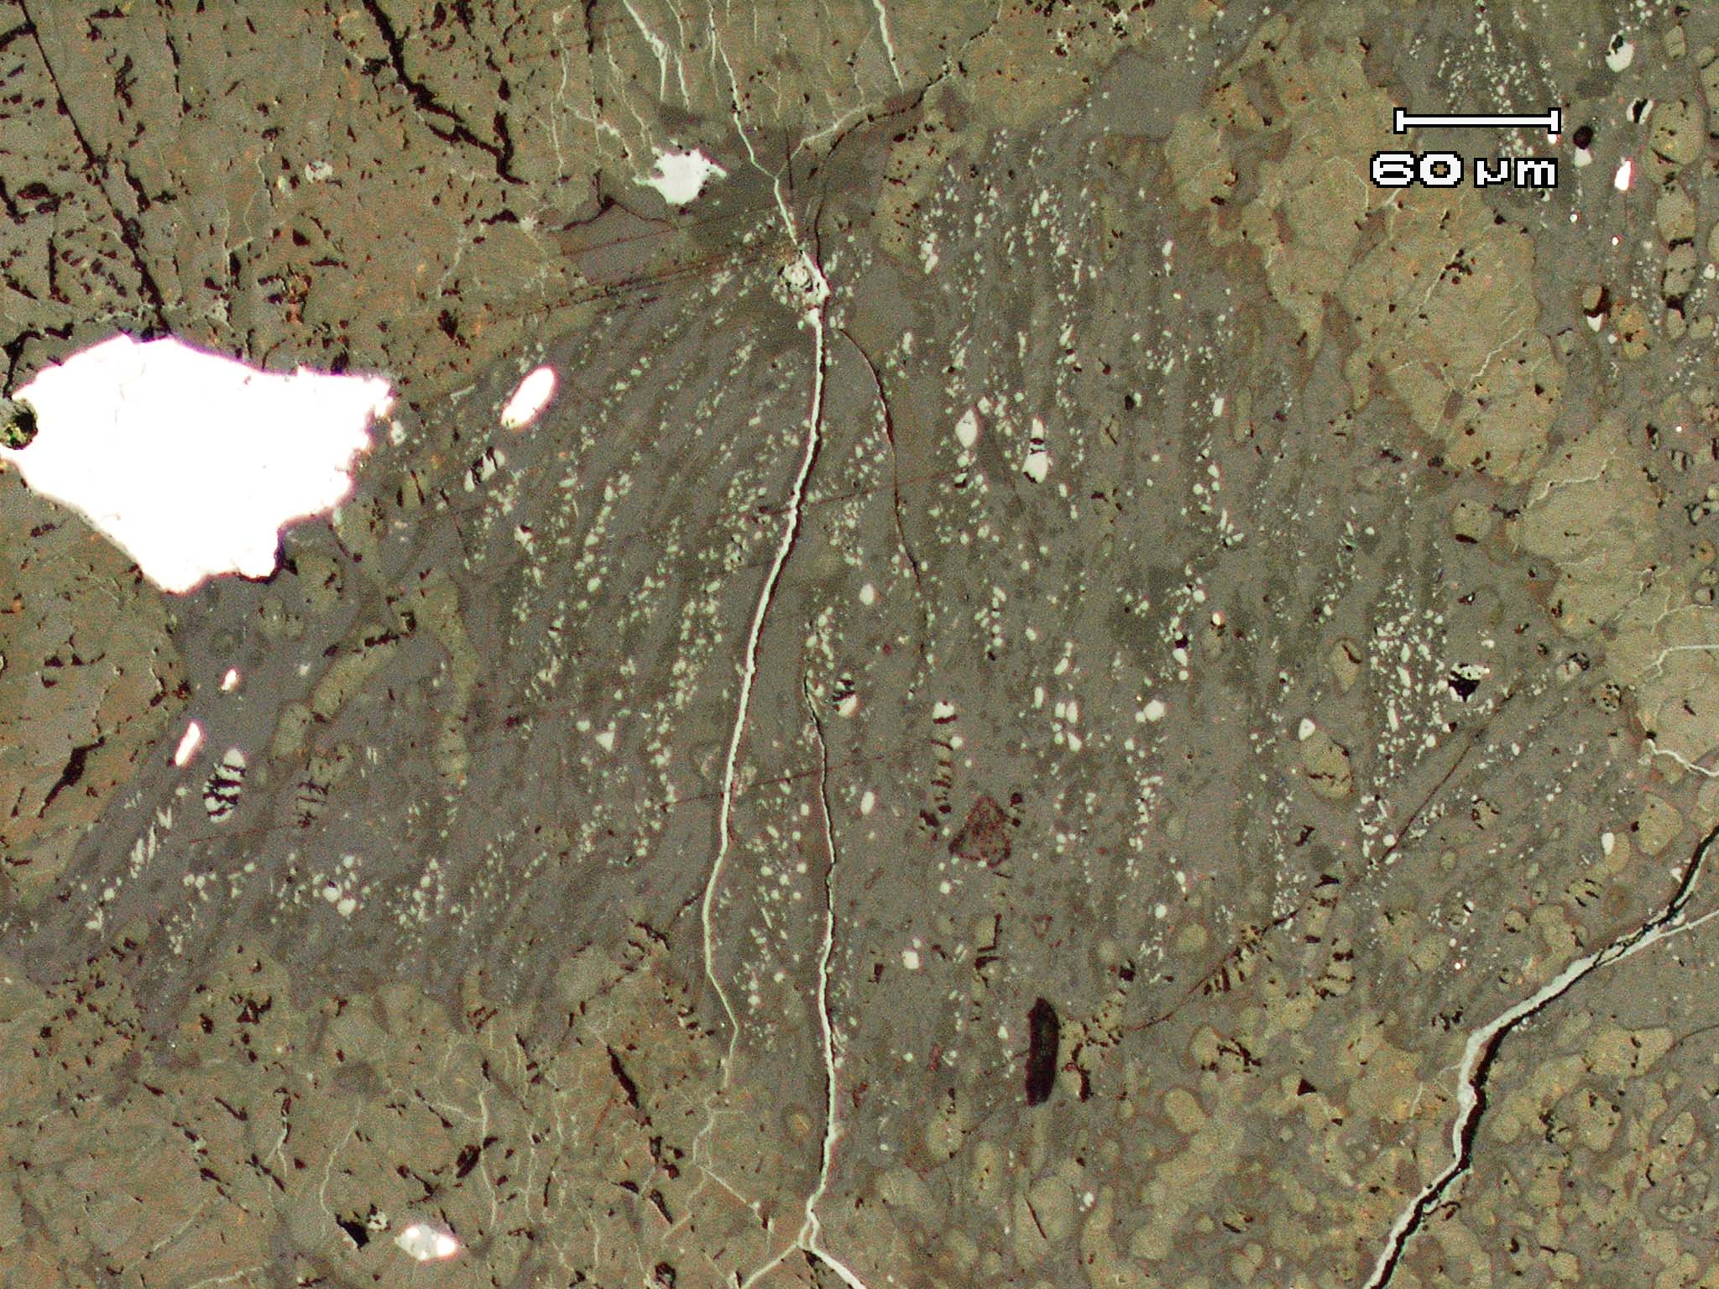
Optical Microscope
ACFER 040 Polarized light
ACFER 040 Reflected light
Notes:
Introduce what we are observing in polarized light and what we observe in reflected light

Slide 6
Scanning Electron Microscope
ACFER040
Notes:
Introduce what we observe SEM images, what we see, what this could mean

Slide 7
NWA 757 (SEM)
Notes:
Notice size variation of chromite is common in many samples. Also note that there are many areas of plagioclase without chromite in the same area where there is abundant amounts of disseminated chromite in plagioclase

Slide 8
ACFER 040 (SEM)
Notes:
Notice the plagioclase-chromite is not randomly disseminated. It has clean well defined boundaries between plag-chromite assemblage and plagioclase without chromite. Also not the orientation of the chromite and

Slide 9
SEM
ACFER 040
Notes:
Notice clear boundaries between plagioclase with disseminated chromite and plagioclase without chromite

Slide 10
Composition Average (At%)
ACFER 040
NWA 757
Isolated Plagioclase
Isolated Chromite
Chromite disseminated in Plagioclase
O | Na | Al | Si | K | Ca
54.91 | 6.67 | 9.82 | 27.21 | 0.64 | 0.75
O | Na | Al | Si | K | Ca
56.82 | 6.49 | 9.53 | 26.02 | 0.51 | 0.81
O | Mg | Al | Cr | Fe
55.58 | 3.41 | 4.25 | 21.03 | 12.46
O | Mg | Al | Cr | Fe
56.02 | 1.6 | 4.395 | 20.99 | 12.82
O | Mg | Al | Cr | Fe
55.64 | 2.42 | 4.09 | 22.28 | 12.75
O | Mg | Al | Cr | Fe
59.03 | 1.41 | 4.56 | 18.75 | 11.69

Slide 11
Discussion
The abundance of the plagioclase-chromite assemblage is dependant on the abundance of chromite in the meteorite prior to the configuration of the assemblage.
Defined boundaries between pure plagioclase and plagioclase with disseminated chromite suggest preexisting variations in chromite content.
Euhedral to subhedral chromite crystals are commonly equant and elongate suggesting crystallization in a melt or re-crystallization.

Slide 12

Conclusion
Did these features form during shock or in pre-shock thermal metamorphism?
  If formed during pre-shock metamorphism, why didn’t the crystals coarsen by Ostwald ripening?
  These assemblage is not commonly reported in un-shocked meteorites.
  Characterize chromite-plagioclase in un-shocked type 6 chondrites.
Do these textures survive thermal metamorphism?
  Observe highly shocked melt breccias to investigate post-shock annealing

