Slide 1

Aggregate Analysis In A CubeSat Centrifuge: A Study Of Primary Accretion
Sarah Smallwood
Faculty Mentor: Erik Asphaug, School of Earth and Space Exploration
Graduate Student Mentor: Elizabeth Dyer
SpaceTREx Laboratory, Arizona State University
Arizona Space Grant Consortium Symposium
April 18, 2015

Slide 2
Presentation Outline
The Conception of AOSAT
Initial Approach
Results
Project Evolution
Conclusion
Future Work

Slide 3
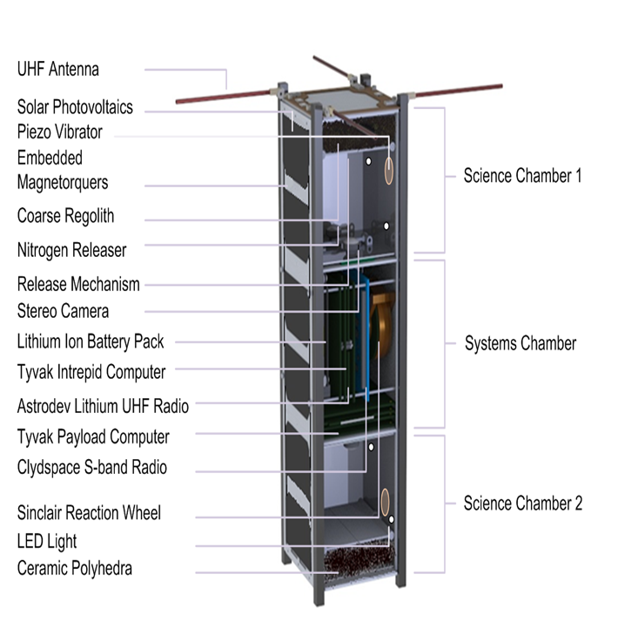
The Conception of AOSAT
Initial Motivation: gain a deeper understanding of primary accretion
Initial Objectives: use a low-cost platform to perform isolated dust coagulation experiments
Initial Challenges: grain size

Slide 4
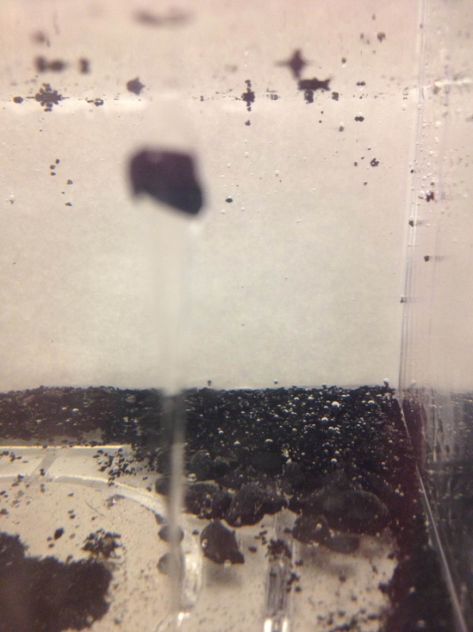
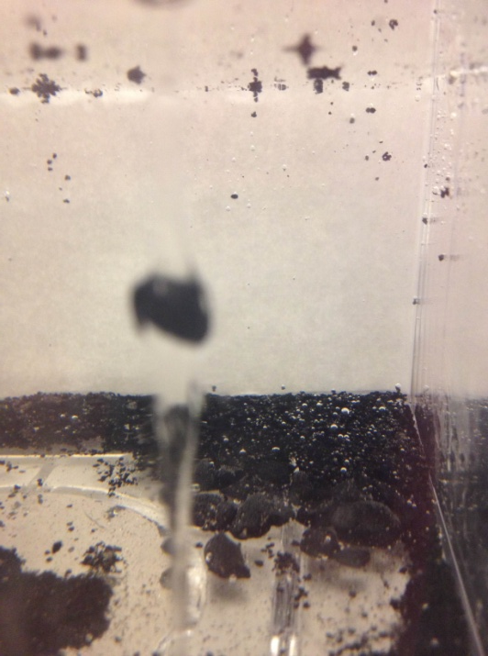
Initial Approach
Simulate primary accretion by revolving CubeSat containing pulverized chondritic meteorite fragments within an isolated chamber
Image the resulting grain coagulation and run the data through the optical flow code
Utilize flow algorithm to reduce data downlink costs
Imaging Methods & Simulations
Sample Image 1 Sample Image 2
Sample Image(s) 1 and 2: progression of a grain falling through liquid medium, 2 seconds apart

Slide 5
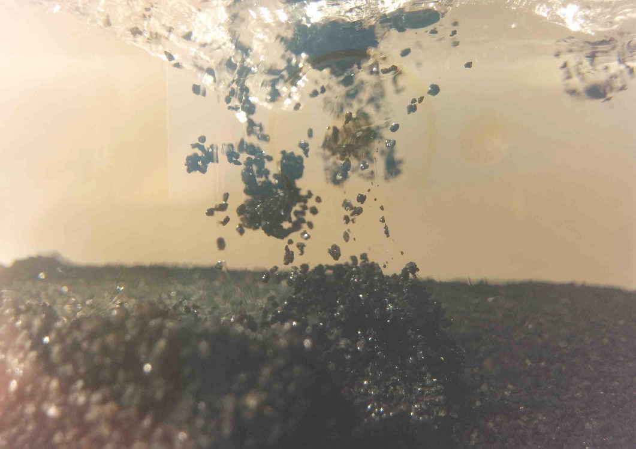
Results
Single image of gravel flow from corn-syrup particle test

Slide 6
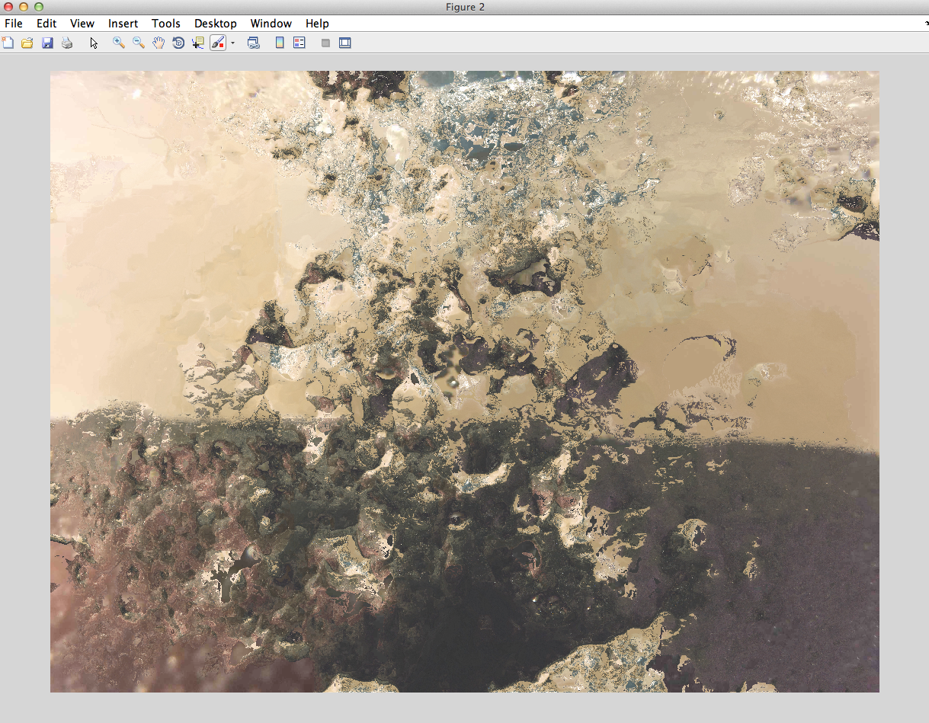
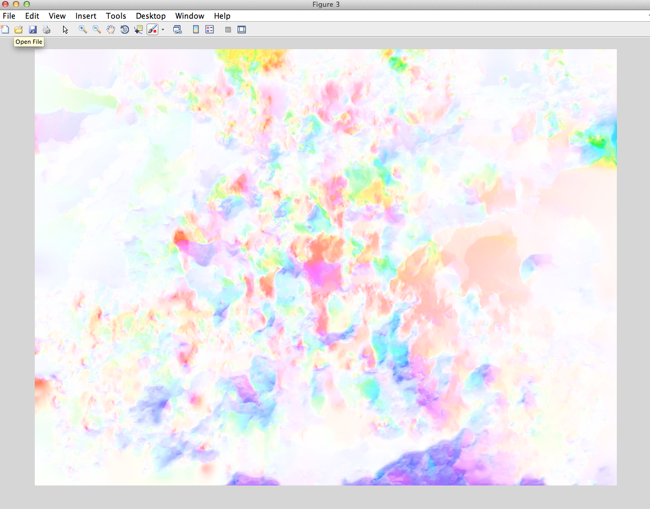
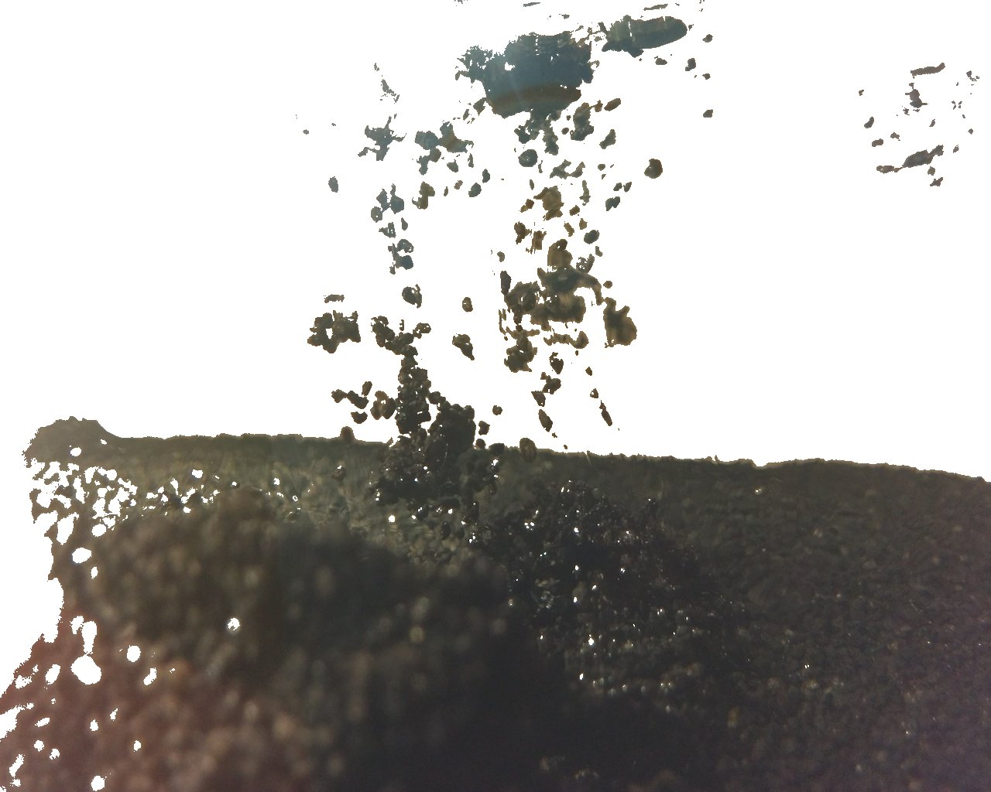

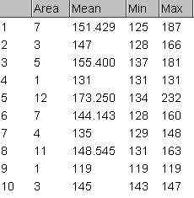
Image 1a: single image from test, run through code with additional image, 6 seconds apart
Image 1b: after particle disruption, yielded flow field in the downward direction
Image 1c: flow field and particles of interest colorized
mm = (pixel count*25.4 mm in an in.)
DPI
Figures 3a, 3b: Data collection in ImageJ
Image 2a: single image above with background changed to white to isolate pixel neighborhood
Image 2b: single particle isolated from previous image for pixel counting

Slide 7
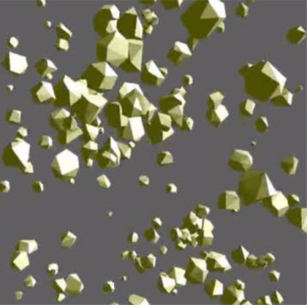
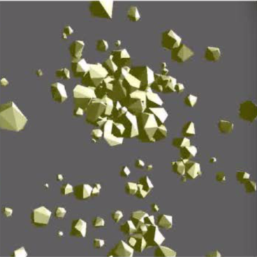
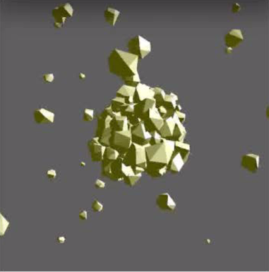
Project Evolution
Merit and Feasibility Review:
  Micron size grains too small
New science objectives:
  Transition from aggregate analysis to asteroid surface analysis
  Replace meteorite fragments with 3D printed colored polyhedra
  Reduce size from two chambers to one
NASA ELaNa proposal was accepted
Figure 4: timesteps from a ruble-accretion simulation using polyhedral rubble pile elements

Slide 8
Conclusions
Evolution of a research project: objectives change over time due to feasibility and opportunity
Theoretical stages can last months before building and data collection begins

Slide 9
Future Work
Imaging will continue
  New science objective, new materials
  New methods: current flow code is no longer needed
Transition from theoretical stage to building stage has officially begun
  Preliminary Design Report due in June
  AOSAT must be turned into NASA in August 2016
  Launch will take place in November 2016

Slide 10
References & Acknowledgments
Thank you to Dr. Erik Asphaug, Elizabeth Dyer, Dr. Jekan Thanga, and to the SpaceTREx Lab at the School of Earth and Space Exploration, ASU.
References:
[1] Perera, V., et al., “Material Studies of Asteroid Regolith and Accretion Using a Low
Cost CubeSat Laboratory,” 65th International Astronautical Congress Conference, 2014.
[2] B. D. Lucas and T. Kanade, "An iterative image registration technique with an
application to stereo vision," 1981. [3] B.K.P. Horn and B.G. Schunck, "Determining
optical flow." Artificial Intelligence, vol17, pp 185–203, 1981. [4] Asphaug, E., “Growth
and Evolution of Asteroids,” Annual Review of Earth and Planetary Sciences, 2009. [5]
Cotto-Figueroa, D., et al., “Measuring Fracture Properties of Meteorites: 3D scans and
disruption experiments,” Asteroids, Comets, Meteors Conference 2014,. [6] Dyer, E. et al.,
“Techniques for Detecting and Tracking Primary Accretion Inside a Microgravity Laboratory to
Enable Improved Observations of Protoplanetary Disks,” Towards Other Earths II: The Star-Planet
Connection Conference, 2014. [7] Asphaug, E., et al., “AOSAT: NASA CubeSat Launch Initiative
Proposal,” 2015.

Slide 11
Thank You

