Slide 1
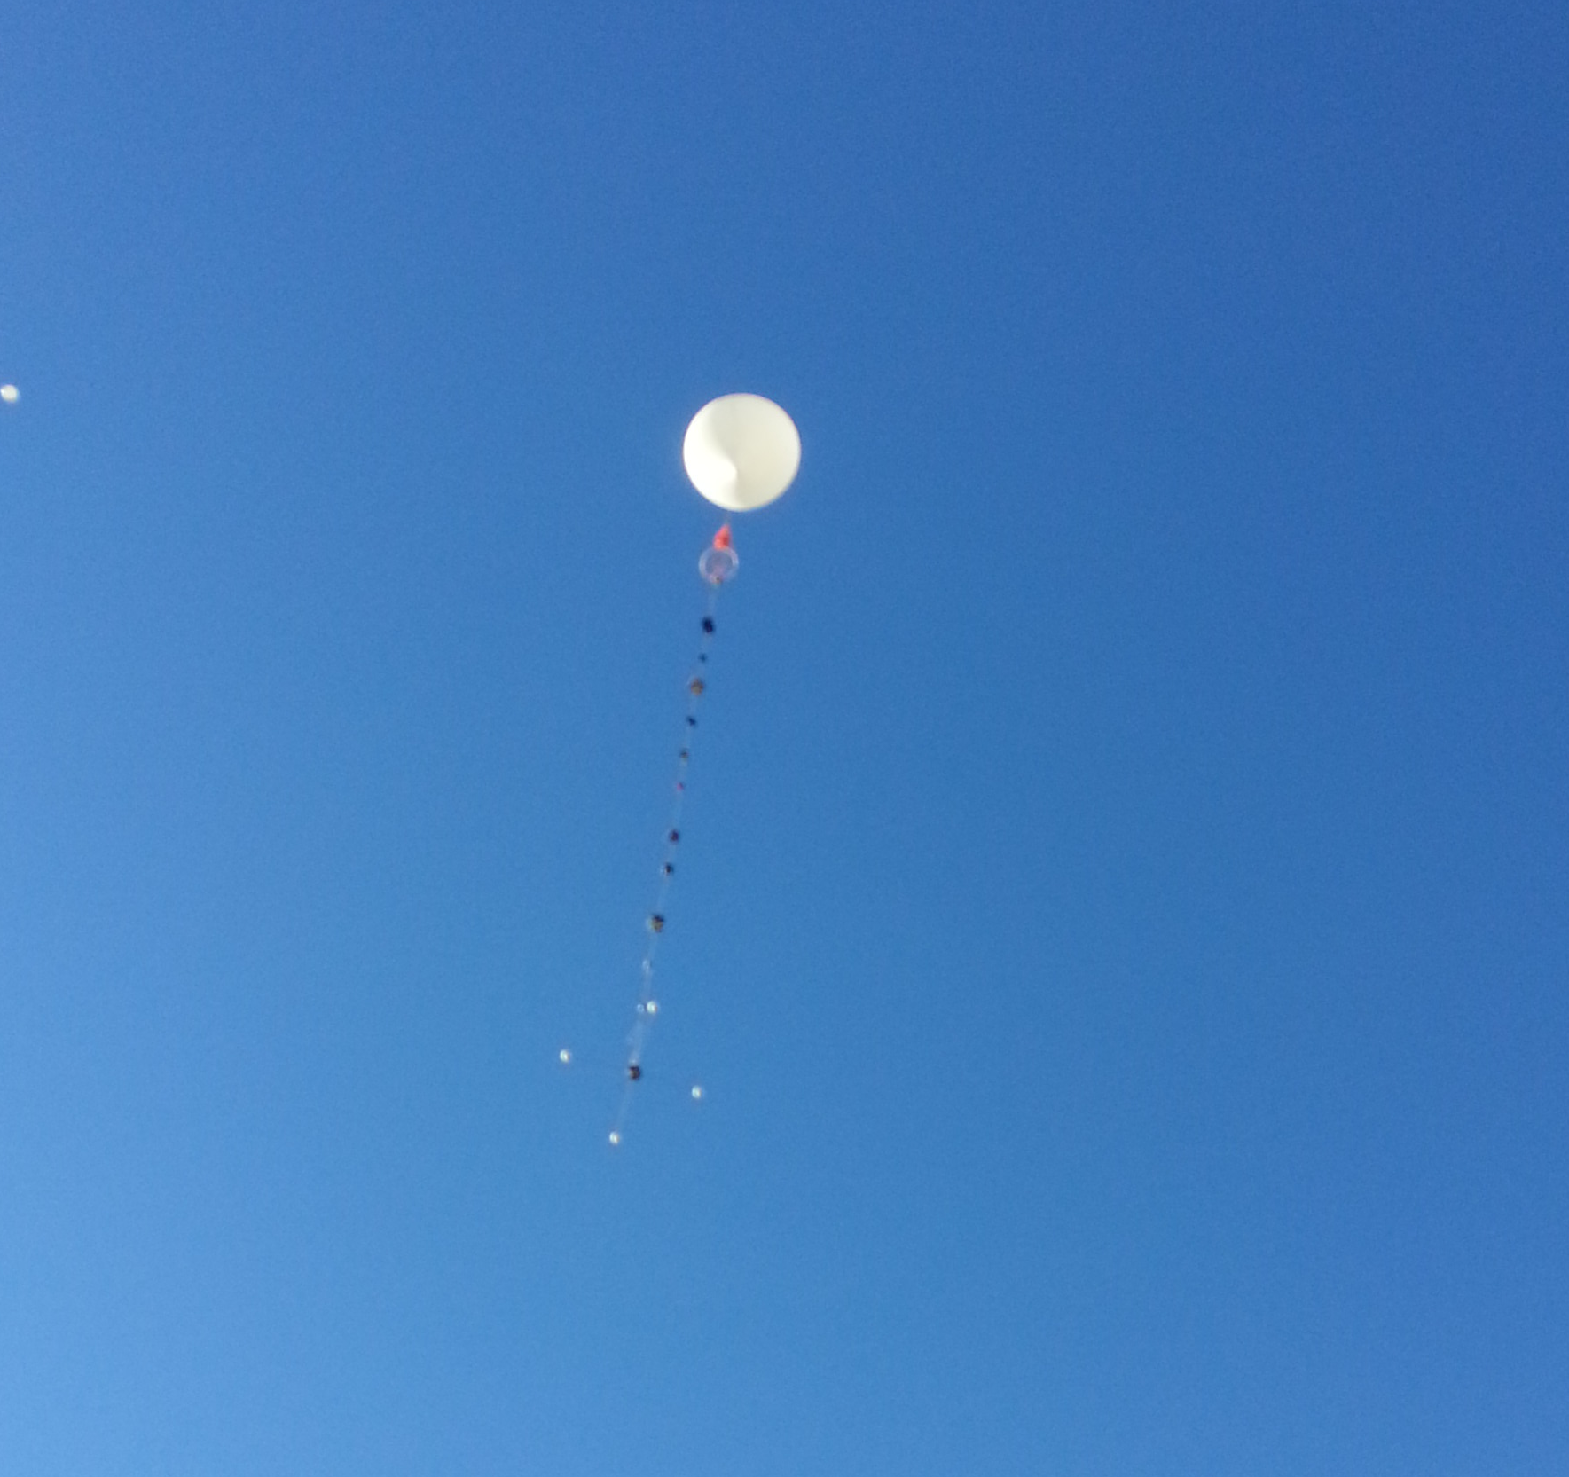
GCC ASCEND 2
Low Cost of Entry Wireless Mobile Network

Slide 2
Abstract
Assemble and configure system featuring Embedded System, GPS, Altimeter, and Radio
Demonstrate the employability of supplemental networking by streaming live video
Develop and configure necessary topology for fully functional WMN;
Correct and Improve PtP system for future PtMP employment
Evaluate shortcomings of COTS comp. inclusions
Non-Deterministic Team Management

Slide 3
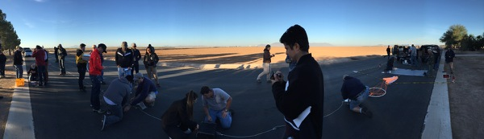
Proof of Concept
Wireless Communication over 900mhz
Limitations: Resources, Crowded Signal, TX/RX Power
Elected New Frequency of 12cm band (2.4 ghz)
New Hardware & Development Platform
Shift in Application Target Employment;
  Transmission of sensor data gauged wireless connectivity
  Availability of tech afforded opportunity to push ASCEND program limits

Slide 4
Revisions
New Development Platform:
  SolidRun Hummingboard i2ex Donated, Supported
  i.MX6 Dual Processor
  1080P GPU Level Capability
  MIPI CSI 2.0, 2 Lane CSI-2 Camera Interface
  PCIe Gen II
  Android KitKat & Linux Distro
  Neo 6M GPS Module
  Buck-booster integrated into necessary POE Radio

Slide 5
Objective
An effective and sufficiently functioning payload for PtP Near-Space Telecommunications
Streaming real-time >=460p @ 14fps video to demonstrate quality of signal; reduce system complexity and scope to fundamental
Implement Differential GPS to serve as reference frame for tracking; auto-configuring station TX/RX

Slide 6
Intent
Intended market, potential applications
Affordable mobile network solutions for wide ranging employment such as:
  Disaster Relief
  Developing Infrastructure
  Remote/Rescue Operations
  Supplementary Secured Network for Defensive Applications

Slide 7
System Overview
Ubiquiti Bullet-M Radio Specifically Designed for Long-Range PtP Networking
Carrier Class Throughput Up to 100Mbps Within 50km Range
24v 0.5a PoE Source
Cat-6 Ethernet Between i2ex & Bullet
Rocket M2 Base Station With NanoBridge Directional

Slide 8
Telecommunications
Payload tx power requires highly accurate directional
Requirements/Limitations necessitate accuracy
Differential GPS increases tracking resolution, auto-configures based on signal strength
Free Space Loss(12cm band) over ~35km:
Loss_{(21mi)}=20log(2400mhz)+20log(21mi)+36.6 ~130.2dB
Loss_{(25mi) ~132.2dB}

Slide 9
Telemetry
DoD limitations limit GPS positional location by way of timing errors; generally under 20 meters
DGPS can correct, improve accuracy from (2cm., 2m)
Neo-6M GPS HW access allowed RAW data access
Assuming errors of proximity were within relative range of each other
*****ADSDDDDSA*****

Slide 10
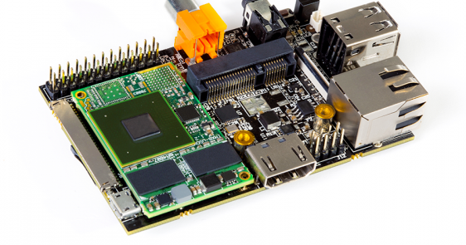
SolidRun i2ex Hummingboard

Slide 11
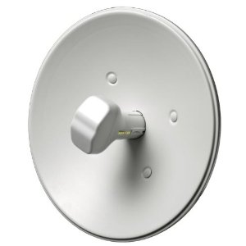
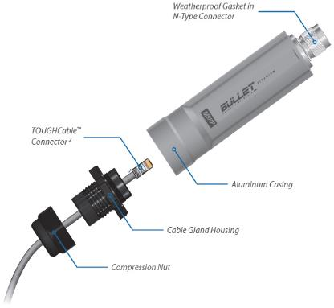
Ubiquiti Bullet-M/NanoBridge

Slide 12
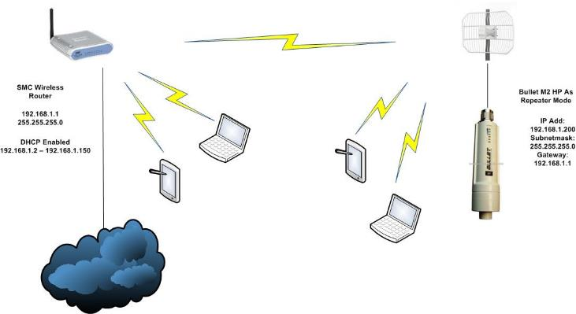
System Graphically

Slide 13
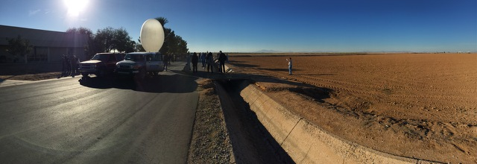
Software Abstract
Capture full HD video
Stream real-time video and data to local network
Host server to capture data, present in usable format.

Slide 14
Software
First approaches
  Difficulties
    Stable environment
    Android rapid development support
  Solutions
    Changed development location.
    Changed systems

Slide 15
Software Technicals
Debian Jessie
  Mostly supported but out of date kernel
Debian Wheezy
  Many out of the box solutions.
  Large support community
  Camera – Initial attempts and final solution
  GPS – Ease of use

Slide 16
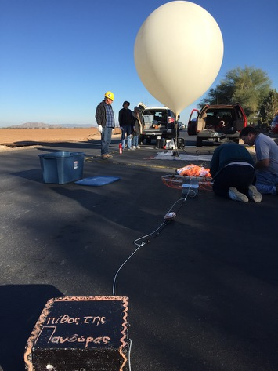
Wireless Network Setup
One Ubiquiti Bullet connected to a Hummingboard-i2ex
One Ubiquiti NanoBeam connected to a laptop
Both devices set up as a wireless bridge
Initial testing was done across 10 meters

Slide 17
Barometer
BMP180 pressure/temperature sensor
Communicating to the Hummingboard via I2C
Using SMBus protocol
Library programmed in Python using the python-smbus module
Temperature testing done using a digital thermometer
Pressure testing done using the elevation of the nearest weather station

Slide 18
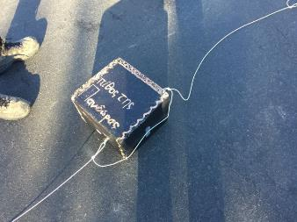
Assembly
Adhering to weight limitations
Structural integrity
Mechanically fastening components
System assembly as a whole

Slide 19
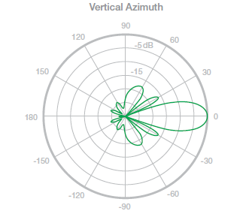
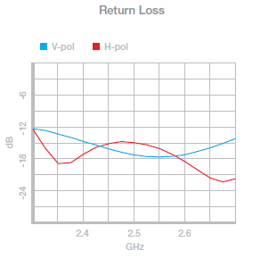
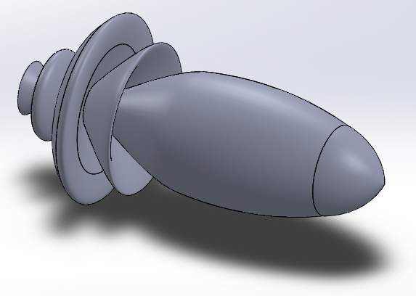
Antenna Specifications

Slide 20
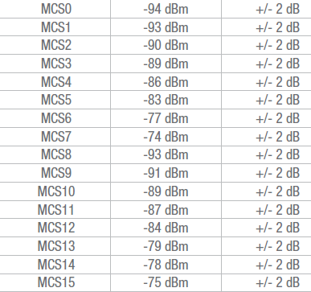
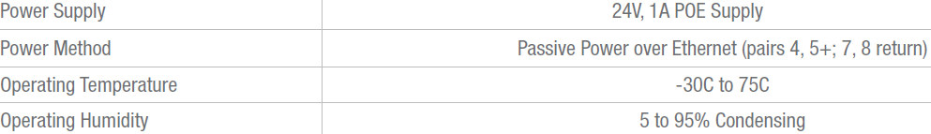
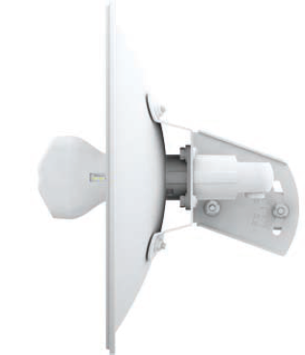
Antenna Specifications

Slide 21
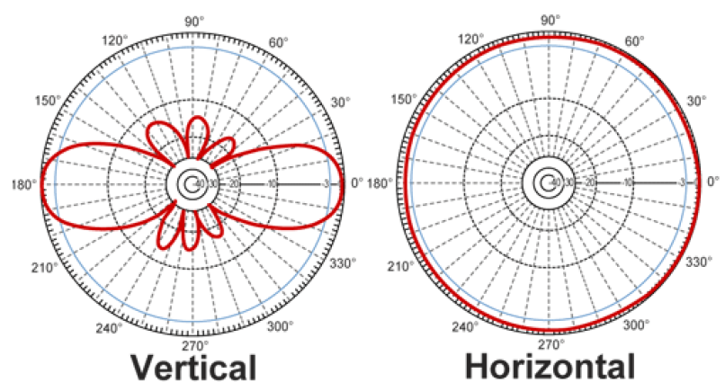
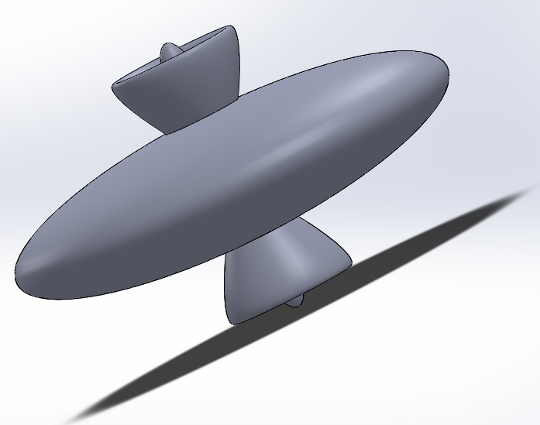
Antenna Specifications

Slide 22
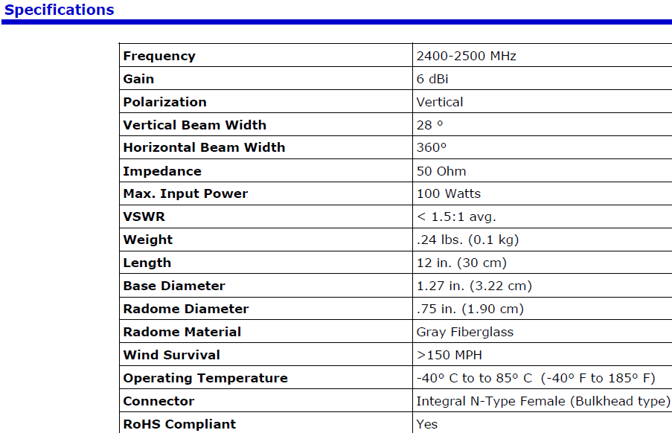

Antenna Specifications

Slide 23
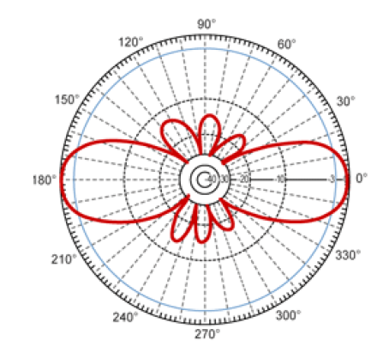
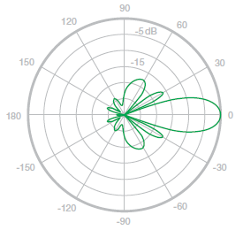
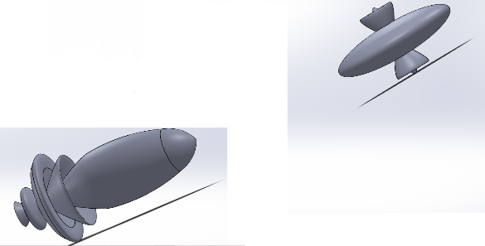

Slide 24
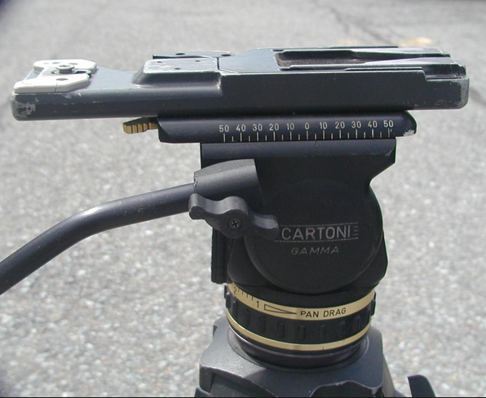
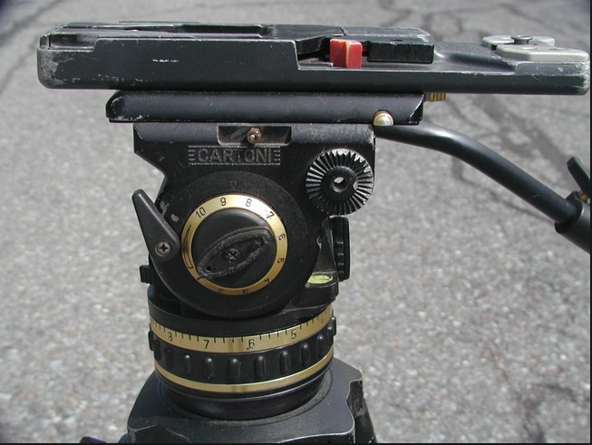
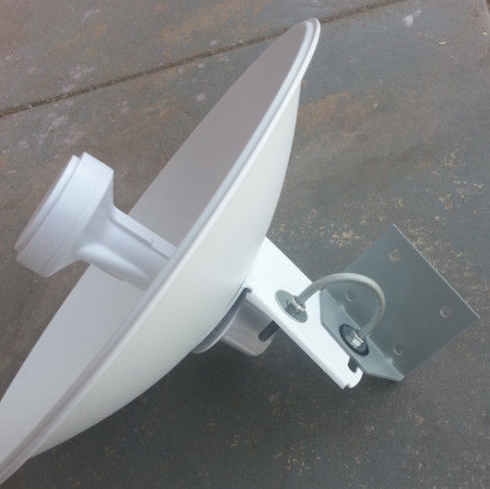

Slide 25
Mapping
Ground Directional LOS Precision
Using GPS Coordinates with Numerical Method/Vector Auto Regression to Best “follow” Payload
Accuracy Allows Weak Omni-Directional to Transmit

Slide 26
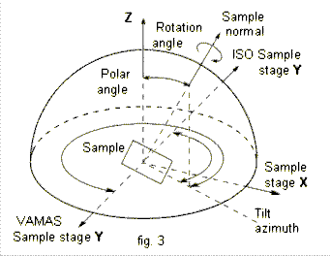
Frame Transfer

Slide 27
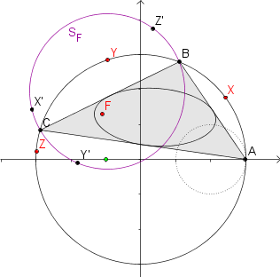
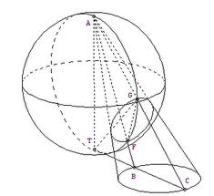
Desired Relation

Slide 28
Struggles
Time & Resources
Weight Limitations / Available Power
Necessary Proficiency with Android API
Geodesic Telemetry and Triangulation
Numerical Methods/Complex Analysis for Mapping

Slide 29
Results
Fall 2014
Spring 2015
Power
Raw Data
  6 miles
  Resets
Antenna Usage
Launch Sequence
Power challenges
Data Prospects
  10 miles HD images
  Component Stability
Antenna Usage
Launch Sequence

Slide 30



Residuals
Overview of Rudimentary System and Resulting Depth
Multidisciplinary Unification & Necessary Proficiency Beyond Subject Area
Team Dynamics & Progressive Methods for Non-Deterministic Short-Run Development
Continuation of Research Into Graduate Level

Slide 31
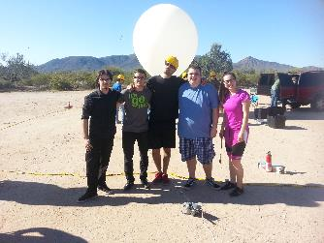
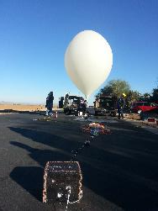
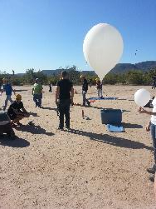
Residuals

