Slide 1
UA ASCEND!
2015 Space Grant Symposium
Saturday, April 18th
University of Arizona

Slide 2
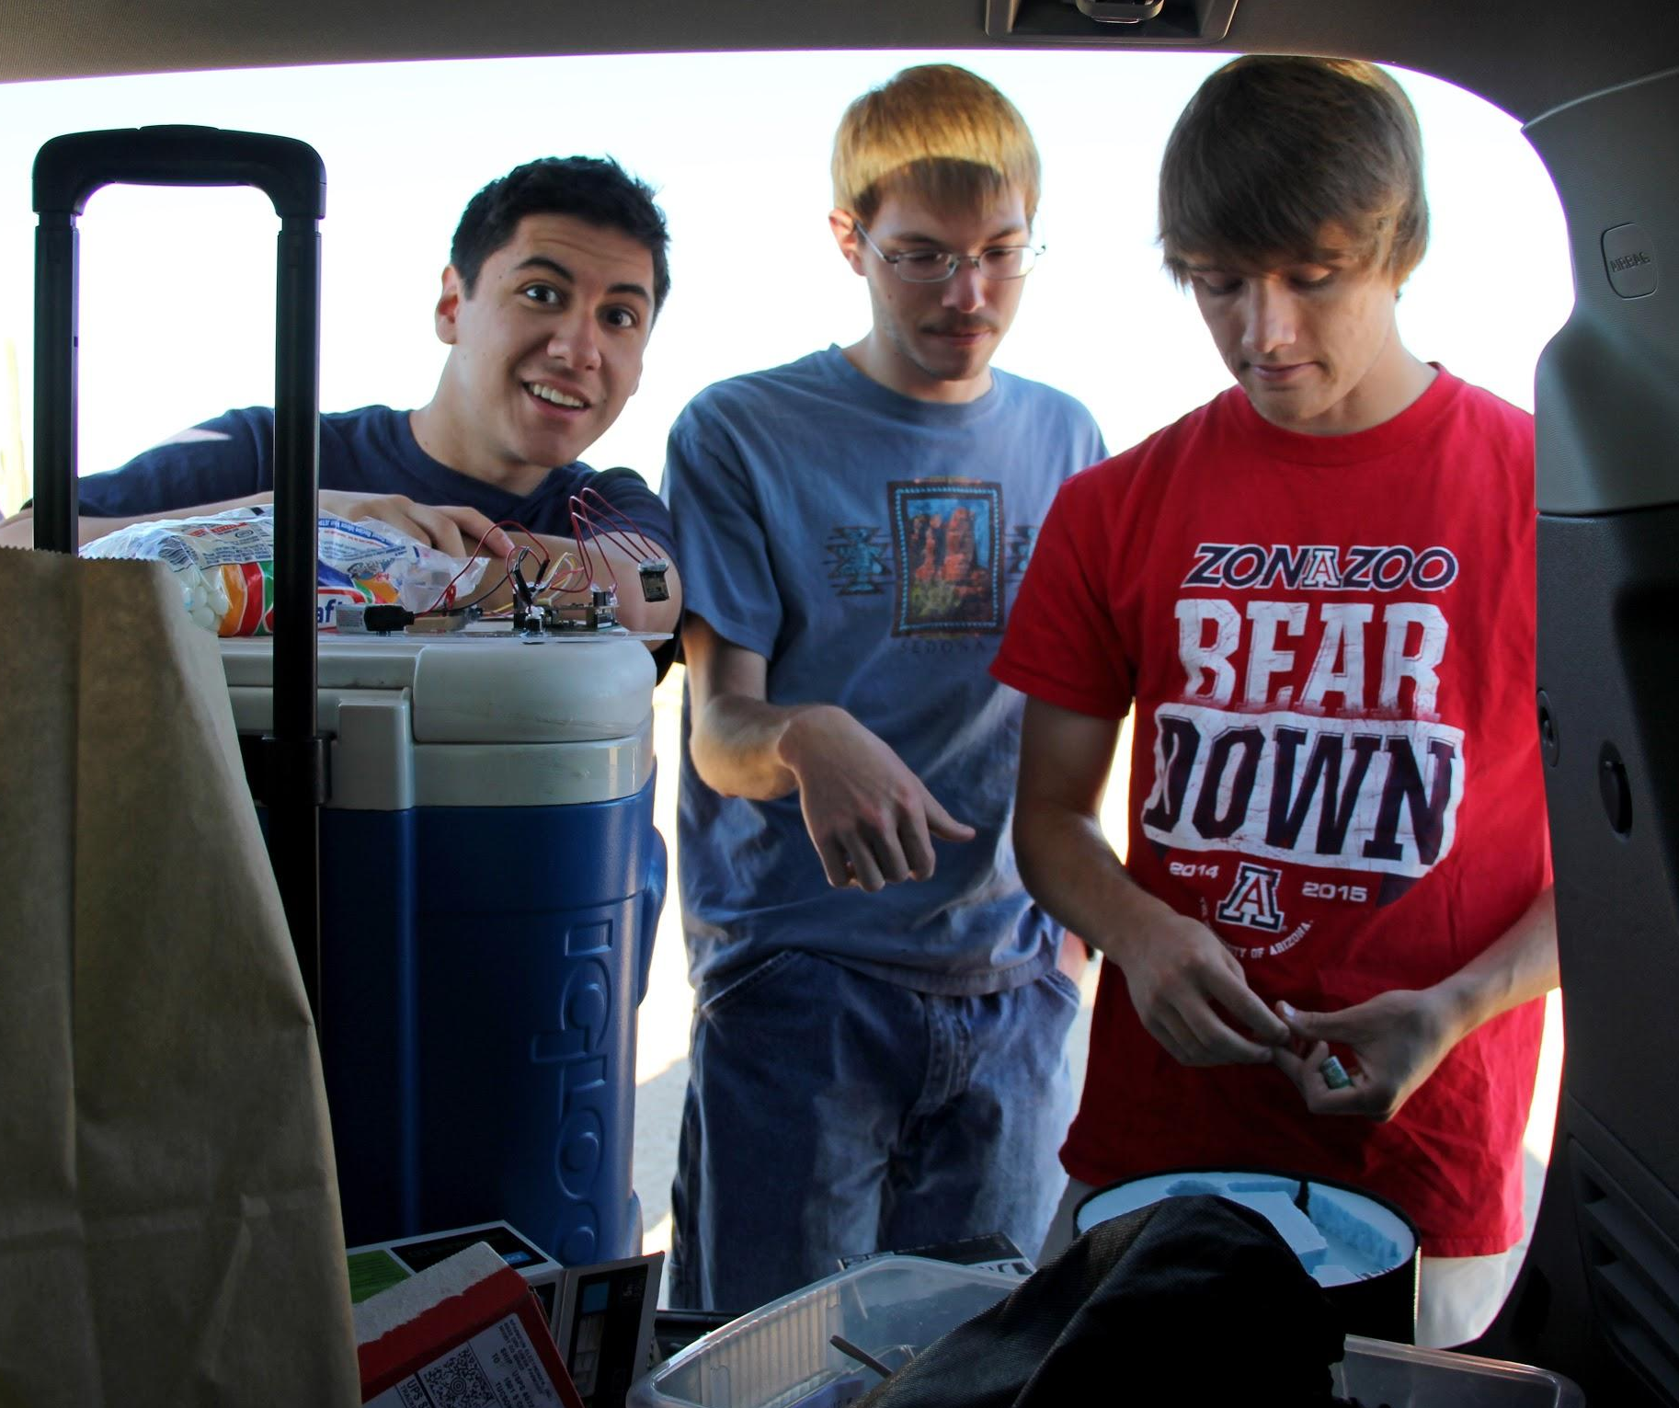
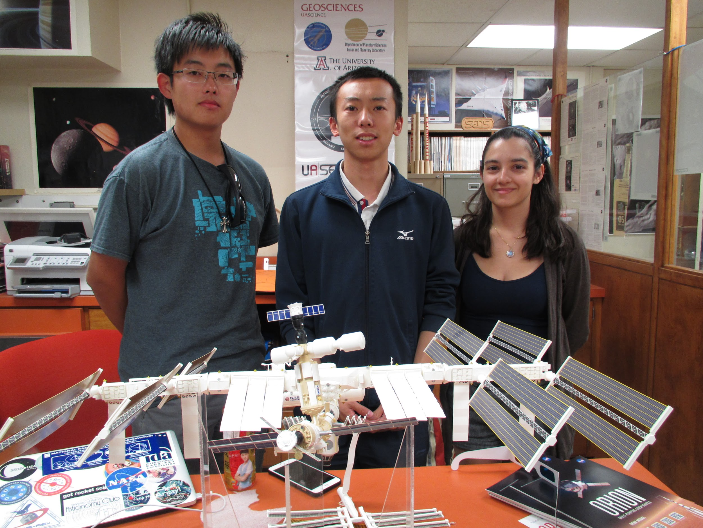

The Team
Carmen Austin
Andrew Siemens
Ryan Stelzer
Marcos De Rose
Xinyi Xu
Ruoyu Li

Slide 3




Acknowledgments

Slide 4
Outline
Objective
Method
Results
Conclusion

Slide 5
Objective
Study vertical wind currents at high altitudes
Hypothesis - As altitude increases, vertical wind will increase in magnitude until the air density causes the effective force from the wind to lessen and read a lower value
Fall 2014 - Gather wind data alongside temperature, pressure, and other data
Spring 2015 - Gather wind and other data again due to payload damage and do experiment for outreach

Slide 6
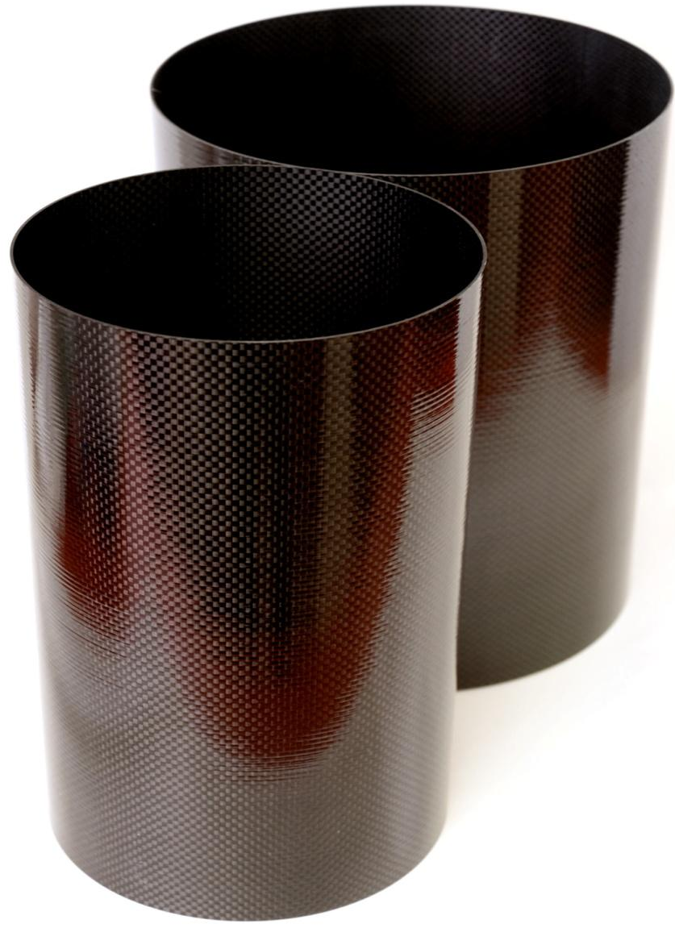
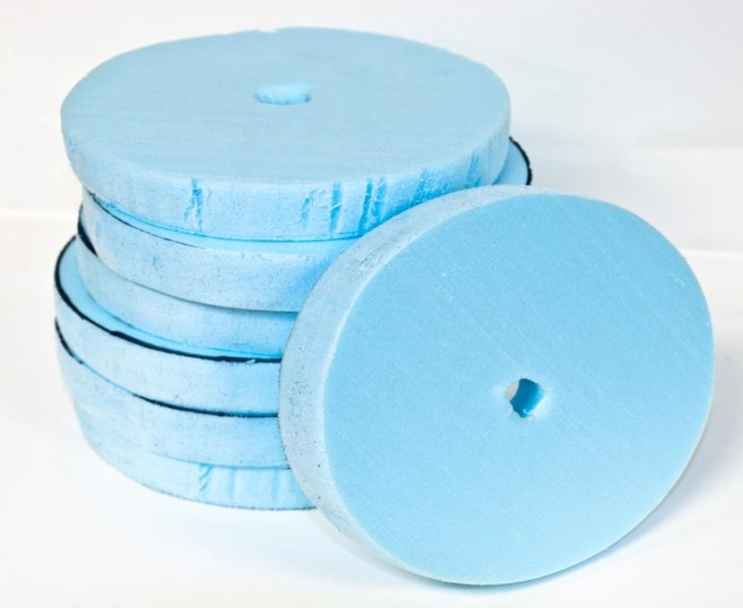
Payload Shell
Carbon fiber cylinder
Short Sturdy Shell to protect the rest of the payload
Polystyrene Foam
Lightweight cushion for components
Lexan Polycarbonate
Used to cap the top and bottom of payload

Slide 7

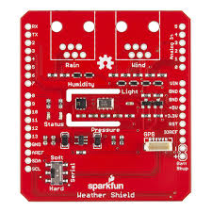

Electronics
Arduino Uno
Writes and interprets the data
Powered by a 9V battery
Sparkfun WeatherShield
Reads temperature, pressure, humidity, and luminosity all in one
Sparkfun ToF Range Finder
Measures distances up to 25cm in addition to measuring luminosity

Slide 8
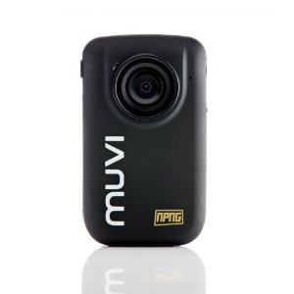
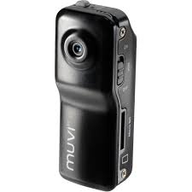
MUVI Cameras
Veho MUVI HD ActionCam
170 degree wide angle lens
5MP HD video resolution
8GB memory card
Pointed at ground
Veho Muvi Micro Action Cam
Very Compact
2MP video resolution
4GB memory card
Pointed at marshmallow
Both have internal batteries

Slide 9
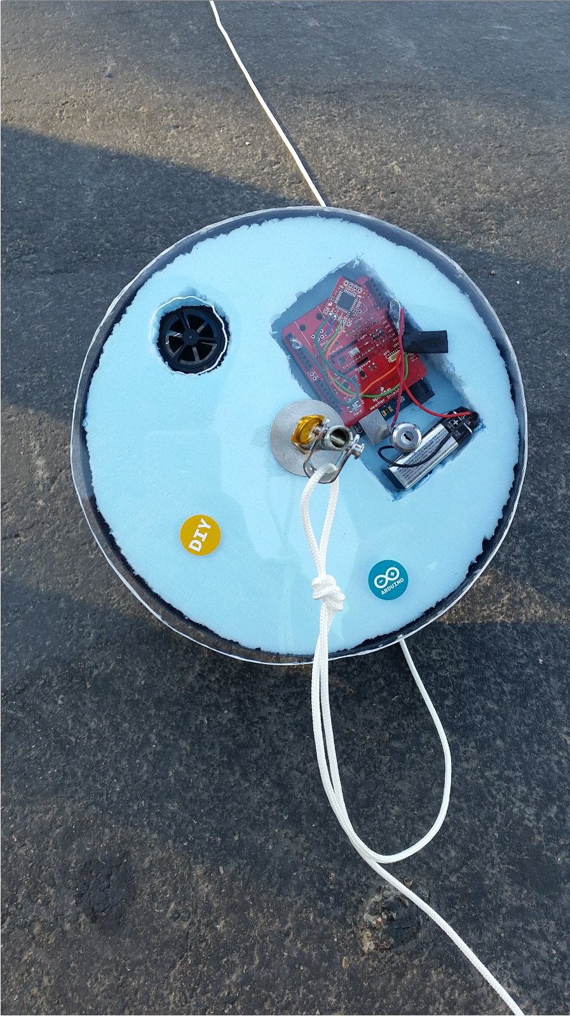
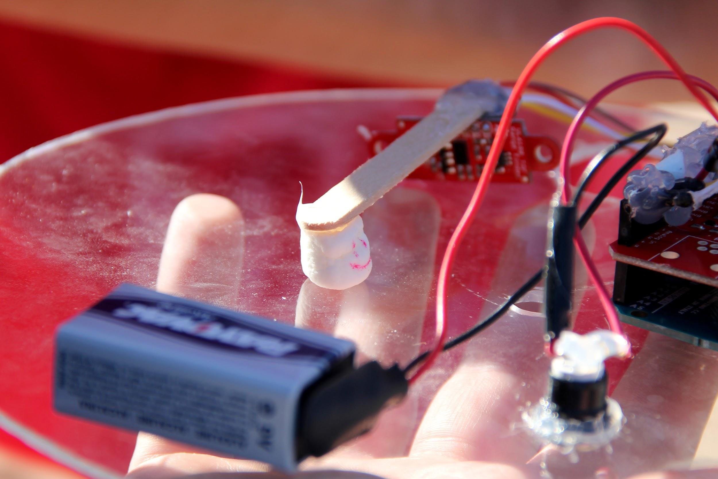
Experiment
Sample Output:
Time: 0:0:14
Humidity: 12.6
Temperature: 87.6
Pressure: 95599.50
Batt_lvl: 8.48
Light_lvl: 3.10
Ambient Light Level (Lux) = 1113.66
Distance measured (mm) = 80

Slide 10
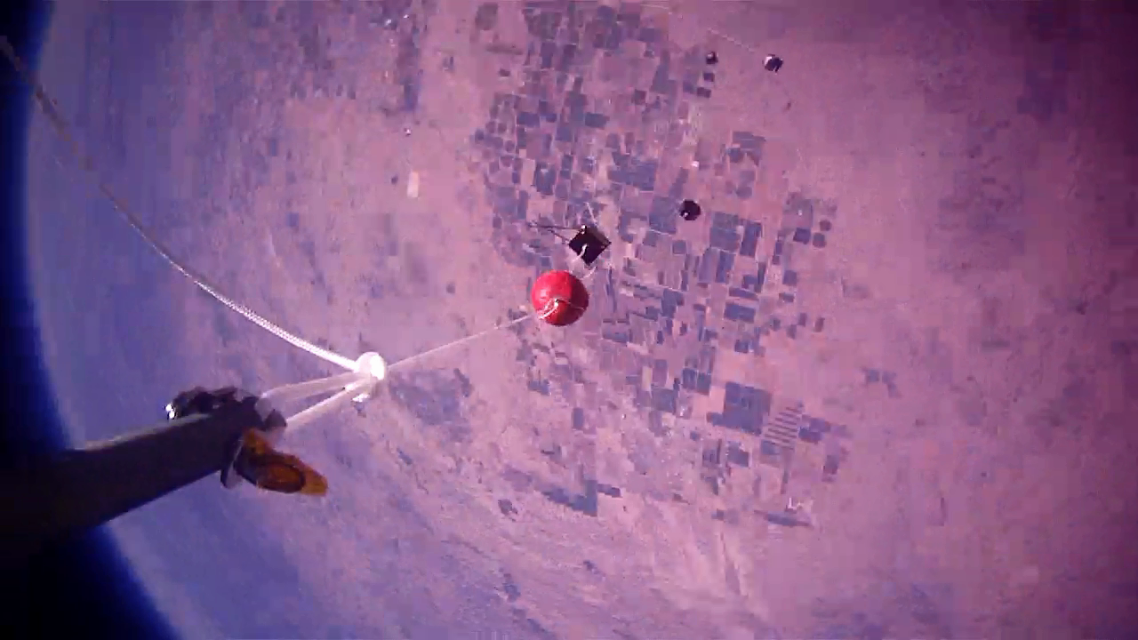
MUVI ActionCam

Slide 11
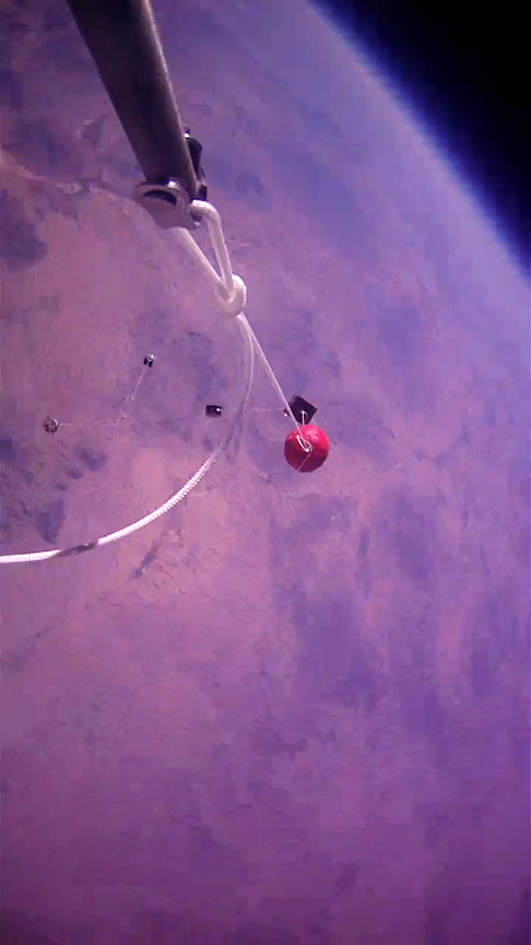
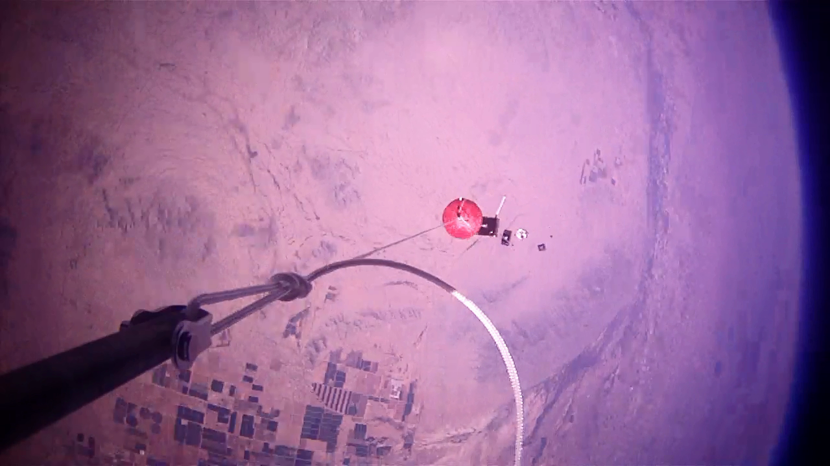
MUVI ActionCam

Slide 12
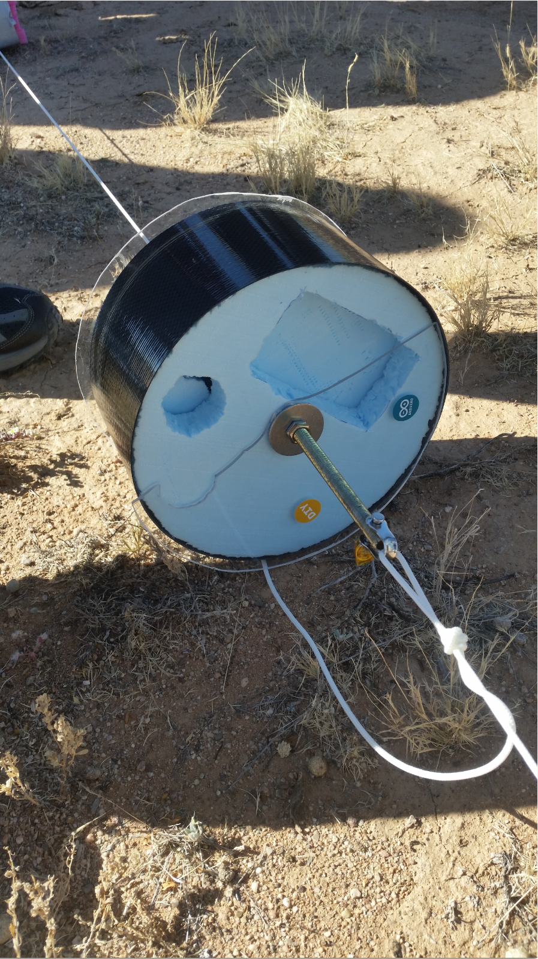
Results
Fall
Electronics fell out
Wind path blocked for descent
Spring
Most everything worked
No video of marshmallow

Slide 13
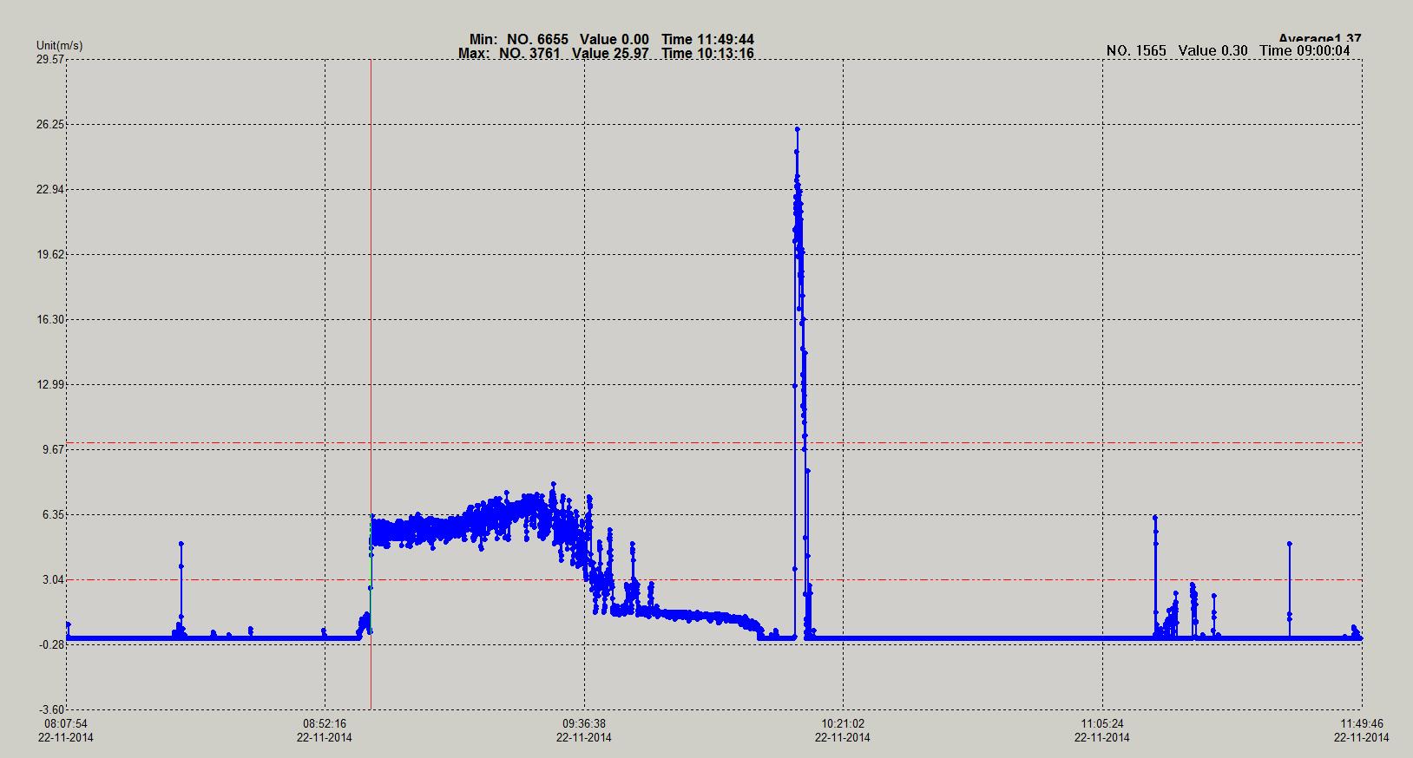
Fall Results

Slide 14
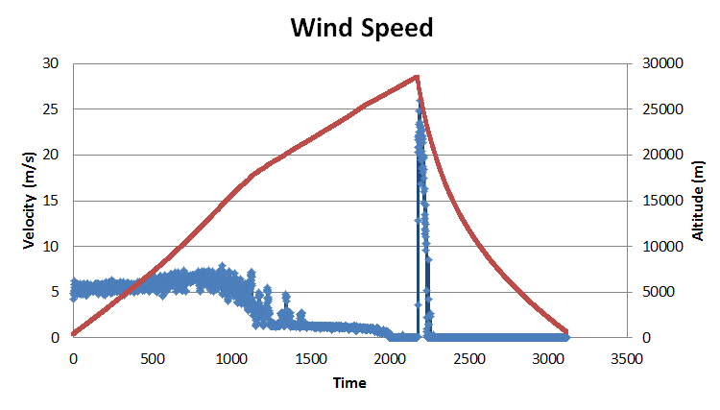
Altitude from ANSR data

Slide 15
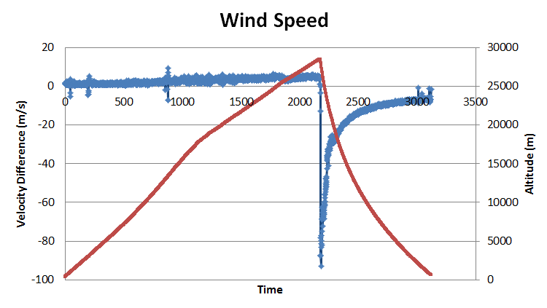
Altitude from ANSR data

Slide 16
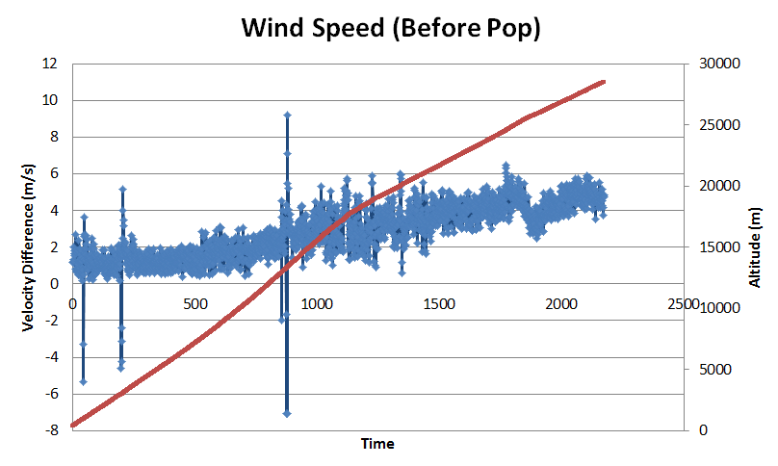
Altitude from ANSR data

Slide 17
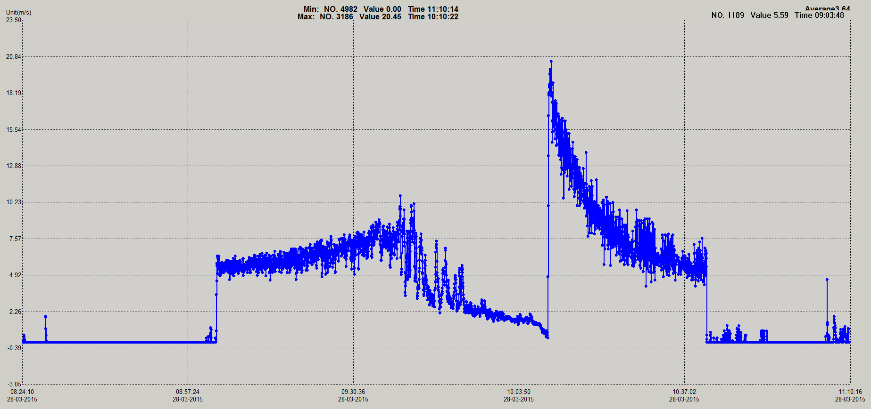
Spring Results
Altitude from ANSR data

Slide 18
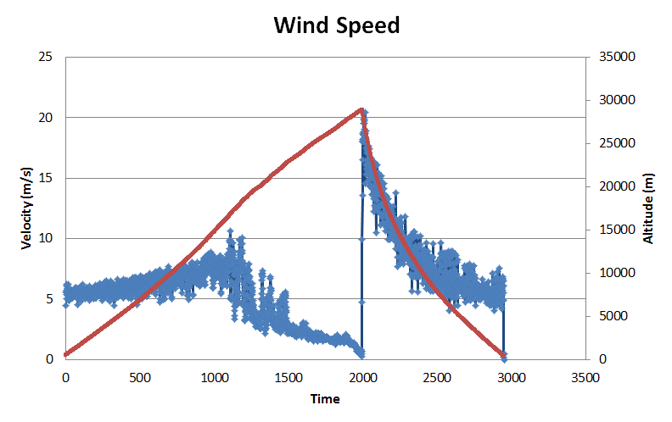
Altitude from ANSR data

Slide 19
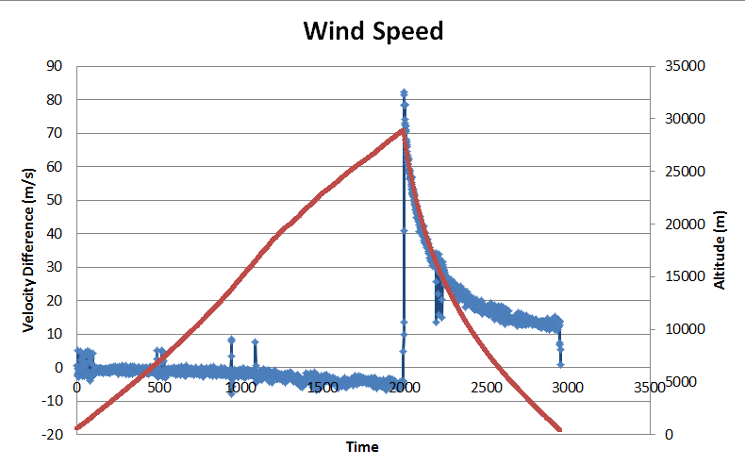
Altitude from ANSR data

Slide 20
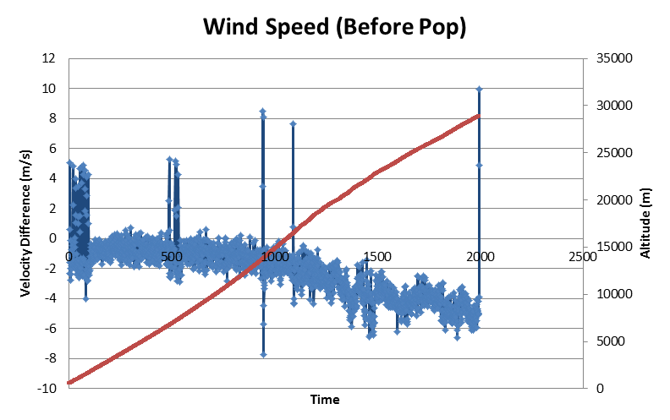
Altitude from ANSR data

Slide 21
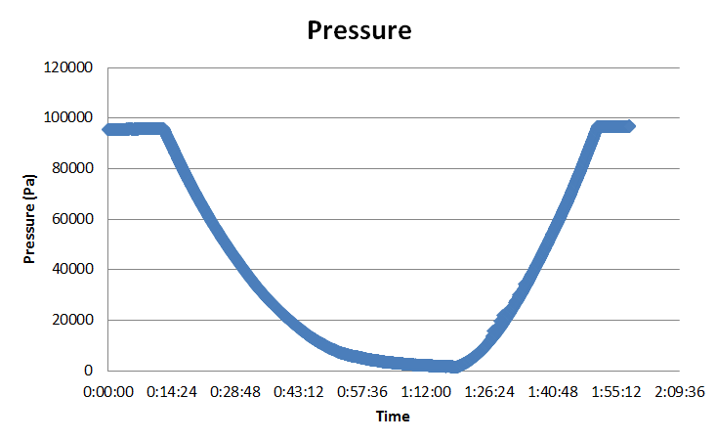

Slide 22
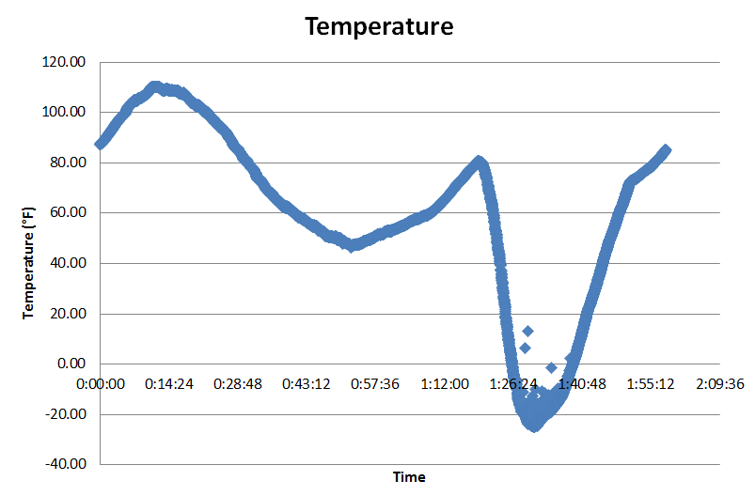
Launch at 11:40, Landing at 1:51:06

Slide 23
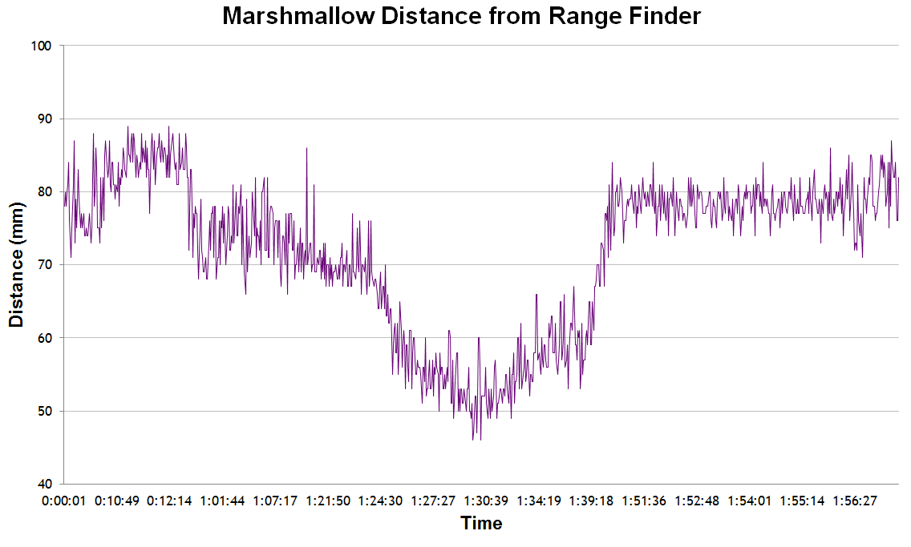

Slide 24
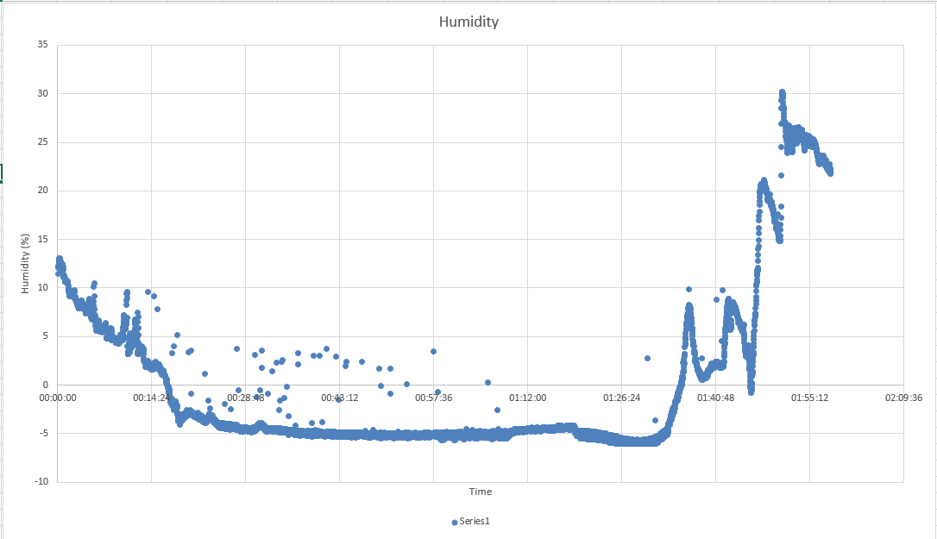

Slide 25
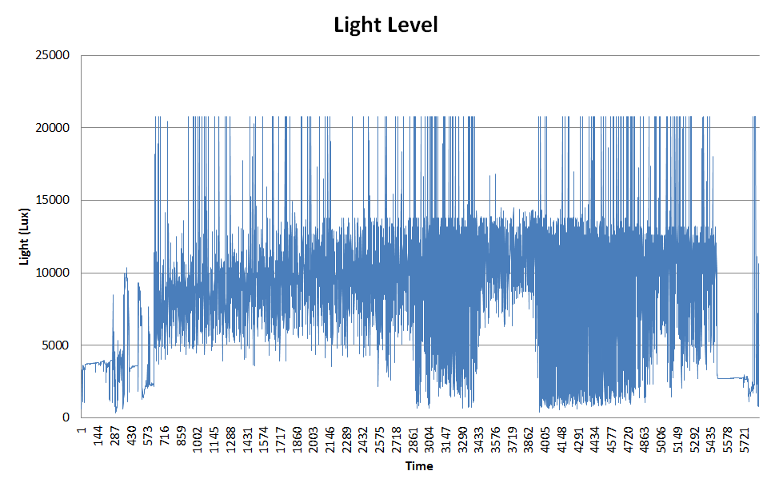

Slide 26
Conclusion
Successfully measured vertical wind speed during flight
At lower altitudes winds were mostly updrafts while at higher altitudes air density caused measured wind speed to go down and read as downdrafts
Successfully captured video of entire flight

Slide 27
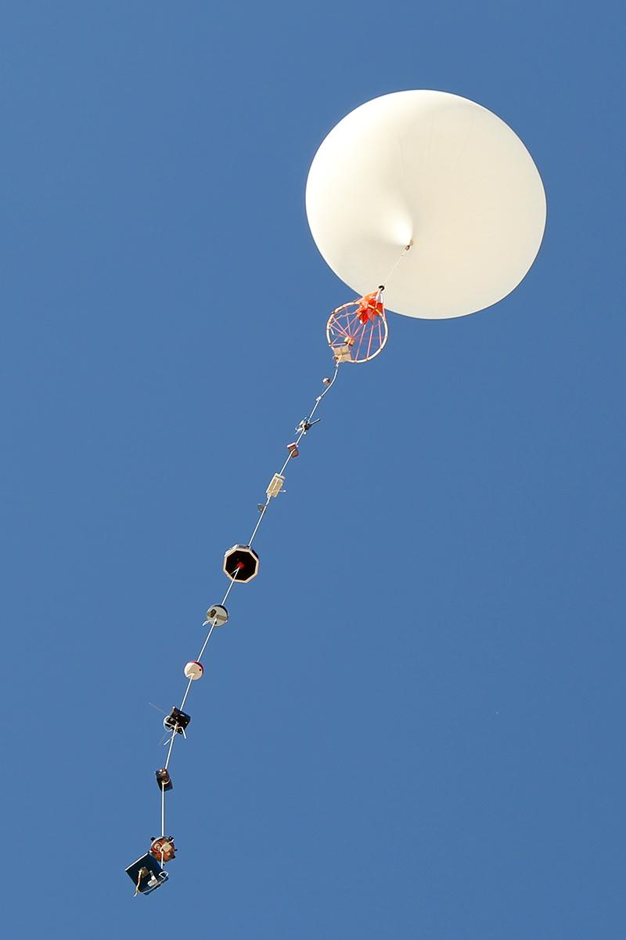
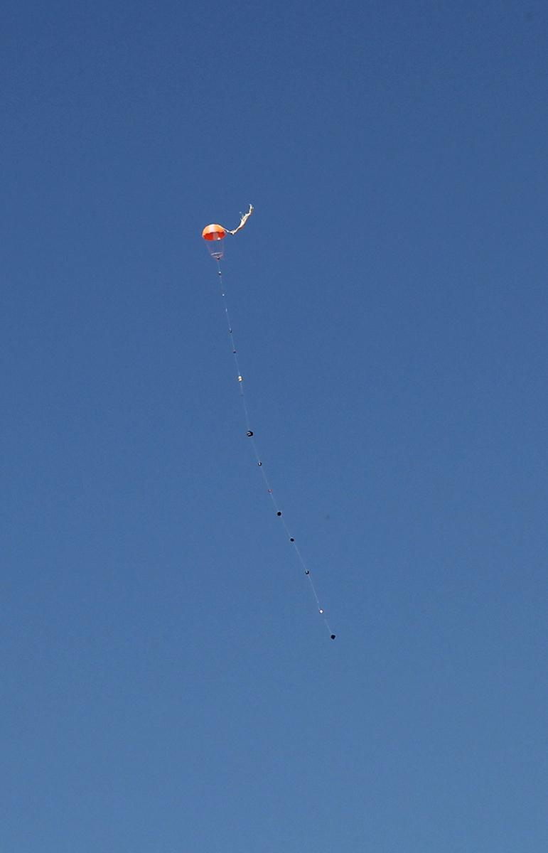
Pictures

Slide 28
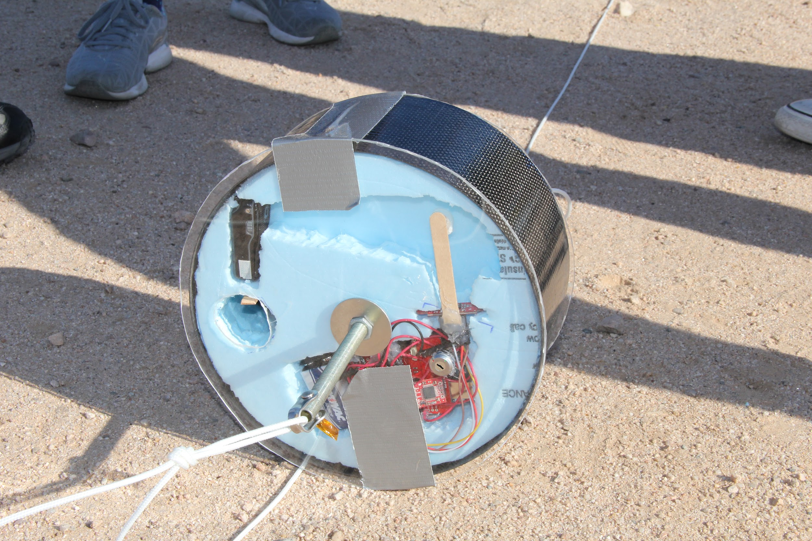
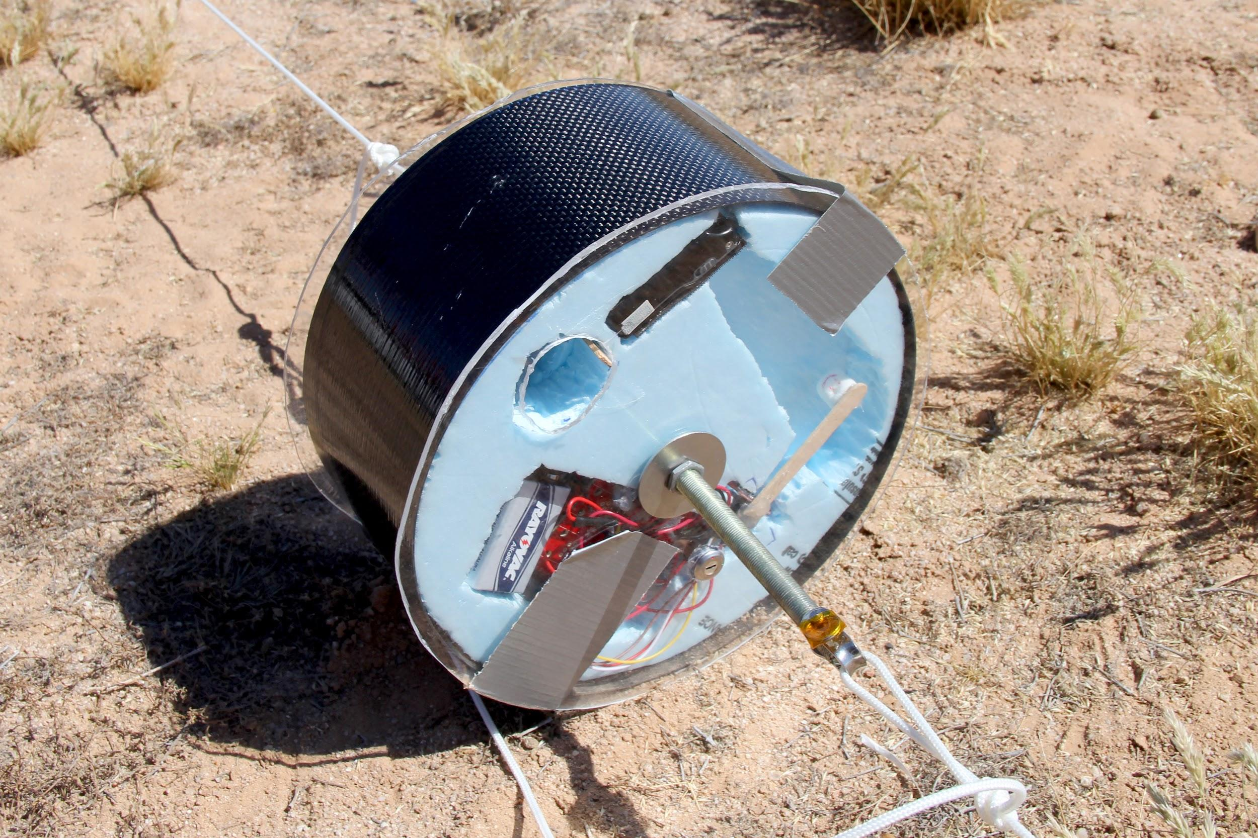

Slide 29
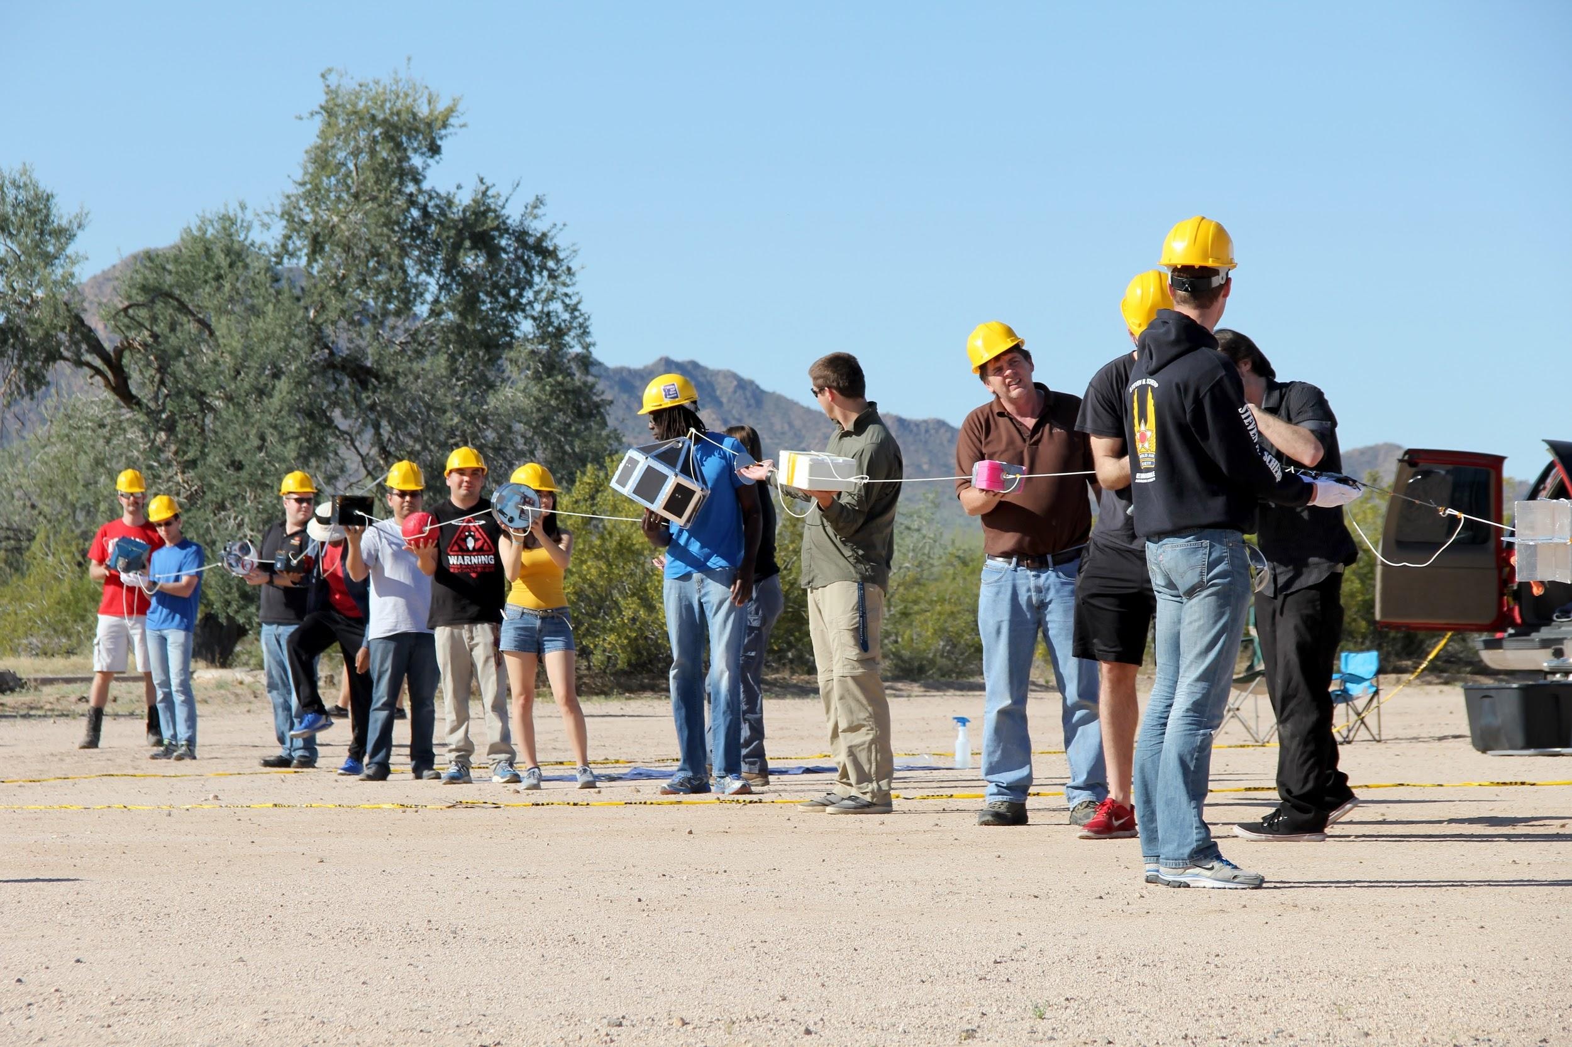

Slide 30
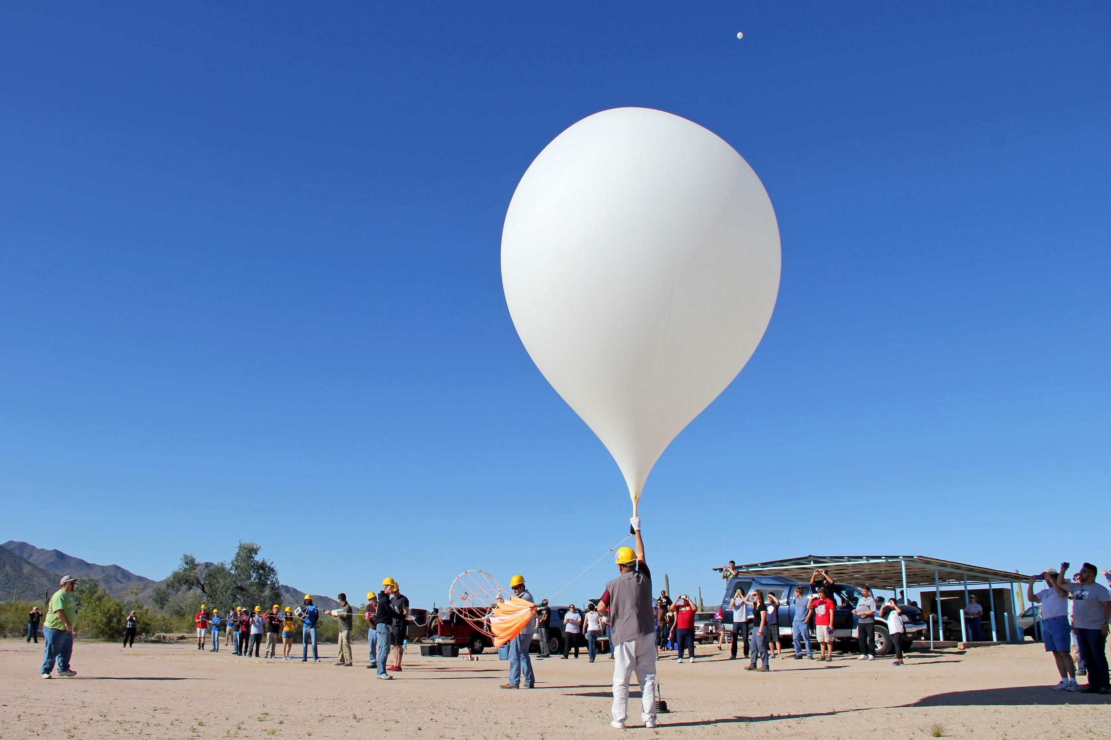

Slide 31
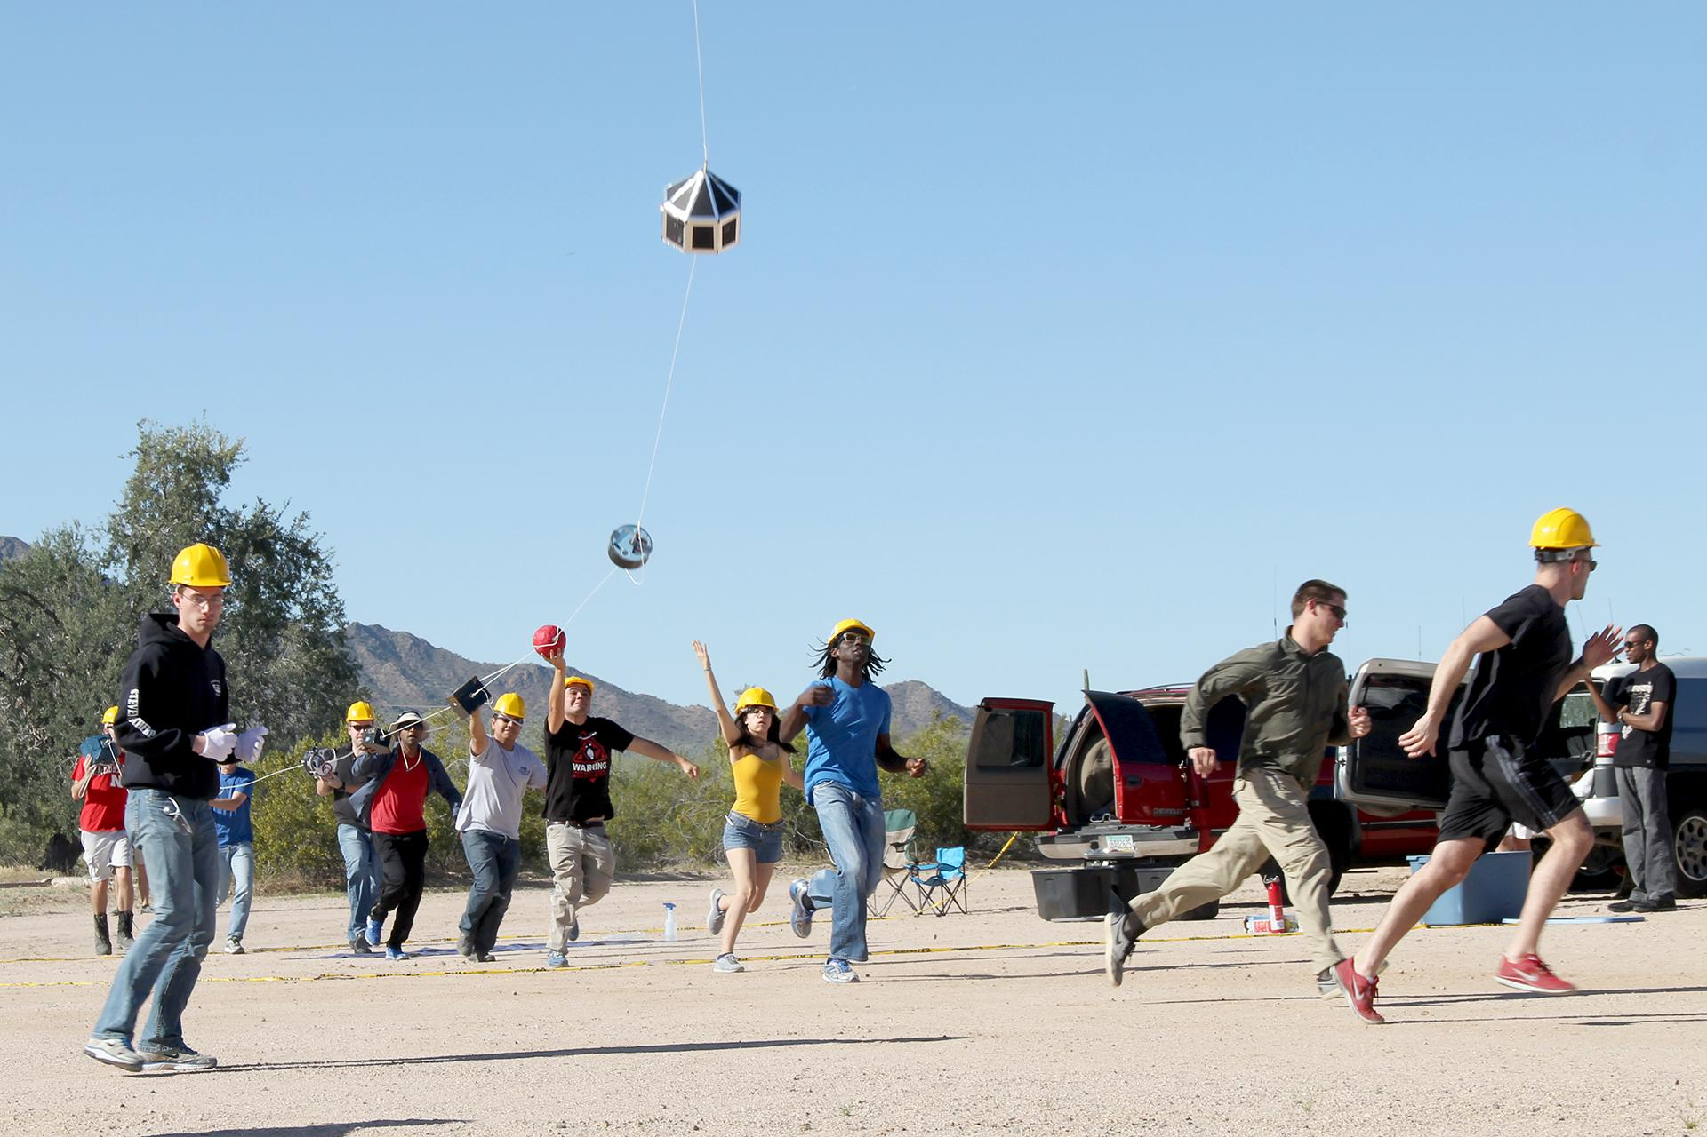

Slide 32
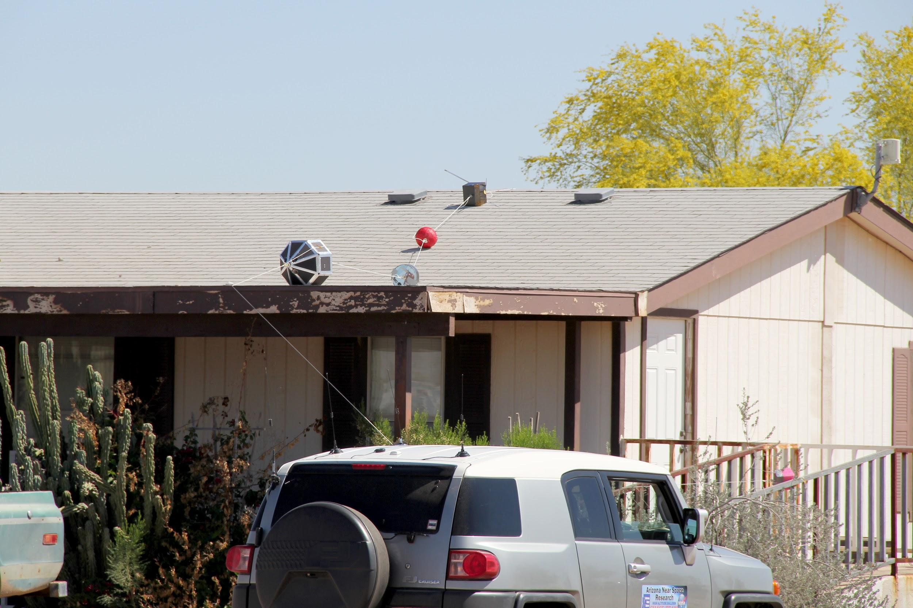

Slide 33
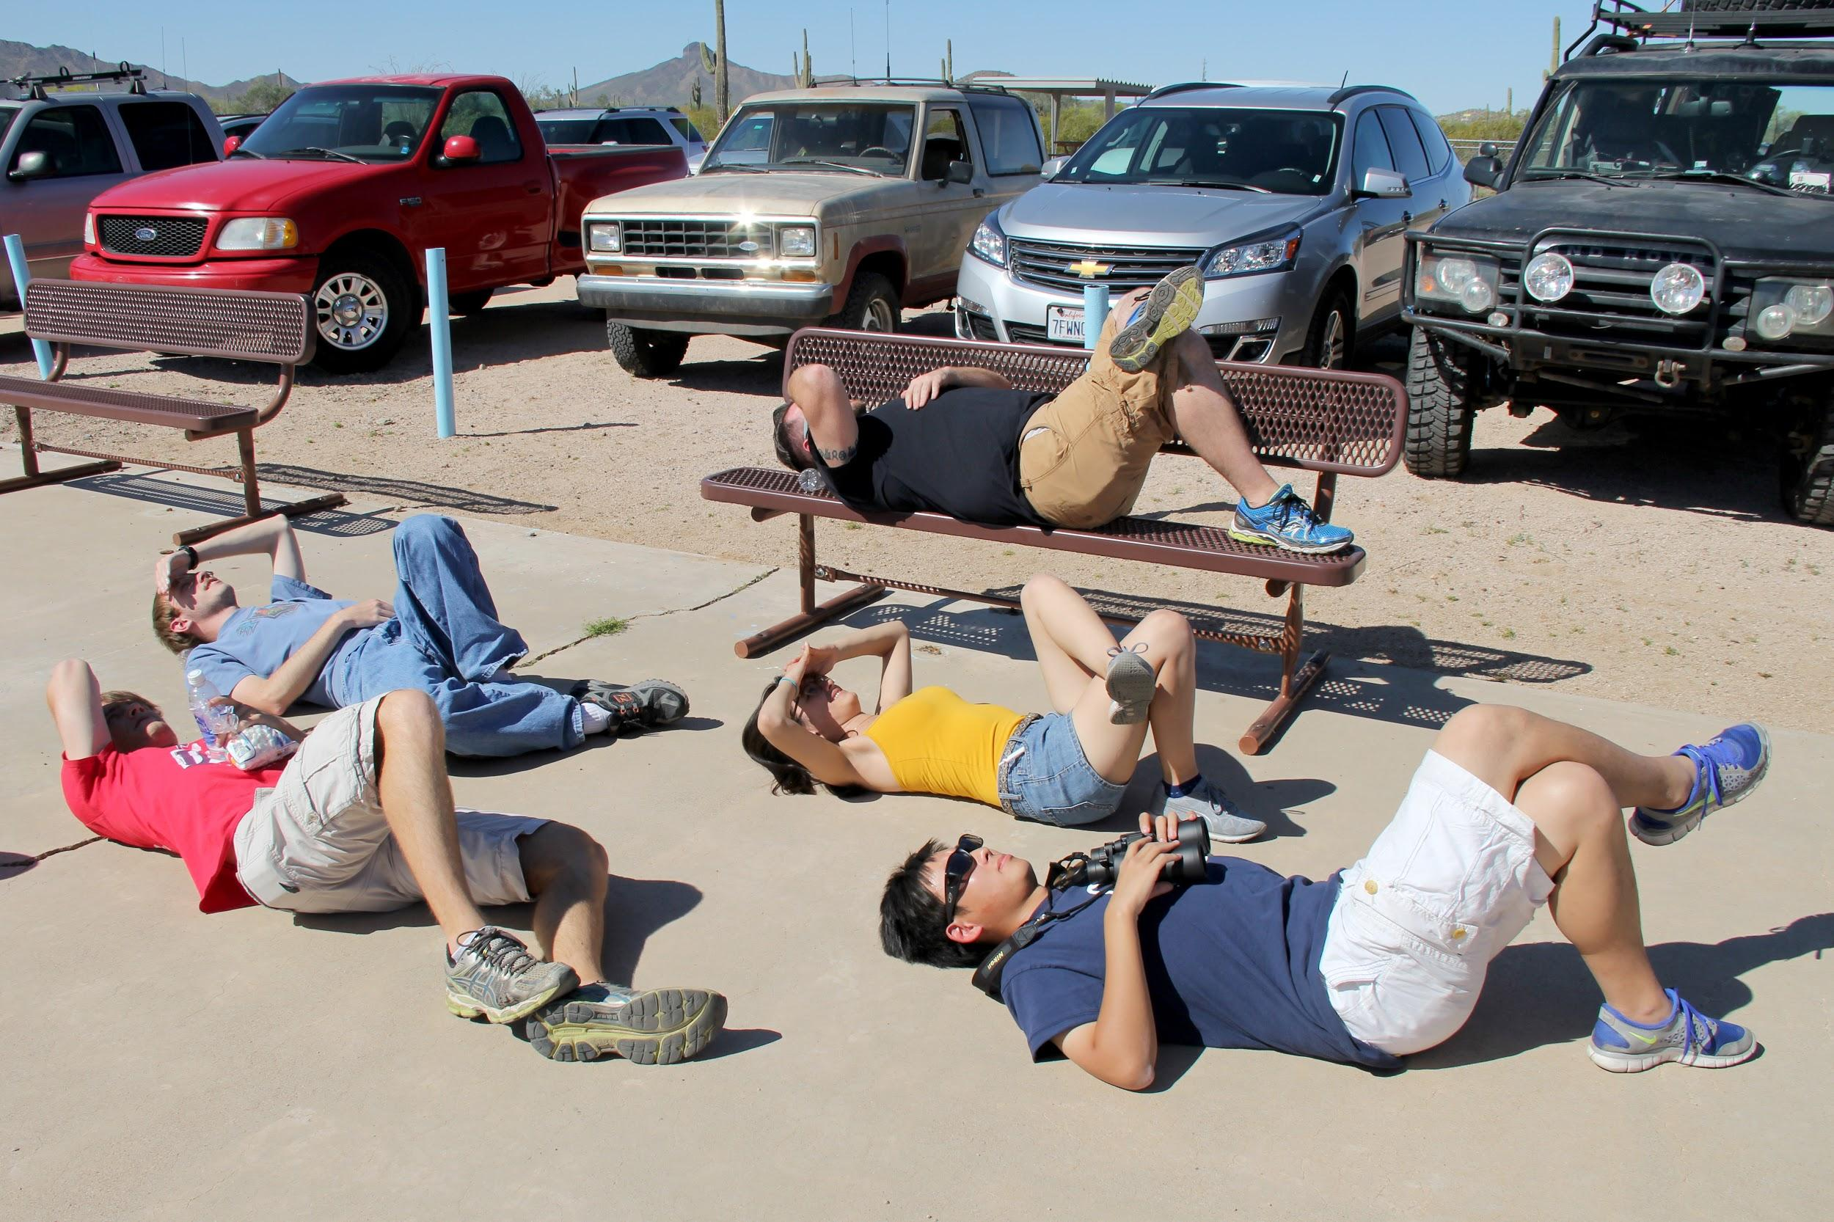
Thank you!

