Slide 1



Low Altitude Particle
Detection #1
Pima Community College ASCEND Team
Team Members: Andrew Okonya, Paria Khamsehzadeh,
Hasti Khamsehzadeh, Joel Thibault
1

Slide 2
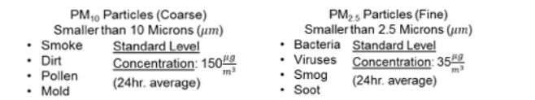
Motivation and Methodology
What is particulate matter?
A microscopic solid or liquid suspended in the Earth’s atmosphere
The mixture of atmosphere and matter is commonly referred to as an aerosol
Two Main Classifications of Particle Sizes
2

Slide 3
Motivation and Methodology
A simple particle collection apparatus to collect data on particles
Several boxes containing fly paper resin mounted on a rotating wheel
Samples were collected every 1,550 meters of altitude up to a maximum altitude of 10,580 meters
A trend of decreasing particle size with increasing altitude was investigated
3

Slide 4
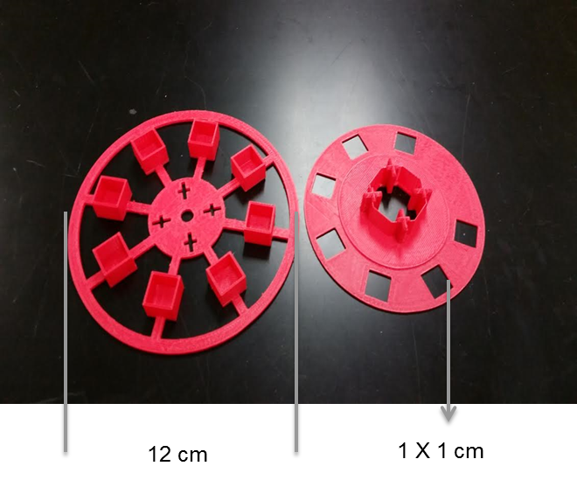
Motivation and Methodology
Means of Collection:
Induction port for intake of aerosol
Wheel with 7 collection chambers, set to rotate every 1,550 meters of altitude
1 Contamination Control Chamber
4

Slide 5
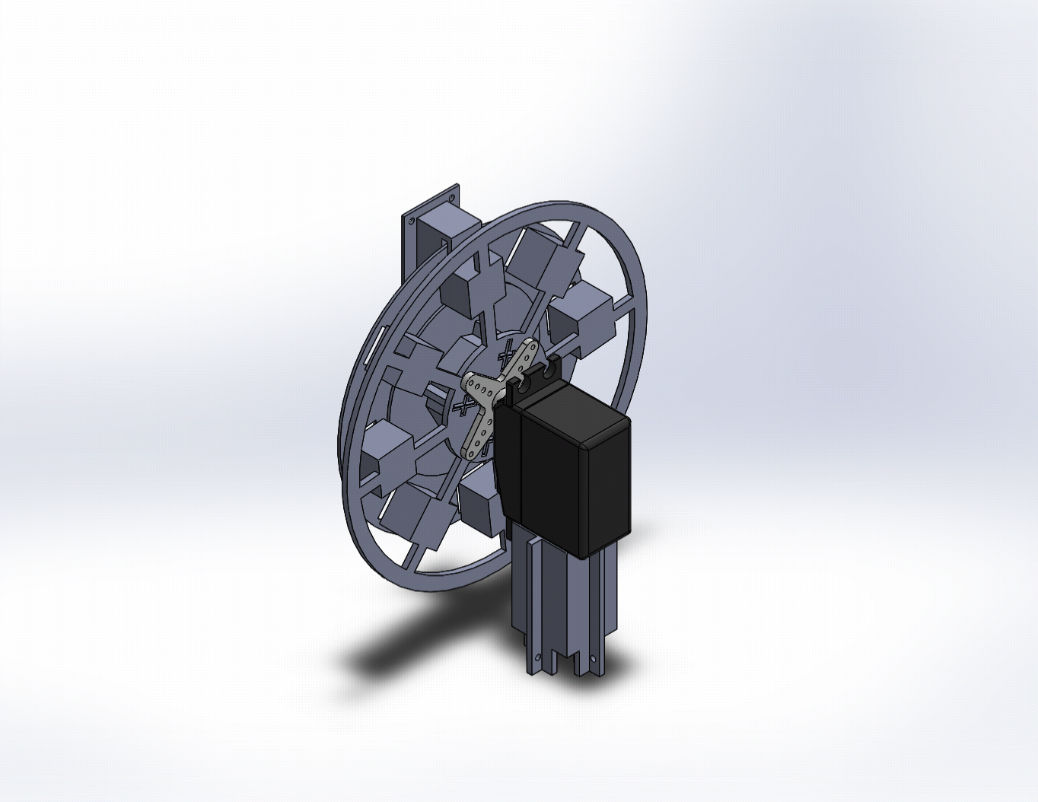
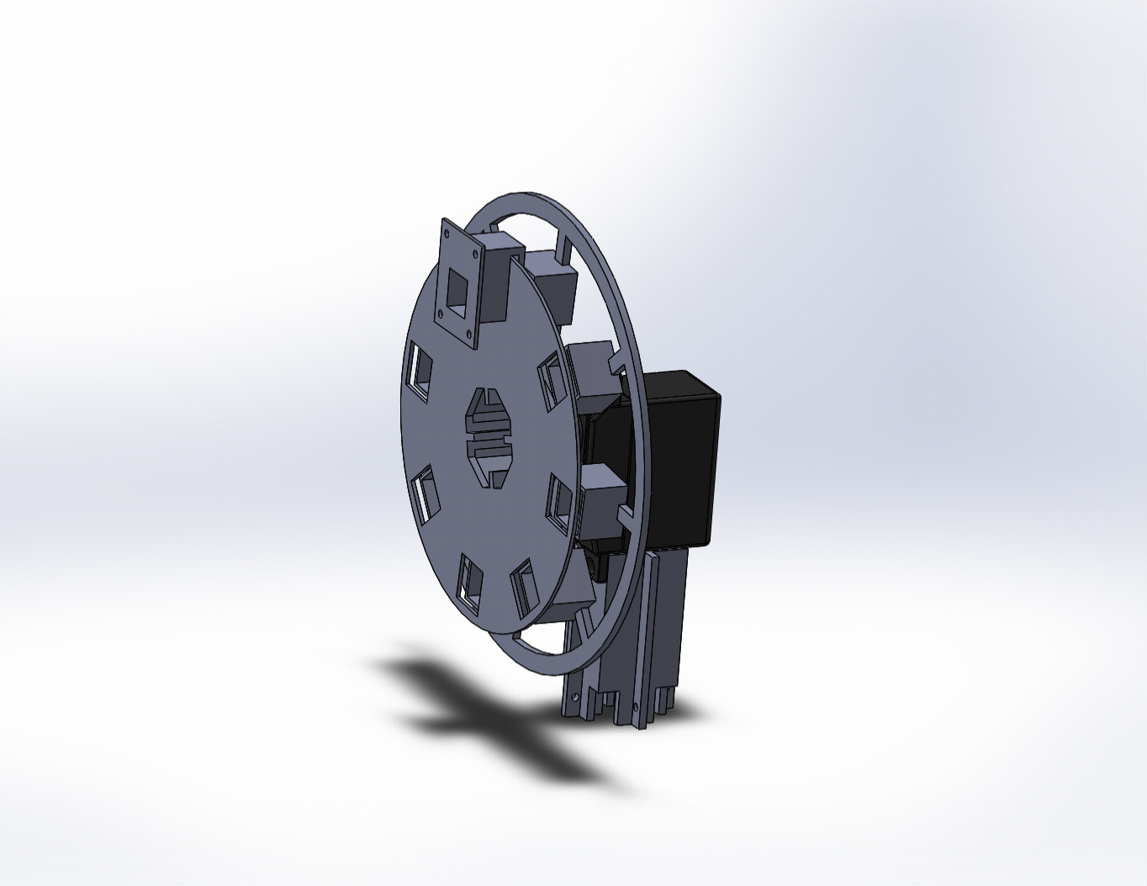
Particle Collection
5

Slide 6
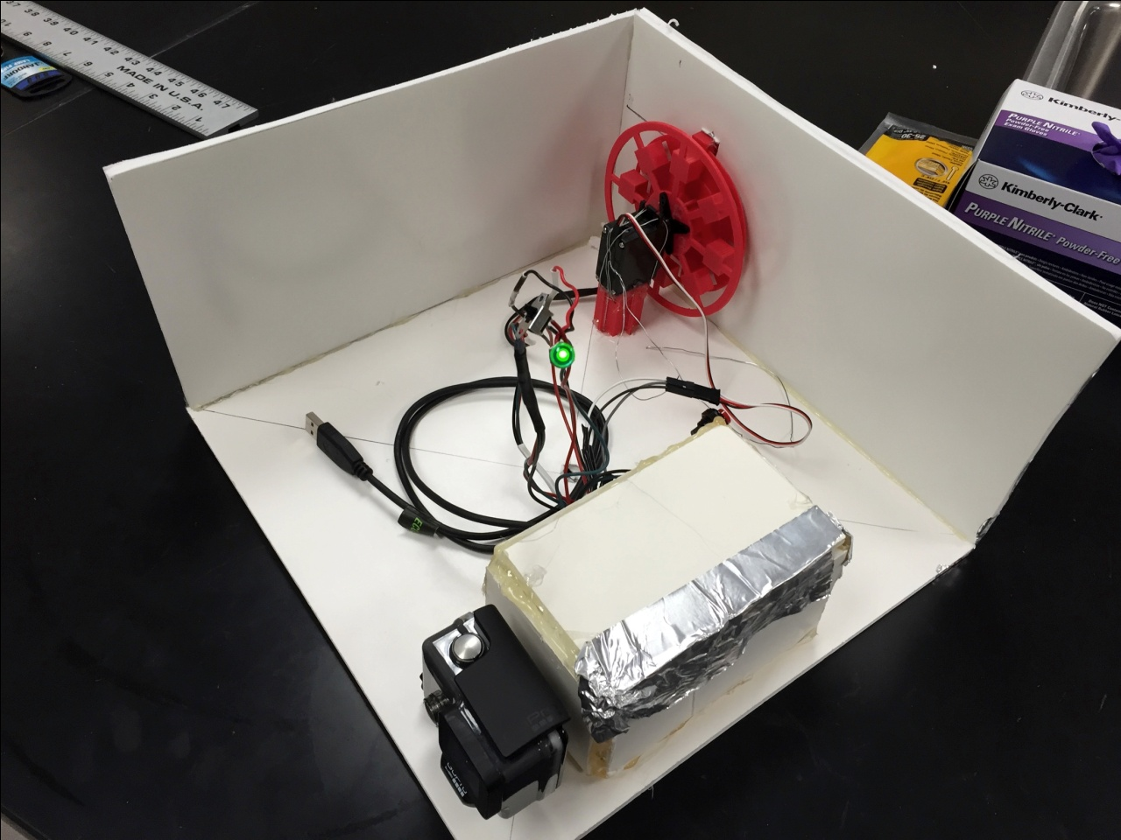
Payload Design: Primary Considerations
6

Slide 7
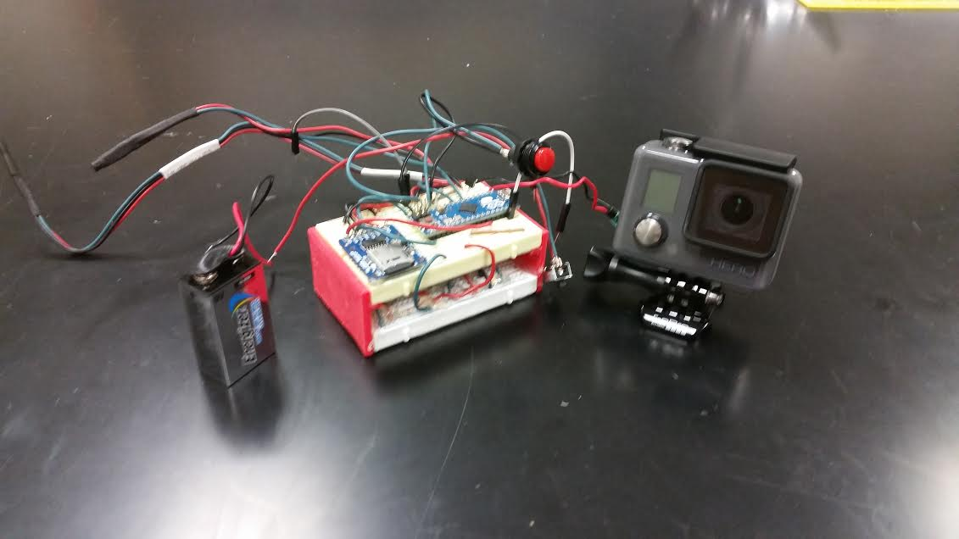
Payload Design: System Controls
1 Arduino Micro microcontroller
3 TMP36 analog temperature tensors
1 MPL3115A2 Altimeter
1 Micro-SD Data Logger
1 DS1307 Real-Time Clock
1 MMA8451 Triple-Axis Accelerometer
1 GoPro Hero HD Camera
Energizer Advanced Lithium Battery
*All mounted on 2 half sized breadboards
7

Slide 8
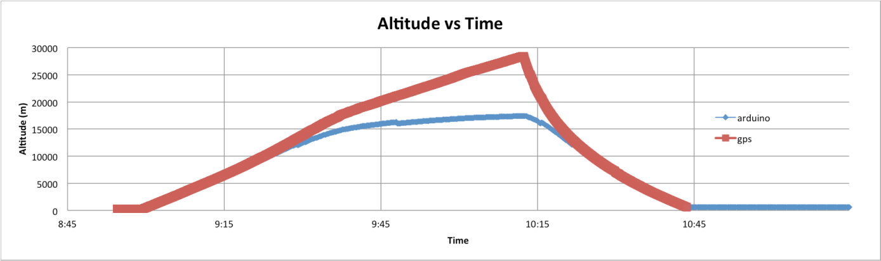
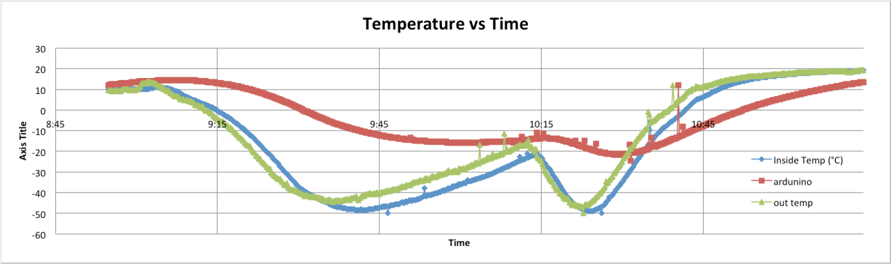
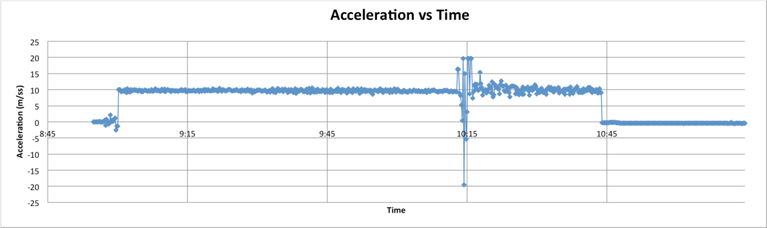
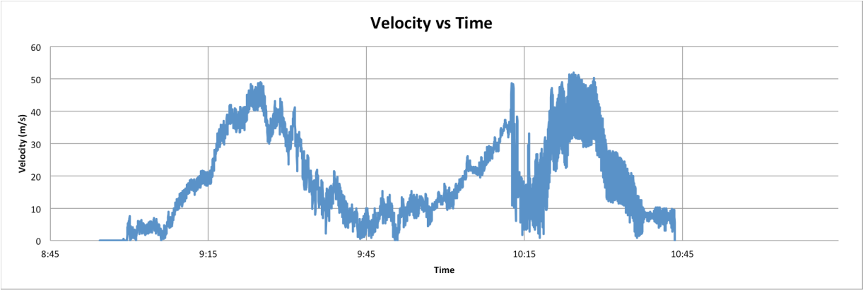
Data Collection
*Altitude and Velocity from ANSR-86 beacon
8

Slide 9
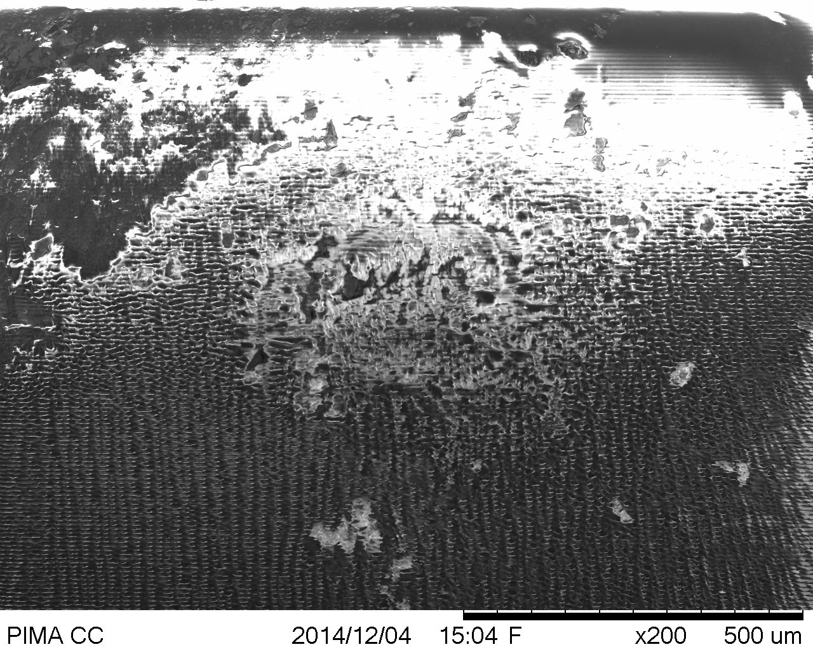
Data Analysis: Particle Collection
Located 4 highest particle counting adhesive papers
Observed them under a SEM
Decreasing particle size with increasing altitude
9

Slide 10
Acknowledgements
Special thanks to the following:
Susan Brew and NASA Space Grant, Jack Crabtree and ANSR,
Silvia Kolchens, Mike Sampogna, Mike Tveten
10

