Slide 1



Low Altitude Particle
Detection #2
Pima Community College ASCEND Team
Team Leader: Andrew Okonya
Team Members: Amorette Dudgeon, Alexandrea Provine, Joel Thibault

Slide 2
Abstract
A new material was used for particle capture
An improved particle collection apparatus was constructed
Significant changes were made to the:
  Location of the intake gates
  Overall shape and size of the payload structure
Hardware was modified for data acquisition

Slide 3
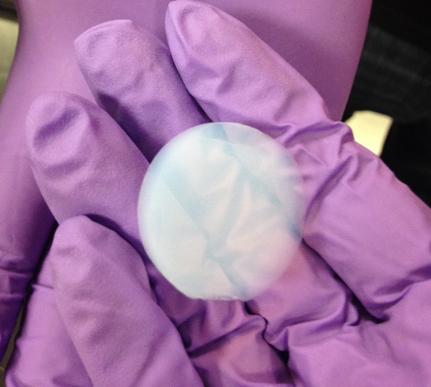
Particle Collection: Aerogel
Based on it’s density, ~0.095 g/cm³, it is one of the lightest materials available
  96% air by volume
Used on Stardust Mission and Mars rover for insulation against very low temperatures

Slide 4
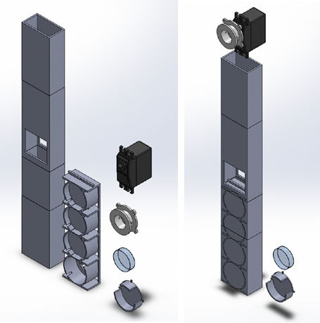
Particle Collection: Apparatus
Induction ports for intake of air
Three cartridges with four sample plates each set to slide approximately every 1,550 meters of altitude
Two sample plates for the fourth and seventh altitude

Slide 5
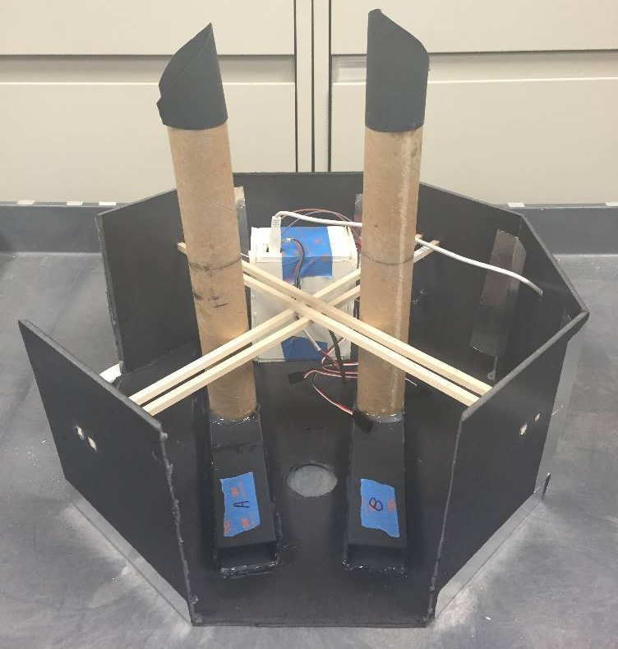
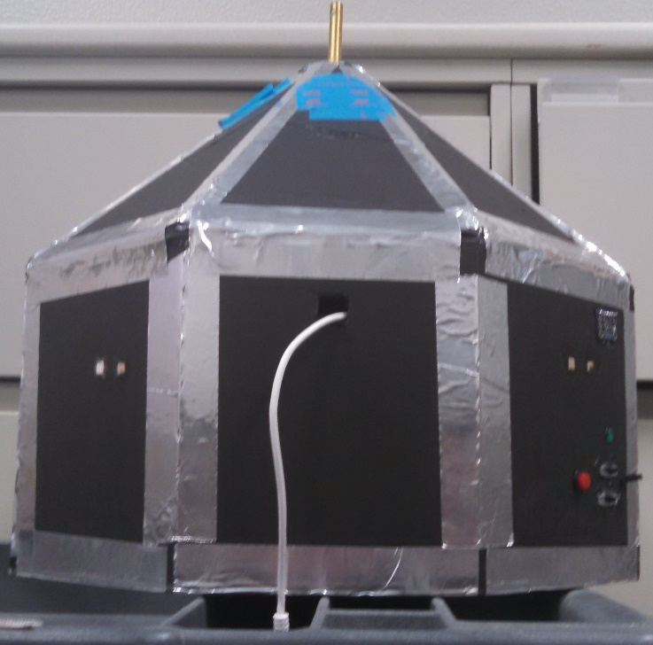
Payload Design: Primary Considerations
Interior view of payload
Exterior view of final payload

Slide 6
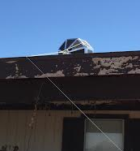
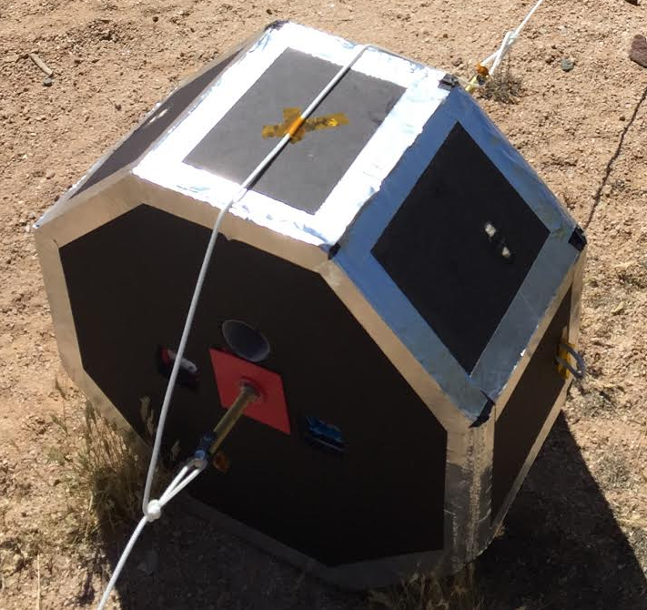
Payload Design: Structural Success!
Location of payload landing
Damage due to impact

Slide 7
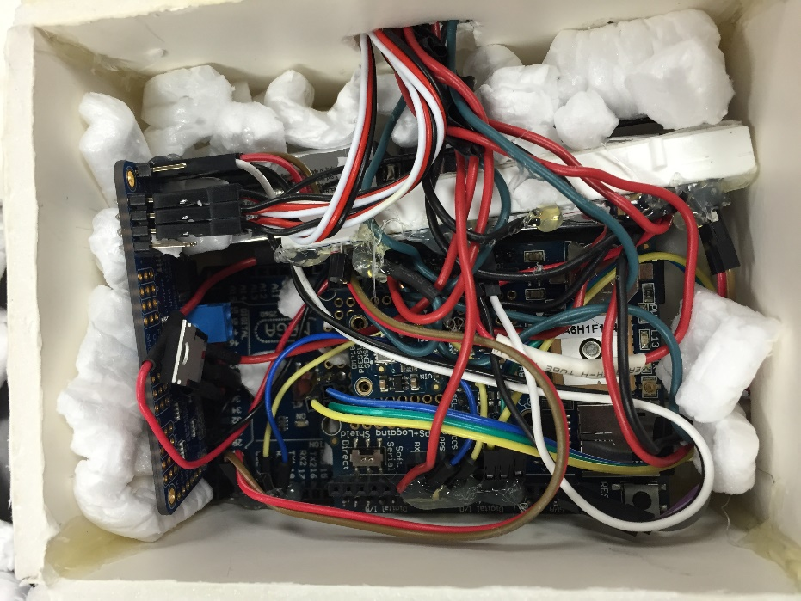
Payload Design: System Controls
1 Arduino Mega microcontroller
1 Ultimate GPS Logger Shield
3 TMP36 analog temperature sensors
1 BMP085 Pressure Sensor
1 MMA8451 Triple-Axis Accelerometer
1 PWM/Servo Driver
2 Energizer Advanced Lithium Battery
3 High Torque Full Rotation Servos

Slide 8
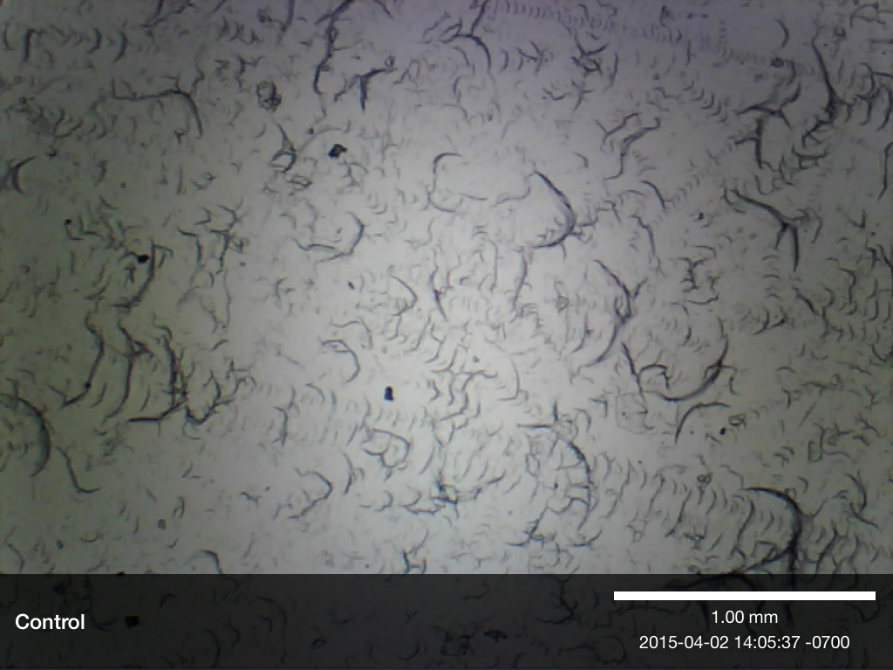
Data Analysis: Particle Collection
Data Collected:
  6 aerogel samples from approximately 500m to 8200m
  2 types of controls
Imaging Tools:
  Light Microscope
  Scanning Electron Microscope (SEM) – Hitachi TM3000
  Energy Dispersive Spectrometer (EDS) – Bruker Quantax 70

Slide 9
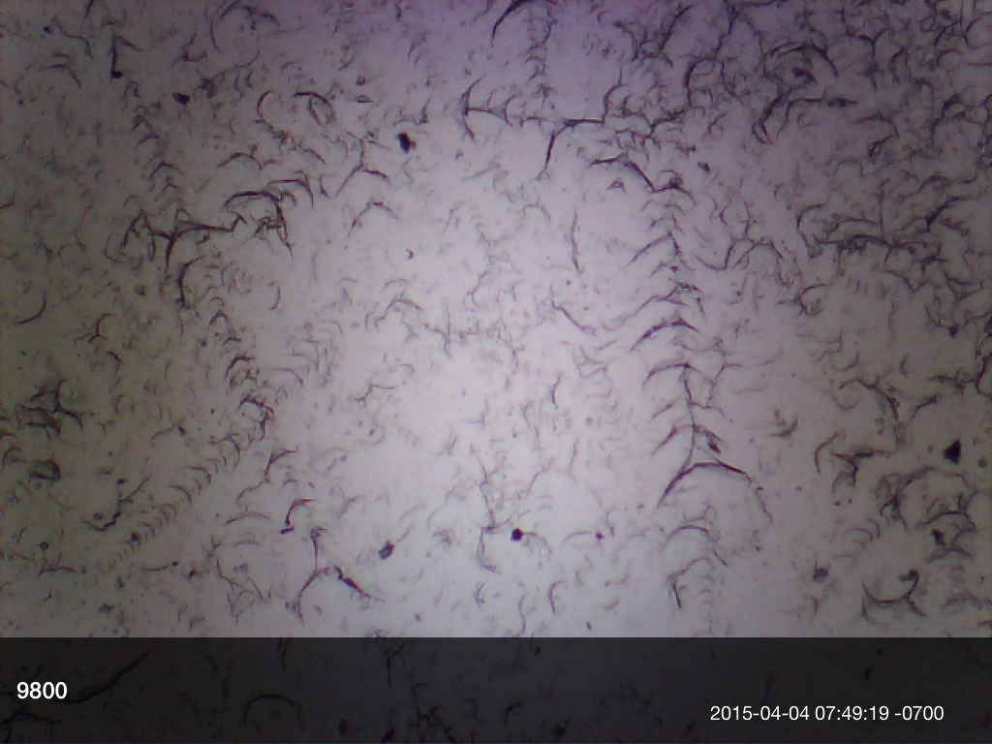
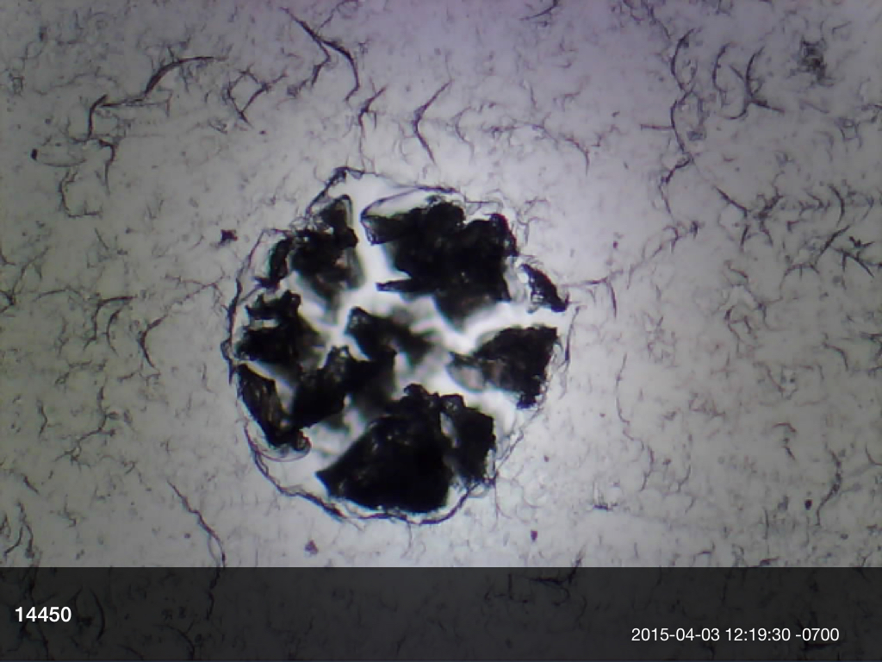
Data Analysis: Light Microscope
“Carrot” type track pattern
Crater type impact pattern

Slide 10
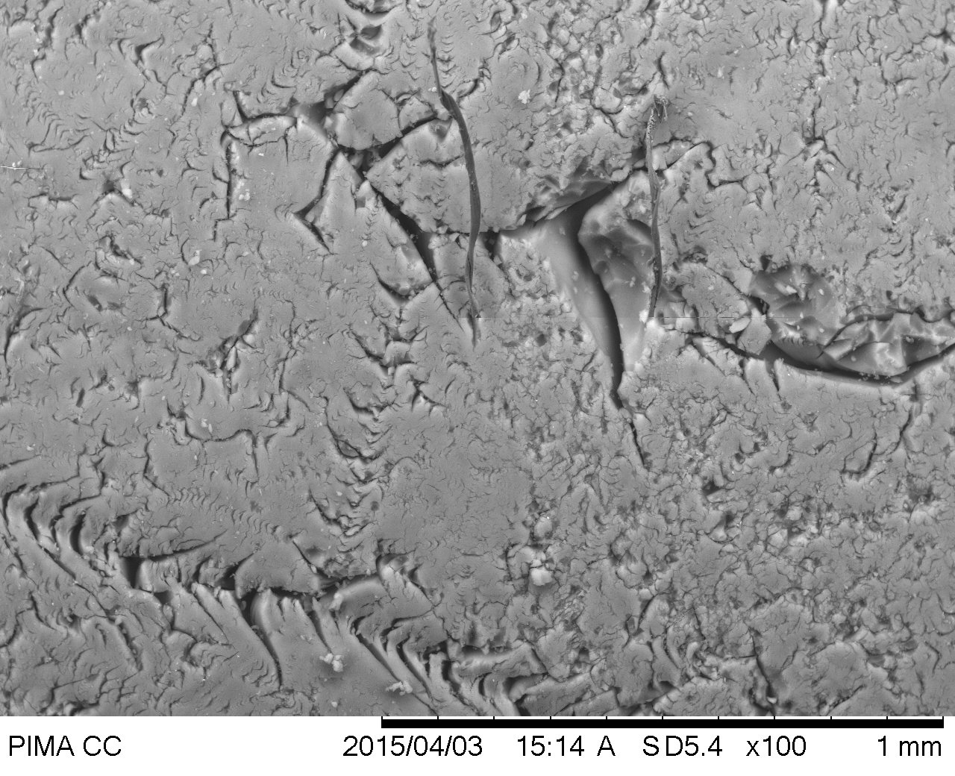
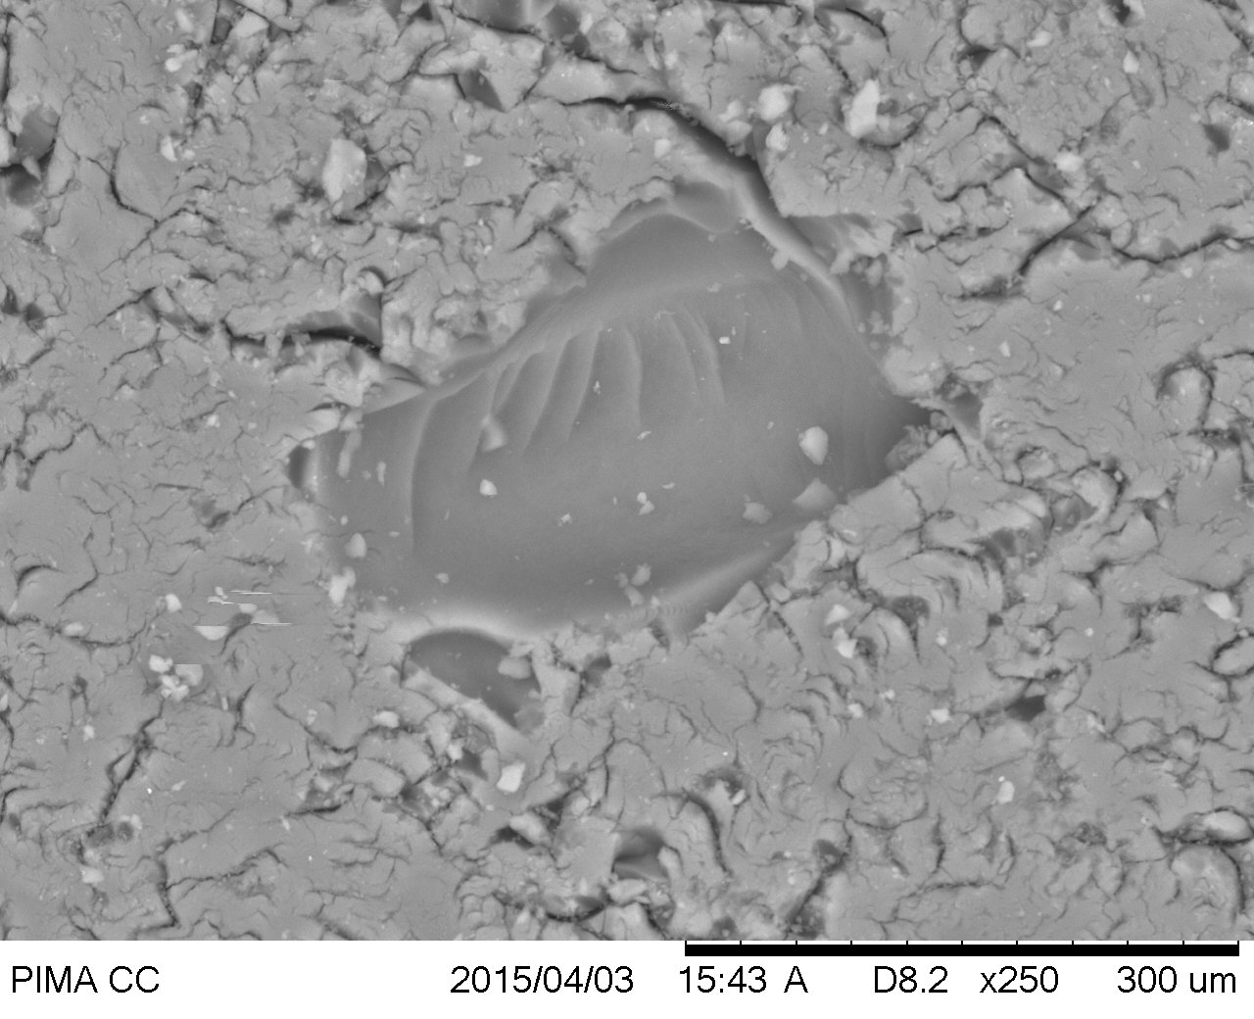
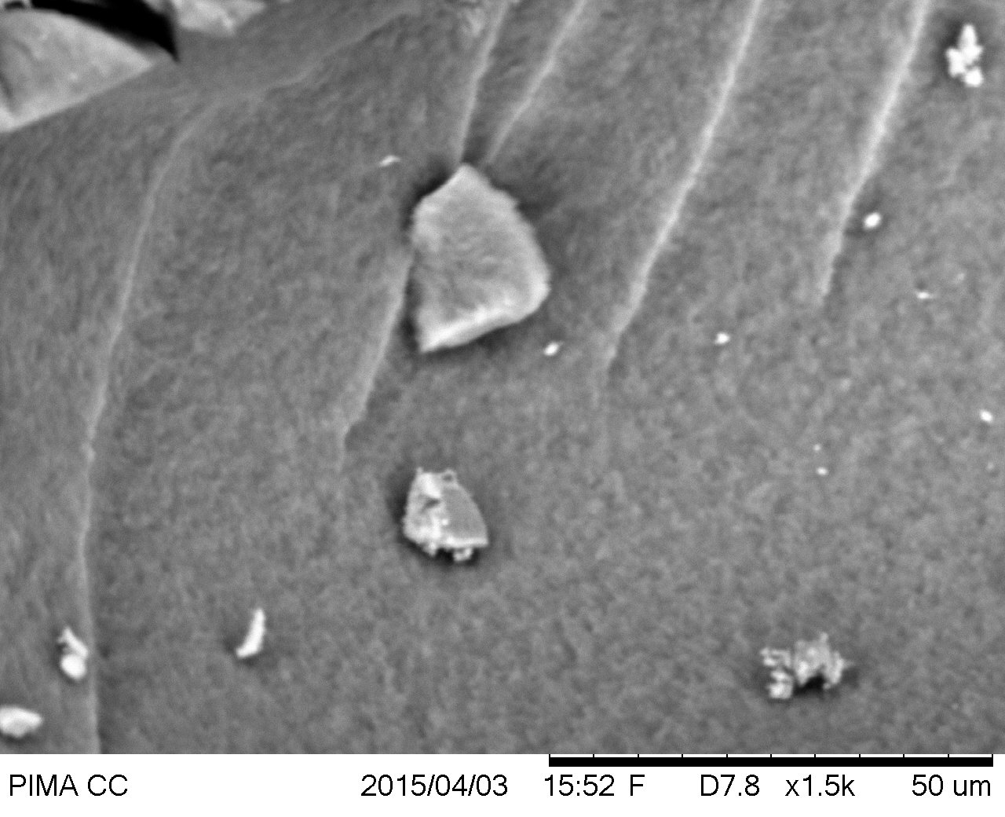
Particle Analysis:
Scanning Electron Microscope

Slide 11
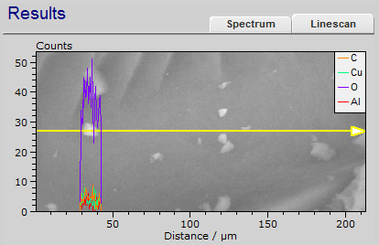
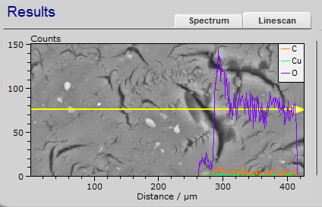
Particle Analysis: Energy Dispersive Spectrometer
EDS analysis revealed the elemental composition of the area underneath the yellow line
In-depth analysis potential
  Particle size vs. altitude
  Complete particle identification
  Particle type vs. altitude
Notes:
EDS attachment on SEM allowed for elemental composition of particles captured
With time, potential analysis could include:
Complete particle identification
Trends in size vs. altitude
Trends in particle type vs. altitude

Slide 12
Lessons Learned
More cognizant of time constraints
  Time between launch and symposium is not conducive for in-depth analysis
  Get materials earlier to do bench testing
Avoid overcomplicating the design
  Fewer aerogel samples; more redundancy
Improved particle collection
Improved structural design
  Pre-assembled payload made for a smooth launch day
Notes:
EDS attachment on SEM allowed for elemental composition of particles captured
With time, potential analysis could include:
Complete particle identification
Trends in size vs. altitude
Trends in particle type vs. altitude

Slide 13
Acknowledgements
Special thanks to the following:
Susan Brew and NASA Space Grant, Jack Crabtree and ANSR,
Silvia Kolchens, Mike Sampogna, Mike Tveten

Slide 14
Works Cited
"Classic Silica™ Disc." BuyAerogelcom. Web. <http://www.buyaerogel.com/product/classic-silica-disc/>.
"Silica AeroGels." Thermal Properties : Silica Aerogels. Web. <http://energy.lbl.gov/ecs/aerogels/sa-thermal.html>.
"Aerogel - and the Mars Rover - NASA Science." Aerogel - and the Mars Rover - NASA Science. Web. <http://science.nasa.gov/science-news/science-at-nasa/1997/msad08jul97_2/>.

