Slide 1
ASU ASCEND
Sensors and Visuals
By
Mason Denney
Mentored By
Thomas Sharp

Slide 2
Chandler
Gila River
Maricopa
Casa Grande Copper Mine
Nissan Testing Course

Slide 3
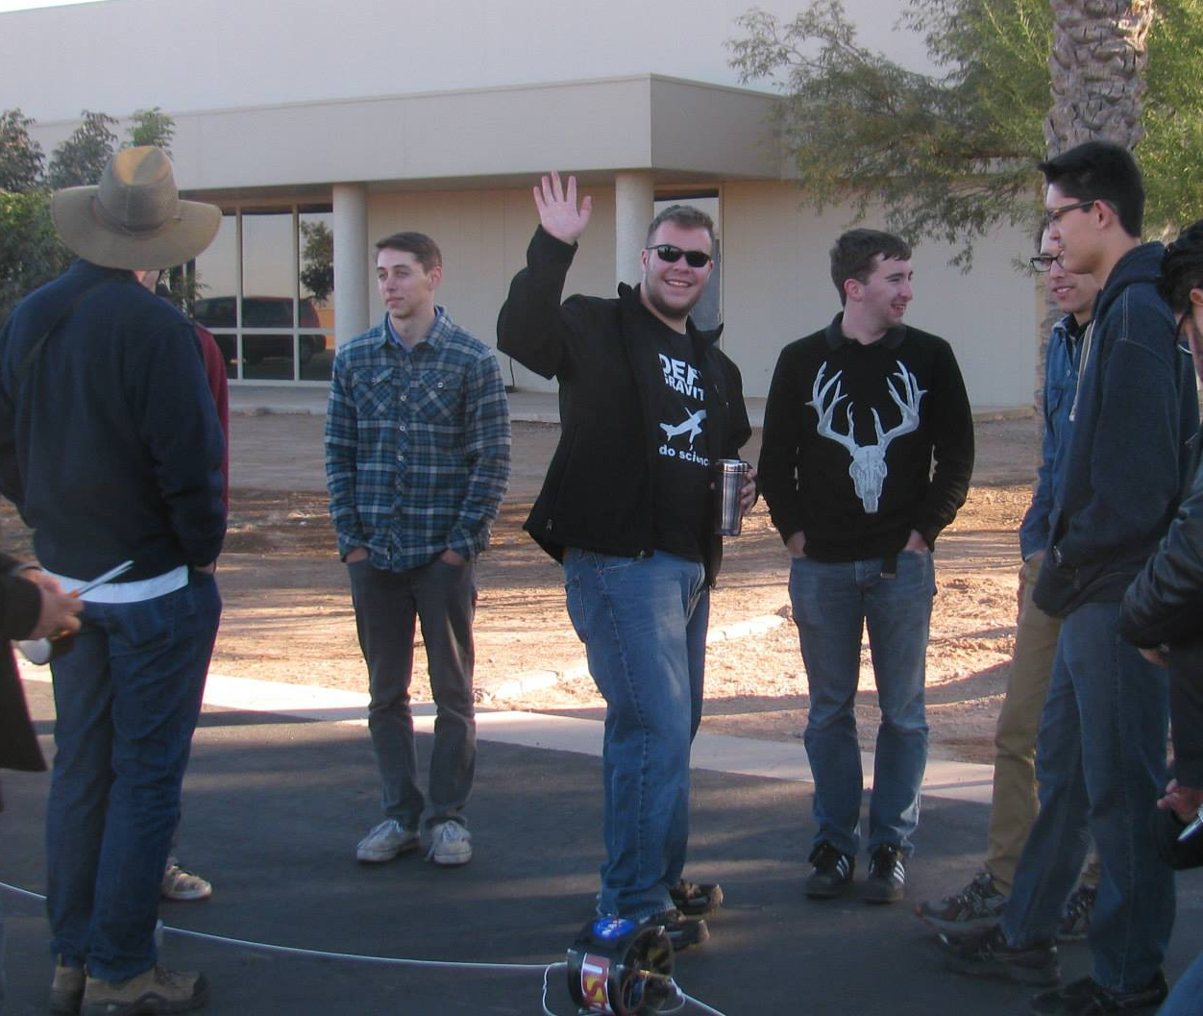
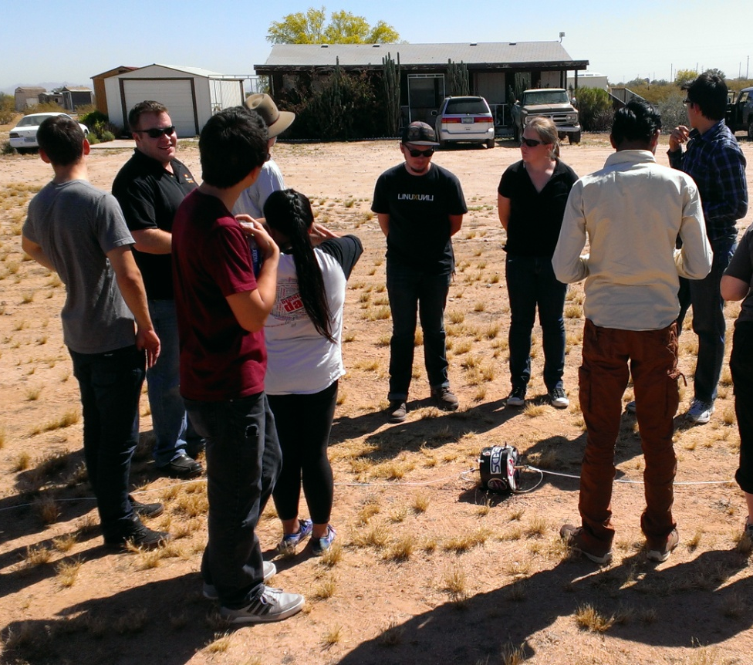
The Team
~12 Members

Slide 4
Recent Flight History
Fall(2012)
  Flip camera failure, sensor success, bike seat fuselage
Spring(2013)
  Hack HD success, sensor failure, box fuselage
Fall(2013) &
  Hack HD failure, sensor success, teardrop fuselage
Spring(2014)
  Hack HD failure, sensor success, teardrop fuselage

Slide 5
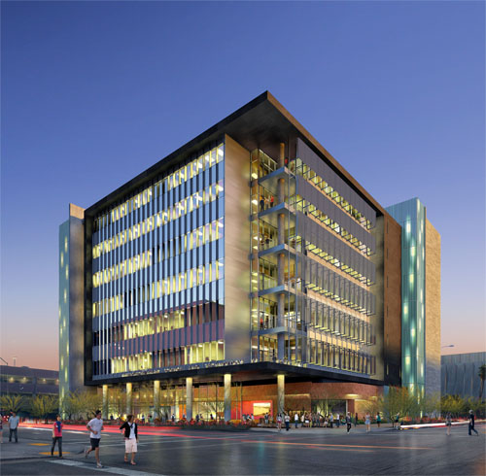
2014-15 Objectives
Fuselage comparison
  Teardrop vs. Cylinder
Add new types of environmental data
  Geiger Counters, UV
Reliable cameras
360° Panorama
  Outreach at ISTB4

Slide 6

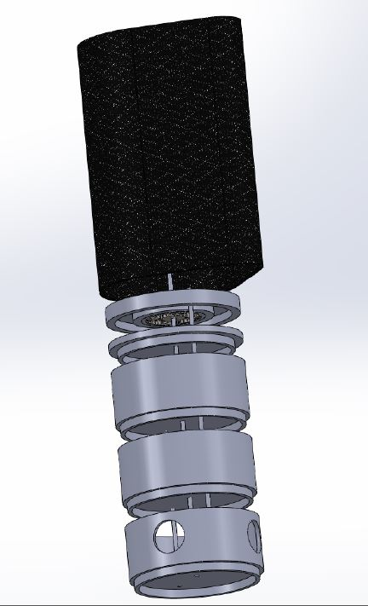
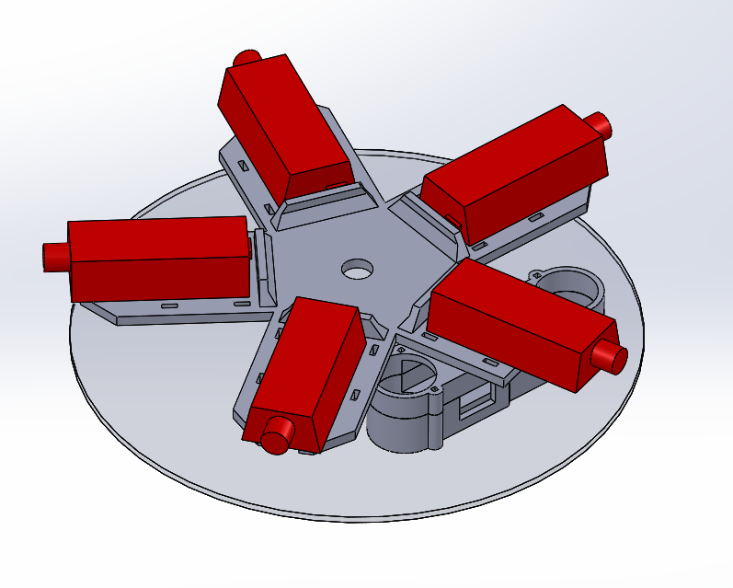
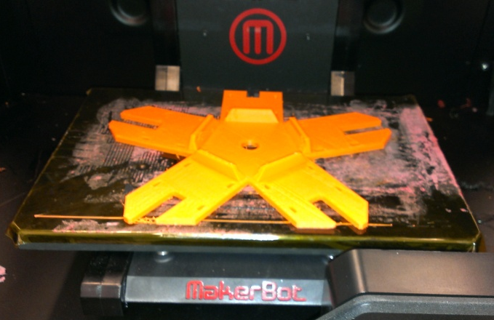
New Fuselage and Support
Wind Stabilization
Unobstructed Panorama
Dependable Materials
3D Support Structure

Slide 7

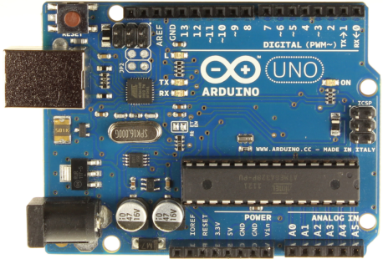
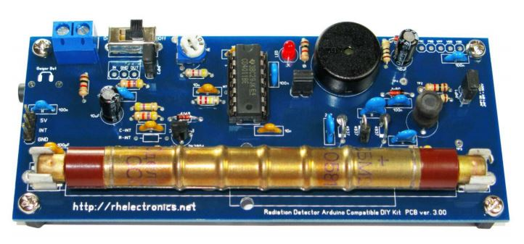
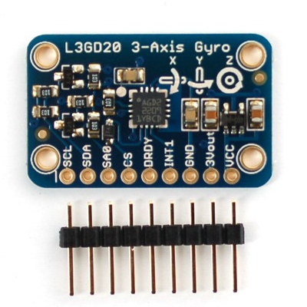
Sensors
Arduino Uno
Barometer
  Altitude
  Temperature
  Air Pressure
Accelerometer
Gyroscope
UV Sensor
Geiger Counter
  SBM-20

Slide 8
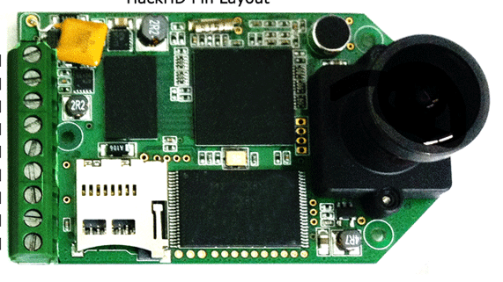
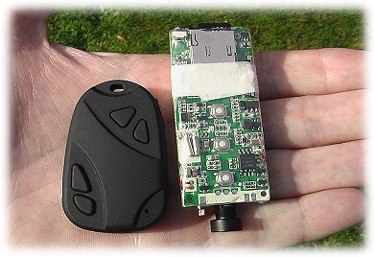
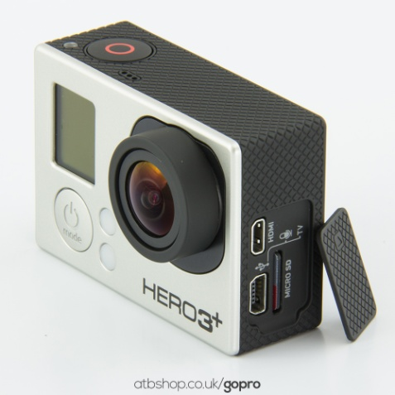
Cameras
Hack HD replaced by HD Wing
GoPro Hero3+ Black

Slide 9
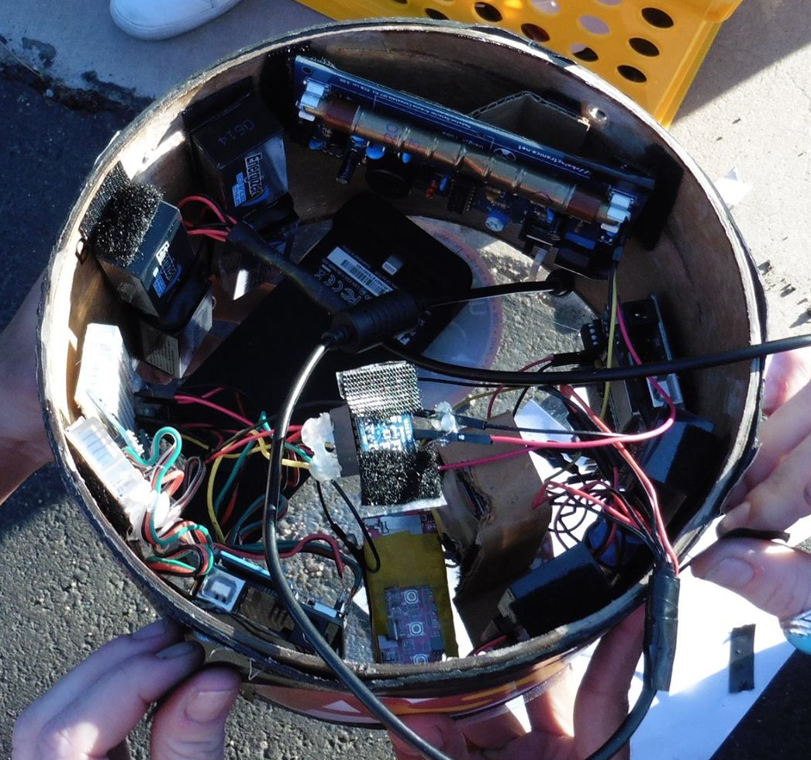
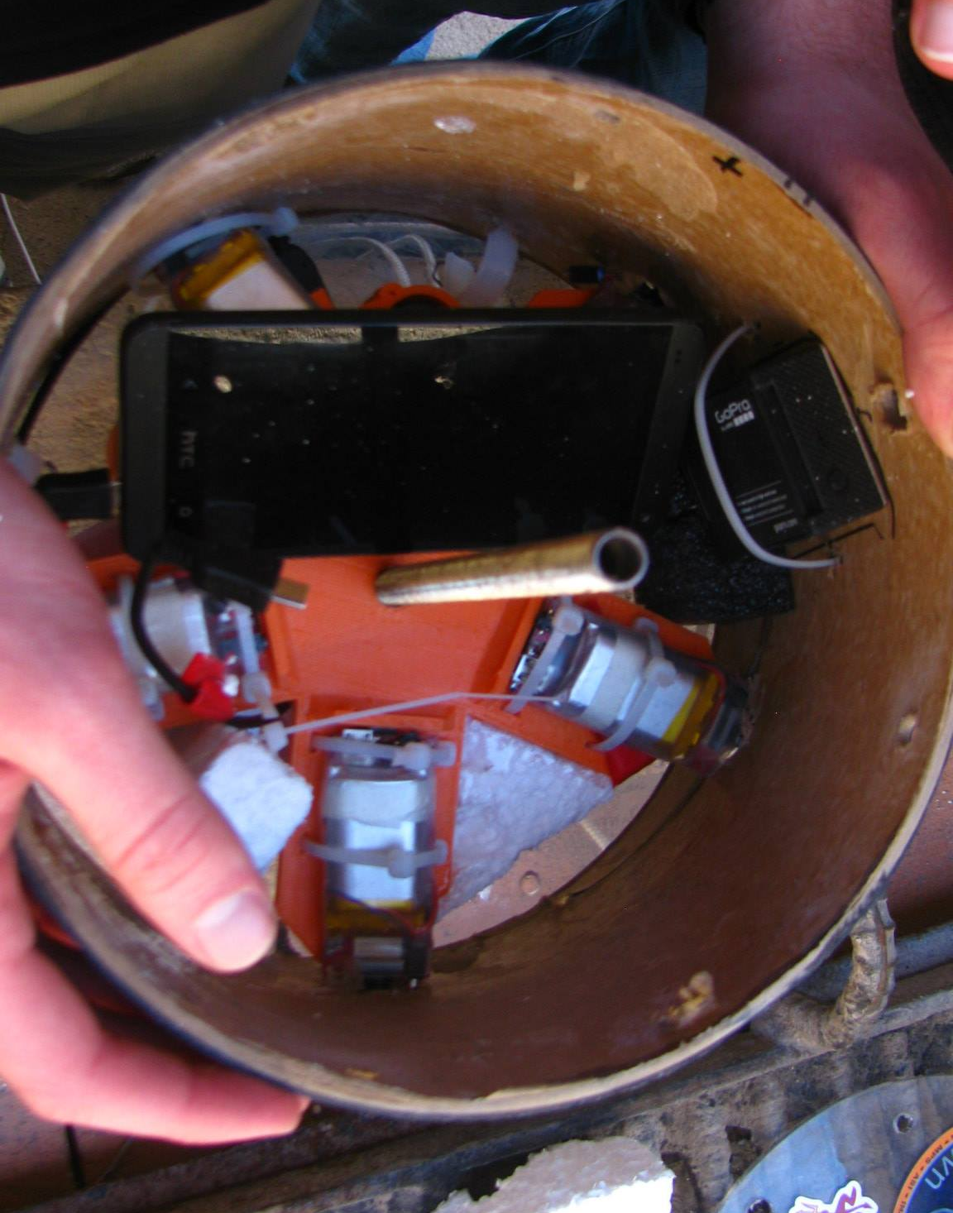
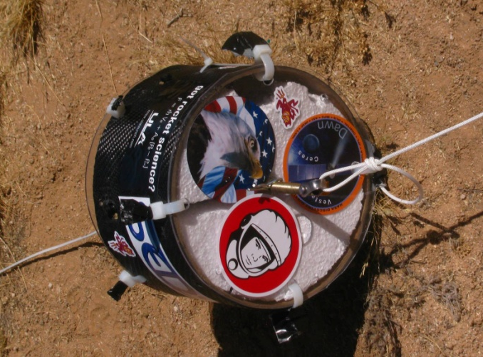
The Payload

Slide 10
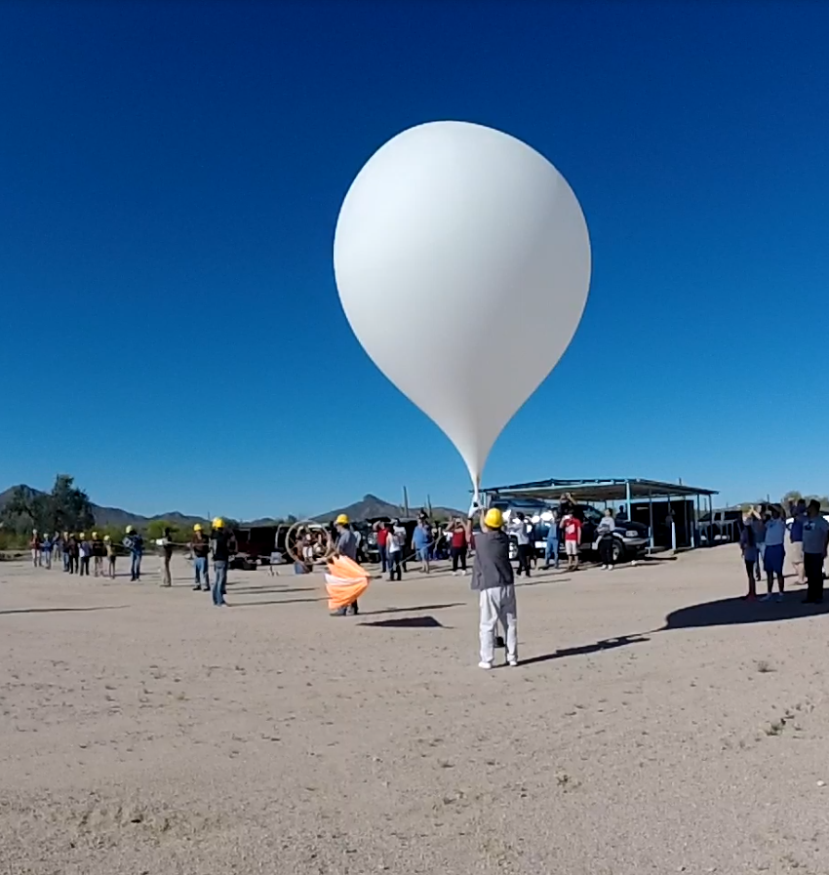
Launch and Retrieval

Slide 11

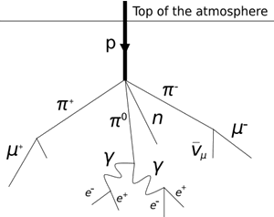
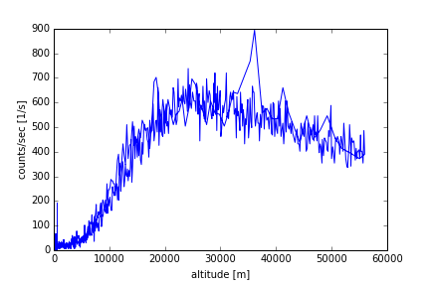
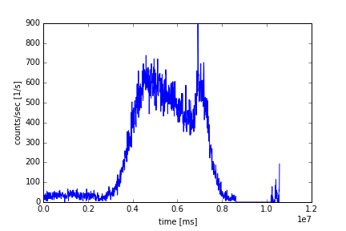
Data Processing - Geiger Counter
with Python

Slide 12
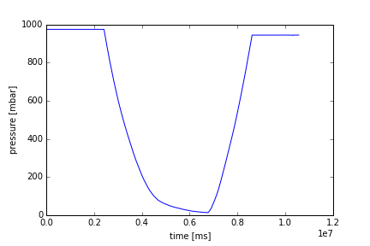
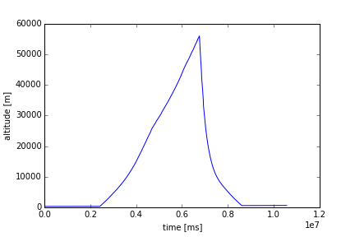
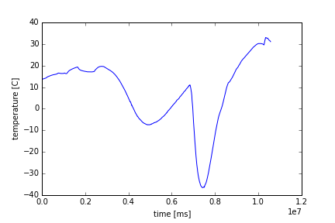
Data Processing - Barometer

Slide 13

Camera Footage
Visual cameras worked!
Youtube: ASU/NASA Space Grant
Processing panorama

Slide 14

Conclusion
2014-15
  Success!
  Processing data
2015-16
  New Sensors
  More 3D printed parts

Slide 15

Thank You!
Questions?

