Slide 1


Utilizing High Altitude Balloon Platforms for Super Resolution Imaging
Jack lightholder
Mentor: DR. tom sharp
Space grant Symposium
April 18th, 2015

Slide 2
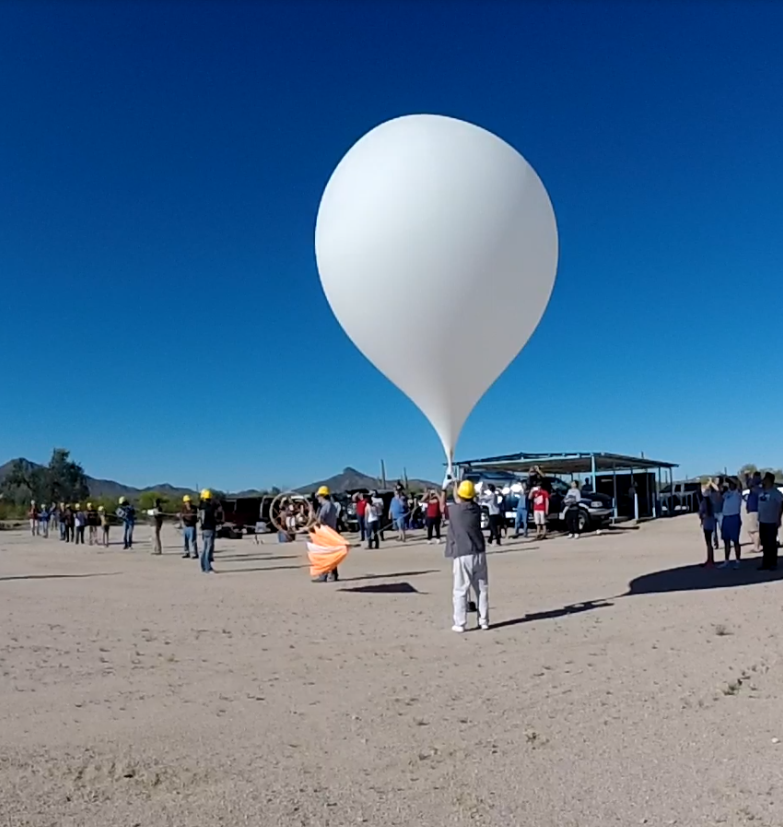
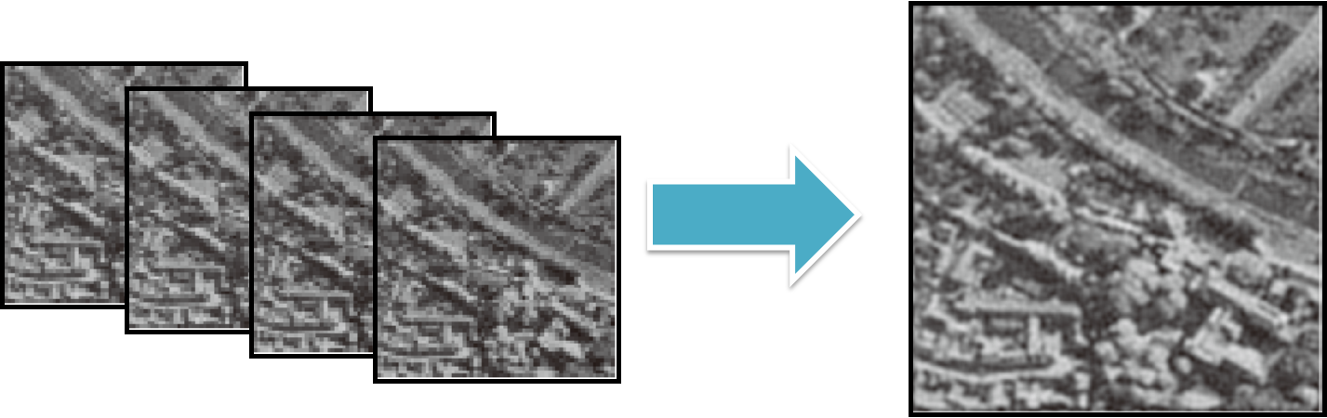
objectives
Enhance super resolution imaging algorithms.
Collect thermal images of population centers and agricultural areas.
Test infrared sensing depth from near space.
Capture thermal data of high altitude payloads.
April 18, 2015

Slide 3
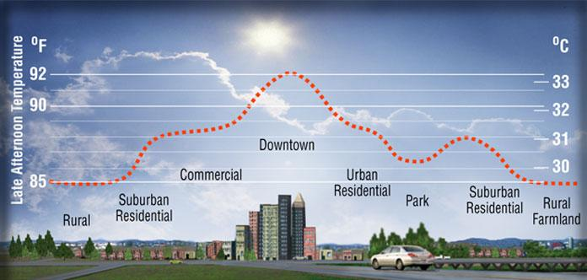
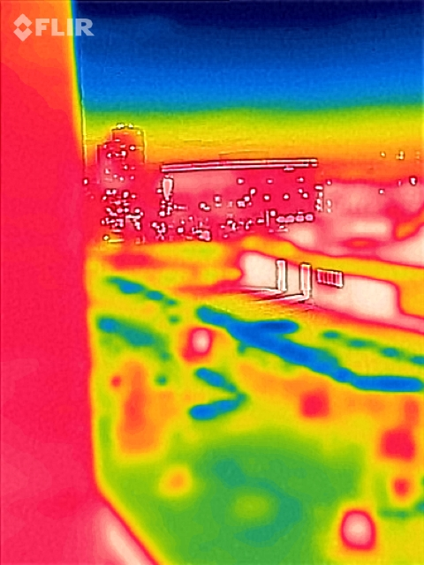
Technology applications
Satellite resolution enhancement.
Reduction of the urban heat island.
Simplified data set for algorithmic enhancement.
New high altitude balloon instrumentation capabilities.
April 18, 2015

Slide 4
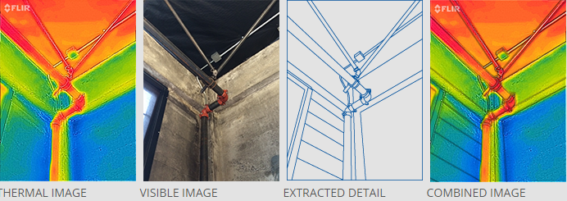
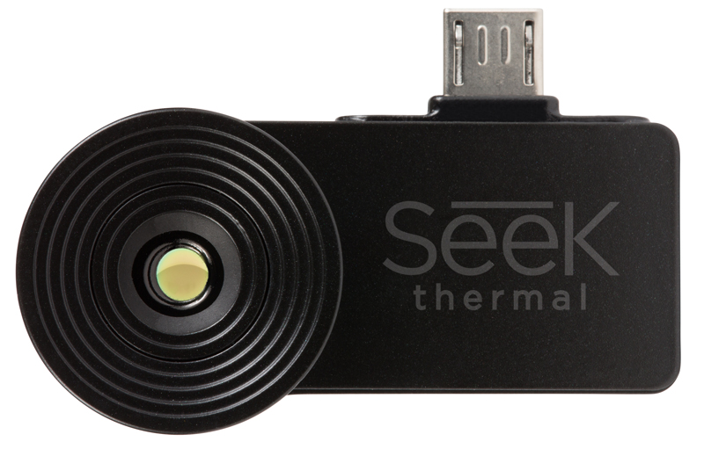
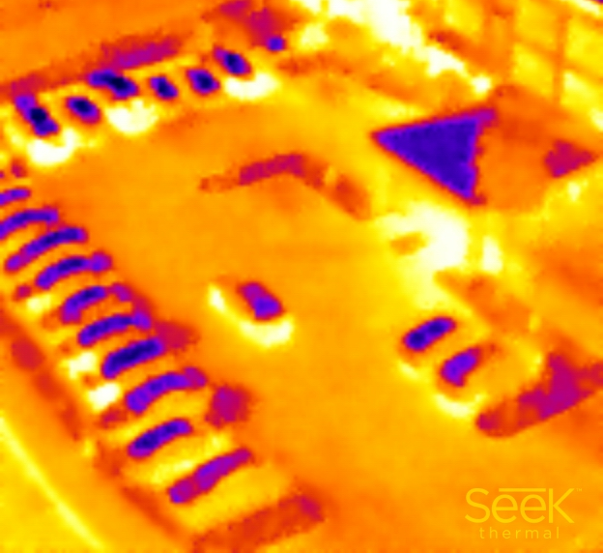
Infrared equipment
36º Field of View
Fixed Focus
Resolution: 206 x 156 Array
-40C to 330C Detection
Long Wave Infrared 7.2 – 13 Microns
Combined Imaging Vs. Thermal Standalone
April 18, 2015

Slide 5
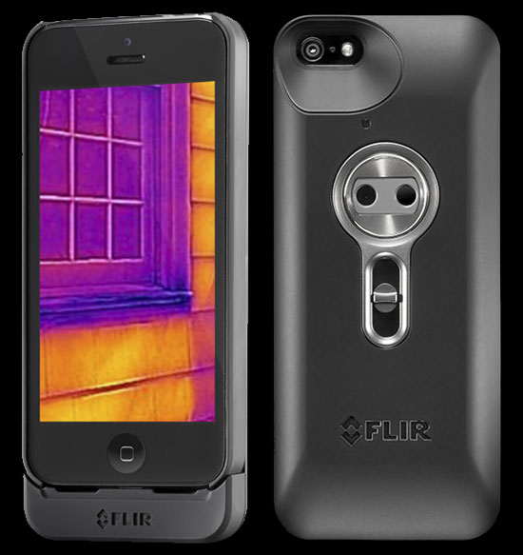
approach
Two phase approach for cost reduction and technology verification.
Phase 1
Single camera system – depth and resolution testing
Visual/IR combined imaging system
Verify feasibility of high altitude IR measurements
Phase 2
Dual camera system – precision data set development
Standalone IR dataset with relative reference visual cameras.
Incorporate precision pointing technologies.
April 18, 2015

Slide 6
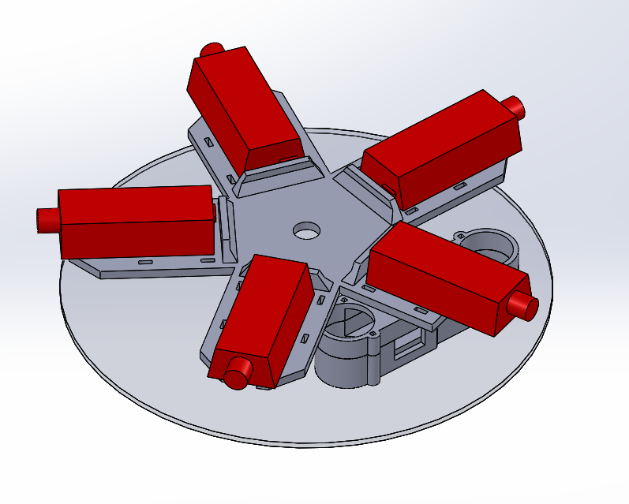
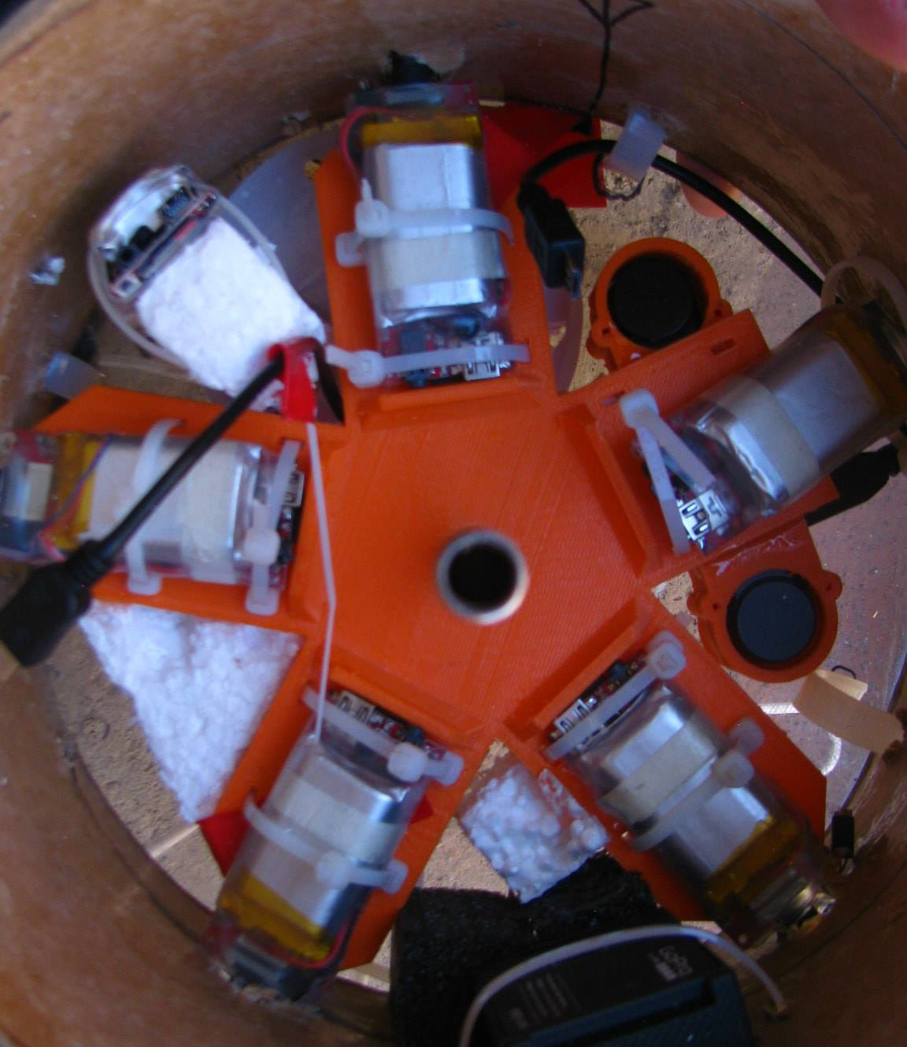
Payloads
Fall 2014
Carbon fiber shell with acrylic endcaps
2 visual cameras
FLIR camera (FLIR ONE)
Geiger counter
UV sensor
Accelerometer/gyroscope/altimeter
2.75 lbs.
Spring 2015
Carbon fiber shell with acrylic endcaps
7 visual cameras
2 FLIR cameras (Seek thermal)
3D printed alignment bracket
2 android smartphones
2.88 lbs.
April 18, 2015

Slide 7
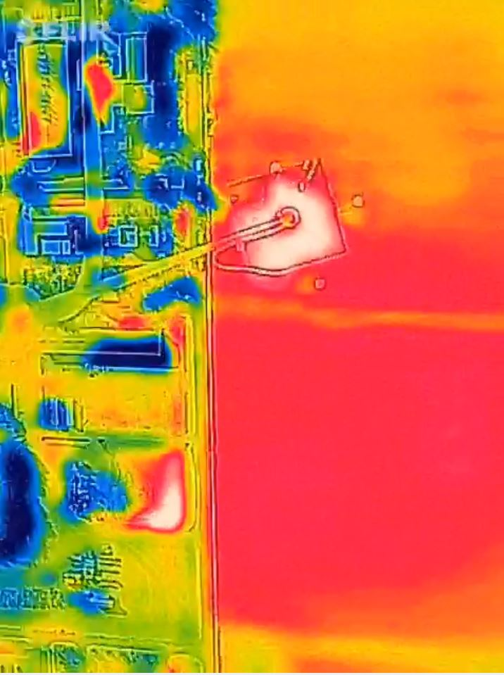
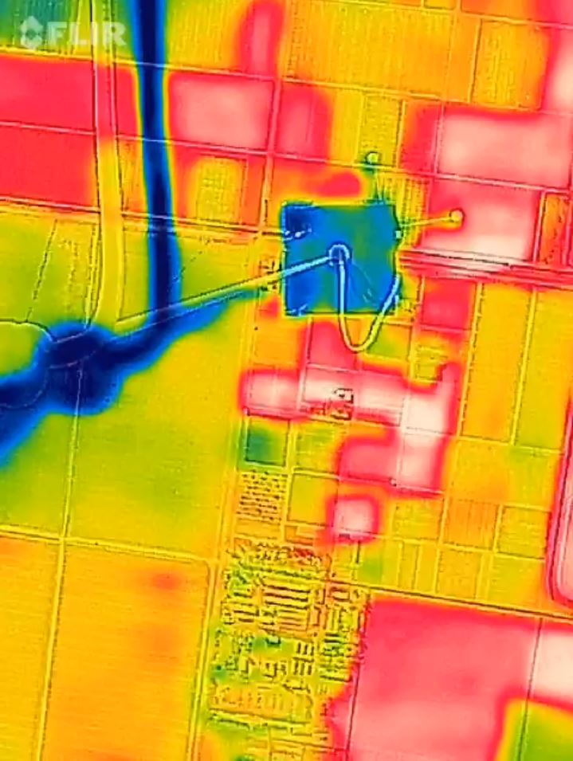
results
Temperature Variation Following Ground Shadows
Ground temperature variation consistent with sun angle and obstruction shadowing.
Agricultural Field Differentiation
Varied heat signatures from fields containing different crops.
April 18, 2015

Slide 8
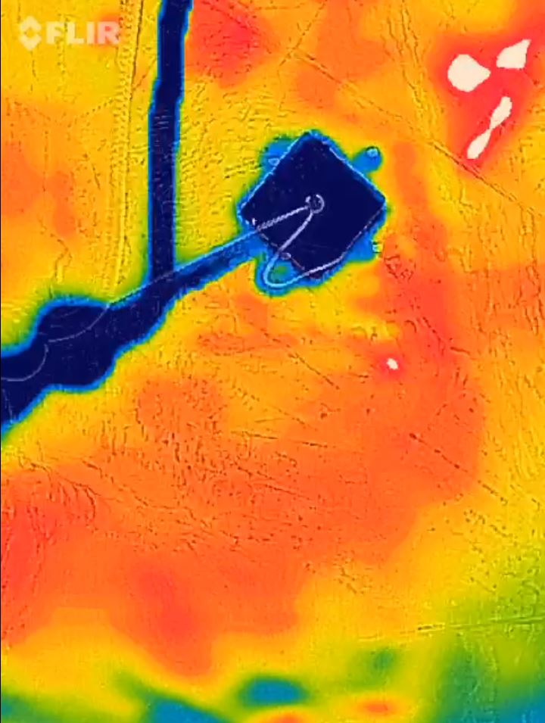
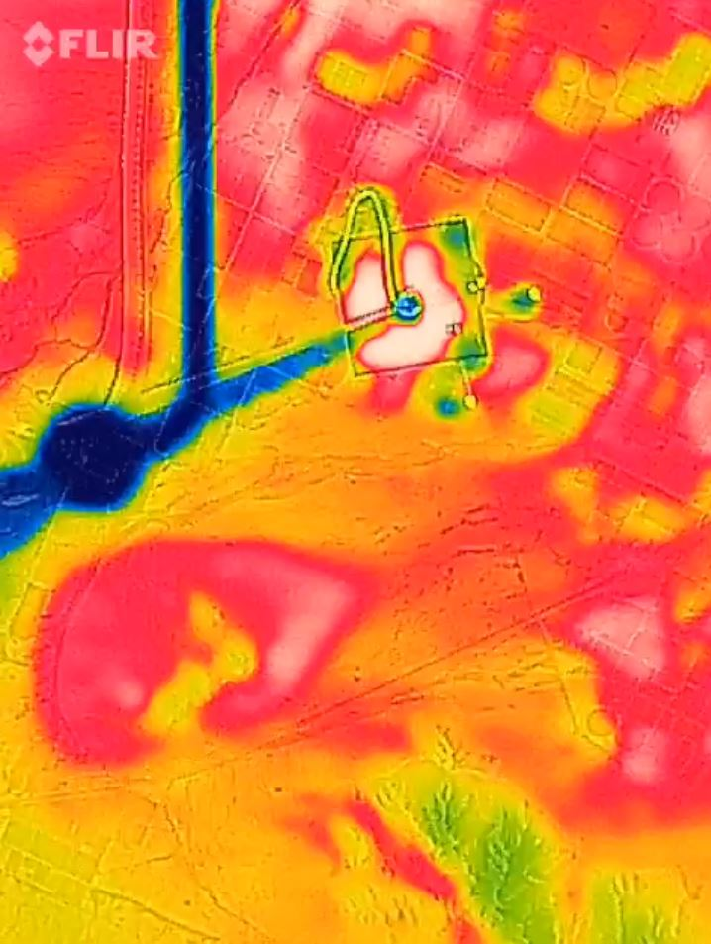
results
High altitude depth verification
Contrast between cold near space payload & hot ground surface.
Foreground and background precision
Local accuracy of object’s expected temperatures at both low and high altitudes.
April 18, 2015

Slide 9
Results
Successful data collection of city centers & agricultural fields
Successful imaging of near space payloads
Verified high altitude sensing depth of off the shelf IR cameras
Failed to produce stereo dataset capable of being super resolved
IR Data Products | Time (minutes) | Data (MB)
Fall Camera | 87 | 890
Spring Cameras | 16 | 75
Combined Imaging | Thermal Standalone
10 MB / Minute | 5 MB / Minute
80 x 60 (IR) 640 x 480 (visual) | 206 x 156 pixel array
April 18, 2015

Slide 10
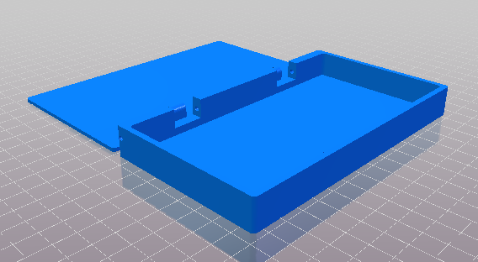
Future work
Eliminate smartphone fault issues
Collect overlapping standalone IR datasets.
Compare existing super resolution imaging algorithms.
Test potential enhancements to existing algorithms.
Incorporate overlapping visual spectrum images for computational comparison.
Quantify ground features and their impact on the urban heat island.
Smartphone protective housing.
April 18, 2015

Slide 11
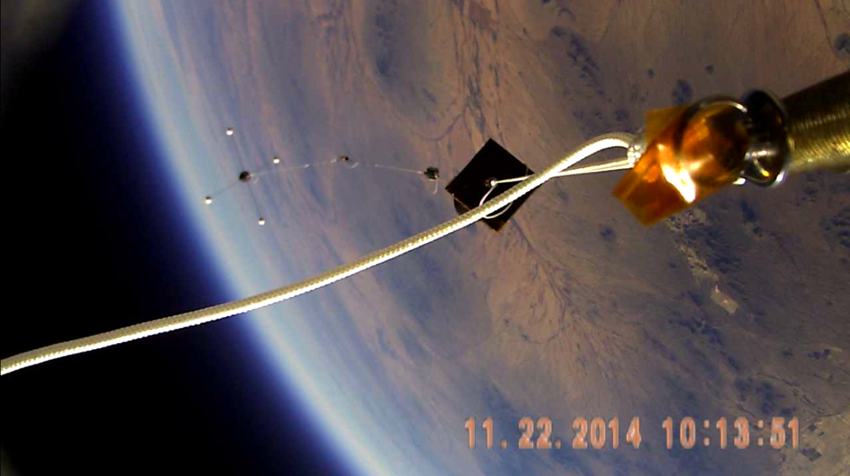
Thank you!
Questions?

