Slide 1




AC & the Ciscos
Amelia, Cesar, Francisco, & Francisco
ASCEND Balloon Project

Slide 2

PROJECT GOALS
Circuit Design
Antenna Build
Bluetooth Communication
Live Position Reporting
Arduino Software Development

Slide 3

Earned Our Ham Radio Licenses
Two Ham Radio Operators
First things first!
Cesar Marin KG7OKP
Amelia Guice

Slide 4
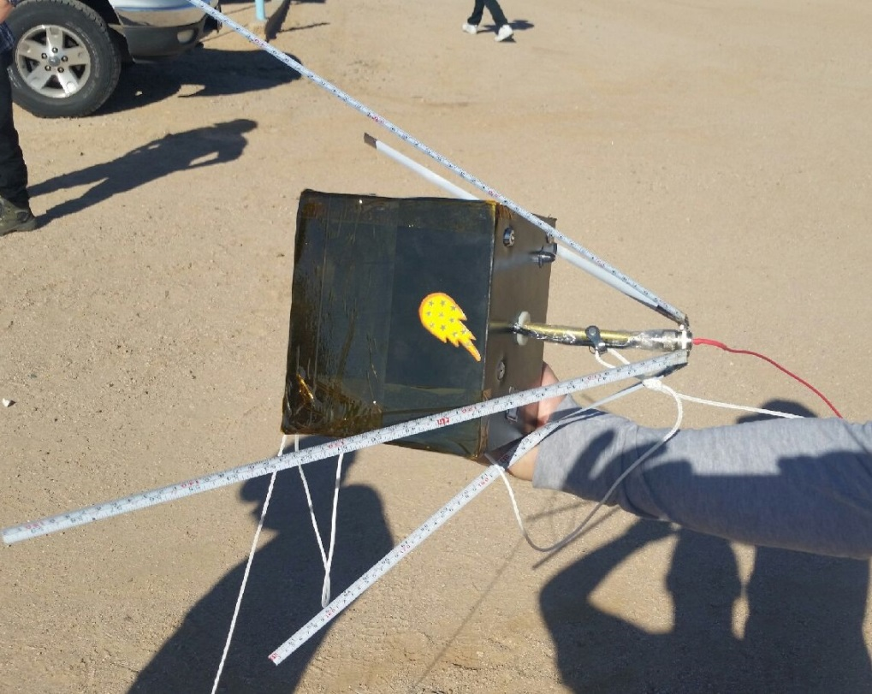
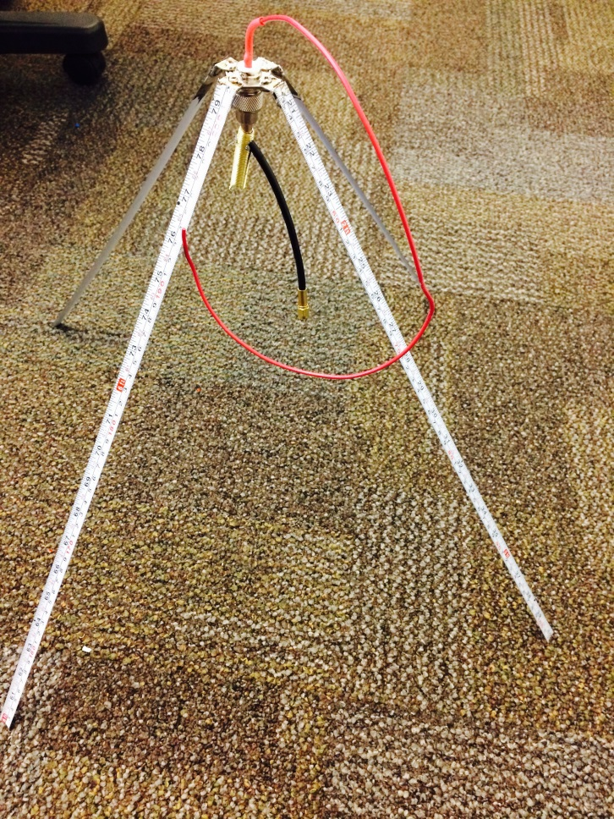
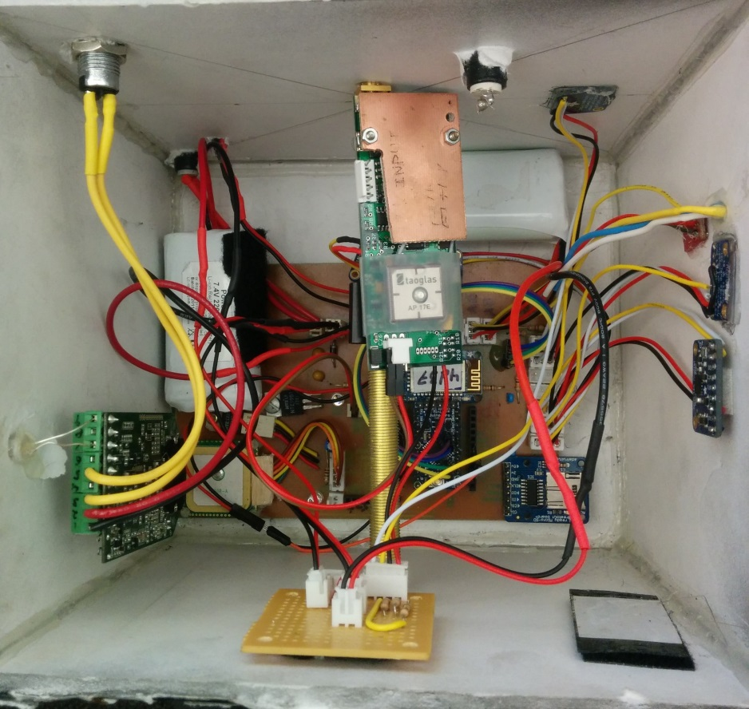
OUR PAYLOAD
Electronics
Antenna

Slide 5
System Block Diagram
Big Reed Bee
GPS
Humidity
Arduino
Bluetooth
Accelerometer
Back up GPS
Micro SD
Temperature

Slide 6
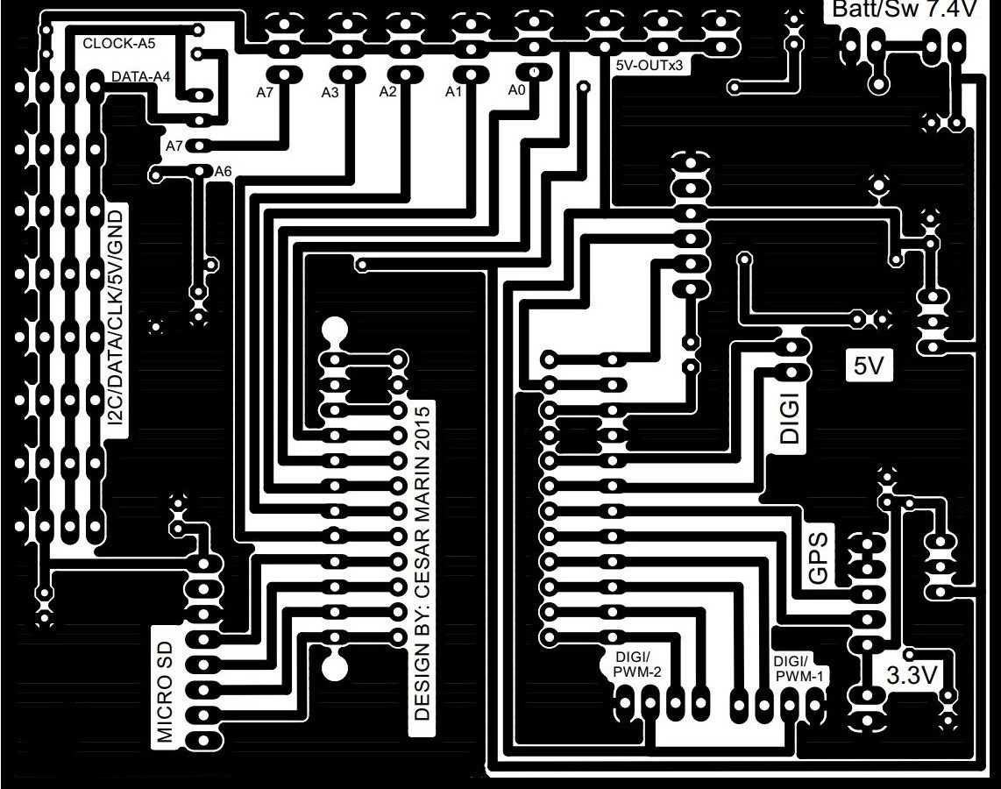
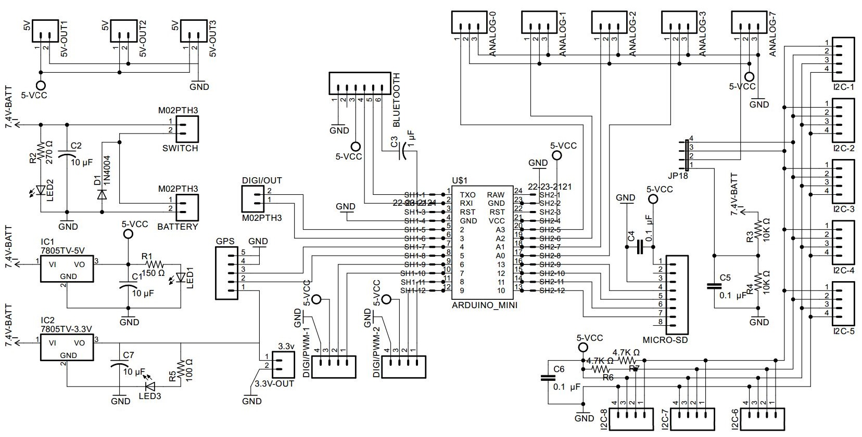
Circuit Design
Schematic
Arduino Board

Slide 7
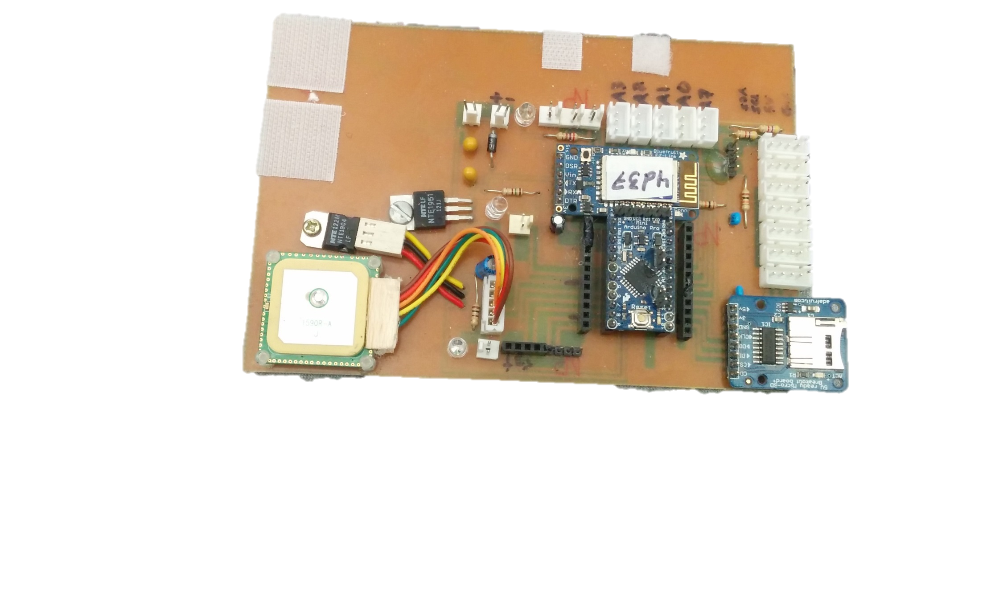
Circuit Design

Slide 8
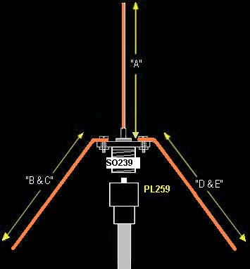
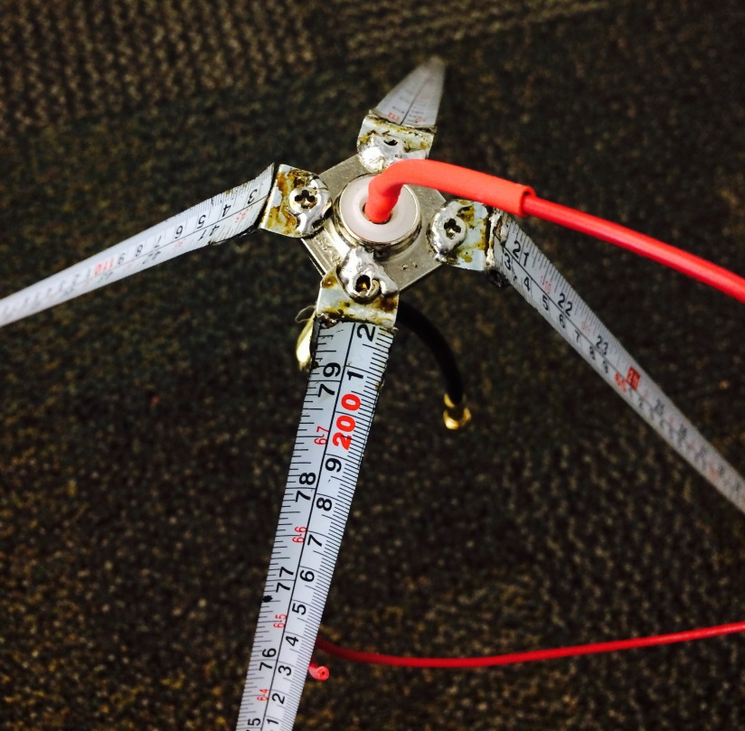
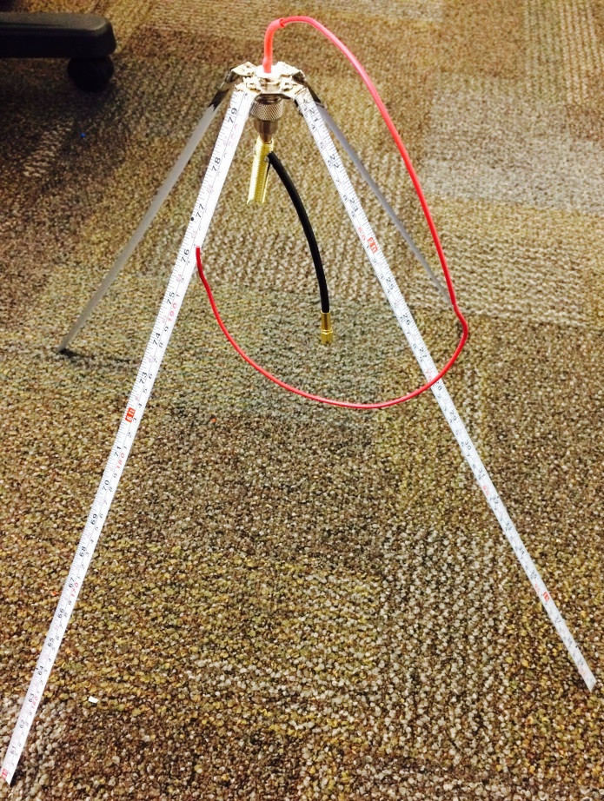
Antenna Build
50cm Length Radials (B,C,D &E) & Radiator (A)
Quarter Wave Ground Plane Antenna

Slide 9
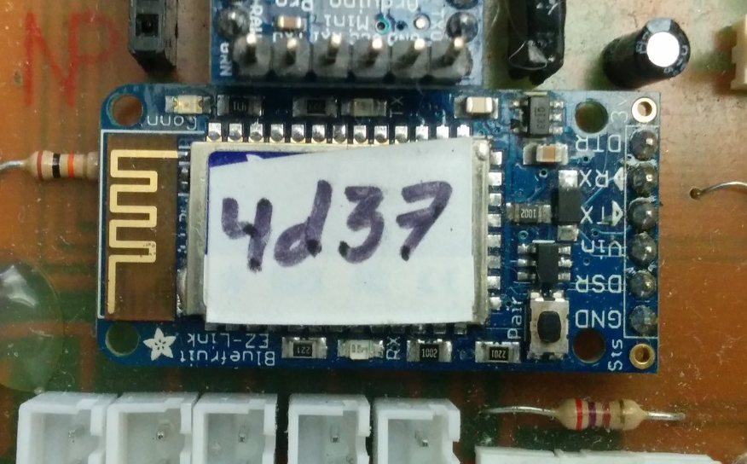
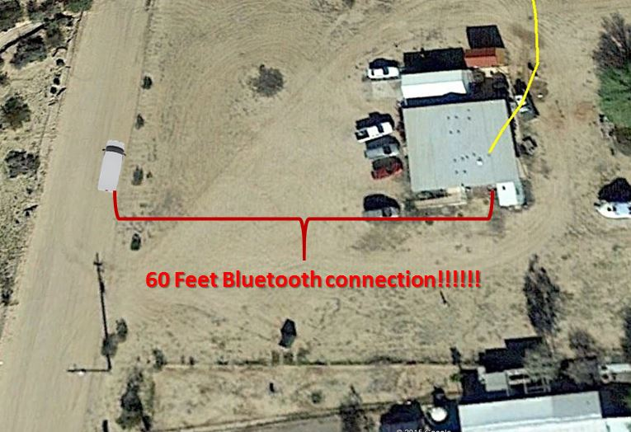
Bluetooth Communication
Bluetooth
Remote Data Retrieval

Slide 10
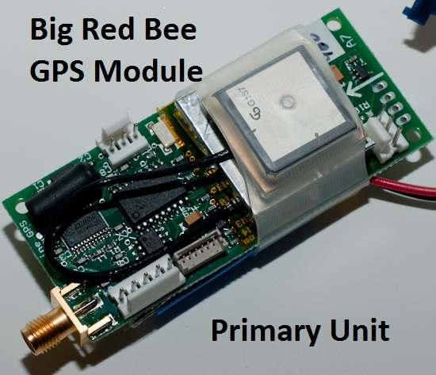
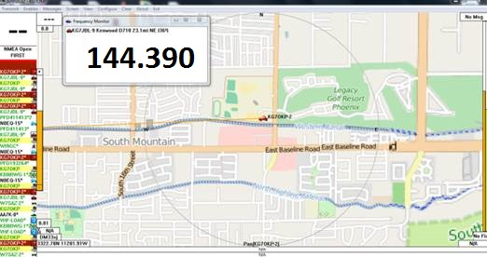
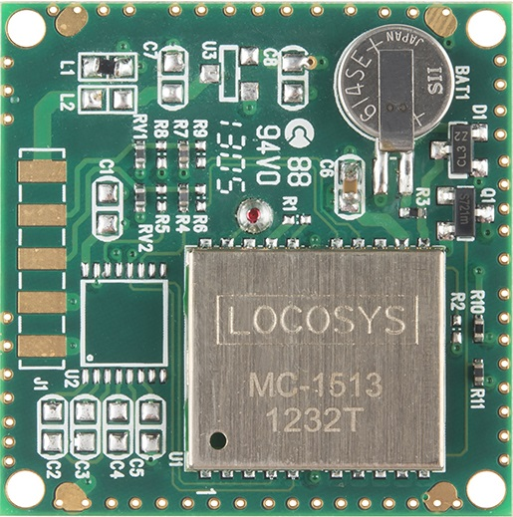
Live Position Reporting
Backup GPS

Slide 11
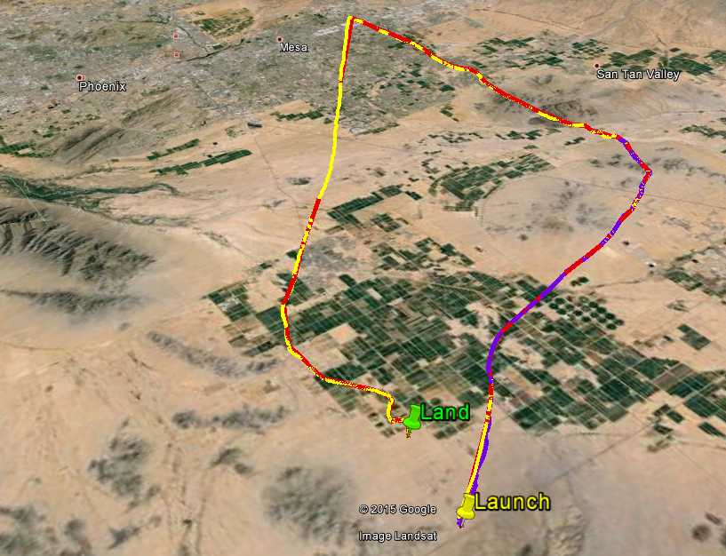

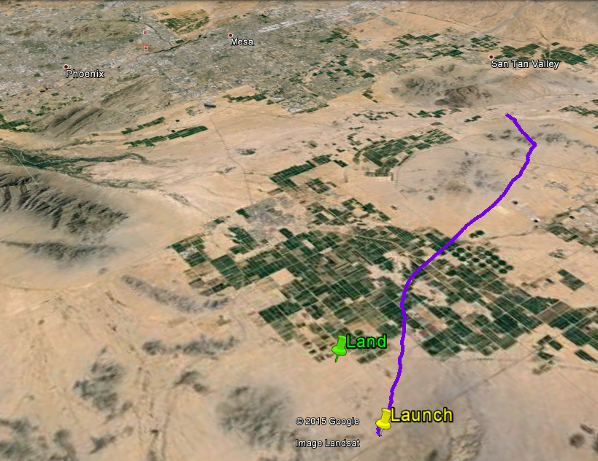
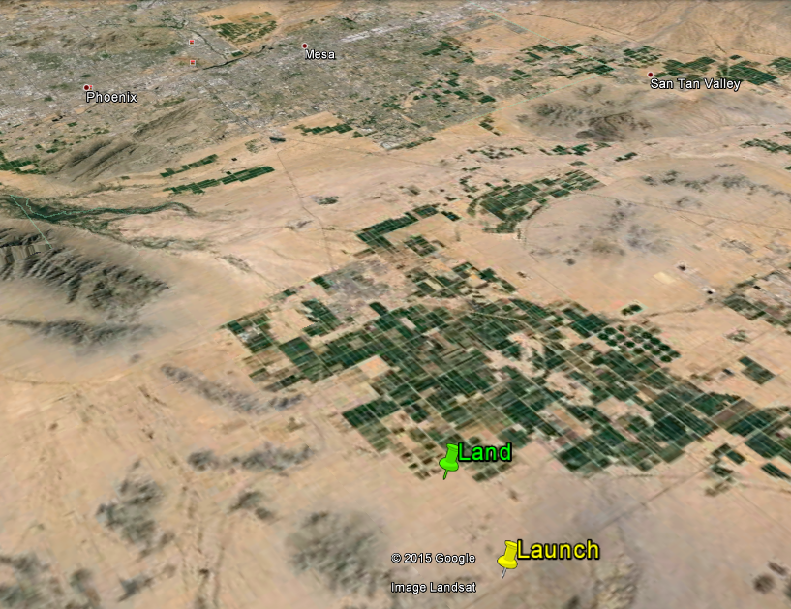
Live Position Reporting
Primary
GPS
Data
Logged
Primary
GPS Data
Received
Launch & Landing
Backup GPS

Slide 12
Arduino Software Development
Start
Collect Data
Transmit Data
False
True
Voltage > 6 volts?
Save Data to SD Card

Slide 13
OUR DATA

Slide 14
