Slide 1
NASA Balloon Project:
SMCC’s Microbe Capture Payload
By Team Astral: Lucas Jarman, Rahim Muhammad, Natnael Neguse, and Eleazar Leija

Slide 2
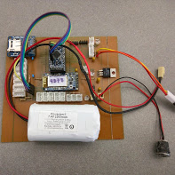
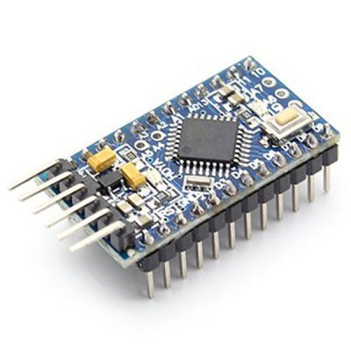
Payload Structural Design:
Strayed away from the traditional BASIC Stamp circuit board
Used more advanced Arduino Pro Mini board
Arduino Pro Mini board is far more power and more user friendly

Slide 3
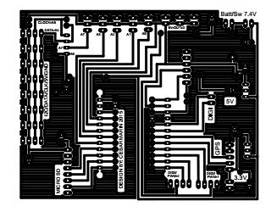
Payload Structural Design cont.:
Board Fabrication
Printing circuit design on a transparency/transfer sheet.
Placed printed design on exposure frame

Slide 4
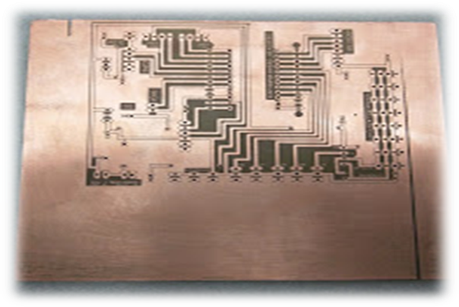
Payload Structural Design cont.:
Expose board to UV light for 8-10 minutes
Place it in the developer solution ferric chloride.
Placed in agitate solution for 10-15min till copper has dissolved
Wash board with cold water to remove etching solution

Slide 5
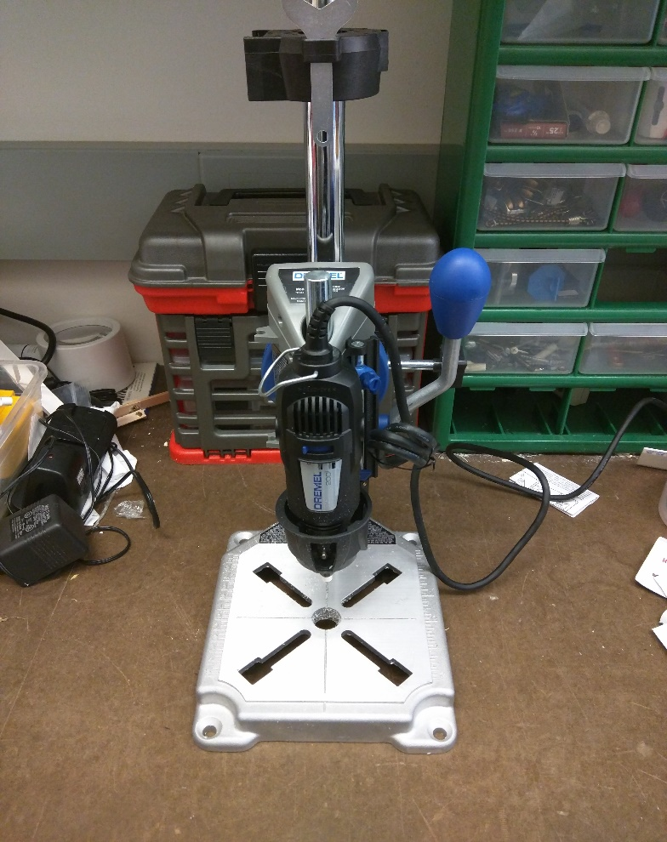
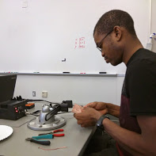
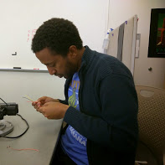
Payload Structural Design cont.:
Use mini press stand to drill the etched board
Soldered on components

Slide 6
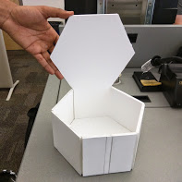
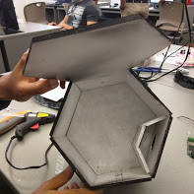
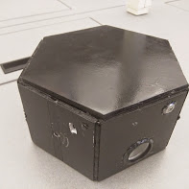
Payload Structural Design cont.:
Structure Design
Payload enclosure is a (6x6x6) hexagonal shape constructed out of foam/display board.
Foam/display board is a good insulator and can protect components from extreme temperatures.

Slide 7
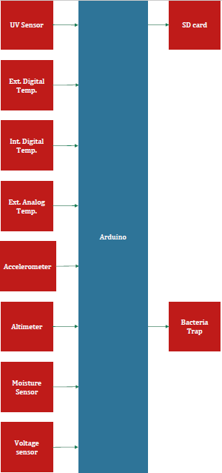
Sensor & Data Analysis:
Sensors in payload
internal and external digital temperature sensor
external analog temperature sensor
UV sensor
humidity sensor
3 axes accelerometer
altimeter (measures barometric pressure and altitude)
Hack HD video camera to record our flight.

Slide 8
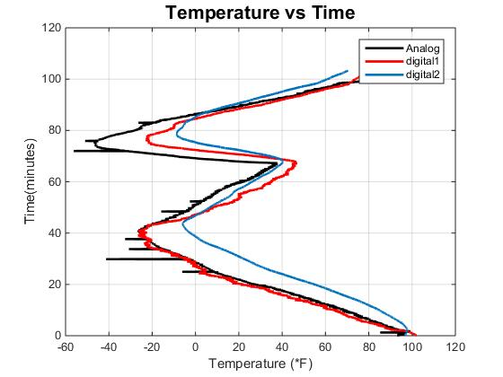
Sensor & Data Analysis:
Internal/External Digital Temperature Sensor
Arduino compatible
Hopes of more accurate readings
External Analog Temperature Sensor:
Compare to the new Digital Temp. Sensors we tested out this flight.

Slide 9
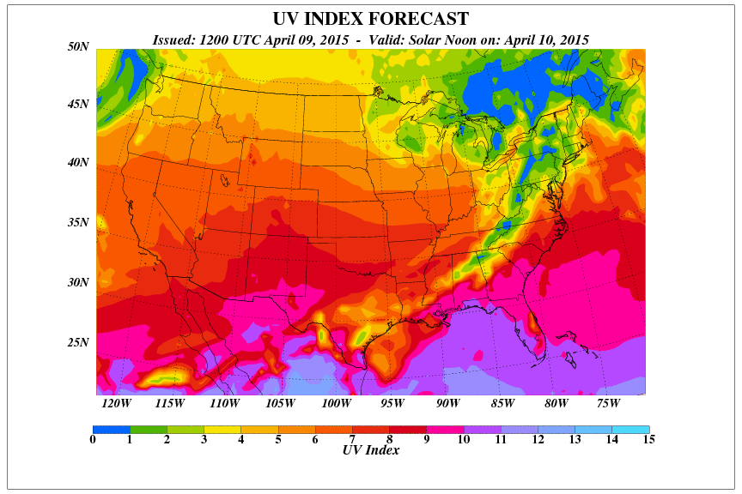
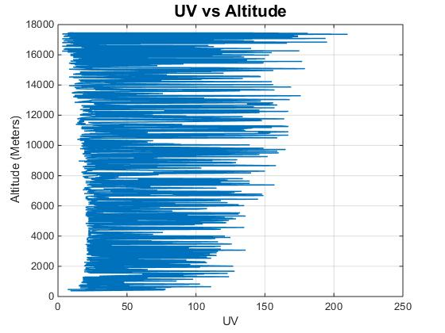
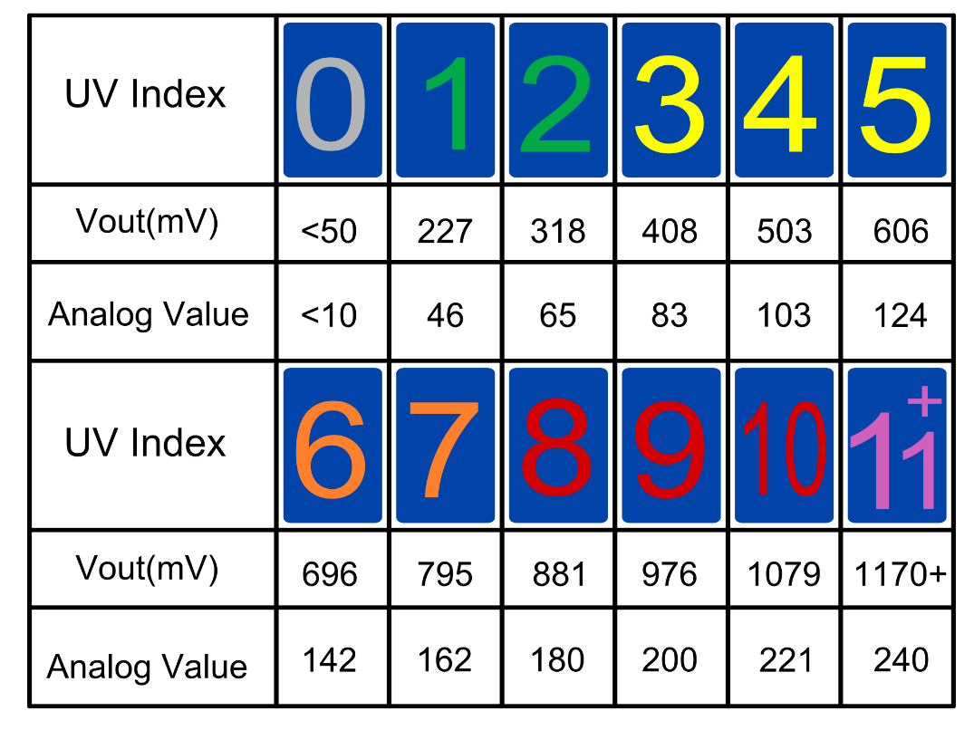
Sensor & Data Analysis:
UV Sensor
To test fluctuation of UV waves throughout the atmosphere.

Slide 10
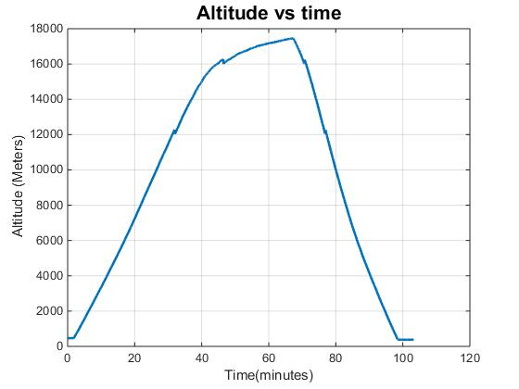
Sensor & Data Analysis:
Altimeter
Measures Barometric Pressure and Altitude
To determine maximum flight height

Slide 11
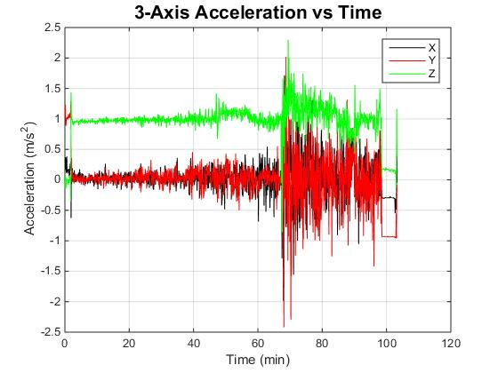
Sensor & Data Analysis:
Accelerometer
Determine max number of g’s required for testing

Slide 12
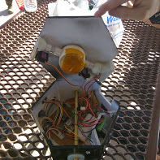
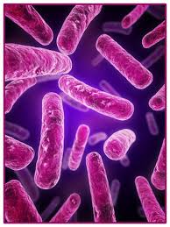
Microbe Capture System:
First team at SMCC to build a payload to capture microorganisms in the stratosphere.
Little known biologically about the upper atmosphere
Microbe Capture system was designed in SolidWorks
3D printed designed parts
Parts used in unison with microfans and servos to funnel air through system.

Slide 13
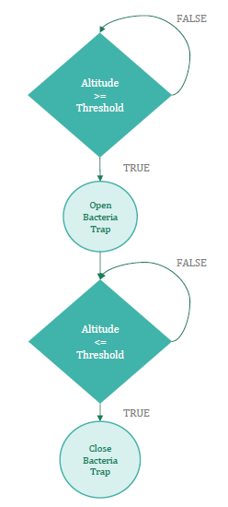
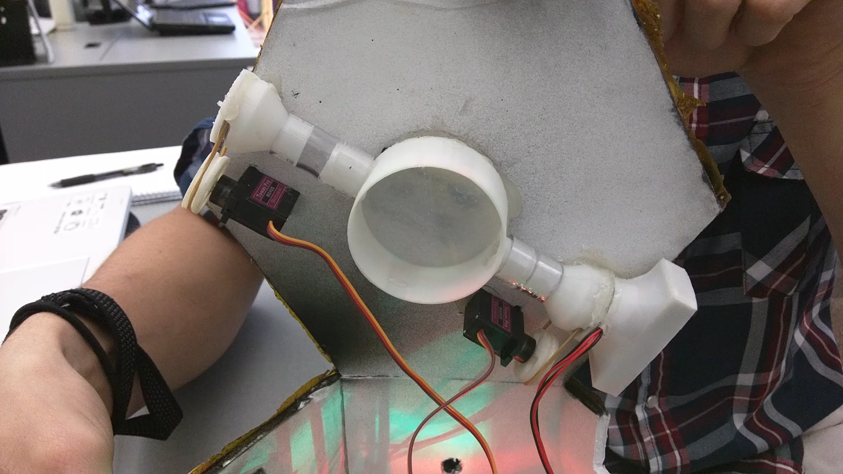
Microbe Capture System:

Slide 14
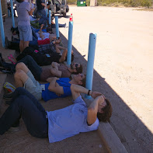
Questions to be answered by our Microbe Sampler:
Do air borne microorganisms exist in Arizona's nutrient rich stratosphere ?

Slide 15
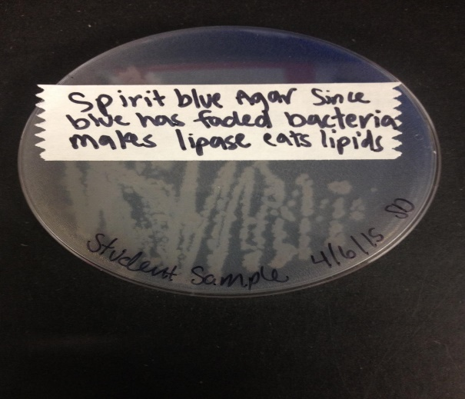
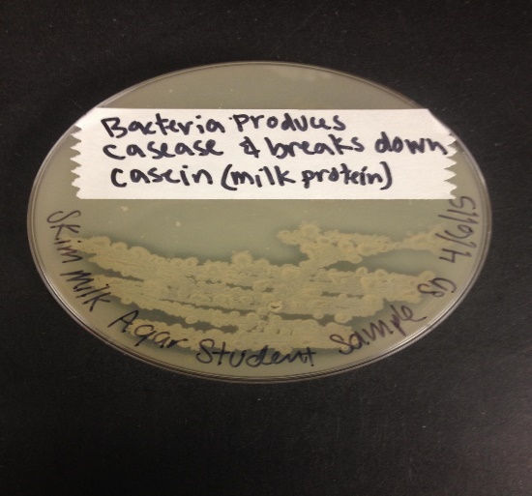
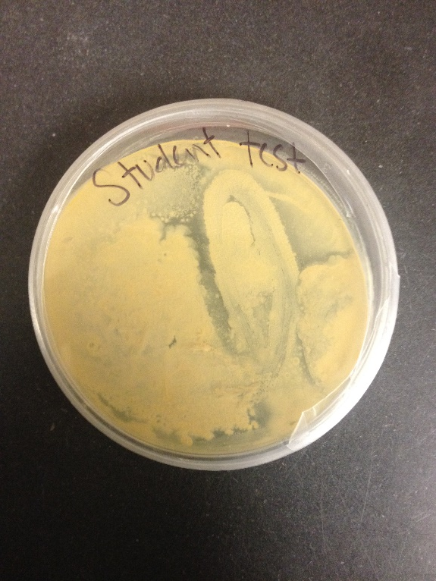
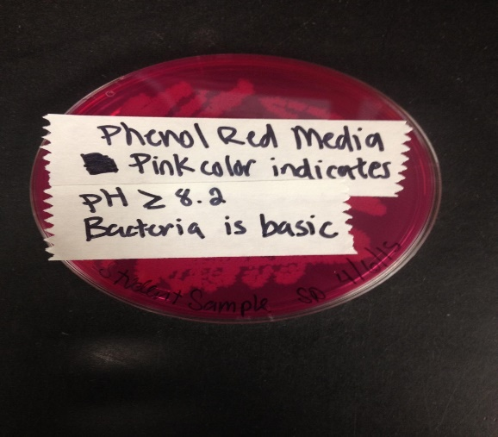
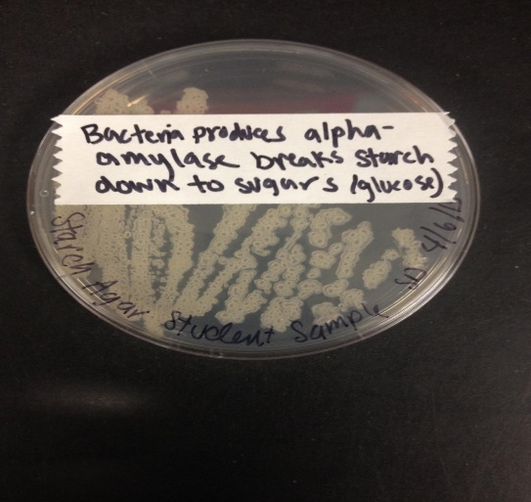
Questions to be answered by our Microbe Sampler:
The answer is YES!!!
Here are just a few of many tests performed on our sample

Slide 16
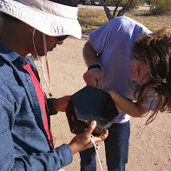
Questions to be answered by our Microbe Sampler:
How many different types can we detect?
We do not know. Due to limited lab resources, it is not possible to determine a number
Gram positive Bacillus and Coccus shaped

Slide 17
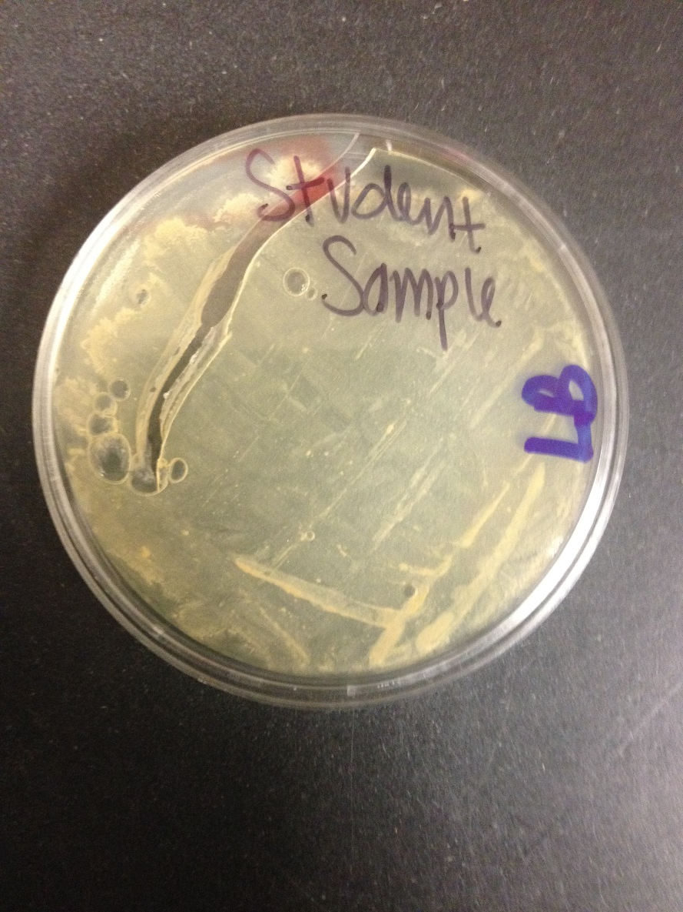
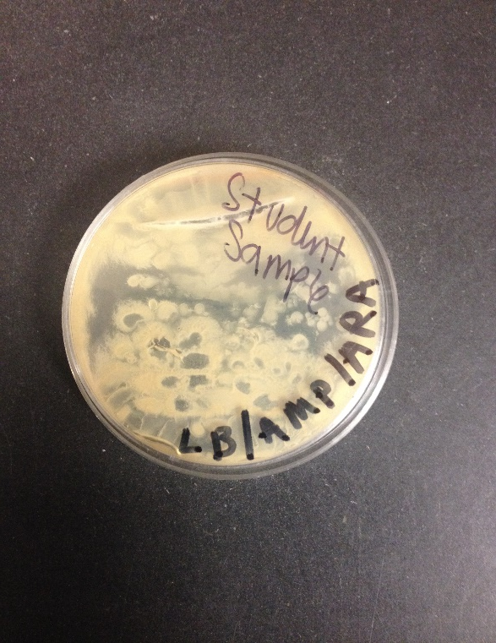
Questions to be answered by our Microbe Sampler:
Are these microorganisms potently dangerous or helpful to ground dwellers?
Tests showed our sample was antibiotic resistant

Slide 18
Questions?
Comments?
Concerns?

