Slide 1
Designing an Antenna for use with the EagleSat CubeSat Communications System
Lisa Ferguson
Dr. Gary Yale, Dr. Ed Post
Arizona Space Grant Symposium
April 18, 2015

Slide 2
Overview
Communication between on-board computer and EagleSat ground station
Current research
  Antenna design & materials
  Antenna position & radiation plotting
  Monofilament deterioration
  Prototyping & integration

Slide 3
Signal Flow Diagram
D to A
Antenna
RF
Transceiver
Modem
Digital
TNC
Packets
OBC
A to D
A = Analog Signal
D = Digital Signal
TNC = Terminal Node Controller
OBC = On Board Computer

Slide 4
Power Flow Diagram
VCC SYS
(System Power)
VCC BATT
(Capacitor Power)
DGND
(Digital Ground)
Radio
Radiation Shield
System Components
(Resistors, Capacitors)
Modem
TNC

Slide 5
Materials Research -
Overview and Rejected Design
Previous design: microstrip
  Circularly polarized quad beam antenna
  Impedance mismatch with circuit board
Conducted a trade study of currently flown CubeSat antennas
  Materials conclusion: Tape measure antenna with printed circuit board (PCB) mounting plate and ground plane

Slide 6
Monopole Design
Definiton: Straight rod conductor mounted perpendicularly to ground plane
Quarter wave monopole
  Same radiation pattern as dipole in free space with twice the voltage
  Operates at a single frequency
  Non-attitude control
Notes:
Monopole antenna: Straight rod conductor mounted perpendicularly to ground plane
Commonly used: A lot of research has previously gone into the tape measure design

Slide 7
Printed Circuit Board (PCB) &
Mounting Techniques
Antenna connects directly to PCB
  Reduces impedance mismatch
  Allows for easily measured anetenna length
Grounding tabs
  Common ground between ground plane, ground of coaxial antenna cable, and satelite structure
  Grounding tabs connected to ground plane through series of vias
Notes:
Printed circuit board: Mechanical support and electrical connection for electronic components such as an antenna
-etched from copper sheets and laminated onto a non-conductive surface

Slide 8
Printed Circuit Board (PCB) &
Mounting Techniques
PCB Components
  Ground Plane
  Mounting Slot
  Grounding Slot
  Grounding Tabs
Coaxial antenna cable with BNC connector used for testing

Slide 9
Antenna Positioning
Different mounting positions result in different radiation patterns
  Center mount
  Side mount
  Corner mount
Goal: Most average loss of gain
  No null extrema
Notes:
-Most average loss of gain: We’d rather have a uniform distribution of small loss than extremes where we would get no signal at all
-More reliable

Slide 10
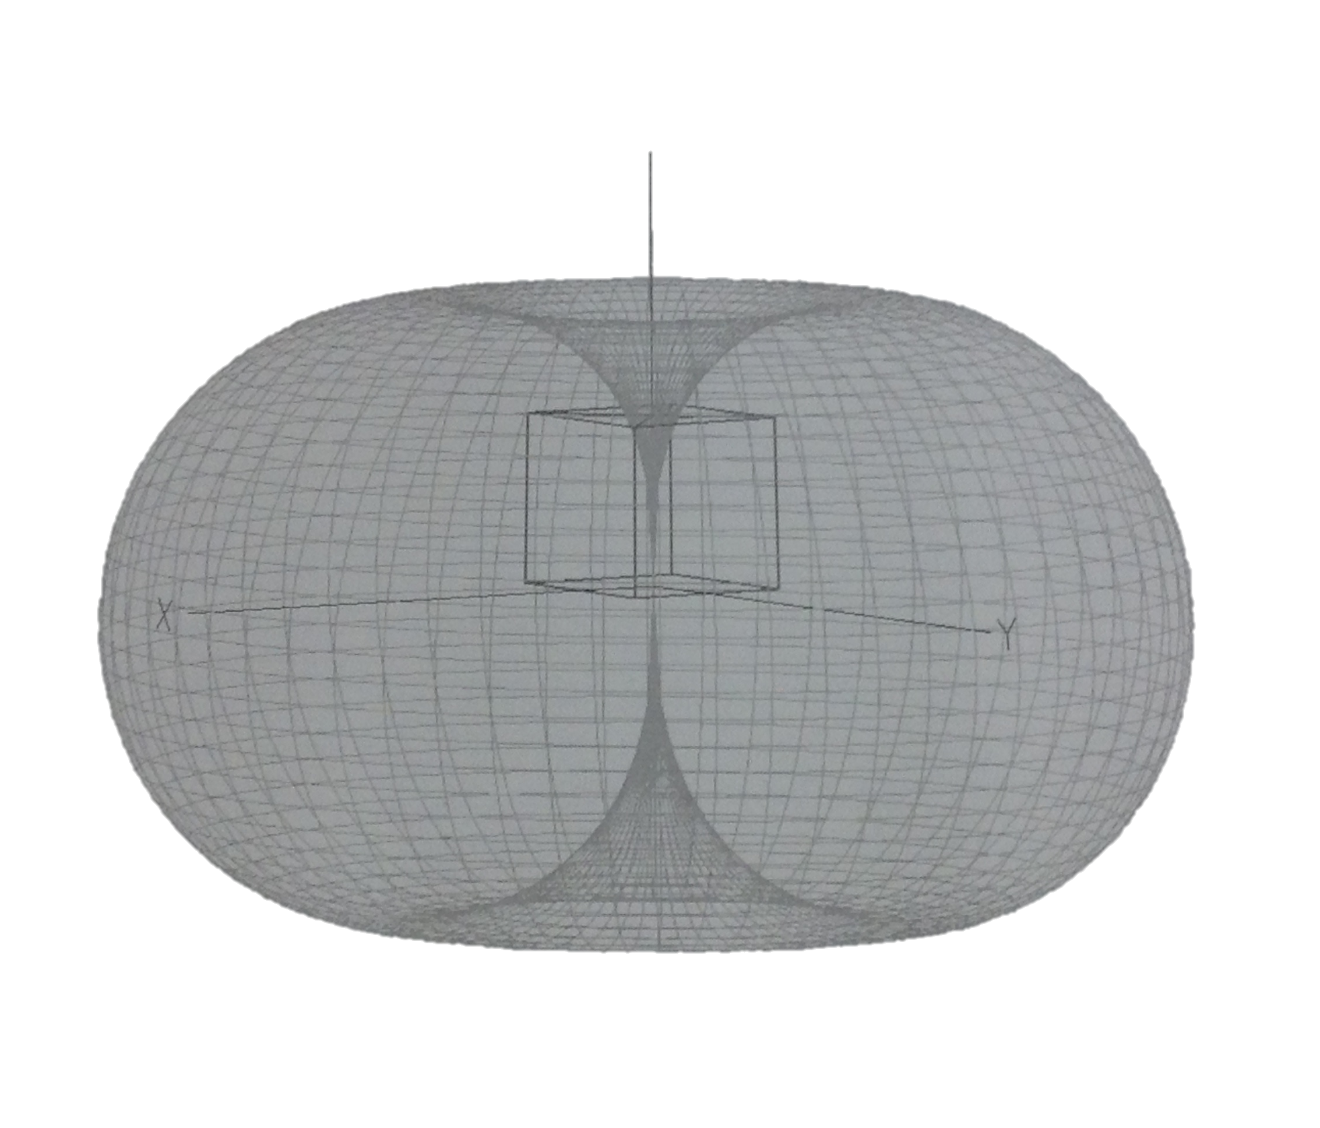
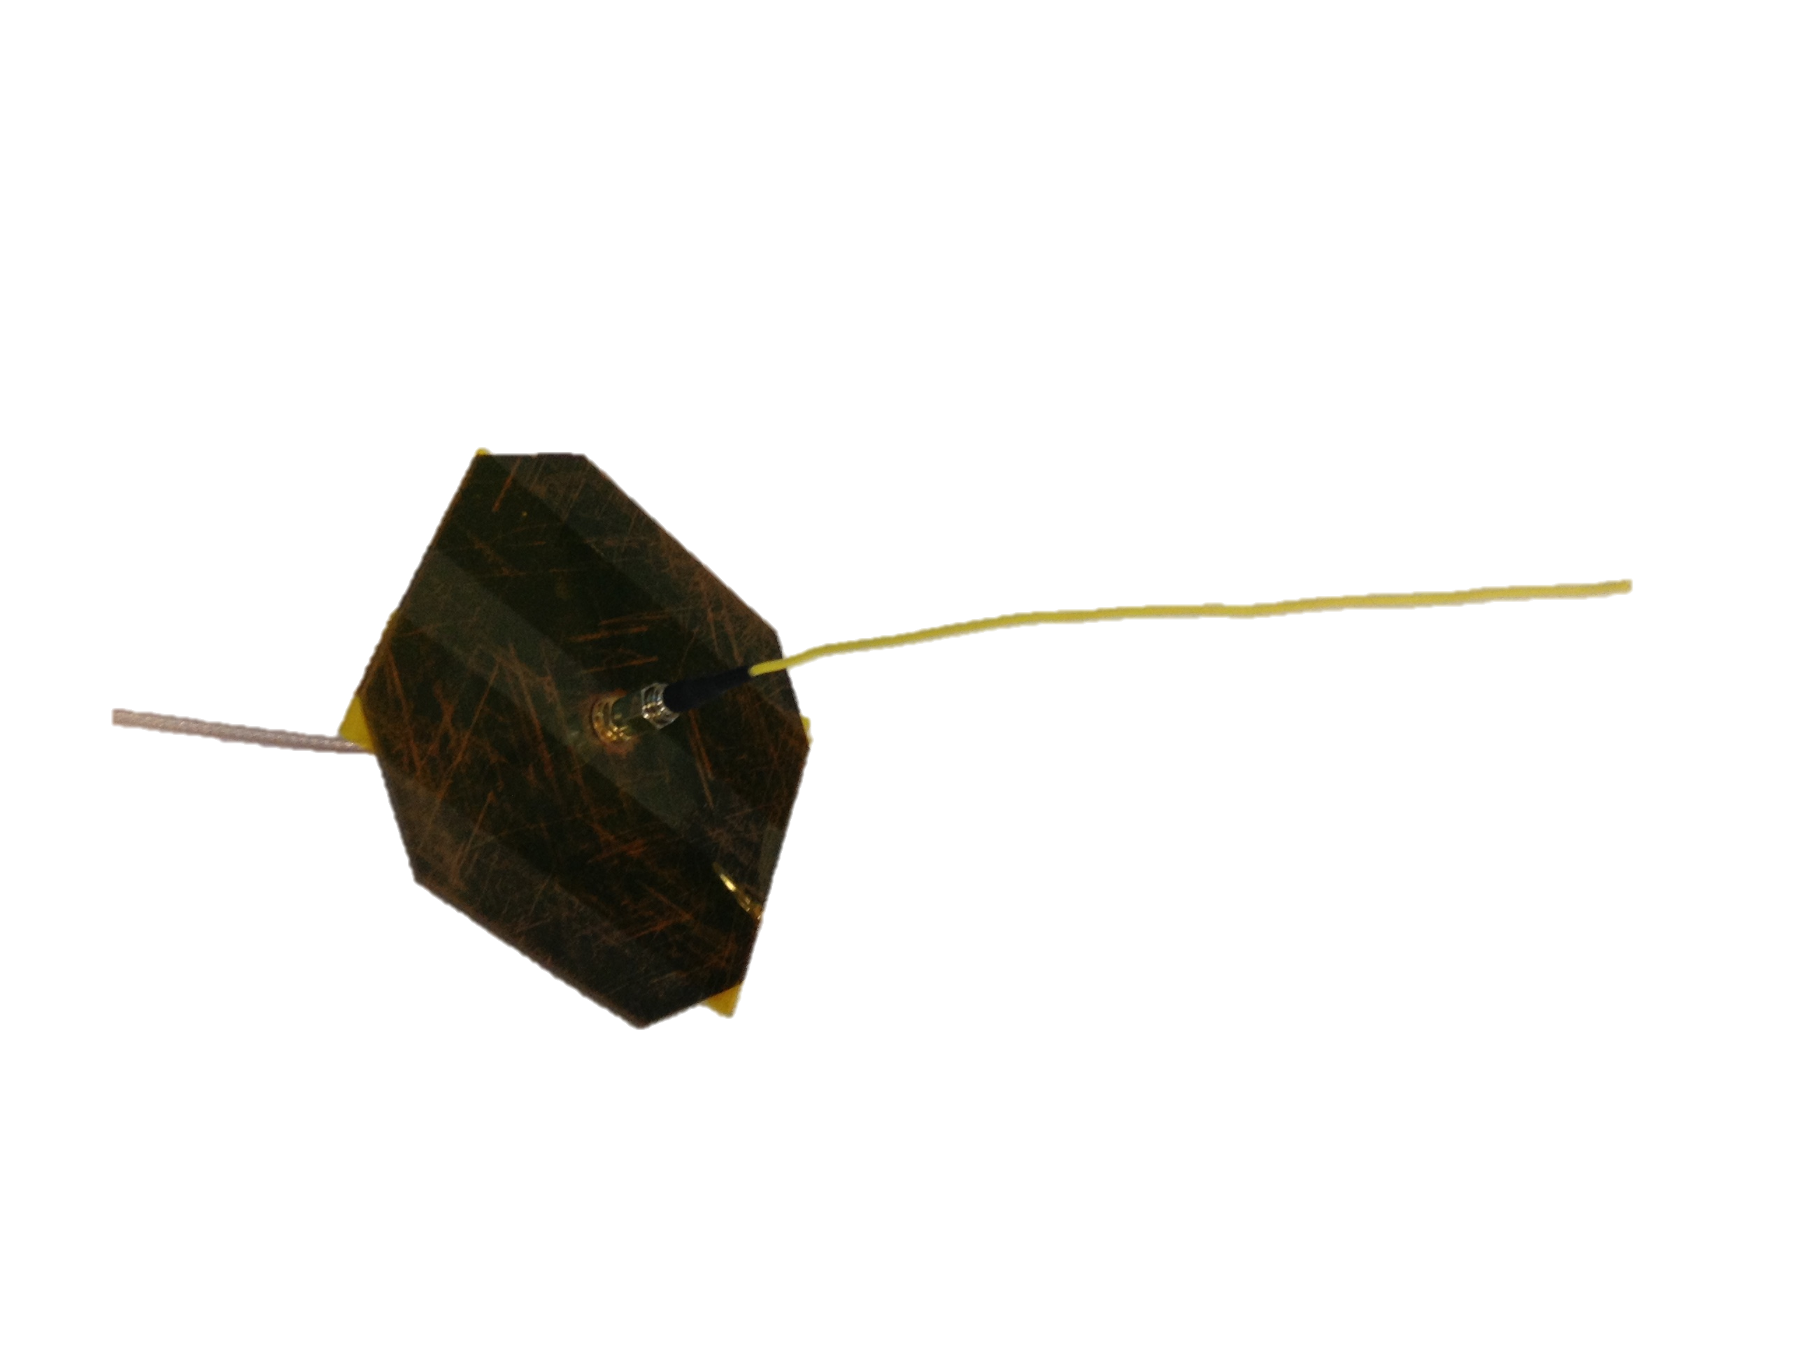
Antenna Position #1: Center Mount

Slide 11
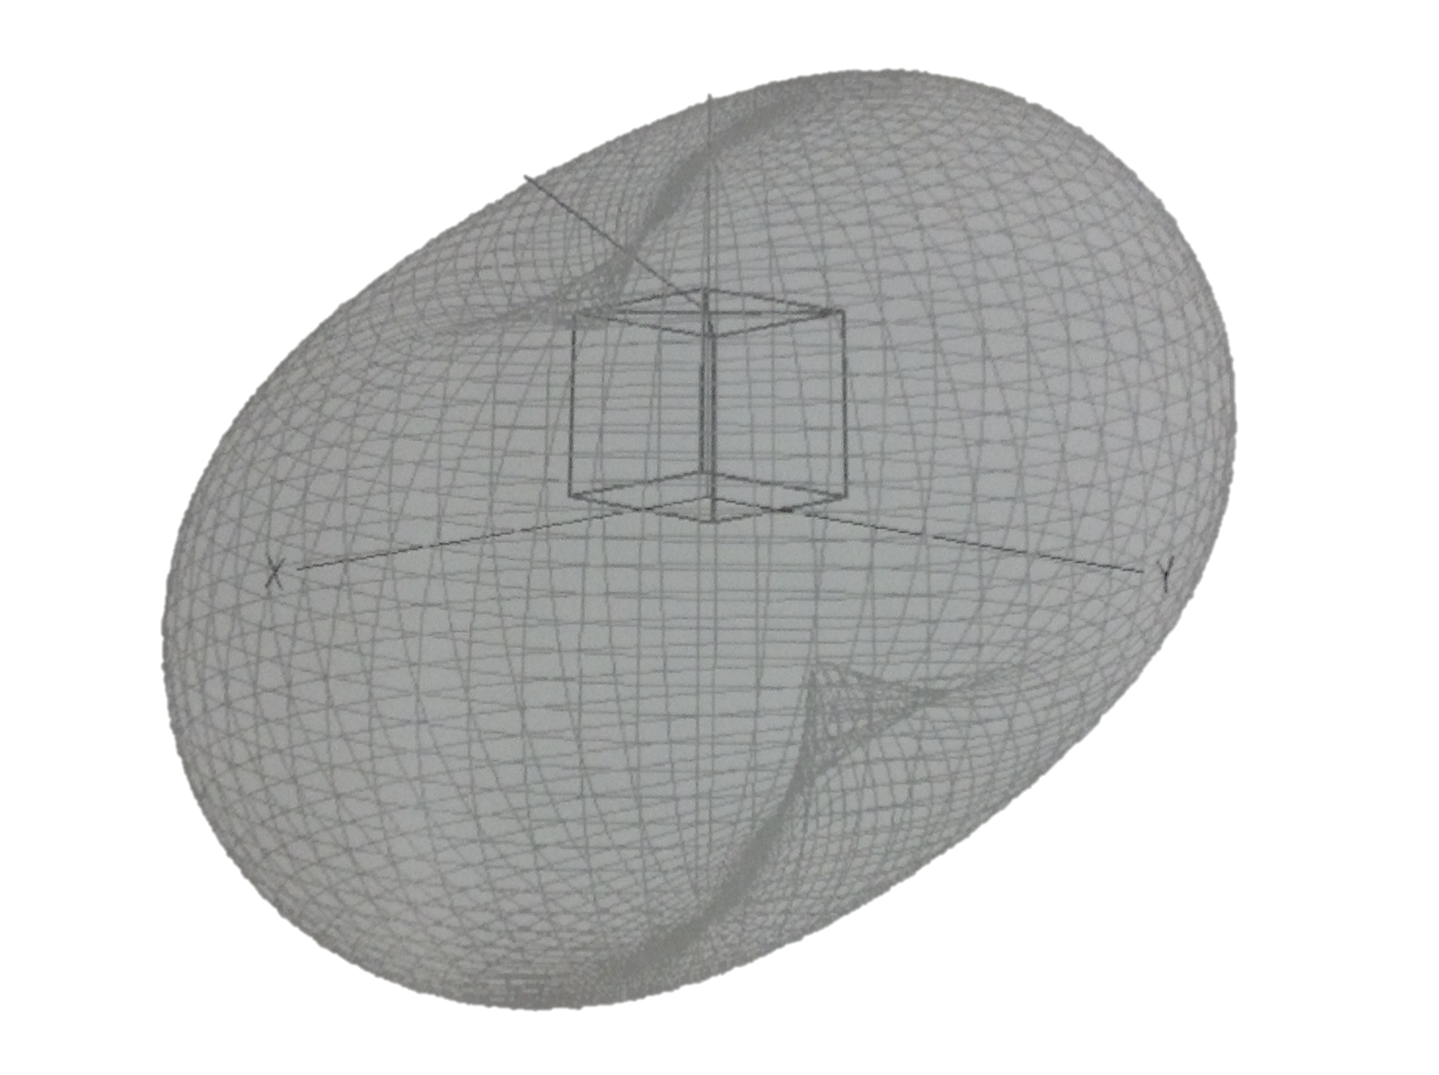
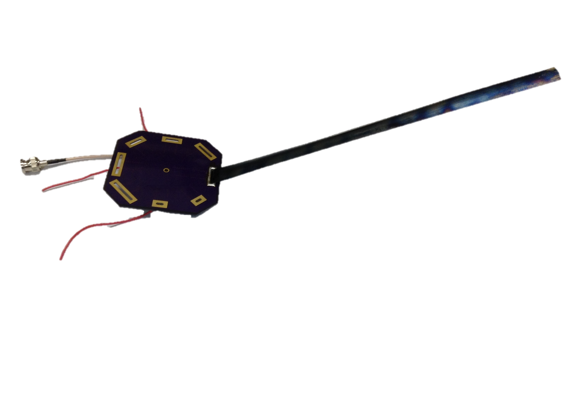
Antenna Position #2: Side Mount

Slide 12
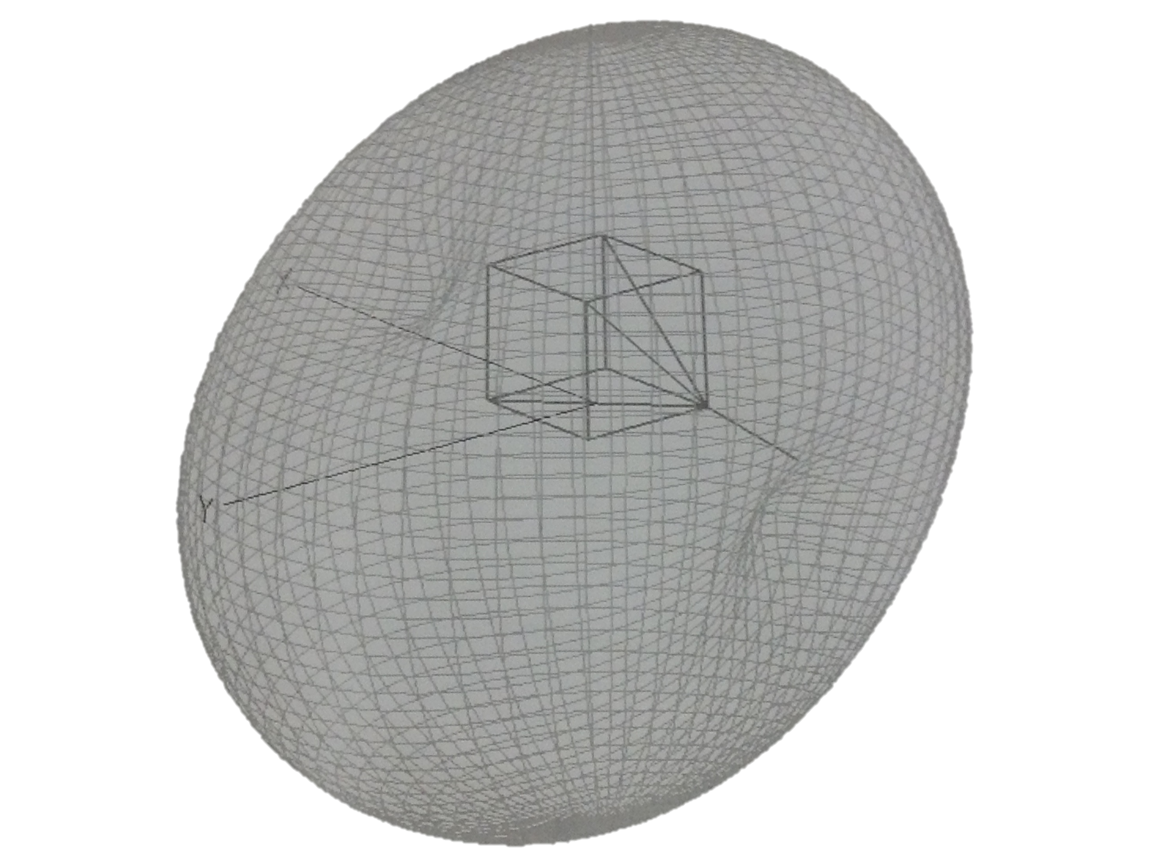
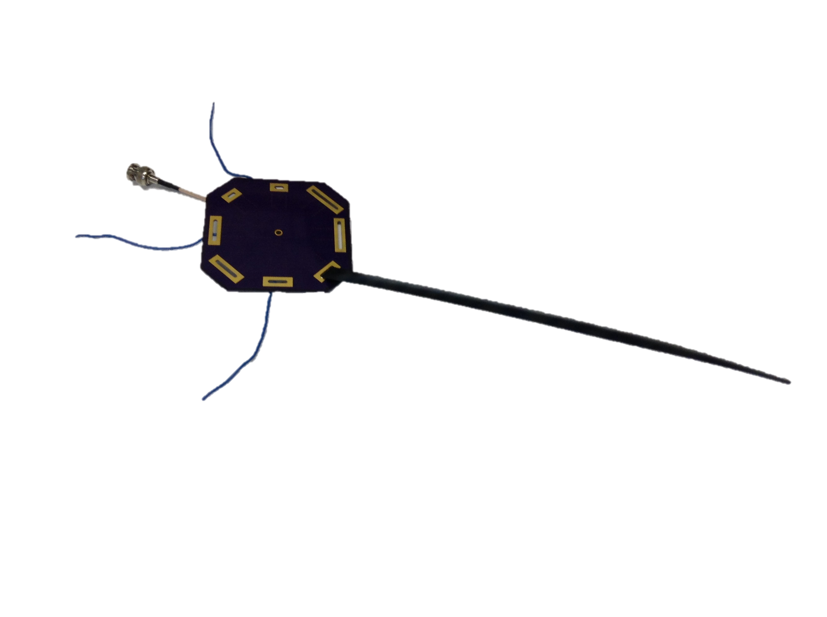
Antenna Position #3: Corner Mount

Slide 13
Antenna Position #3: Corner Mount
Most difficult to attach, but best radiation pattern
May interfere with rail clearance in the launcher

Slide 14
Monofilament Deterioration Overview
Purpose: Deployment mechanism
  Monofilament to hold down antenna before deployment
  Goal: Deterioration under ultraviolet radiation in case of failure of nichrome wire burn system
Materials & Testing
  4-12 lb Test Monofilament Fishing line
  96 Watt UV light source to simulate space radiation

Slide 15
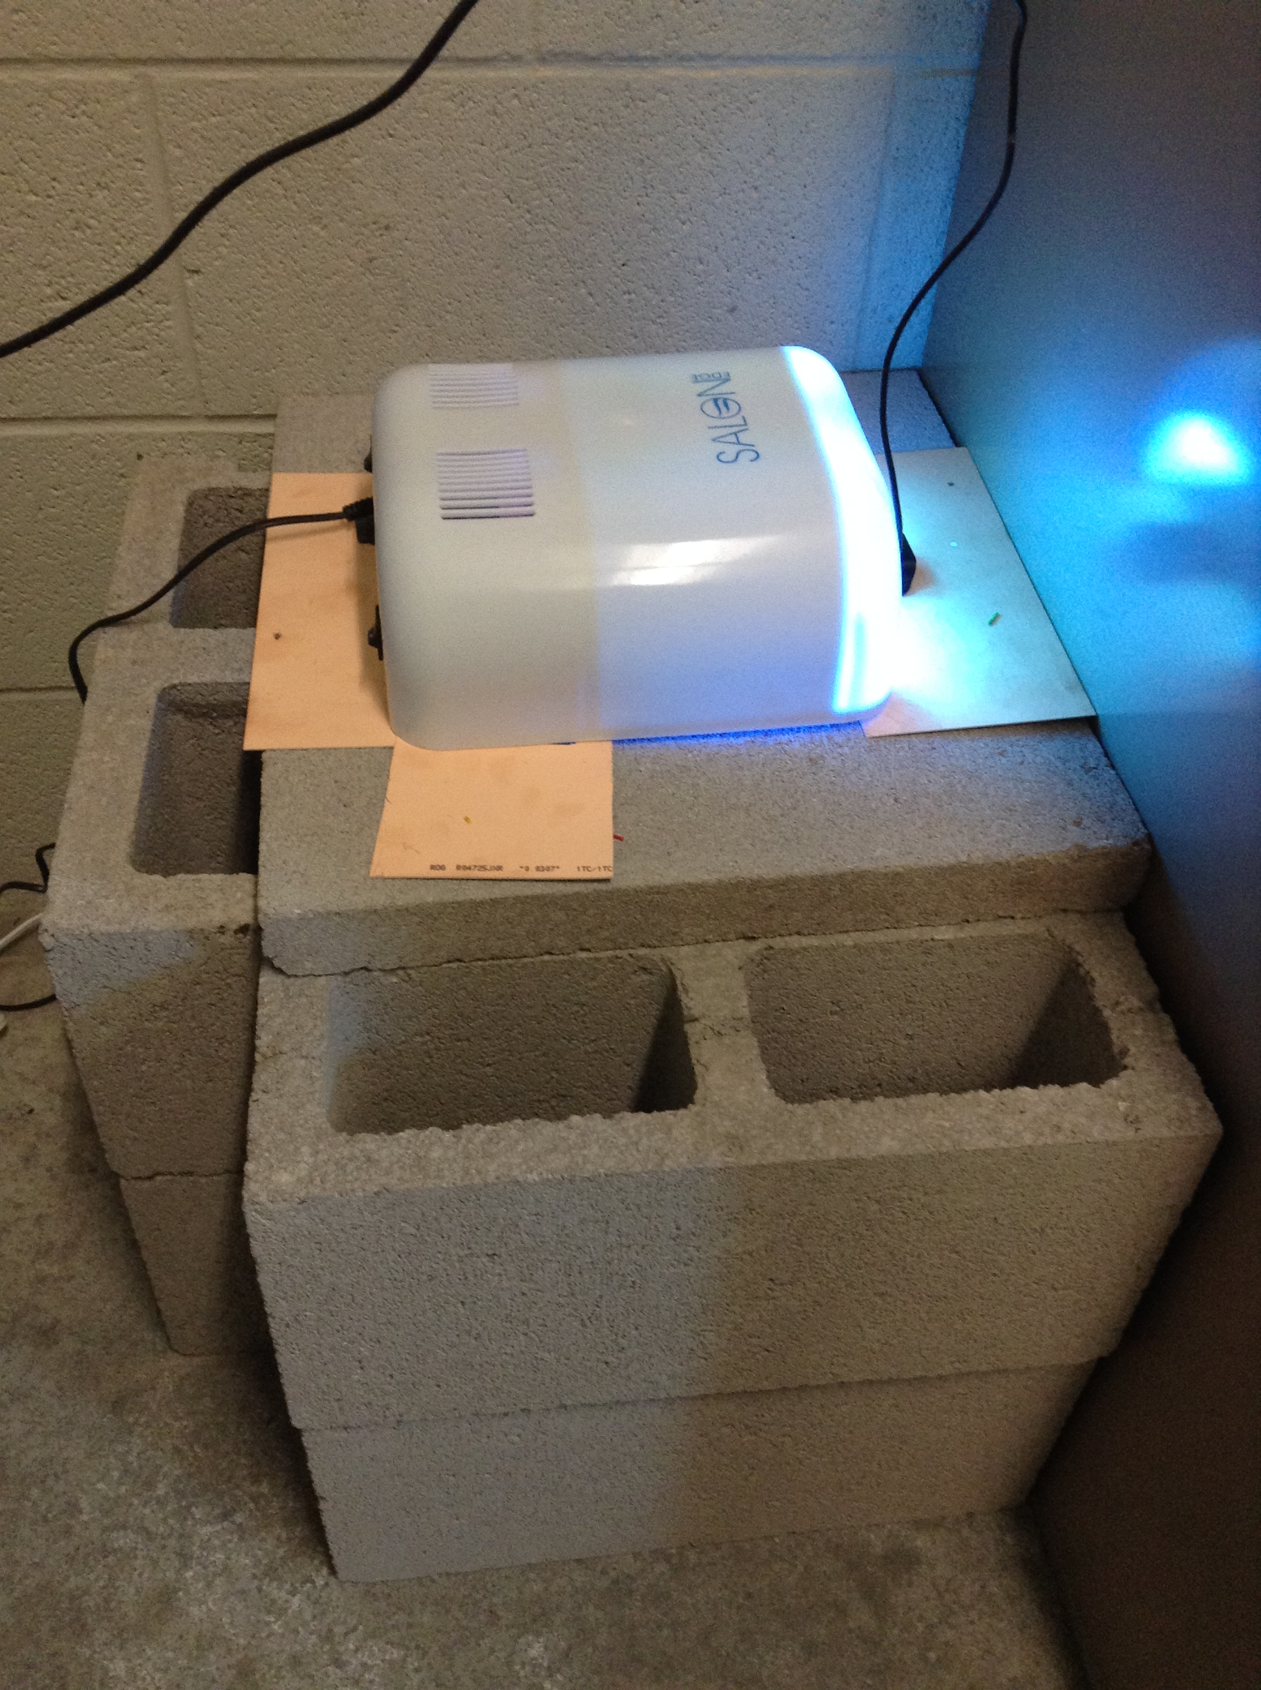
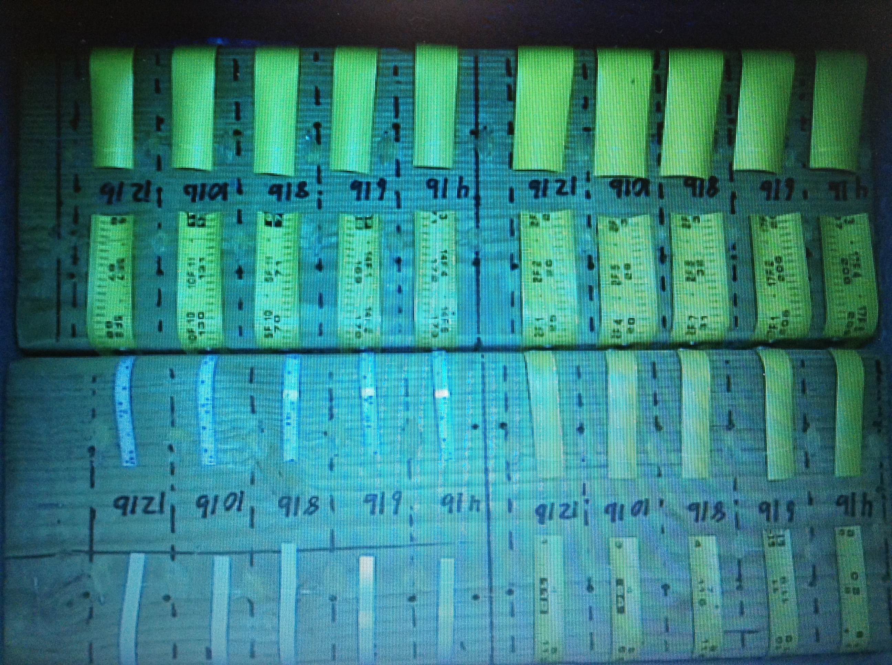
Testing Setup

Slide 16
Monofilament Deterioration Testing & Results
Current testing status
  Monofilaments holding down different widths of antenna tape measure in different orientaions
  UV radiation light source currently active
Testing results
  No results on deterioration yet
  Testing continuing
Notes:
Testing results: Hopefully some of the wires will snap

Slide 17
Current Progress - Antenna Prototyping
Monopole antenna
  27.20175 cm quarter wavelength
  436 MHz radio center frequency
Tape measure design
  1”, ¾”, ½”, ¼”
  Varied widths result in varied bandwidth
  Wider tape measures allow for easier tuning

Slide 18
Current Progress - Antenna Testing and Integration
Standing Wave Ratio Testing
  Used to determine effectiveness of antenna at frequency and offset
Signal Strength Testing
  Field Test conducted by taking signal strength measurements 360° around the antenna at 10’ increments out to 100’
  Satellite mounted in center of plot 10’ off the ground

Slide 19
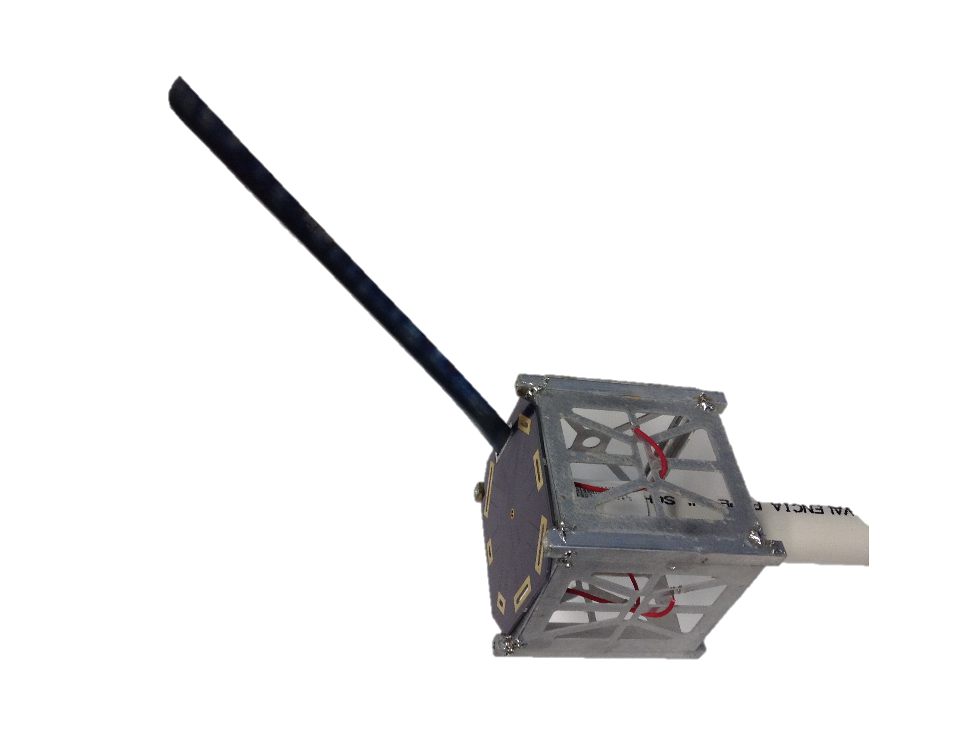
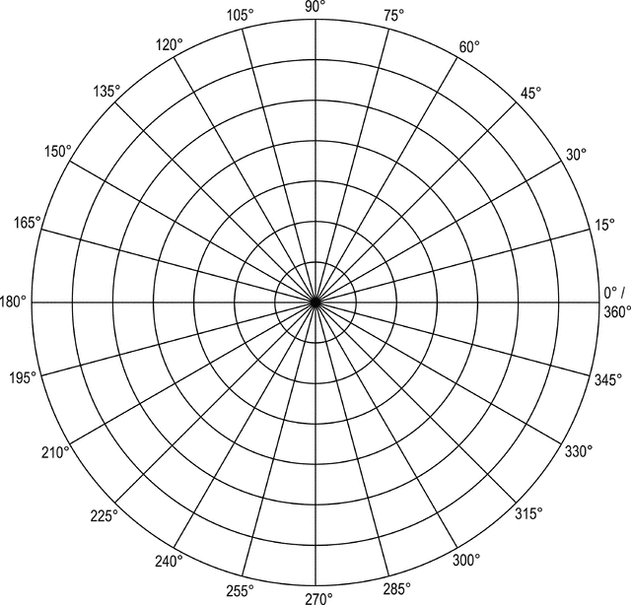
Antenna Testing Rig & Ground Simulant

Slide 20
Space Readiness
Structural Testing
  Thermal Testing
  Vibration Testing
Complete System Integration
High altitude balloon (HASP)
  Complete communications system antenna
  Support HASP field testing

