Slide 1
Memory Testing Payload for Nano-Satellite
Matthew Vis
Embry-Riddle Aeronautical University, EagleSat
NASA Space Grant Intern Symposium, April 2015

Slide 2

Overview
Reasons for Research
Research Options
Detailed Research Plan
Current Progress

Slide 3
Reasons for Research
Measure and analyze effects of solar radiation on different types of computer memory
Gain greater understanding of the limitations and applications of different types of computer memory
Give undergraduate students exposure to creating embedded systems in non-critical space applications.

Slide 4
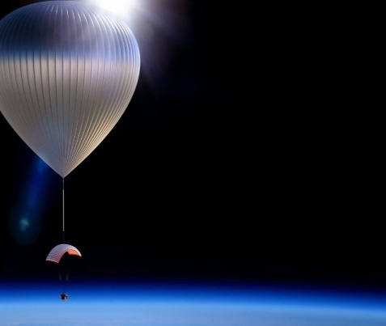
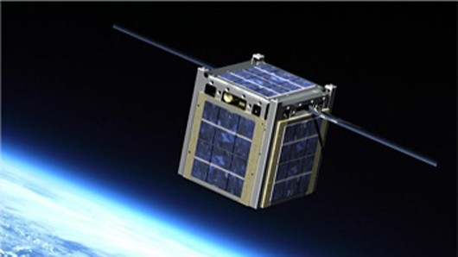
Research Options
High altitude Balloon Payload
  Send payload on a balloon to gain greater access to radiation
  Limited in altitude and little increase in radiation levels
  Limited exposure time
Satellite Payload (Selected)
  Send as payload to small-scale satellite
  Difficult to organize launch, but helped provided by NASA
  Much greater exposure time and radiation levels
(1)
(2)
(1) http://public.media.smithsonianmag.com/legacy_blog/10_22_2013_world-view1.jpg
(2) http://images.gizmag.com/hero/cubesat-missions-1.jpg

Slide 5
Detailed Research Plan
Create Payload for testing five (5) types of computer memory
  Dynamic Random Access Memory (DRAM)
  Static Random Access Memory (SRAM)
  Flash Memory (Flash)
  Ferroelectric Random Access Memory (FRAM)
  Magneto-resistive Random Access Memory (MRAM)
Test for memory data upsets using software algorithms.
Notes:
DRAM – Type of memory typically found in Personal Computers
SRAM – Found in most embedded systems like printers, automobiles, and temporary buffers in more complex systems
Flash – Memory type used mostly in thumb drives and SD cards
FRAM – Lesser known memory type that is still in the process of improvement and looking for suitable large-scale uses
MRAM – Experimental memory type still under development with no real place in the market other than research and very special applications

Slide 6
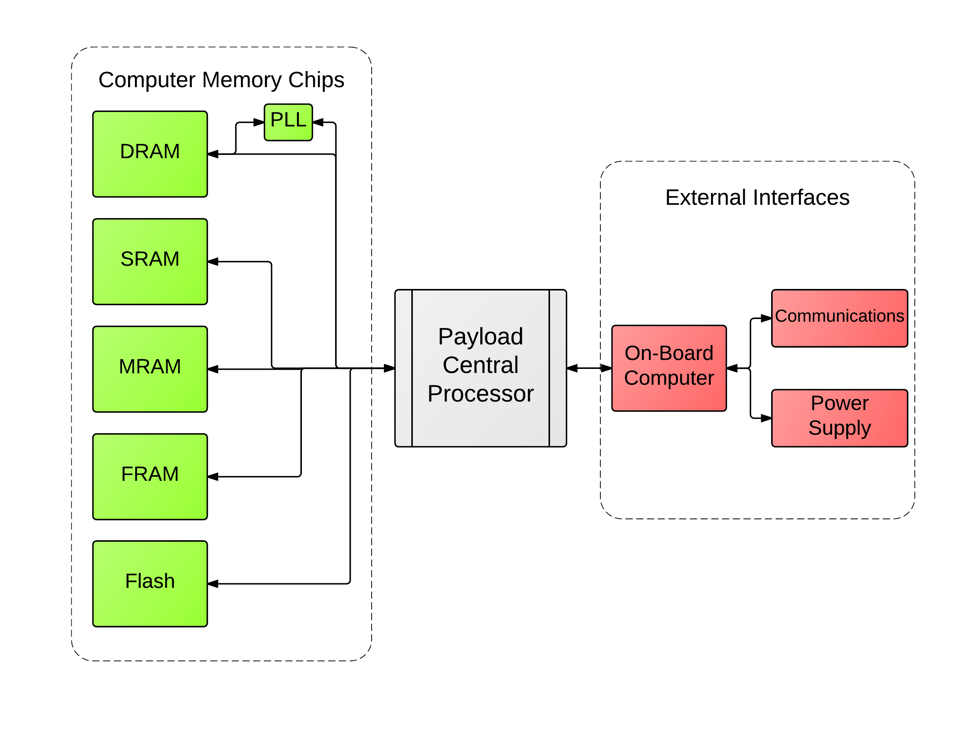
Detailed Research Plan
(cont.)
Payload
Block Diagram
Notes:
Quickly go over the algorithm, what it does, and explain that Determine errors and analyze errors algorithms are separate functions and can be discussed further after presentation should need arise.

Slide 7
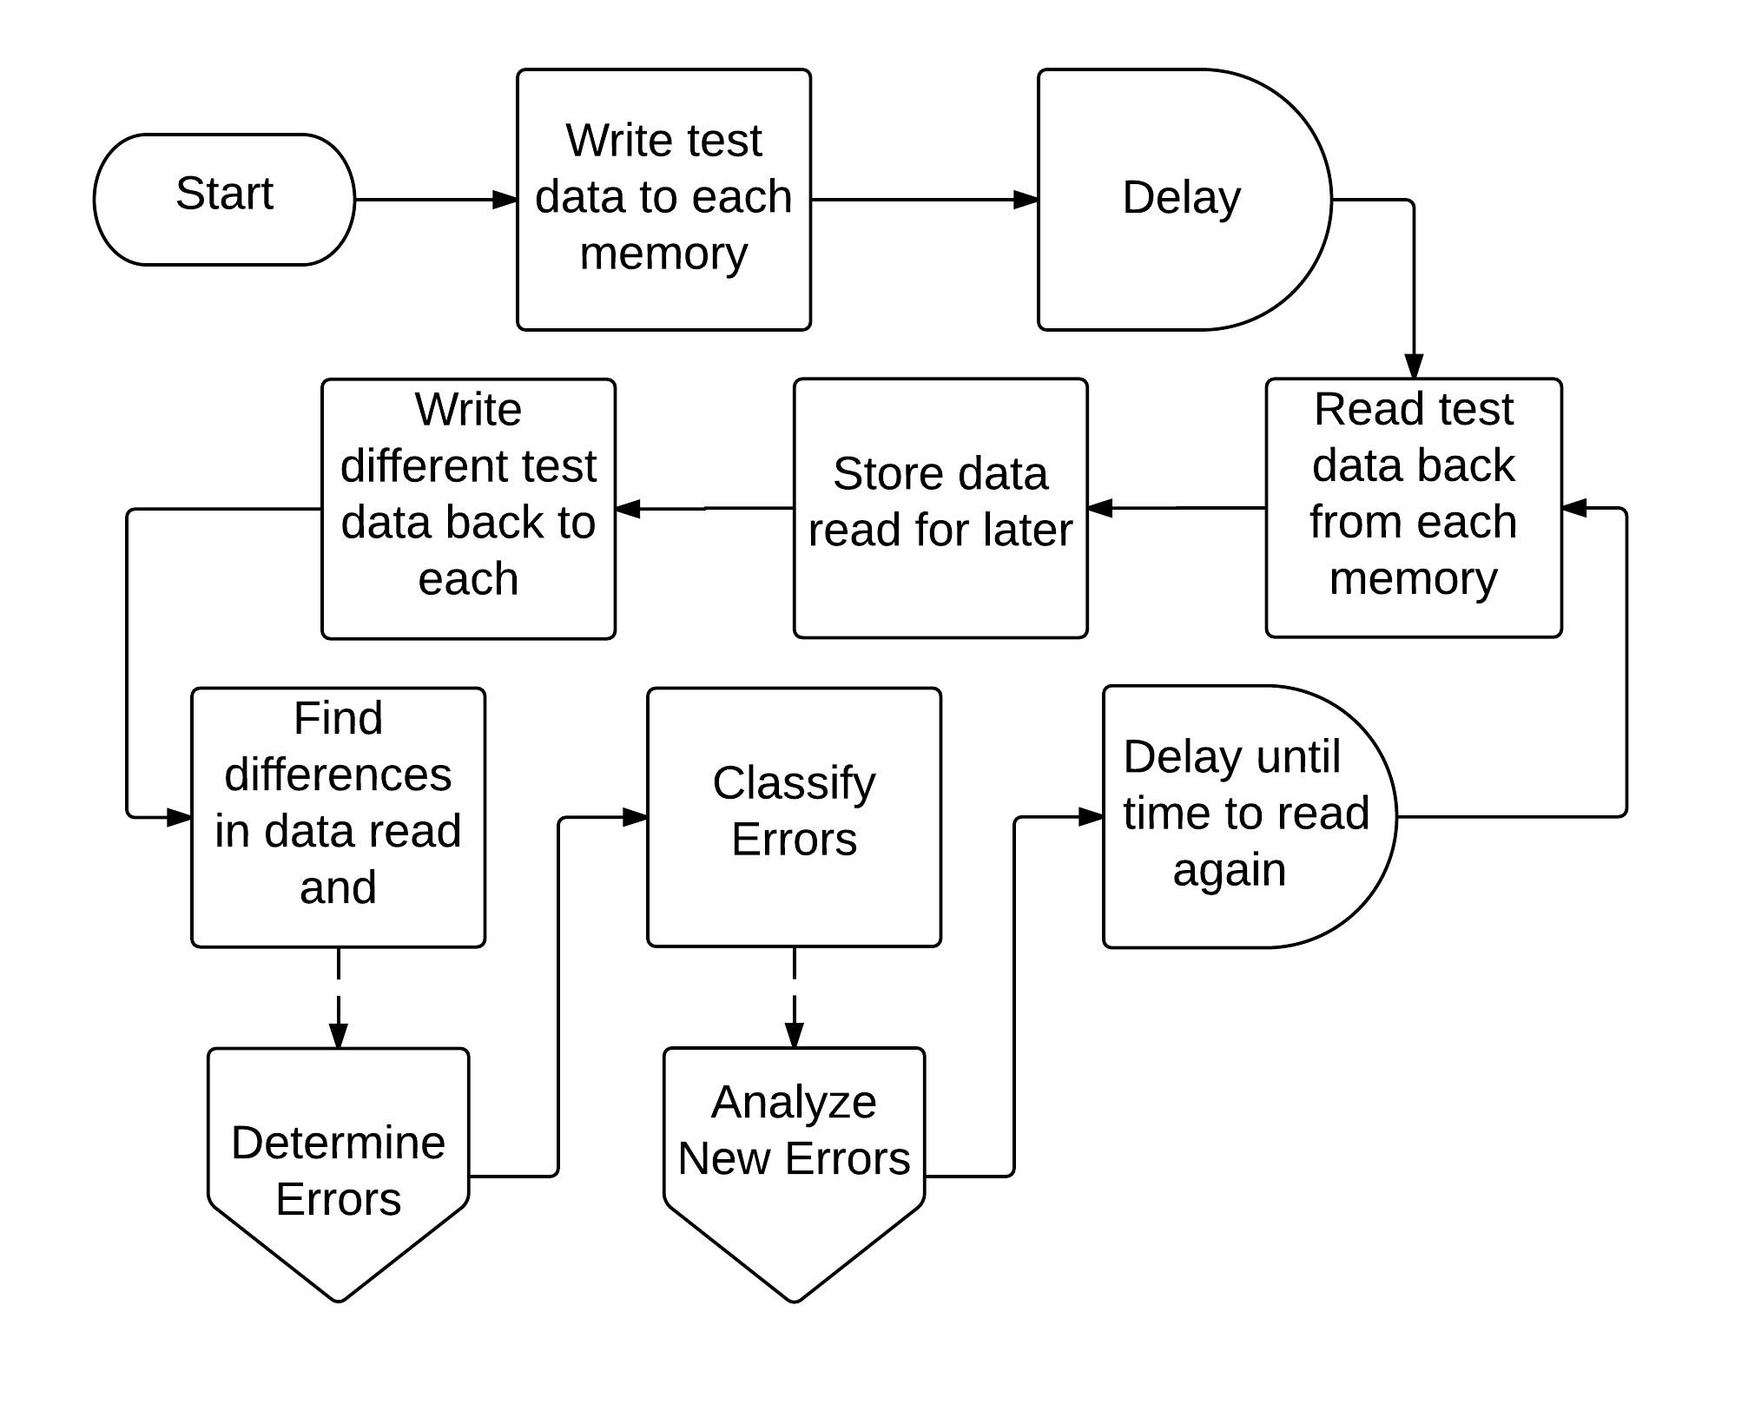
Detailed Research Plan (cont.)
Payload
Software
Algorithm
Notes:
Quickly go over the algorithm, what it does, and explain that Determine errors and analyze errors algorithms are separate functions and can be discussed further after presentation should need arise.

Slide 8
Current Progress
Four (4) of the memory chips are functioning as expected
Protocols and capabilities for communication to/from On-Board Computer functioning as expected
Interface between Payload and On-Board Computer fully defined
Algorithm fully defined and implemented for all error types currently identified
Printed Circuit Board (PCB) design complete
  PCB with testing points still on order
Notes:
Explain where we are and what each bullet means.

Slide 9
Future Work
Add fifth memory chip functionality (DRAM)
Identify more types of errors to analyze and adapt or expand algorithm accordingly
Develop testing procedures to ensure completeness and quality of both Software and Hardware
Test capabilities with PCB that includes testing points
Test interface with On-Board Computer
Build and test flight-model
Notes:
Explain difficulties with each and why it hasn’t been completed yet

Slide 10
Thank you

Slide 11
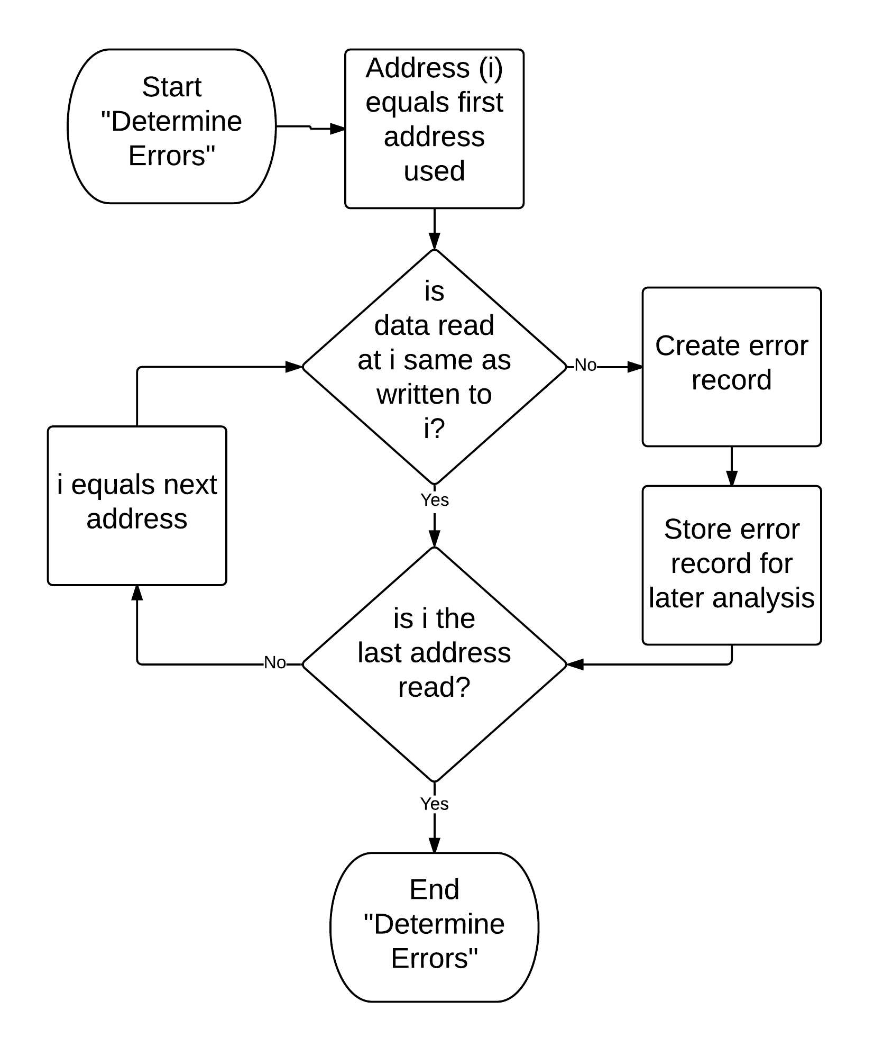
Determine Errors Algorithm

Slide 12
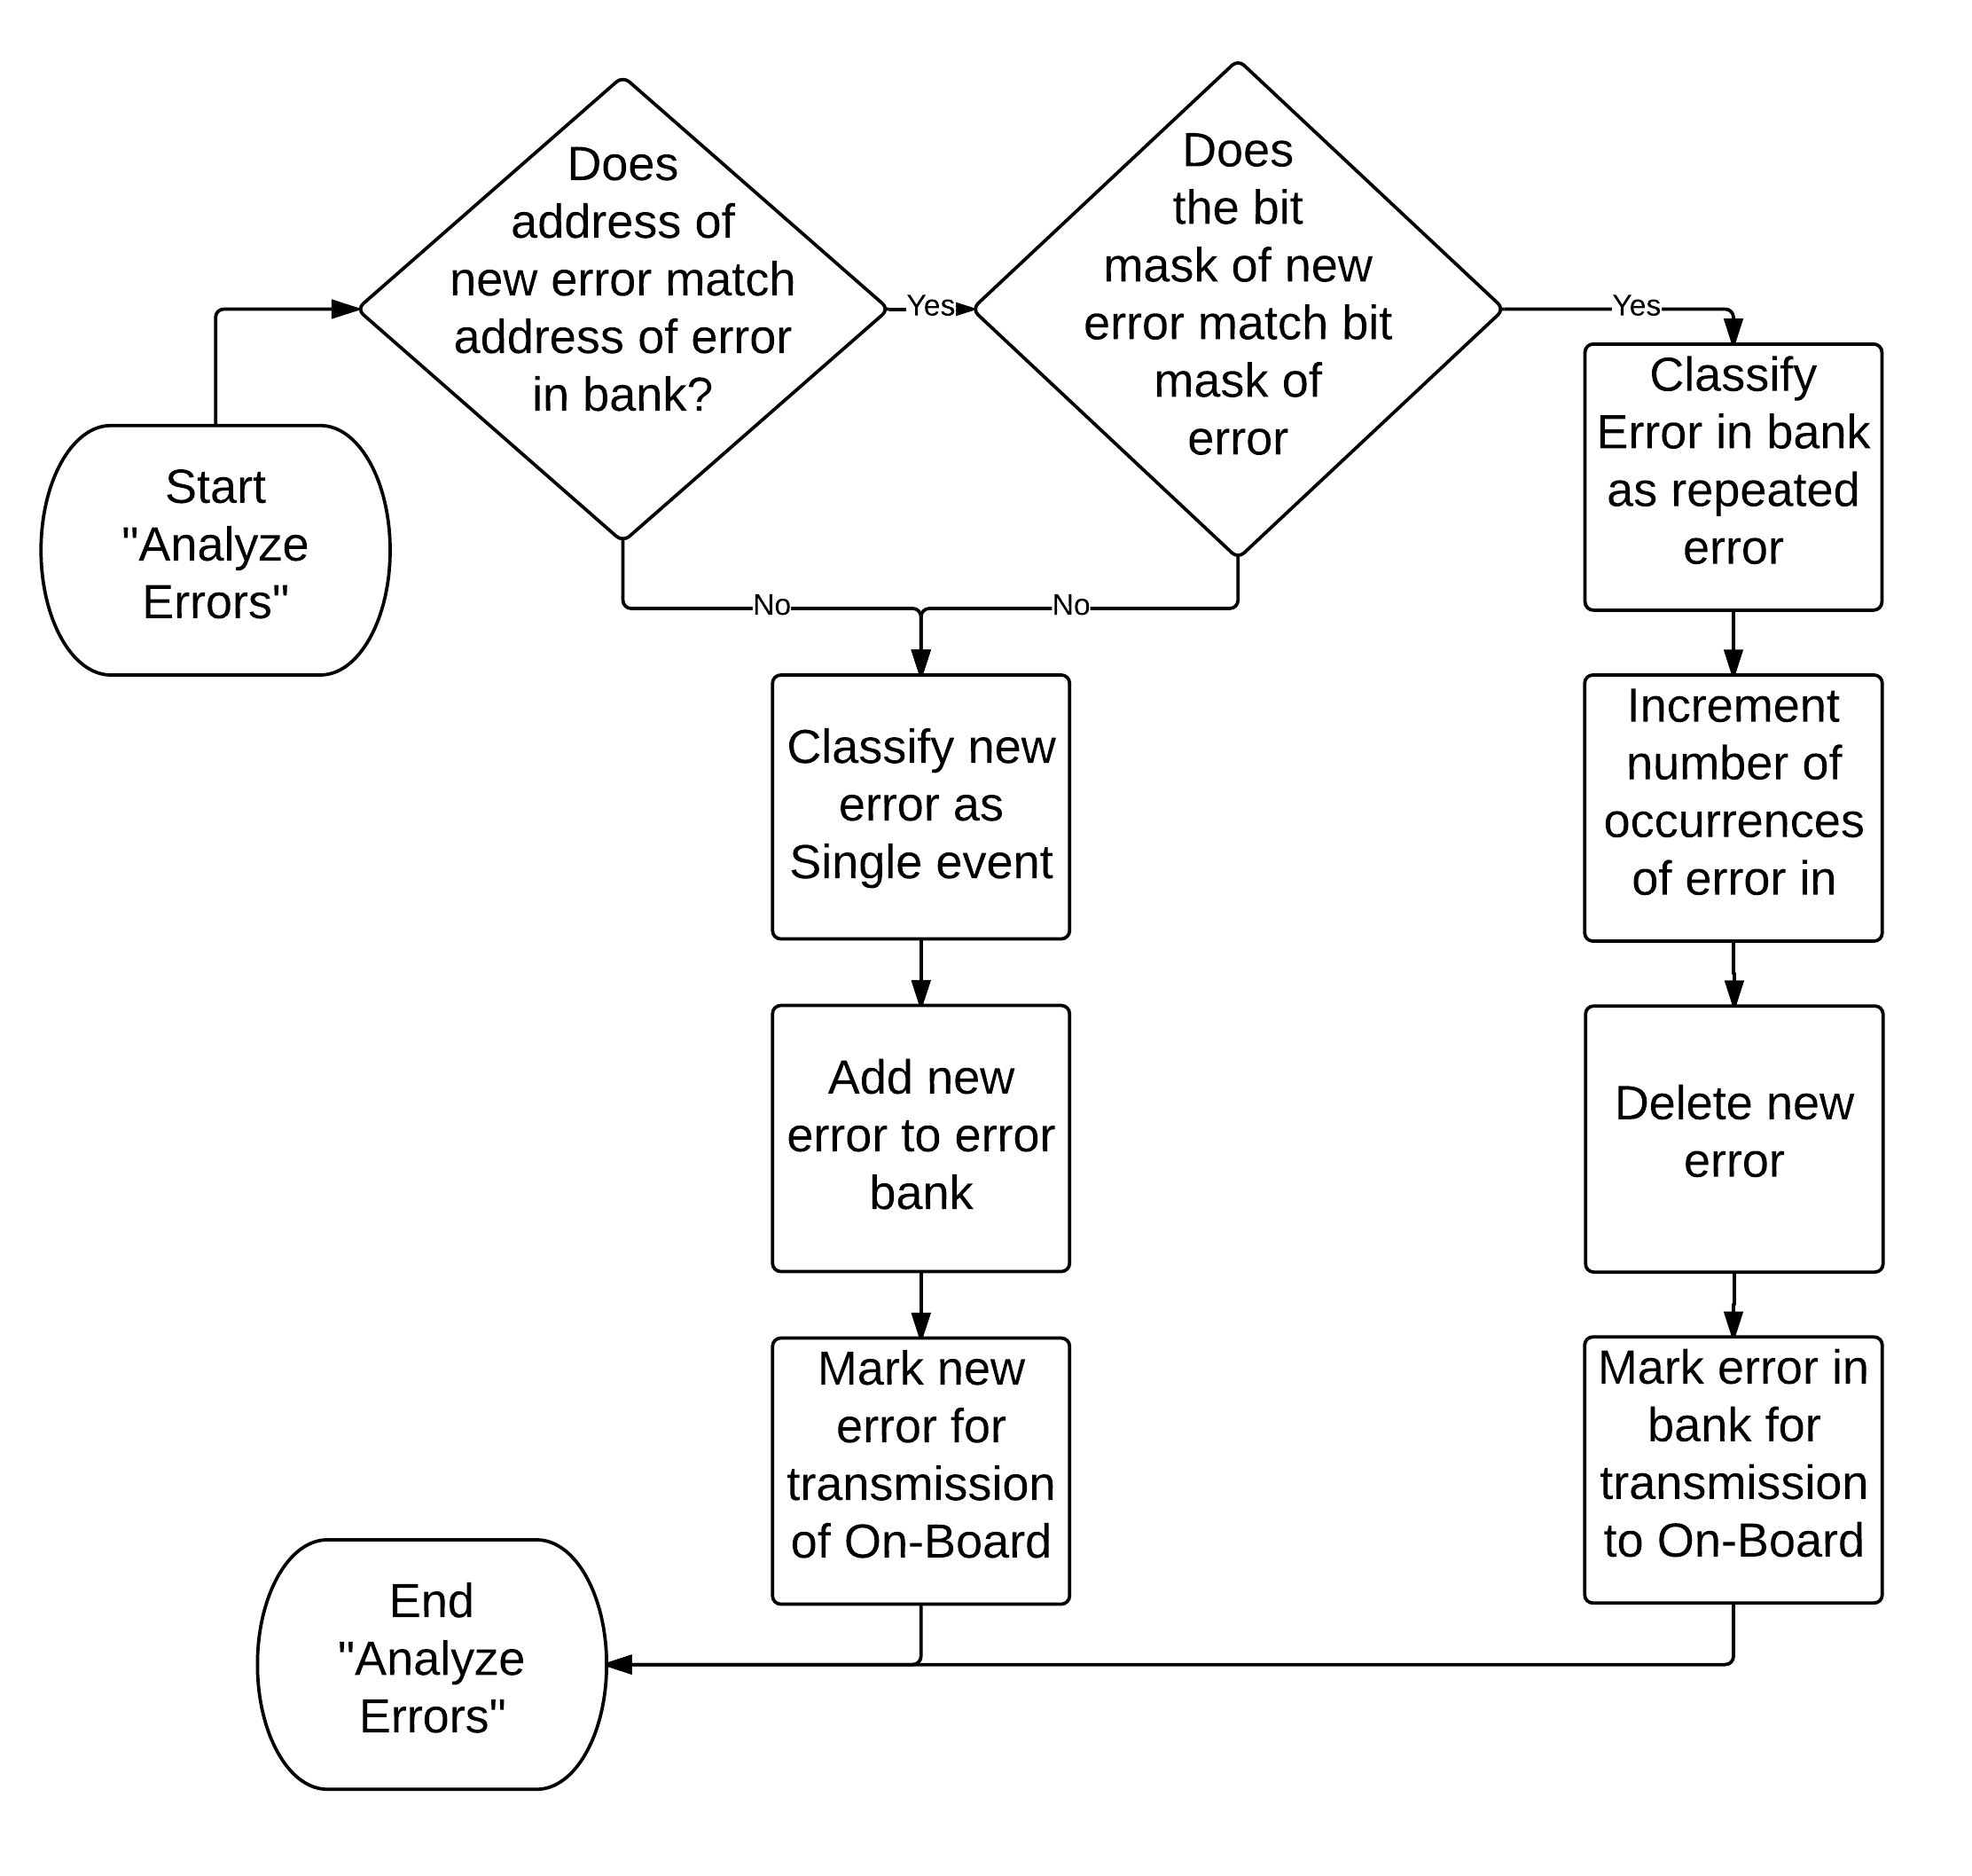
Analyze Errors Algorithm

