Slide 1




Development Progress of the EagleSat GPS Subsystem
Presented by
Tanner R. Hilken
Embry-Riddle Aeronautical University, Prescott
GPS Subsystem Lead

Slide 2
Objectives
To integrate a space rated GPS unit into the existing CubeSat platform
To obtain accurate and precise data on position, altitude, velocity, and trajectory

Slide 3
Standard Operation
Boot
OBC determines that it is generating sufficient power
OBC routes power to the GPS Unit
Operation
GPS boots up and acquires a signal from any satellites it detects
GPS calculates it’s position from the incoming signals
Output
GPS outputs a GGA string to the OBC
GPS outputs an RMC string to the OBC
The GPS unit will continue to output one of each string at a designated time interval so long as it still has sufficient power

Slide 4
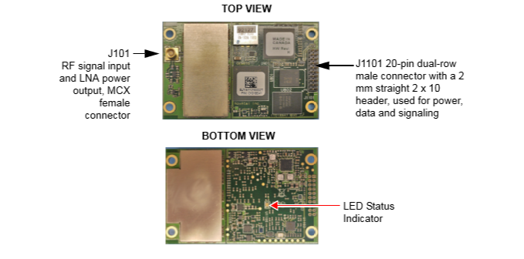
Novatel OEM 615 Receiver

Slide 5
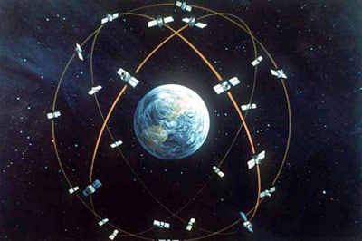
GPS Input and Output
The GPS will intake radio signals from a constellation of satellites
It will output two ASCII strings, RMC (Recommended Minimum Sentence C) and GGA (Global Positioning System Fix Data)
http://rammb.cira.colostate.edu/dev/hillger/GPS.htm

Slide 6
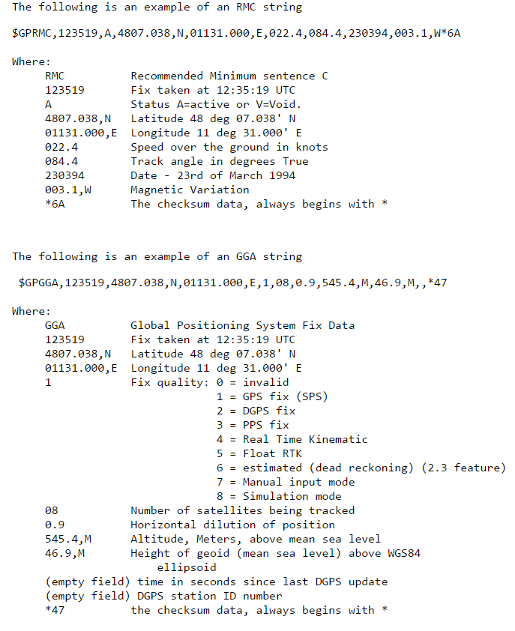
GPS Output

Slide 7
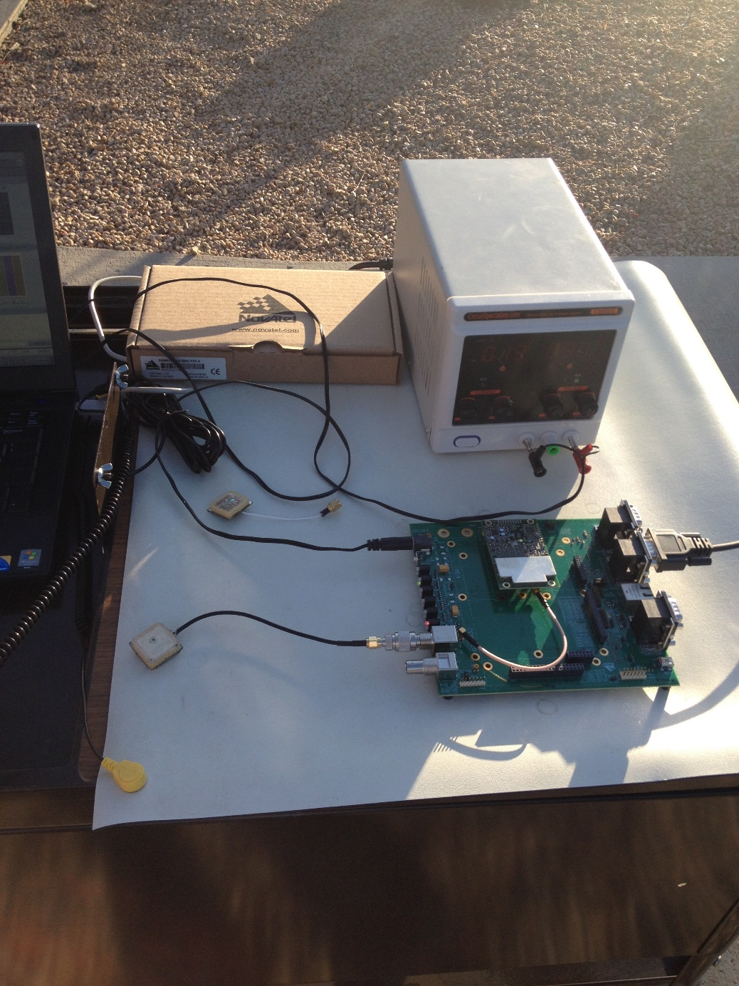
Testing Setup
The GPS unit is currently set up on the development kit on a mobile cart. This is to make signal acquisition simpler, as well as to allow more versatility in testing.

Slide 8
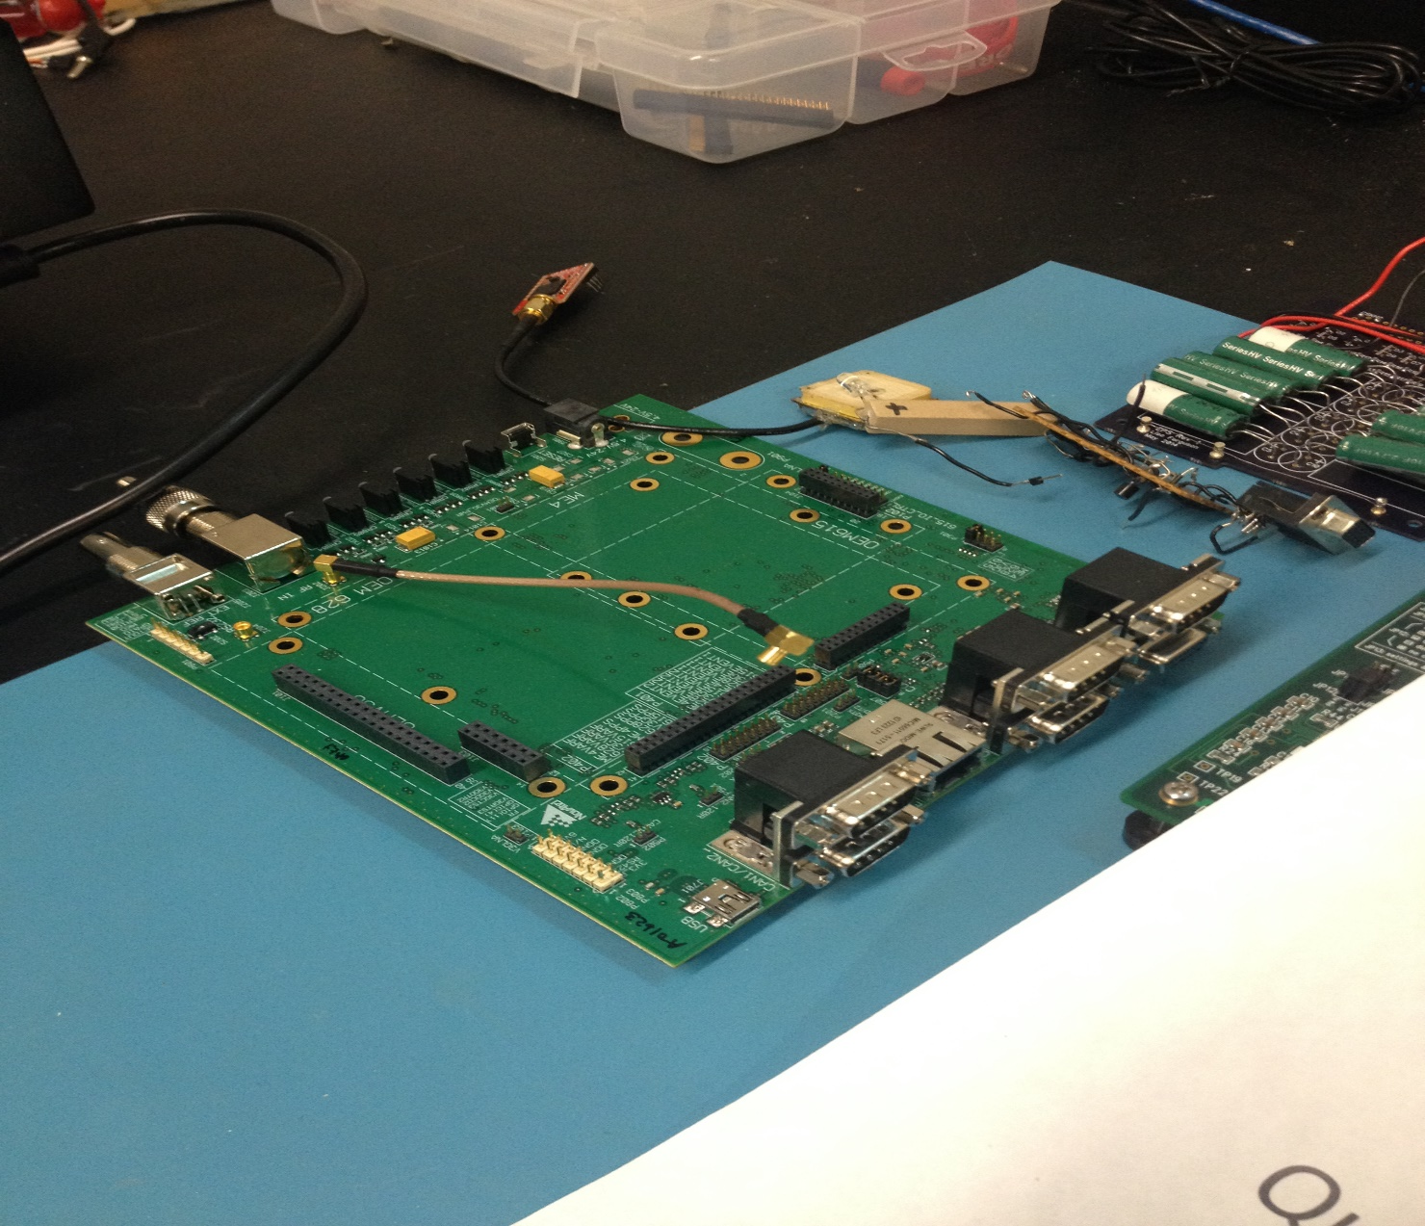
The Development Kit

Slide 9
The Testing Interface
Novatel provides users with a program for interfacing with the unit through the development kit
Novatel Connect allows the user to design a custom dashboard displaying information about various satellite functions
It also allows for easy, streamlined programming of the GPS with a variety of options through a command window (Ex. LOG COM1 GPGGA ONTIME 1 0 HOLD)

Slide 10
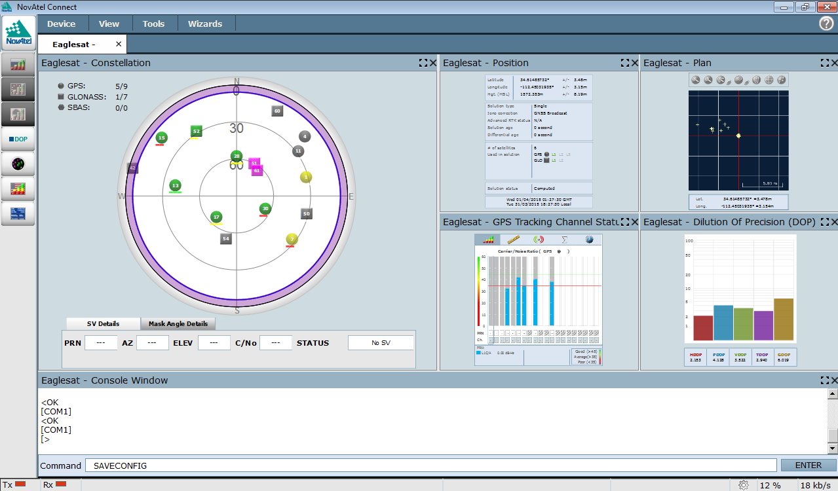
Novatel Connect Dashboard

Slide 11
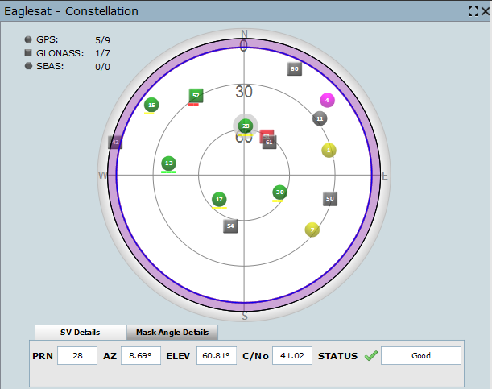
Constellation

Slide 12
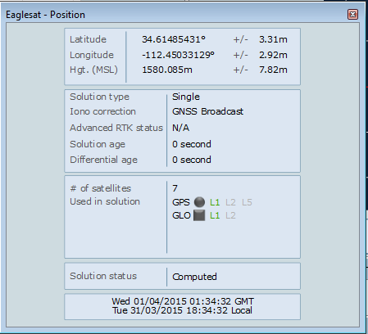
Position

Slide 13
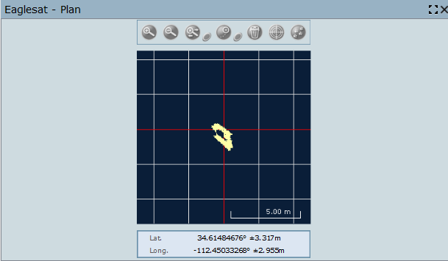
Plan

Slide 14
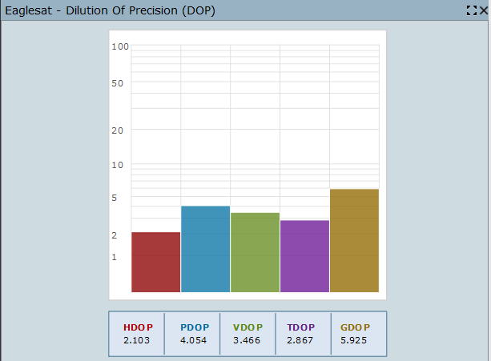
Dilution of Precision

Slide 15
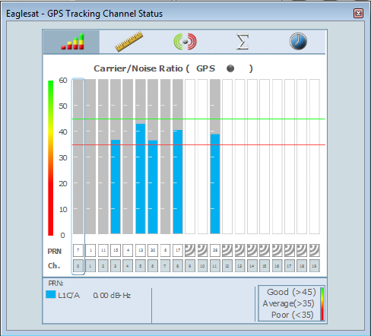
Channel Status

Slide 16
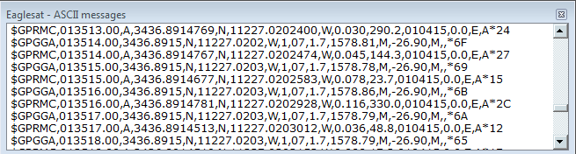
ASCII Output

Slide 17
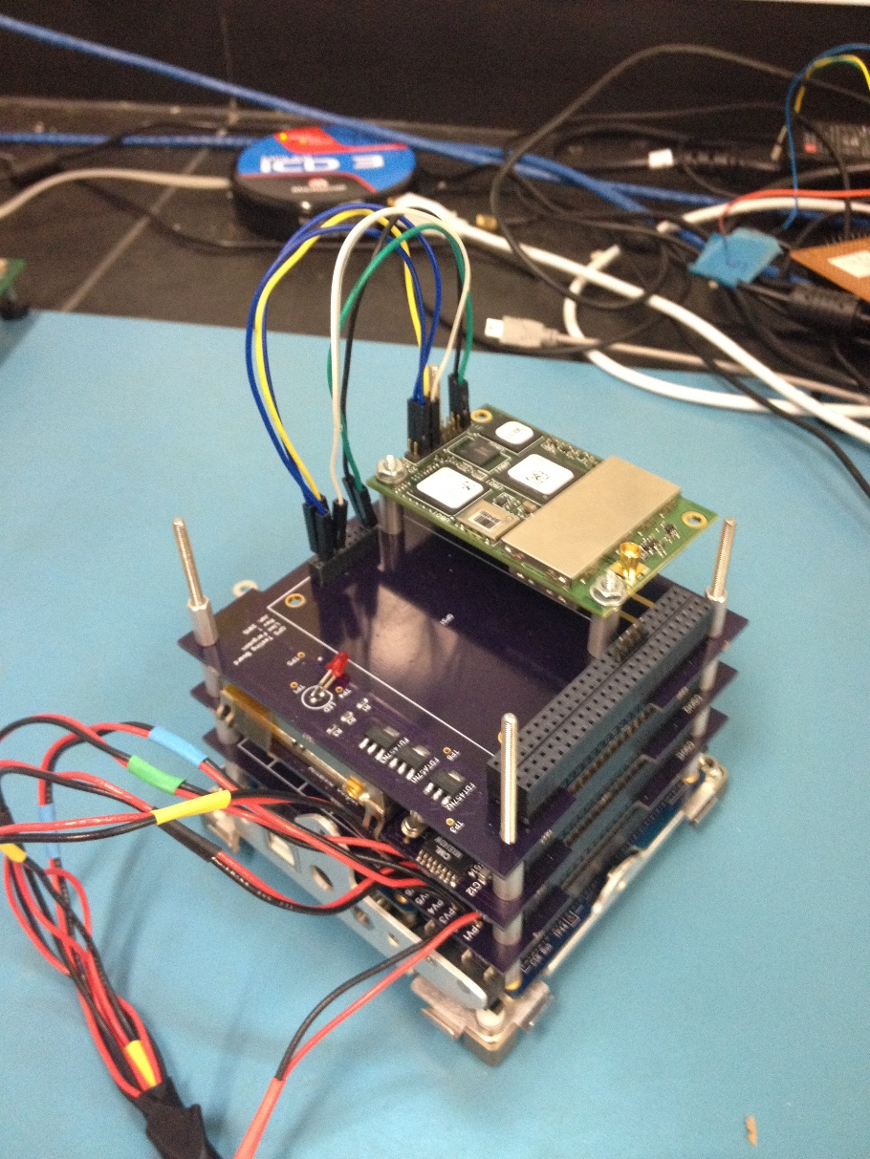
Further Testing
Dr. Post’s testing arrangement

Slide 18
Future Development
Despite the continuing success of tests utilizing this unit, testing will continue
Future testing may include booting the GPS after varying dormancy times
It may also include moving the unit around campus to measure various carrier/noise ratios
Either way, the GPS will continue to be tested rigorously before it is deemed flight ready

Slide 19
Acknowledgements
Dr. John Post, Dr. Gary Yale, and Jack Crabtree for their technical guidance and support of the EagleSat Program
ERAU College of Engineering for the continuing support of expert faculty and financial backing
Arizona NASA Space Grant Consortium for the continued support of funding student research interns and research projects

Slide 20
Thank you very much for your attention.
Contact Information:
Tanner R. Hilken
hilkent@my.erau.edu
(210) 380-3084

