Slide 1




Improving the Reliability of GPS Tracking Beacons
Clayton Jacobs
jacobsc6@my.erau.edu
Mentor: Jack Crabtree

Slide 2
Outline
Program History
Legacy Designs
New Hardware Specifications
Design Methodology
System Description
Future Developments

Slide 3
Program History
Embry-Riddle Project HiBall created to support the launch of high altitude balloons from ERAU campus.
Balloon train consists of multiple payloads which support on-campus organizations
Engineering Classes: AE226, Experimental Space Systems Lab
Preliminary/Detain Design: AE427
NASA ASCEND!
ERAU Summer Camps: Middle/High School Students
Beacons support the launch, ascent, decent and recovery
Provide position and velocity information on the airborne balloon

Slide 4
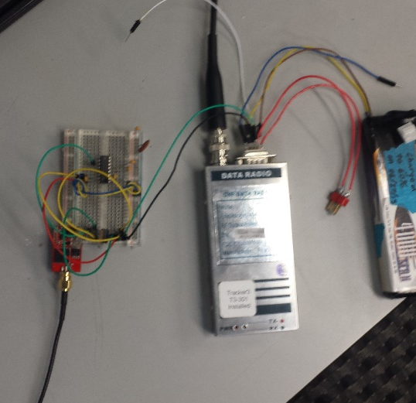
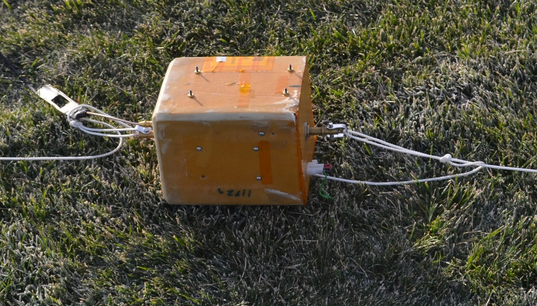
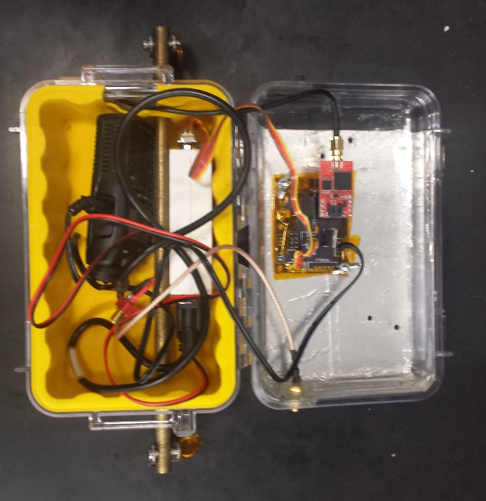
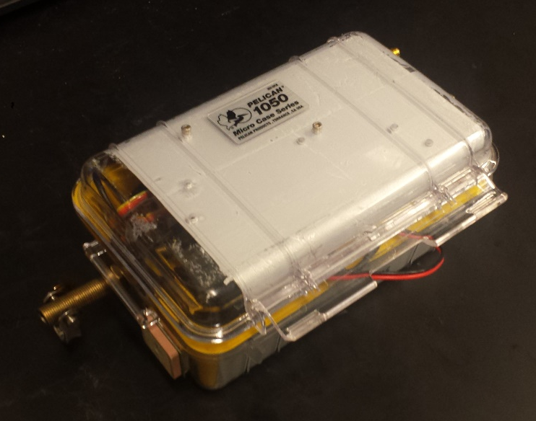
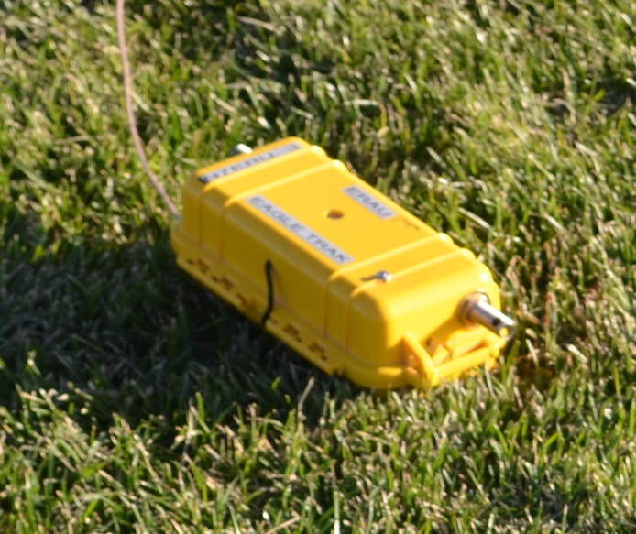
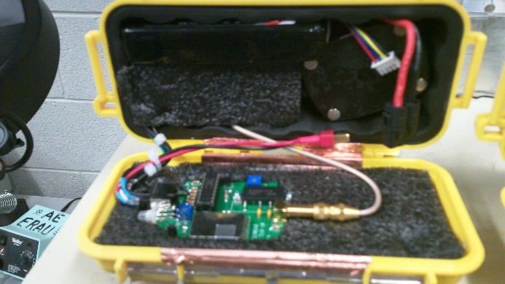
Legacy Designs

Slide 5
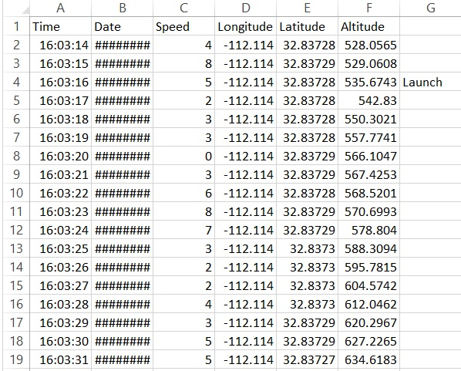
Legacy Designs
Sample Post-Flight Data (ANSR-88)

Slide 6
Legacy Designs
Maintainability
N7ERU beacons rebuilt before each flight and tested for correct operation. Damage from previous flights was corrected by short-term fix or replacement
Flaws
Heavy: Over 2lbs
Reprogramed before flight
High failure rate, unknown causes
Long wires, RF interference, unseen damage

Slide 7
New Hardware Specifications
Total weight under 2lbs
Minimize weight
24 Hour battery life
Maximize operational time
Beacon must be reusable
Ability to perform maintenance is important
Must be reprogrammed for each flight

Slide 8
Design Methodology
Byonics TinyTrak3plus (TT3+)
Converts serial GPS data into analog audio tones to be transmitted by the transceiver
Converts the GPS information into a standard APRS packet structure for reception by Amateur Radio operators
Venus GPS
Reports serial NMEA formatted position/velocity information
Not limited to 60,000ft AGL
UHF Transceiver SA828
Transmits analog audio signals as RF
Operating range from 400Mhz-480Mhz

Slide 9
System Block Diagram
Support Circuitry
UHF
TCVR
Venus GPS
Audio Signal
TT3+
Serial Receive
Signal Ground
Serial Transmit
3.3V Regulator
12V Battery
5.0V Regulator

Slide 10
Further Development
Assemble functional circuit board when the PCB is delivered.
Test system performance under thermal and pressure cycling in a thermal vacuum chamber with the addition of RF interference.
First scheduled flight in June 2015 on ERAU Summer Camp balloon.
Write a user guide which includes:
Circuit Descriptions
Maintenance procedures
Operation procedures

Slide 11
Acknowledgements
Dr. Gary Yale –ERAU Space Grant Coordinator
Prof. Jack Crabtree – Project Mentor

Slide 12
End
Thank you for your attention.

