Slide 1
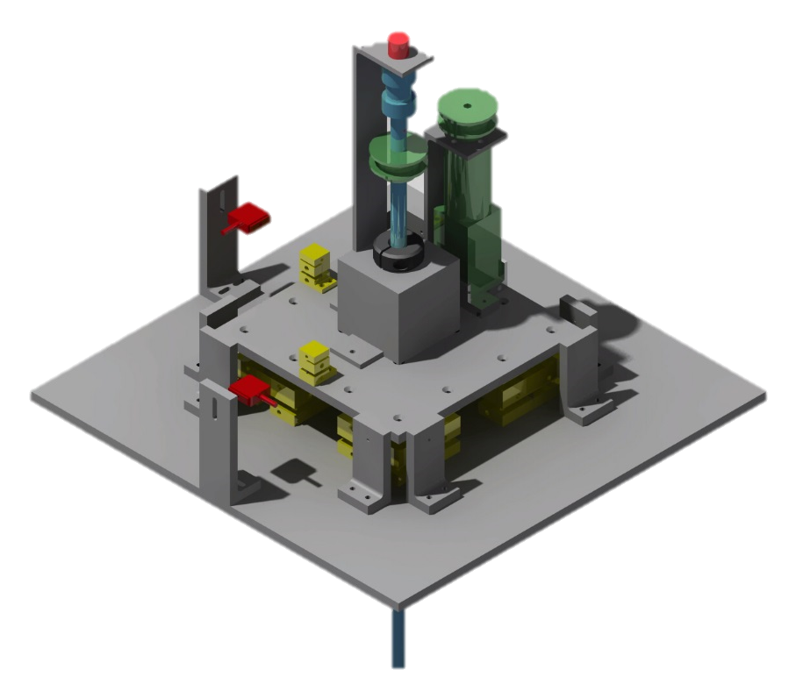

Low-Range Force Balance Research Project
By:
James McClure III
Arizona Space Grant Consortium, Phoenix, AZ
April 17-18, 2015

Slide 2
Project Purpose
Design, manufacture, and test a force balance
Precise
Portable
Easy to manufacture, use
Low Reynold’s Number testing ability
Yellow: Joints
Red: Sensors
Green: Power
Blue: Central Shaft

Slide 3

Major Components
Flexure Joints
Must rotate with virtually no resistance
Component Use
Forces applied to load cells must not exceed 100 grams
Stepper Motor
Model Attachment Shaft

Slide 4
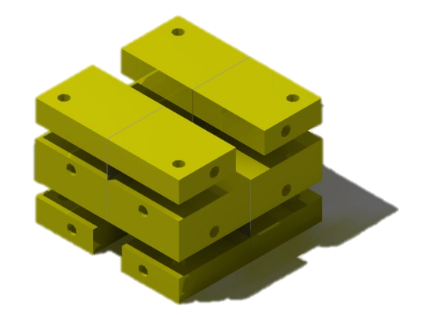
Flexure Joints
Spring Steel sheets clamped with aluminum blocks
Spring steel rotates through small angles only

Slide 5
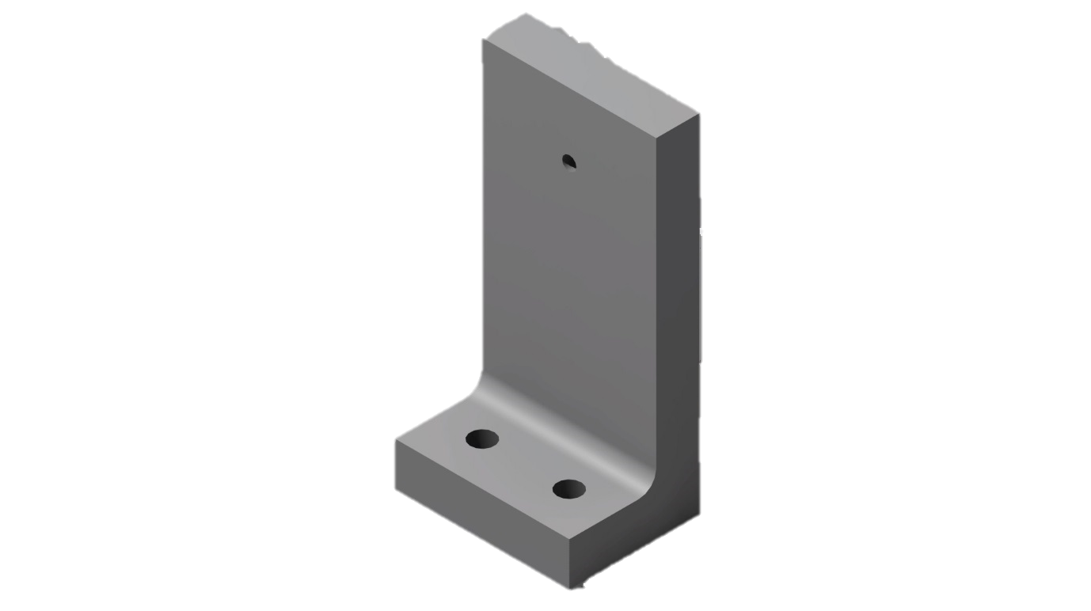
Safety Towers
L-Brackets with tapped holes for fine pitch screws
Secure screws to top plate to anchor in place

Slide 6
Portability
Balance should not exceed 5 pounds
Easy to carry across short distances

Slide 7
Special Thanks
Dr. Lance Traub
Mentor for this project
Mr. Patrick David
ERAU Prescott Machinist
Jet Cutting Solutions
Manufacturer of base, top plate and flexure supports

Slide 8
Questions?

