Slide 1
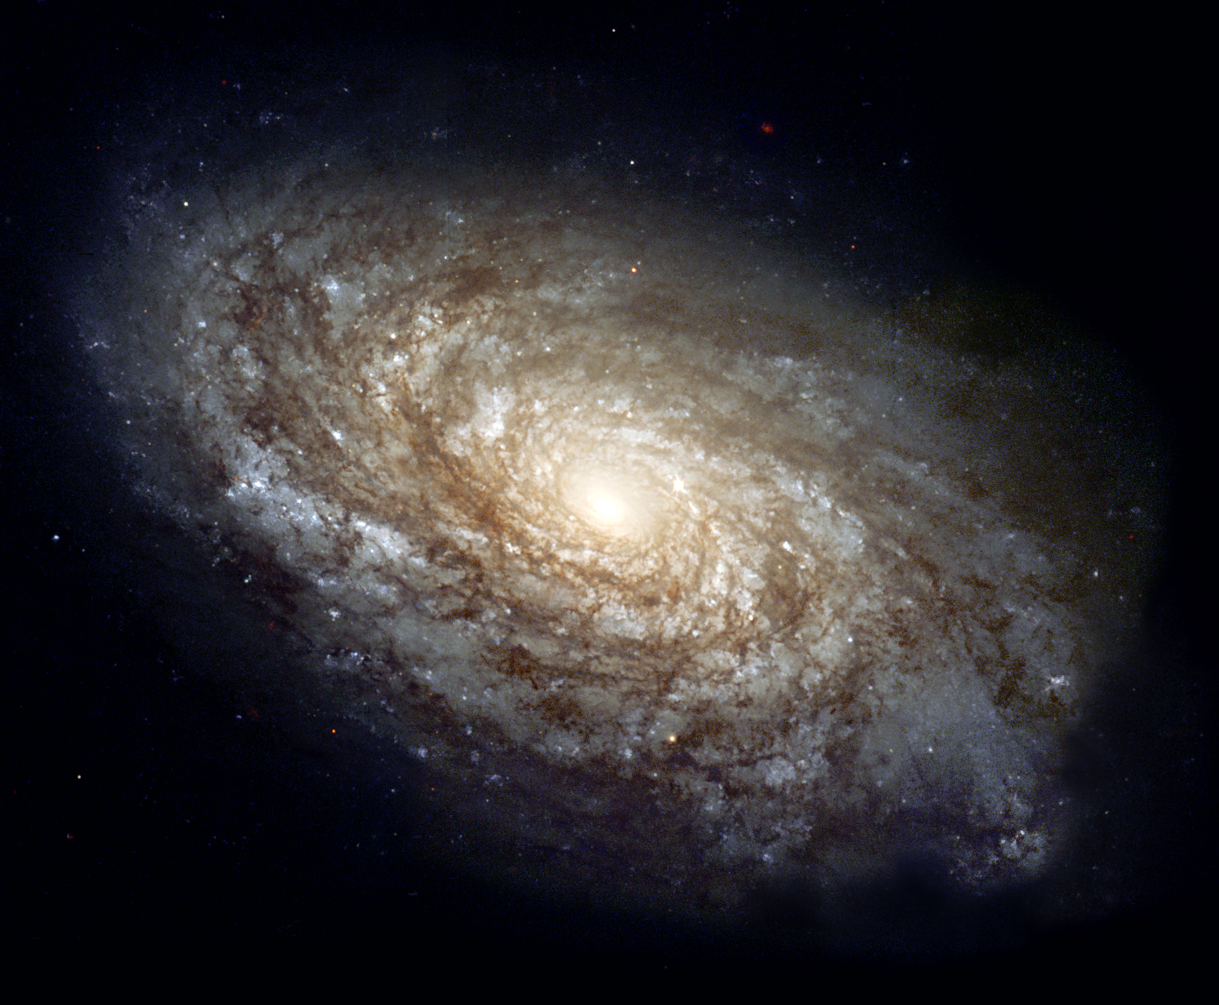
Breaks in Radial Stellar Surface Brightness in Spiral Galaxies
Brian Barandi (NAU)
Mentor: Dr. Deidre Hunter (Lowell Observatory)
Image: NASA

Slide 2
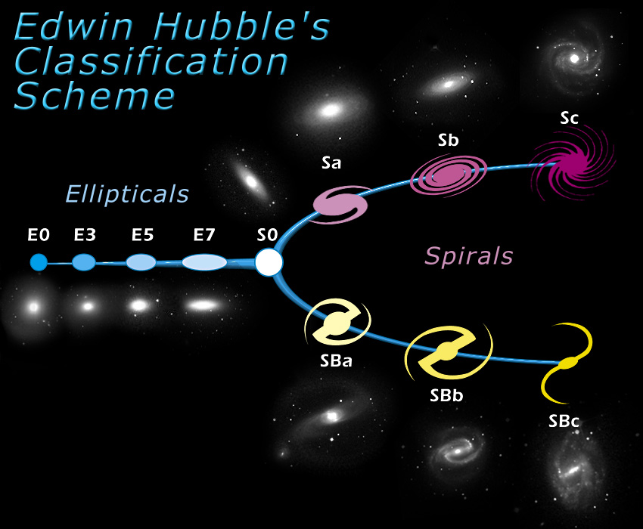
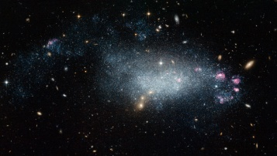
Galaxies
What is a galaxy?
Generally a galaxy is a gravitationally bound system of stars, interstellar dust, and gas.
Dwarfs Irregulars
Image:en.wikipedia

Slide 3
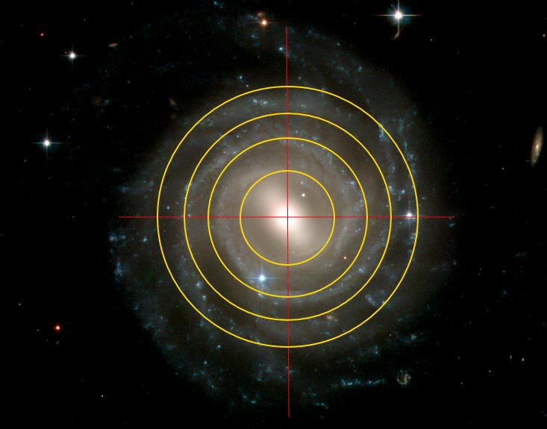
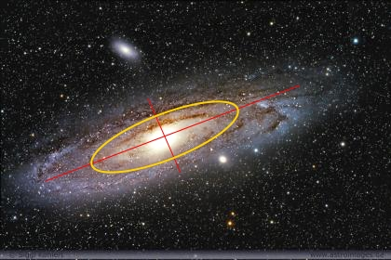
Radial Stellar Surface Brightness
What is Radial Stellar Surface Brightness?
Stellar Surface Brightness – The measure of light emitted by stars in a galaxy per area in a particular band pass.
Radial- Measuring with circles of increasing radius.
Needs to be transformed to face-on.

Slide 4
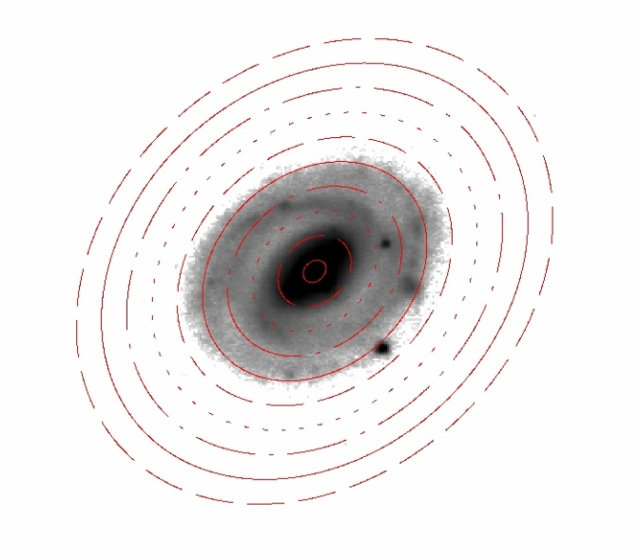
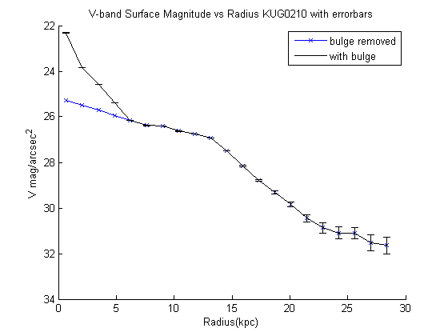
Surface Brightness and the Break
V band – Centered at 463-639nm(4630-6390 Å) Green.
An indicator for on-going star formation in the last 1 Gyr of galaxies that are still active.
Break
KUG 0210-078 V-band

Slide 5
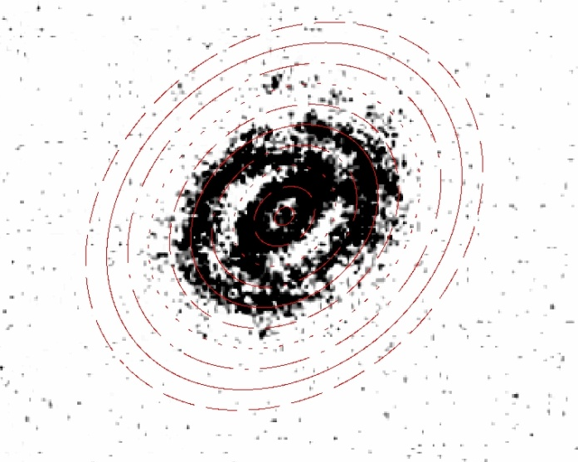
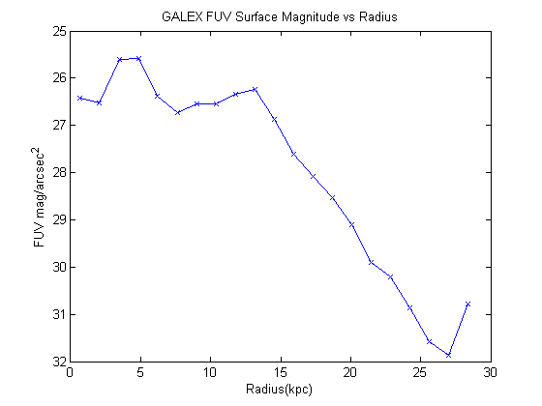
Surface Brightness FUV
FUV (Far Ultra Violet) band from GALEX, 140-170nm(1400-1700Å) .
Indicator for new star formation in the last 100 Myr.
Radius corresponding to V-band break
KUG 0210-078 FUV-band

Slide 6
Ratios and What does it mean.
FUV/V inside break = 0.99
FUV/V outside break = 0.94
Inside break/Outside break ratio = 1.05
This is the ratio used to compare with other galaxies
This means that new star formation, relative to old star formation, inside the break and outside the break are almost equal.
How does this compare to dwarf galaxies?

Slide 7
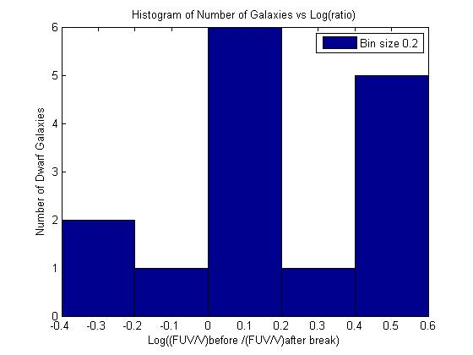
Data From: Hunter 2014
Spiral Ratio=1.05
Log(1.05)=0.05
Greater Star Formation after break
Greater Star Formation before break

Slide 8
Future Work
Perform surface photometry on more spirals for a larger comparison sample.
Look for correlations between spiral galaxy morphological types.
Look for other correlations between dwarf and spiral surface photometry.

Slide 9
Acknowledgments
I would like to thank:
Dr. Deidre Hunter - Mentor
Dr. Nadine Barlow - Associate Director of Arizona Space Grant Consortium
Kathleen Stigmon - Sr. Program Coordinator - NAU/NASA Space Grant
Northern Arizona University
NASA Space Grant Program
Lowell Observatory

