Slide 1



Star Formation in
Interacting Galaxies
Ian Beagles
Advisor: Dr. Lisa Chien
Northern Arizona University
Arizona space grant consortium symposium 2015

Slide 2
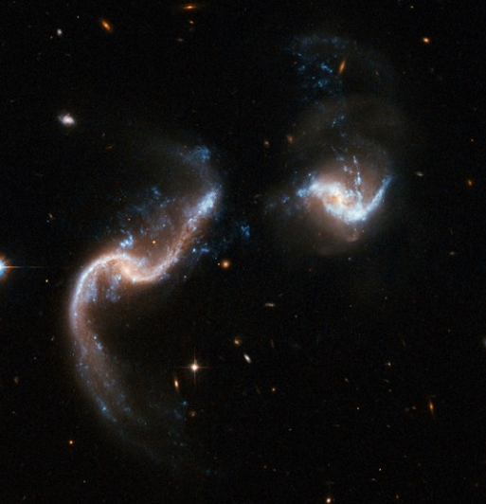
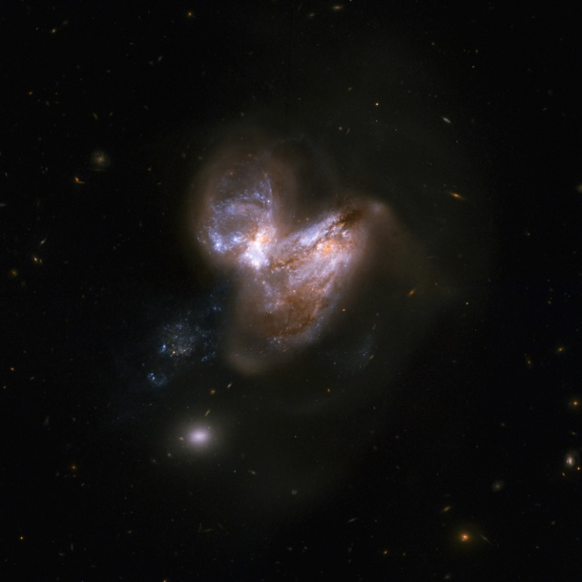
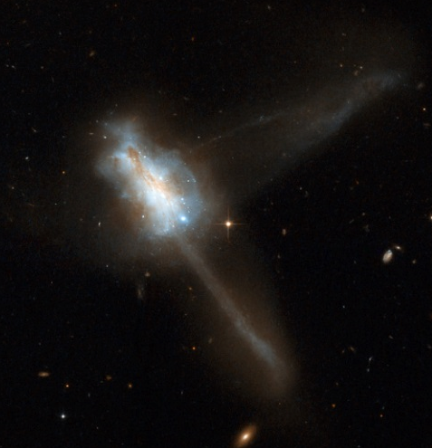
Overview
Cluster ages provide insight into the star formation history of interacting galaxies
Arp 256
Arp 299
IC 883

Slide 3
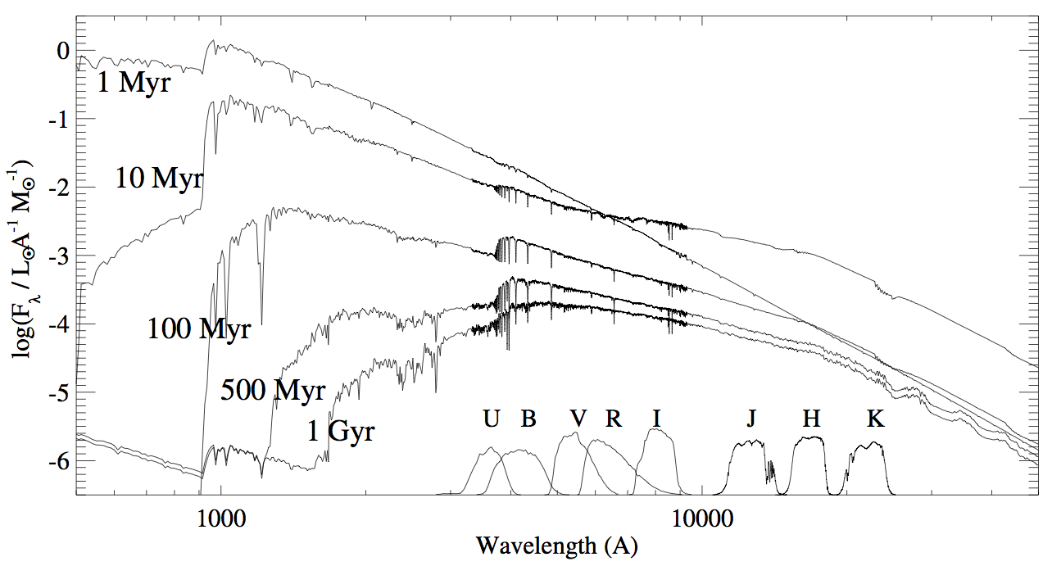
Overview
Photometric analysis of star clusters gives their ages
Determine cluster ages in three interacting galaxy pairs
(Tremonti 2004)

Slide 4
Data
Two images from Hubble Space Telescope
    One in visible at 435 nm and one in infrared at 814 nm
Selected cluster candidates and performed photometry using IRAF
Created color-magnitude diagrams for each galaxy

Slide 5
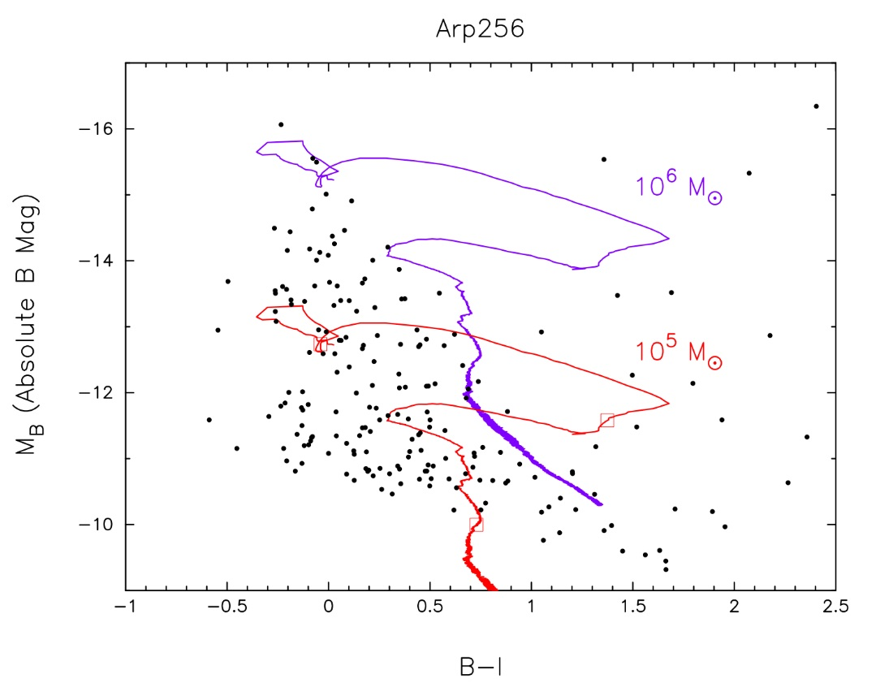
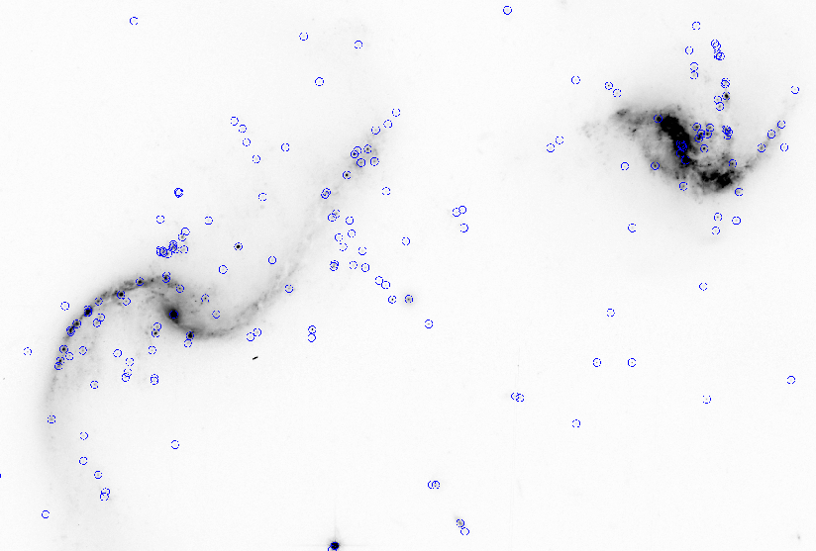
Arp 256
Dots represent each of the 222 cluster candidates
Color lines represent the evolution of the clusters with different masses

Slide 6
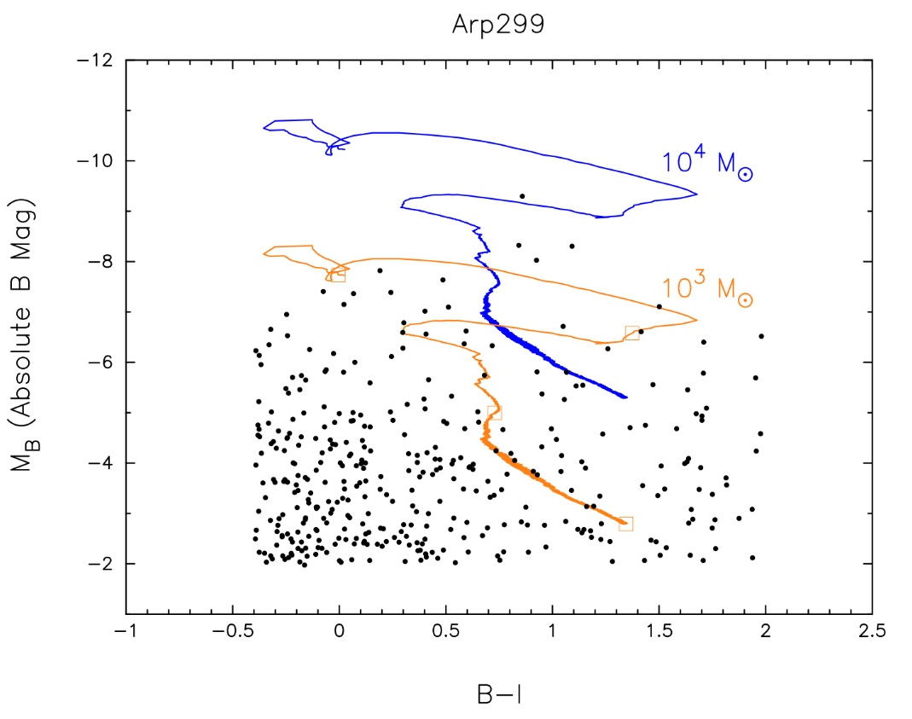
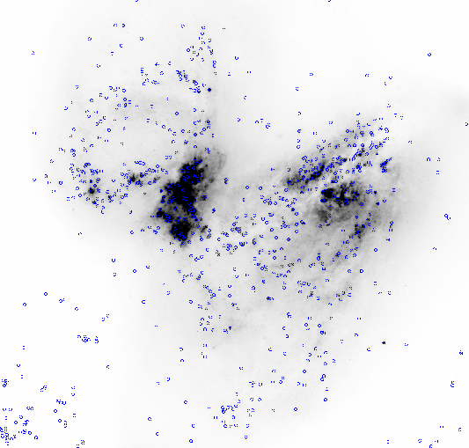
Arp 299
Dots represent each of the 1078 cluster candidates

Slide 7
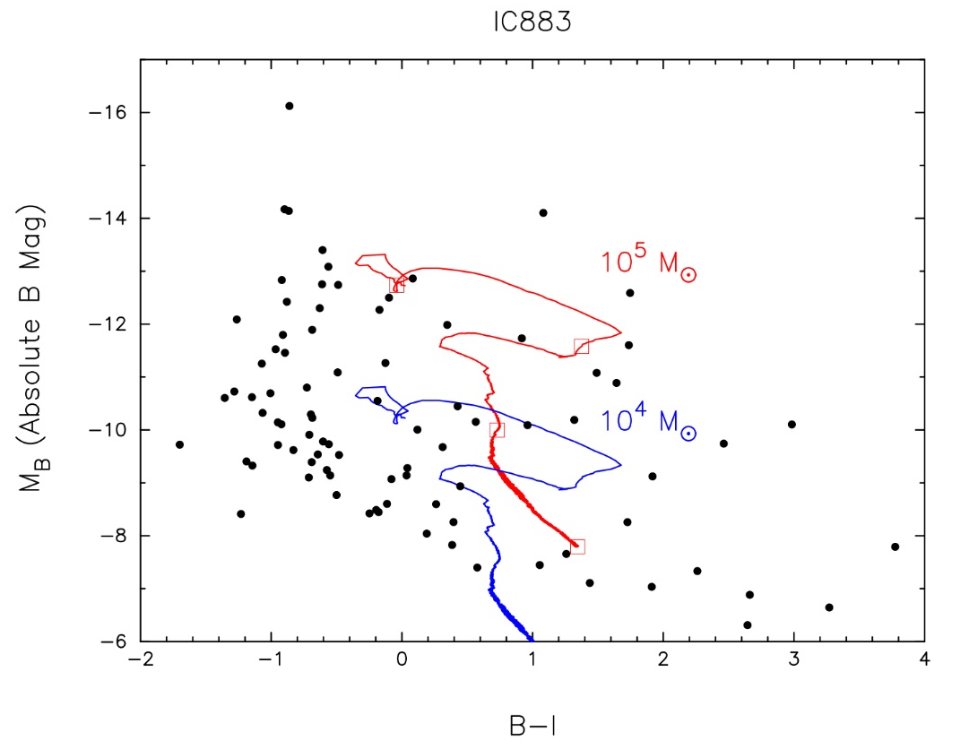
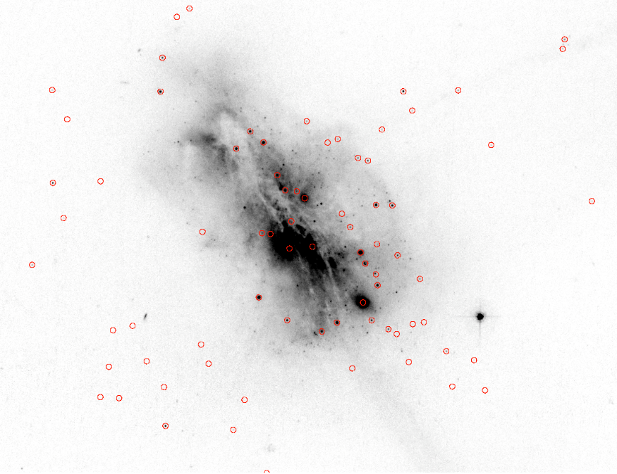
IC 883
Dots represent each of the 94 cluster candidates

Slide 8
Results
Clusters in Arp 256
  Mass between 10⁵ to 10⁶ M_{ʘ}
  Ages as young as 1 Myr
Clusters in Arp 299
  Mass between 10³ to 10⁵ M_{ʘ}
  Ages as young as 1 Myr
Clusters in IC 883
  Mass between 10⁴ to 10⁵ M_{ʘ}
  Ages of 100 Myr to 1 Gyr, with a few younger than 100 Myr

Slide 9


Acknowledgements
I would like to thank:
Dr. Lisa Chien
NASA Space Grant
Arizona Space Grant Consortium
NAU Space Grant
Any Questions?

