Slide 1




Measuring the UV Luminosity Function of High Redshift Galaxies
David Setton

Slide 2
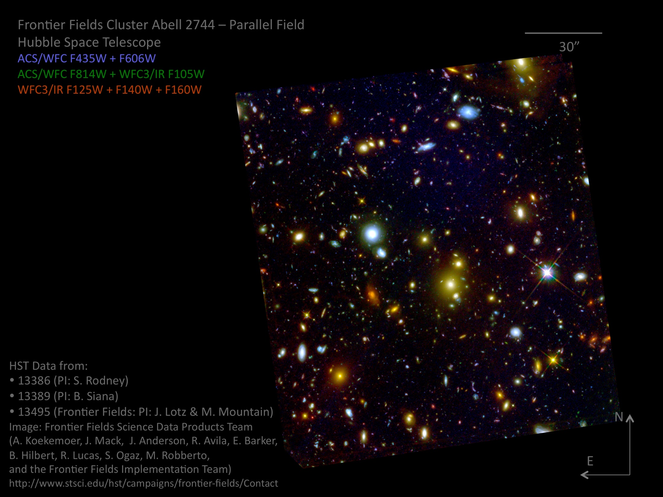

Slide 3
Goals
Obtain photometric data on Abell 2744 and Macs 0416 Parallel Fields
Determine the redshift of the galaxies
Account for stellar contaminants and noisy regions
Determine the Ultraviolet Luminosity Function for the galaxies at high redshift

Slide 4
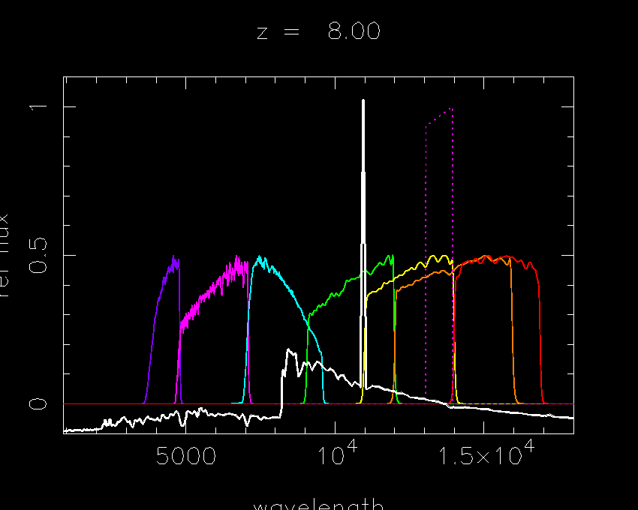
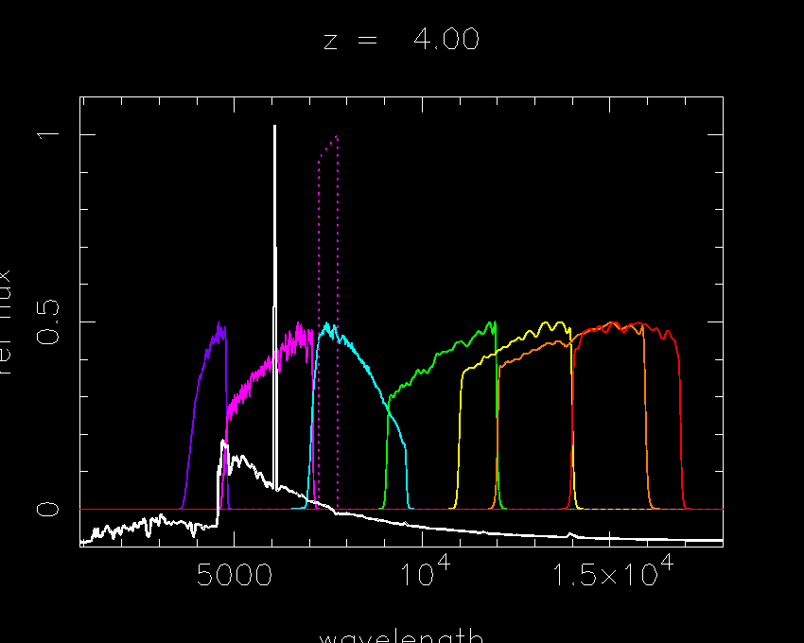
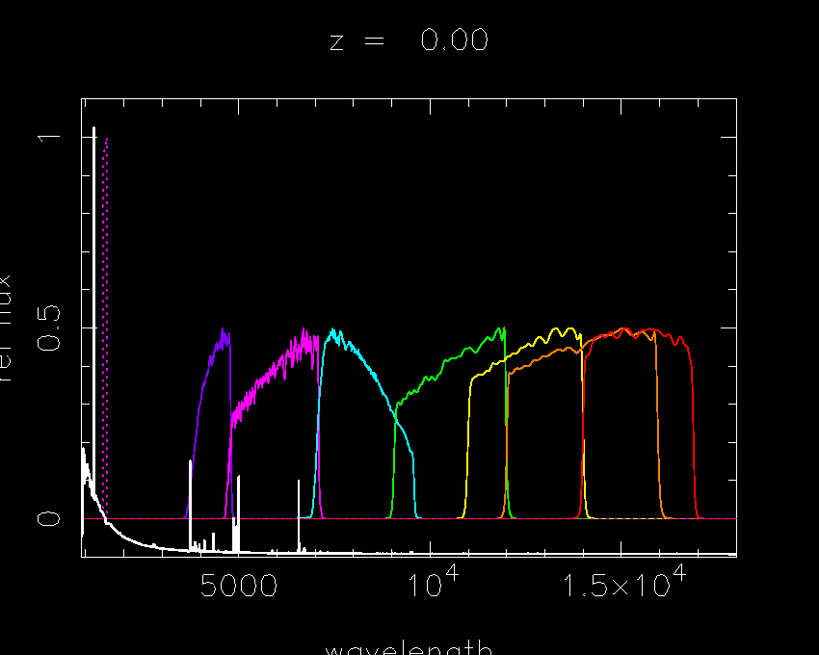
F435w
F606w
F814w
F105w
F125w
F140w
F160w

Slide 5
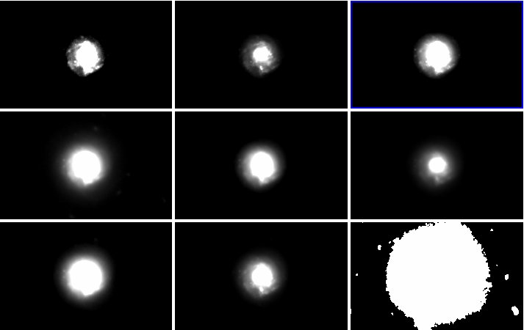
A2744 901 (Galaxy)
F435w
F606w
F814w
F105w
F125w
F140w
F160w
Chi²
Seg

Slide 6
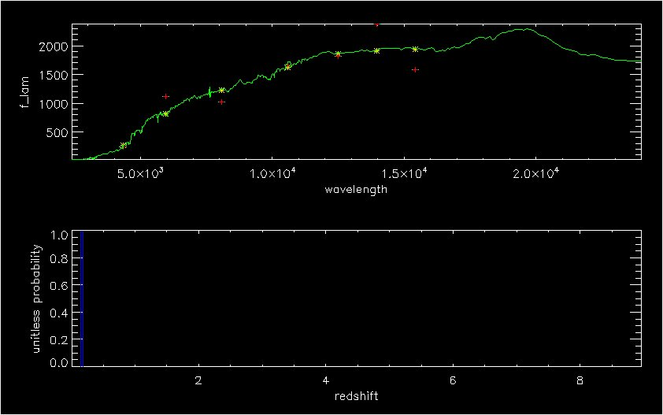
A2744 901 Spectrum (z~.161)

Slide 7
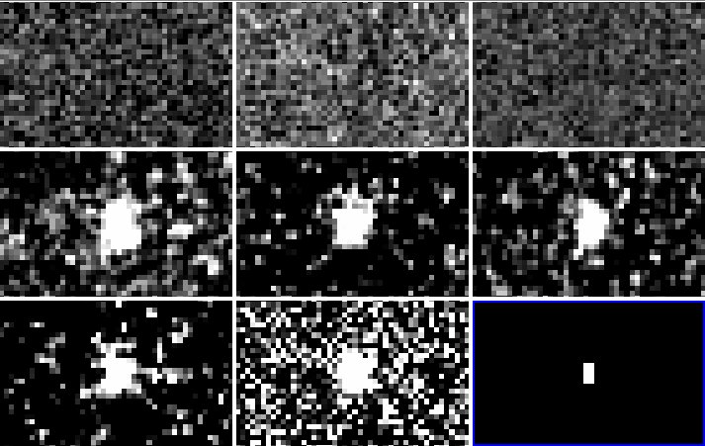
A2744 289 (Galaxy)
F435w
F606w
F814w
F105w
F125w
F140w
F160w
Chi²
Seg

Slide 8
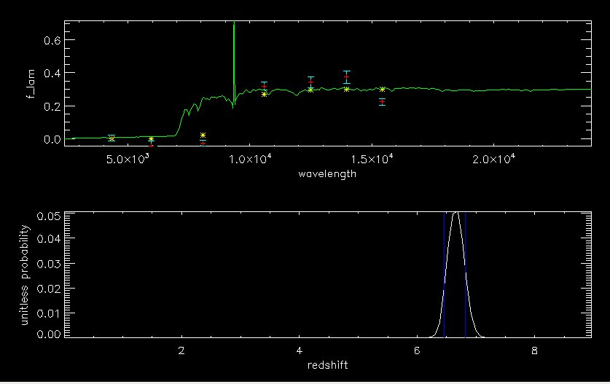
A2744 289 Spectrum (z~6.89)

Slide 9
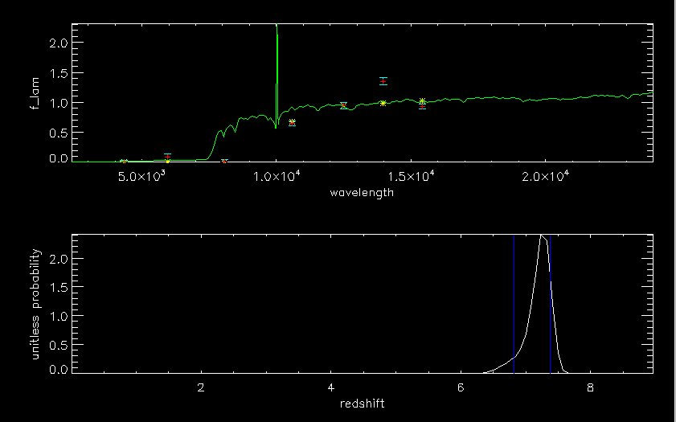
A2744 1437 Spectrum (Star)

Slide 10
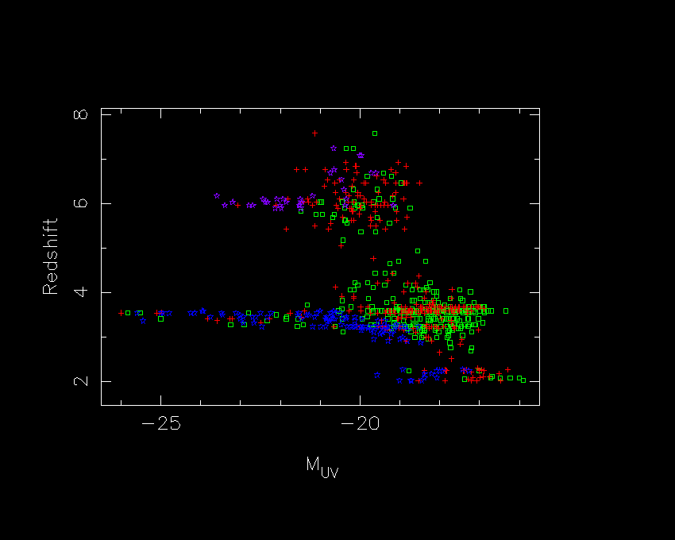
Redshift vs.
Absolute UV Magnitude
Abell 2744 parallels
Macs 0416 parallels
Stars determined by shape
Stars determined by size

Slide 11
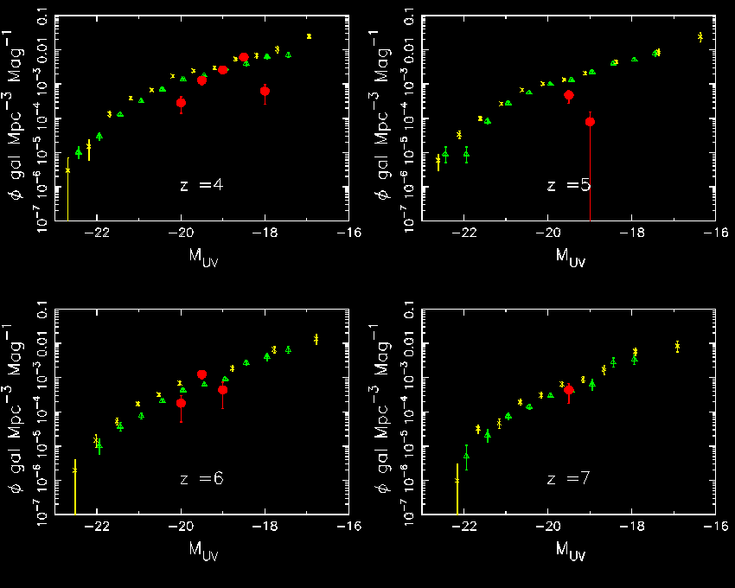
UV Luminosity Function
Our data
Finkelstein et al
Bouwen et al

Slide 12
Looking Forward
Pipeline set up and ready to churn!
James Webb Space Telescope

Slide 13
Acknowledgements
Christopher Willmer
Marcia Rieke and the entire NIRCam team
Susan Brew and all the NASA Space Grant Staff

Slide 14
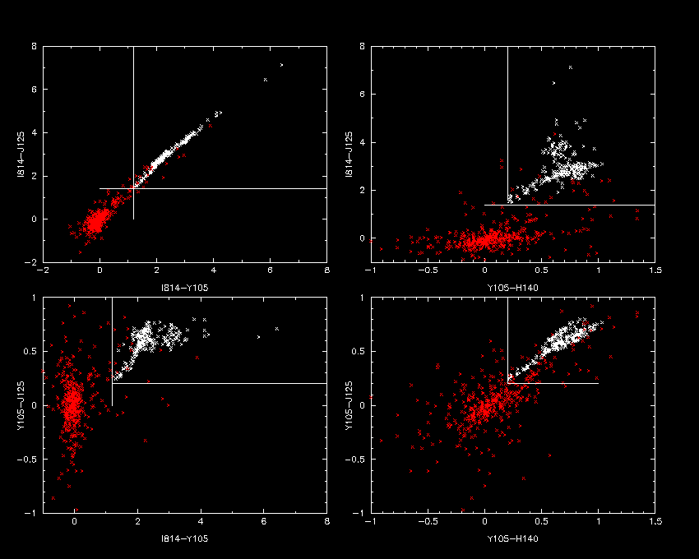
Color-Color
Plots
(Red points are our data, white points are a sample of brown dwarfs)

