Slide 1

An Investigation of Densities of Transit Detected Exoplanets
Mason Waaler
Advisor: Jennifer Patience

Slide 2
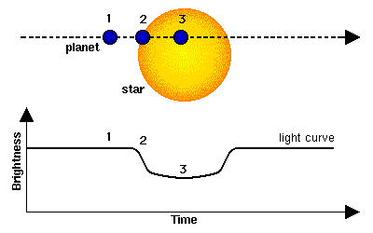
Transit Detection
When a planet crosses in front of its host star it disrupts the signal we receive from the star
By analyzing this signal we can determine the radius of the planet
Taking into account the stellar properties of the host star we can determine the density of the planet as well

Slide 3
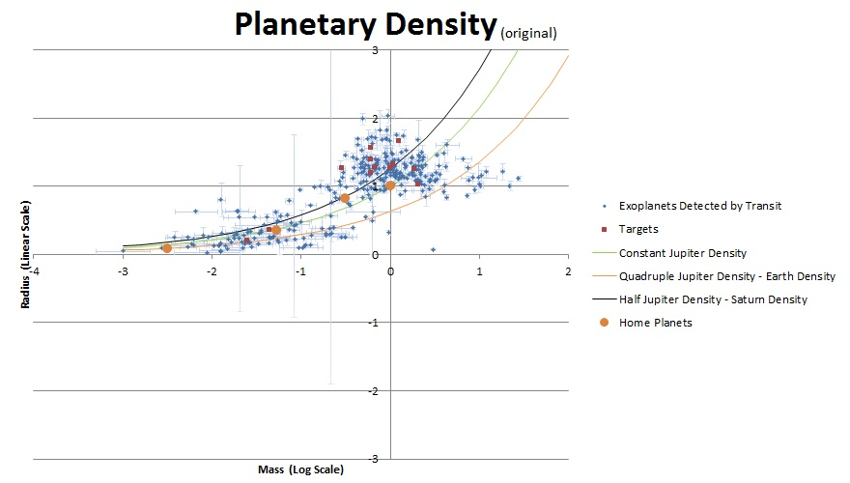
Transit Detection
Many planets are detected via the Transit method

Slide 4
This Project
This project selected 12 stars with detected exoplanets to investigate the possibility of the host “star” actually being “stars”
The chosen targets –
  HATP[35b,36b, 39b, 42b, 43b], HD97658b, GJ3470b, and WASP[39b, 43b, 54b, 56b, 82b]
The targets were imaged at the MMT Observatory on Mt. Hopkins
3 nights of viewing to collect the raw images

Slide 5
Correcting the Images
Each raw image had to be fixed before it could be analyzed
  First the images had to be dark subtracted and flat-fielded
    This process begins to filter out any imperfections due to the sky itself
  Then a “sky” image was created which was then applied to the images to further correct them
  Then a bad pixel mask was applied to each image and all the images were combined and aligned
  Finally the images were rotated so that they all were in the same set of coordinates

Slide 6
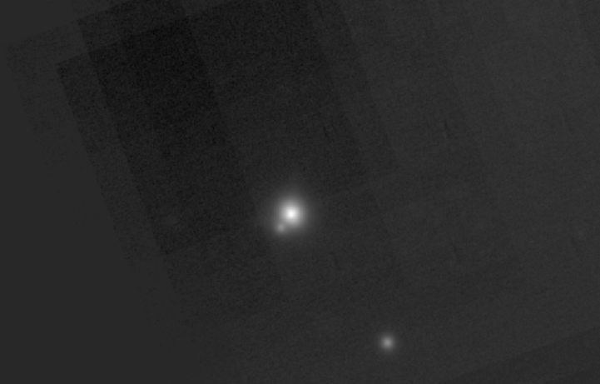
Analyzing the Images
First all the images were observed by eye to see if they had the potential to be binary or trinary systems
At first glance the following systems look promising…
  Binaries: HATP43b, WASP54b, WASP56b
  Trinaries: HATP35b (pictured), 39b
But every system will be analyzed

Slide 7
What does this mean?
The planet’s properties are determined by the star we detect
So if that star is actually two or three stars it changes the properties of the planet we detected
So we need to analyze the images to gather information about the host star(s)

Slide 8
Analysis
The project is not complete yet and as of the creation of this presentation we are still analyzing our images
The systems with multiple stars are our primary concern
The possible trinary and binary systems are exciting

Slide 9
Conclusion
Working on this project has exposed me to incredible opportunities that I would not have had elsewhere
I especially appreciate all the help and guidance from Dr. Patience, Kimberly Ward-Duong and Miranda Herman
Thank You for Listening

