Slide 1


Development of a Spectrophotometric Data Reduction Pipeline
Arizona Space Grant Consortium
NAU/NASA Space Grant
Ryan Buckingham
Northern Arizona University
Gerard van Belle
Lowell Observatory

Slide 2
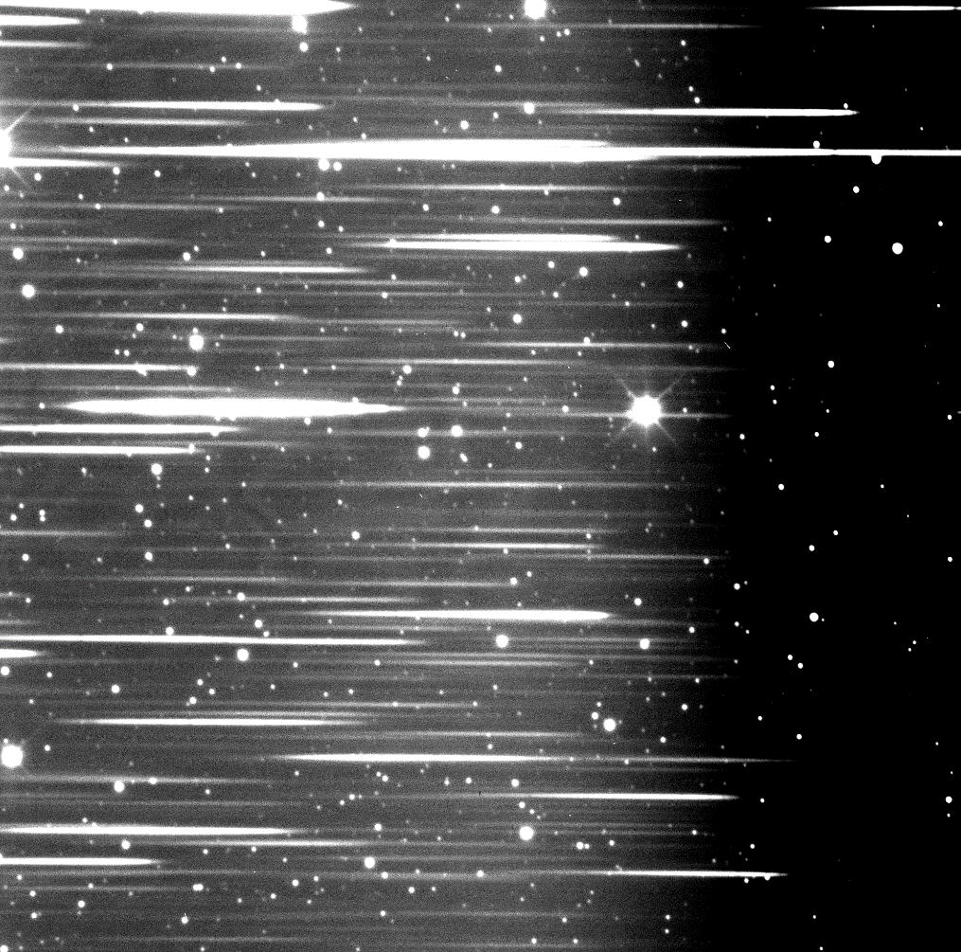
Spectrophotometry
Big Word: Break it up
  Spectra
  Photo
Significance
  Best of both worlds

Slide 3
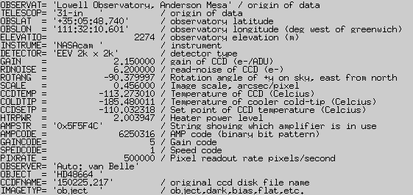
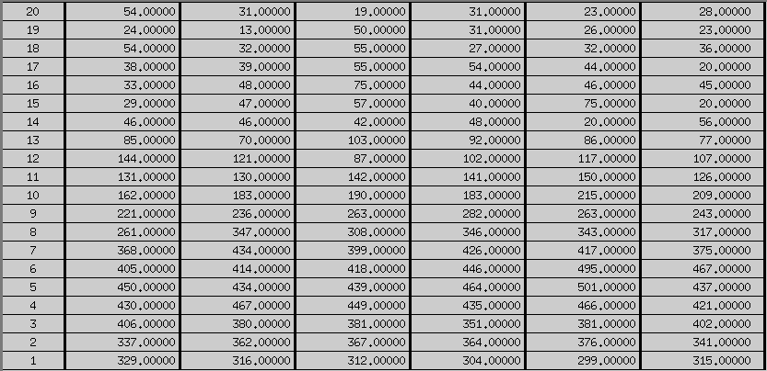
Data
FITS Files
Header
  Information
Image
Table

Slide 4
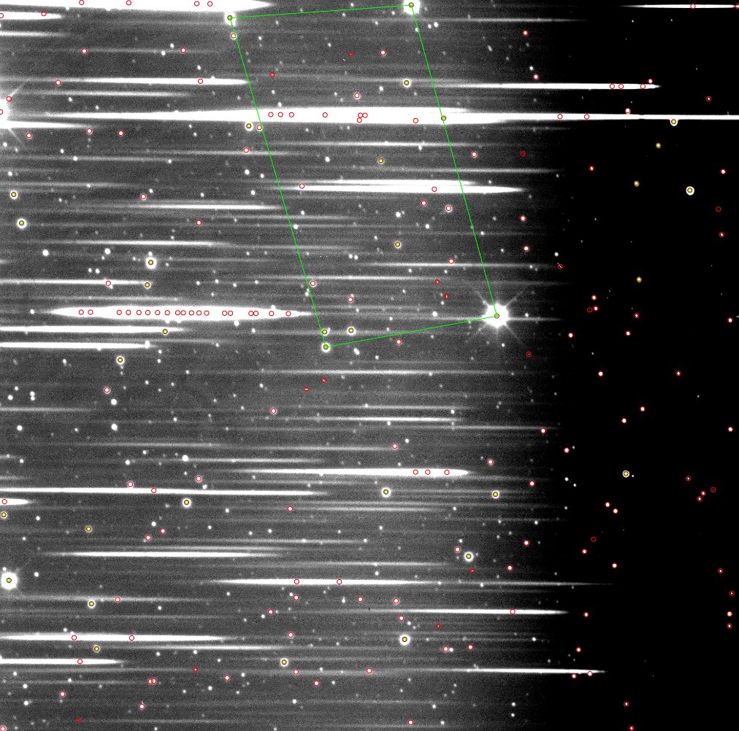
Data Reduction
Preprocessing
  Sorting
  Trimming
Astrometry.net

Slide 5
Data Reduction
Calibration
  HST STIS Library
  Calibrators
  Science Targets

Slide 6
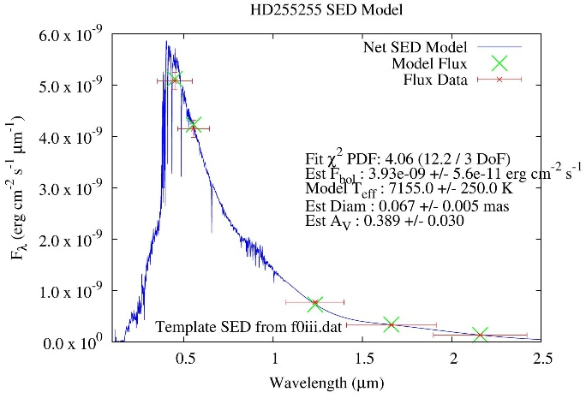
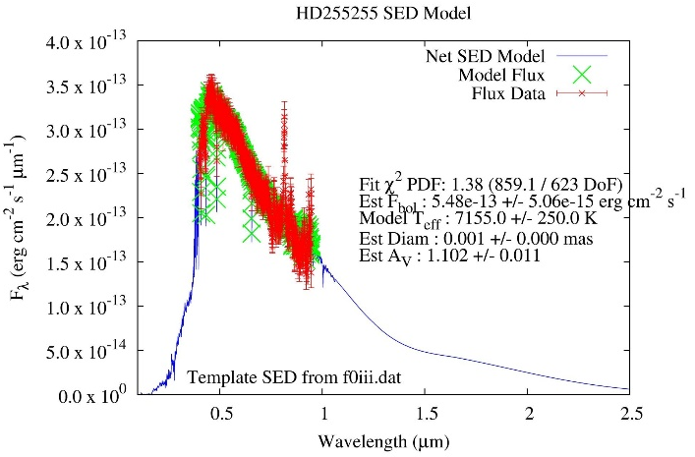
Analysis
Flux vs Wavelength
True Spectra
Composition
Temperature

Slide 7
Conclusion
Functioning Spectrophotometric Data Reduction Pipeline
Processing spectrophotometric data
Good results
Testing
Efficiency

Slide 8


Acknowledgements
Arizona Space Grant Consortium
NAU/NASA Space Grant
Gerard van Belle, Lowell Observatory

Slide 9
Questions

